Slide 1
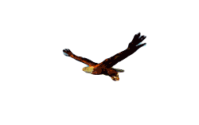
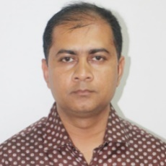
Welcome to today’s class
Bibek Biswas, Assistant Teacher, Rameshworpur Government Primary School, Narail Sadar, Narail. Email: bibekmitna@gmail.com, fbook: bibekbiswas, contact: 01914244847

Slide 2
Lesson’s Information
Class: Five
Unit: 2, See you!
Lessons: 3-4, D
Page No: 7
Teacher’s Information
Bibek Biswas
Assistant Teacher
Rameshworpur GPS
Sadar, Narail.
Email: bibekmitna@gmail.com
fbook: bibekbiswas
Contact: 01914244847

Slide 4
Good Morning Song
Good morning song from EIA song/any song.

Slide 5
Look at the picture carefully
Do you know the people are in the picture?
Where are they?
How do you know?

Slide 6
Colleague – সহকর্মী

Slide 7
Colleague – সহকর্মী
Listen the dialogue and put your finger under the lines
Listen and repeat after me

Slide 8
Now read the dialogue silently
Who are the other people with Tamal and Andy?
Who is the new English teacher?

Slide 9
Listen the dialogue one more time and repeat after the audio.
Now everyone read the dialogue

Slide 10
Three students act the dialogue

Slide 11
What we have learnt today?
We have learnt how to introduce colleagues and friends.

Slide 12
No more today
Stay home
Stay safe
Stay online…

