Slide 1


Slide 2

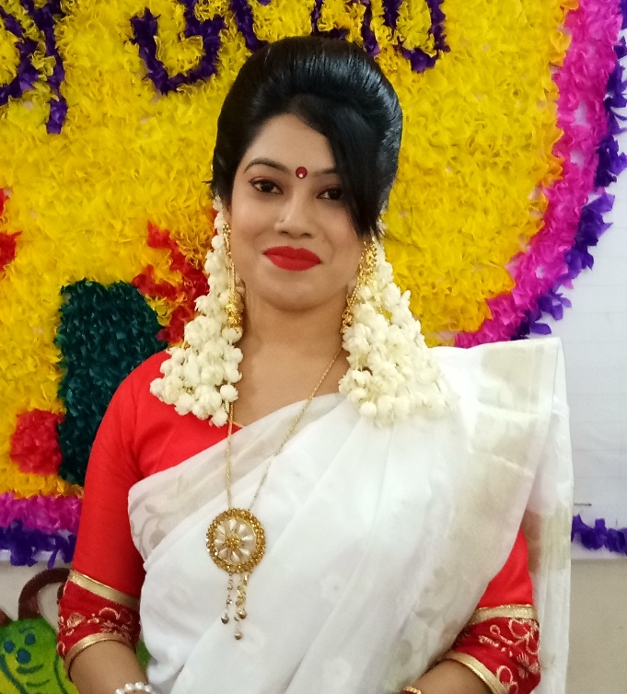

Teacher’s identity
Farhana bintee Reza
Assistant teacher
Chakpara No-2 Govt. Primary School
Sreepur,Gazipur

Slide 3
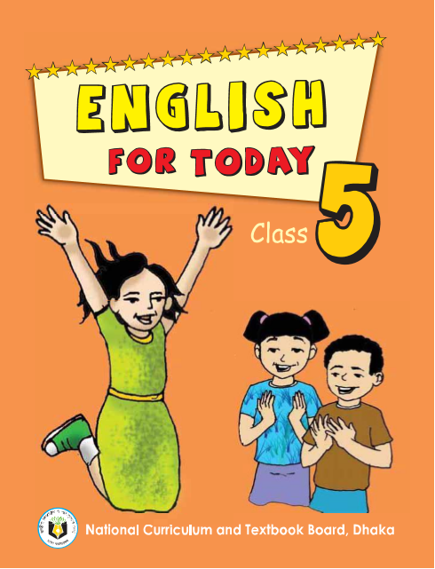
Introduction of the lesson
Class : Five
Unit : 12
Lesson : 1(listen and read)
Lesson Title : How far is saint Martins ?
Today`s Lesson : A(listen and read)

Slide 4
Learning Outcomes
By the end of the lesson students will be able to-
Listening :
1.3.1 recognize which words in sentence are stressed.
3.1.1 understand questions asked by the teacher.
Speaking :
1.1.2 say the words, phrases and sentences with proper intonation.
Reading :
1.5.1 read words and sentences
writting
3.1.1 write words,phrases and sentences using non-cursive capital letters.

Slide 5
Let`s see a video
What have you seen in this video ?
Have you ever heard the name of Saint Martin?
Can you tell where is it located?
Is it near to us ?

Slide 6
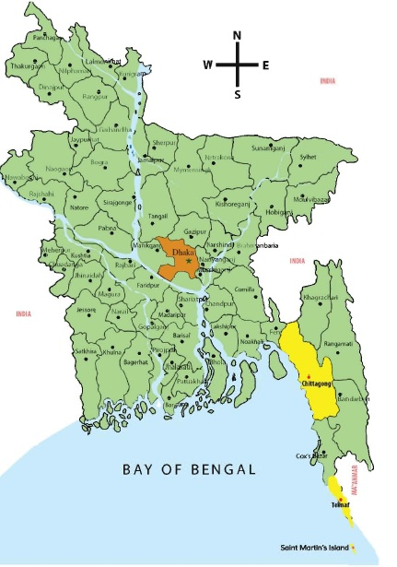
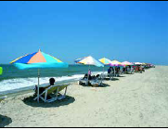
Todays Lesson
How far is Saint Martins ?

Slide 7

NEW WORD
Help
support
সাহায্য করা

Slide 8
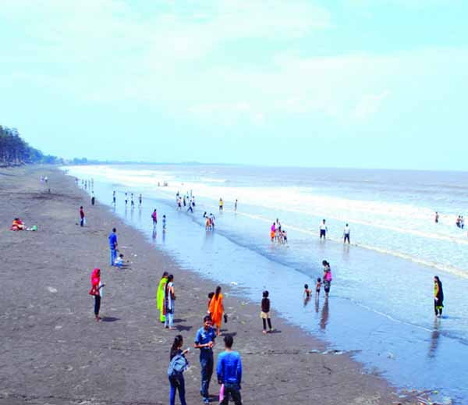
Tourist
Traveler
পর্যটক/
ভ্রমনকারী

Slide 9
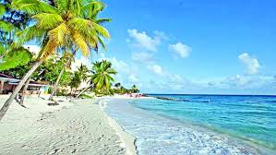
Beach
Seashore/Bank
সমুদ্রতীর

Slide 10
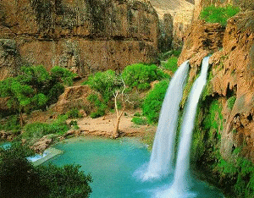
waterfalls
Fountain
জলপ্রপাত/
ঝরনা

Slide 11
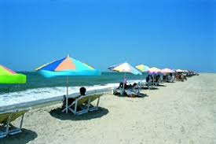
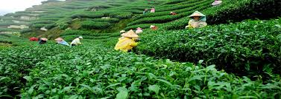
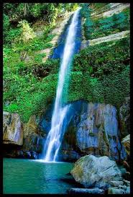
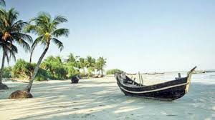
Tourist spot
Cox`s Bazar
Sreemangal
Madhobkundu
Saint Martin`s islant

Slide 12
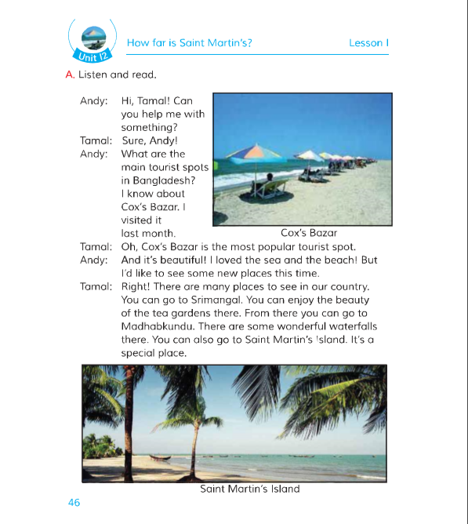
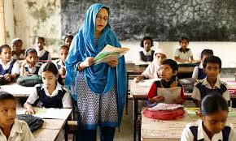
Teacher’s reading

Slide 13

Student’s reading
One student
read the text
and others
listen.

Slide 14
GROUP WORK
Rearrange the words :
1.acbeh
2.leph
3.ritsotu
4.terawllafs

Slide 15
Rearrange the word
1.acbeh ----- beach
2.leph ----- help
3.ritsotu ---- tourist
4.terawllafs ----- waterfalls

Slide 16
Individual Work
Fill in the gaps :
visit
are
popular
beautiful
special
1.Bangladesh is a_____ country.
2.There many places to see in our country:
3.Saint Martins Island is a ______ place .
4. The most _______ tourist spot is Coxs Bazar .
5.Everyday hundreads of people this place.`

Slide 17
Evaluation
Ans the following question:
1. What are the main tourist spots in Bangladesh ?
Ans :Cox`s Bazar is the main tourist spots in Bangladesh.
2. What is a special place ?
Ans: Saint Martin`s is a special place.
3. Where is the tea garden ?
Ans: Sreemangal

Slide 18
Home task
Write a short composition about “Tourist spots in Bangladesh” with five sentence .

Slide 19


