Slide 2
Welcome to Gafargaon on line School

Slide 3
Introduction
Name : Md . Mazaharul Islam
Assistant Teacher
Gafargaon Islamia Gvernment High chool
E-mail: mmislam085@gmail.com
Mobile phone :01719692619
Class: 9
Subject: English 1st paper
Unit:07
Lesson:07
Date : 18.07.2020

Slide 4
Look at picture

Slide 12
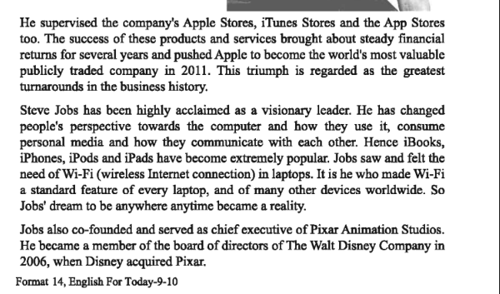

Slide 16
Choose the correct answer from the following alternatives
1. Which of the following has the closest meaning of the word ‘Pix ‘ used in the last para?
( a ) pictures (b ) photograph ( c ) both a & c ( d )none of the above
2. Jobs left Apple Computer
(a ) on personal ground ( b) losing power battle
( c )on legal grounds ( d ) on love affairs
3. Which of the following statement is about Steven Paul Jobs ?
( a) Jobs innovative ideas brought about revolution
(b ) Jobs innovative ideas changed the world
( c) Jobs innovative ideas made a big profit
( d) Jobs innovative ideas changed people’s notion regarding computer
4. When did Apple become the world’s most valuable publicly traded company ?
(a ) In 2011 ( b) In 1958 (c ) In 1998 (d) In 2006
(b) Losing a power battle

Slide 17
5. Which of following word describes Jobs best ?
(a ) Weak (b ) Talented ( c ) Talkative (d ) Smart
6. The word feature means ………………
( a ) gesture (b) posture (c ) Characteristic ( d) mein
7. What does the word executive in the passage refer to ?
( a) boss (b ) administrator ( c ) arbitrator ( d) caretaker
8. Jobs is highly praised as a ……………….
(a ) good supervisor ( b ) good scientist
( c ) visionary leader ( d ) good mechanic
9. The word verge mentioned the passage means ………………..
( a ) corner (b ) edge (c ) beneath ( d ) side
10. The word bankruptcy mentioned in the passage means ……………..
(a ) damage ( b) havocs (c ) wants ( d ) loss
characteristics
Visionary leader
edge

Slide 18
False
C/A: Jobs spent most of his career working for apple
True
C/A : He became a member of the board of directors of the Walt Disney company
False
False
C/A: Jobs left apple in 1985
True

Slide 20
24 February 1955
iMac , iTunes , iPad ,iPhone etc.
Steven Paul Jobs
Chief executive officer
2006

