Slide 1
Welcome

Slide 2
Introduction
Teacher
Class
Md. Shahidul Alom
Rajar Gaon High School
Sylhet Sadar, Sylhet
Mob: 01715 720 745
Email: msagainer@gmail.com
Fb: msamartyr/msagainer
Subject: English Second Paper
Class: IX-X
Date: 13 September 2020

Slide 3
Read the following table and try to say our topic of the class.
Definition | It is the quality of a verb that explains when its subject is acting out the verb. | When the subject of the sentence is being acted upon by the verb.
Flow of Sentence | The subject comes first, and then comes the object. | First comes the object, and then comes the subject.
Focuses On | Focus is on the subject i.e. what subject is doing in the sentence. | Focus is on the action i.e. what action is being performed.
Examples | The dog chased the boy. | The boy was chased by the dog.

Slide 4
Our topic is on
Voice change
Imperative sentence
Part - II

Slide 5
WE know
Imperative Sentence
A sentence which expresses command or request or advice is called imperative sentence.
For example
Open the door.
Turn off the television.
Learn your lesson.

Slide 6
01
Active
শুধু মাত্র মূল verb দিয়ে শুরু যুক্ত active voice কে passive voice এ রুপান্তর করার নিয়ম-
Passive
Let + sub of the obj.+ be + verb (PP) + other words.
Active | Passive
Open the door. Complete the work. Turn off the television. Learn your lesson. Kill the snake. Punish him. Speak the truth. | Let the door be opened. Let the worked be completed. Let the television be tuned off. Let your lesson be learnt. Let the snake be killed. Let him be punished. Let the truth be spoken.

Slide 7
02
Active
When Imperative Active Voice has two objects
Passive
Let + direct obj + be + verb (PP) + for/to/with + personal obj
Active Voice: Buy me a shirt
Passive Voice: Let a shirt be bought for me.
Active Voice: Give me the pen.
Passive Voice: Let the pen be given to me.
Active Voice: Bring me a book.
Passive Voice: Let a book be brought for me.

Slide 8
Group Work
Transform the following Sentences into passive.
1. Help the poor.
2. Revise your book.
3. Clean your room.
4. Shut the door.
5. Write the letter without any delay.
1. Let the poor be helped.
2. Let your book be revised.
3. Let your room be cleaned.
4. Let the door be shut.
5. Let the letter be written without any delay.
Match your answer

Slide 9
03
Active
Do not দিয়ে শুরু যুক্ত যুক্ত active voice কে passive voice এ রুপান্তর করার নিয়ম-
Passive
Let not + object এর subject + be + verb এর past participle form
Active | Passive
Do not play football at noon. Do not laugh at the poor. Do not hate the poor. Do not waste time. Do not kill the rats. | Let not football be played at noon. Let not the poor be laughed at. Let not the poor be hated. Let not time be wasted. Let not the rats be killed.

Slide 10
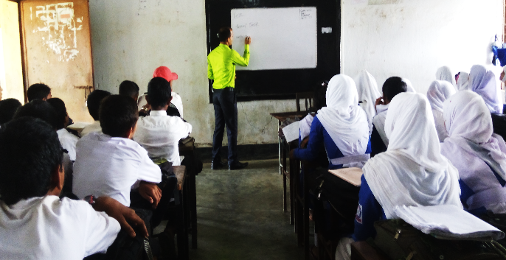
04
Active
Never যুক্ত active voice কে passive voice এ রুপান্তর করার নিয়ম
Passive
Let not + object এর subject + ever be + verb এর past participle form
Active: Never tell a lie.
Passive: Let not a lie ever be told.
Active: Never do this.
Passive: Let not this ever be done.

Slide 11
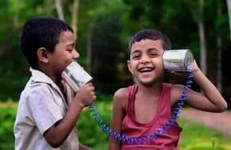
Pair Work
Transform the following Sentences into passive.
1. Do not hate the poor.
2. Do not waste time.
3. Never do this.
Match your answer
1. Let not the poor be hated.
2. Let not time be wasted.
3. Let not this ever be done.

Slide 12
05
Active
Let এর পর যদি কোন ব্যক্তিবাচক object (me, us, you, them, him, her) থাকে এবং তা যদি Imperative sentence হয়, তাহলে
Passive
Let + object এর subject + be + verb (pp)+ by/to + ব্যক্তিবাচক object.
Active | Passive
Let me do the sum Let him write a letter. Let the girl sing a song. Let us judge the boy. Let him take the pen. Let me solve the matter. | Let the sum be done by me. Let a letter be written by him. Let a song be sung by the girl. Le the boy be judged by us. Let the pen be taken by him. Let the matter be solved by me.

Slide 13
06
Active
When Active Voice Starts with Please or Kindly…….
Passive
In this case, Instead of Please/Kindly We have to write “You are requested to”
Active Voice: Please do the sum.
Passive Voice: You are requested to do the sum.
Active Voice: Kindly do the work.
Passive Voice: You are requested to do the work.
Passive Voice: Please have a cup of tea.
Passive Voice: Let a cup of tea be had, please.

Slide 14
Individual Work
Transform the following Sentences into passive.
1. Let him take the pen.
2. Let me solve the matter.
3. Please have a cup of tea.
Match your answer
1. Let the pen be taken by him.
2. Let the matter be solved by me.
3. Let a cup of tea be had, please.

Slide 15
Exception in Imperative
07
Note that the passive form has to begin with ‘you’ when the object of the active verb is not mentioned. Here are some examples that the active verb does not have an object. Therefore the passive form should begin with you.
Active | Passive
Go there Come here. Go to madrasah. Work hard. Get out. | You are requested to go there. You are requested to come here. You are asked to go to madrasah. You are advised to work hard. You are ordered to get out.

Slide 16
Home Work
Transform the following Sentences into passive.
1. Turn off the television.
2. Buy me a shirt
3. Do not laugh at the poor.
4. Work hard.

Slide 17
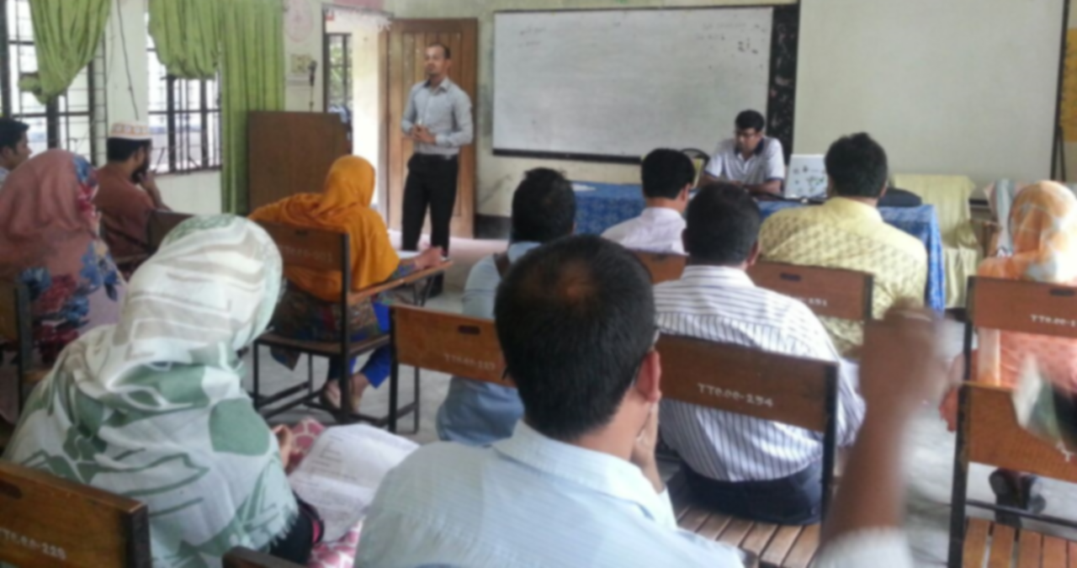
Read, Read, Read
Thank you
Thank you
Practice at HOME

