Slide 1
To
All
in
my
class

Slide 2
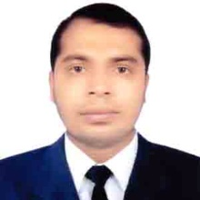
Teacher’s identity
Misbahul haque
Assistant Teacher
Lontirmati government primary school
Kanaighat,Sylhet.
Mobile No:01715453647
Email:mhhaque520@gmail.com

Slide 3
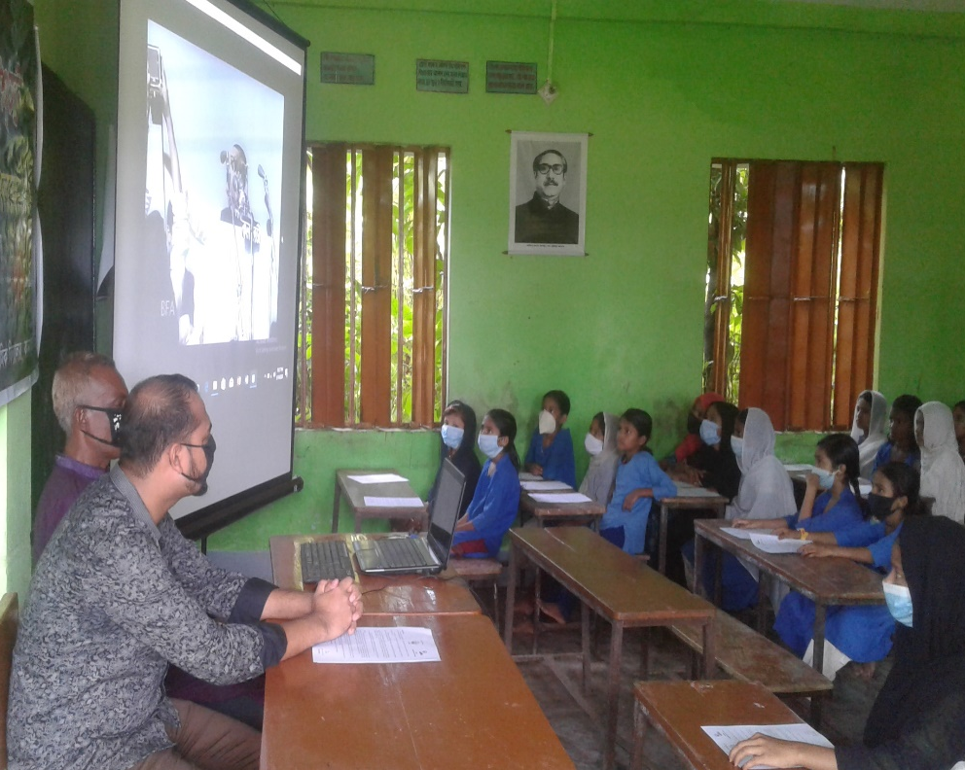
Let’s watch a video

Slide 4
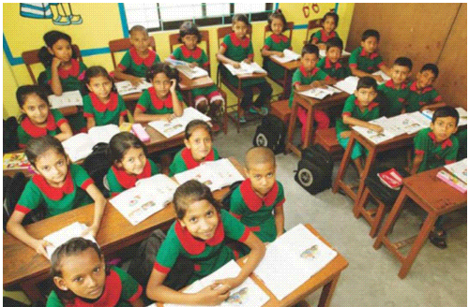
Introduce of the class
Class : One
Section : A
Total students:50
Present students:45
Absent students:05
Date:01/09/2020

Slide 5
Lesson’s introduction
Subject : English
Unit :05
Lesson :1-3
Lesson’s name : Commands
Activity : A
Page : 10
Time : 45 minutes

Slide 6
Learning outcomes
By the end of the lesson students will be able to –
Listening :
1.1.1 become familiar with English sounds by listening to common English words.
Speaking :
1.1.1 repeat after the teacher simple words and phrases with proper sounds and stress.
1.1.2 say simple words and phrases.

Slide 7
Let’s play a game
Teacher will command to the students to be a statue. Among all the students who will stand first and properly as like a statue,he will be a Bingo.

Slide 8
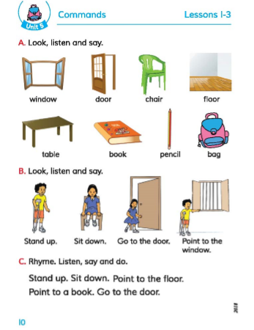
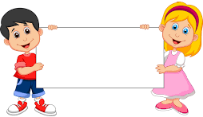
Lesson declaration
Commands

Slide 9
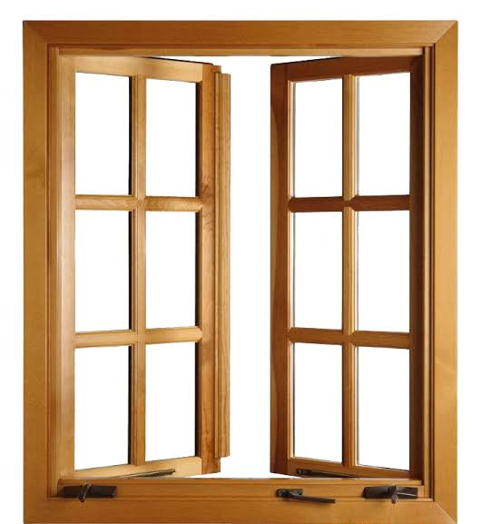
What’s this?
What’s this?
Window
Door

Slide 10
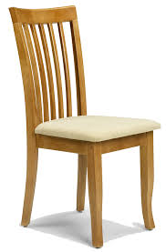
What’s this?
What’s this?
Chair
Floor

Slide 11
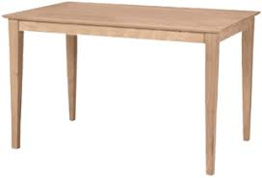
What’s this?
What’s this?
Table
Pencil

Slide 12
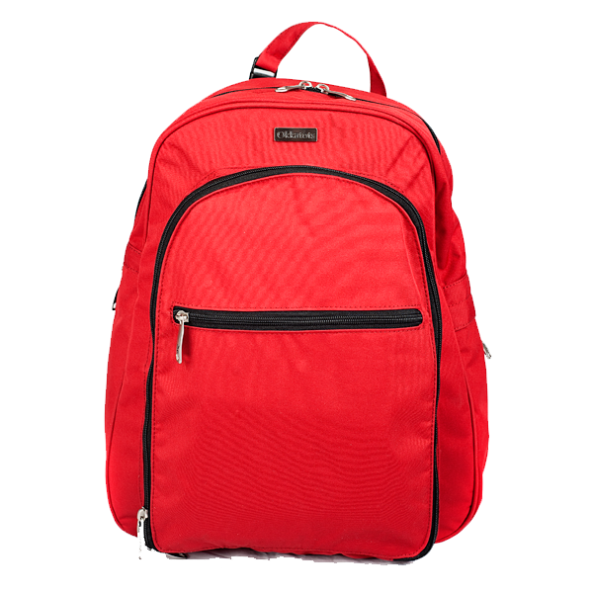
What’s this?
What’s this?
Book
Bag

Slide 13
Word meaning
Window - জানালা।
Door - দরজা।
Chair - কেদারা।
Floor-মেঝ
Table – টেবিল।
Book – বই।
Pencil-পেন্সিল।
Bag-থলে।

Slide 14
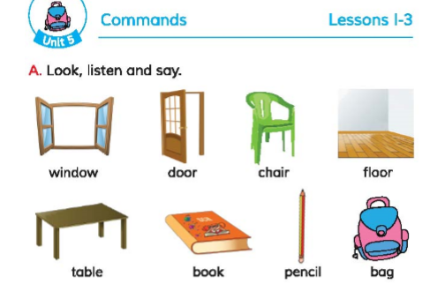
Open at page 10 of your book and look at the activity A
Listen carefully and look at the book.

Slide 15
Window
Door
Chair
Floor
Table
Book
Pencil
Bag
Listen carefully and repeat after it.

Slide 16
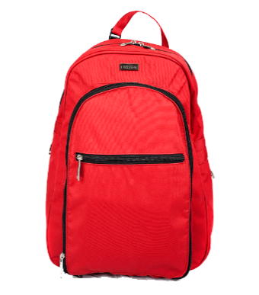
Look and Say
Window
Door
Chair
Floor
Table
Book
Pencil
Bag

Slide 17
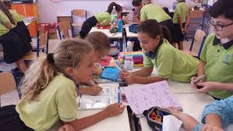
Group work
All the students will be divided in four Groups:
Group-1.Sun
Group-2.Moon
Group-3.Star
Group-4.Jupitar
Every group will practice the words. From every groups one member will show the picture and another members will say the name.

Slide 18
Pair work
Match the following words with pictures:
Door
Chair
Table
Bag
Book

Slide 19
Evaluation
Fill in the gaps with the missing letters:
…oor.
…ook.
B…g.
….indow.
D
B
a
W

Slide 20
One day one word
Book-বই

Slide 21
Thank you. that’s all for today.

