Slide 1
Welcome to all

Slide 2
Introduction
Md Shahneoaz
Assistant Teacher (English)
Jalalabad B/L High School,Sylhet.
E-mail: shahneoazmd@yahoo.com
Cell: 01631712091
Class: ix
English 1st paper
Unit-5, Lesson-1 (A)
Time- 45 Minutes

Slide 3
Click below and say what is the video clip about
Can you say what is responsible for this disaster?

Slide 4
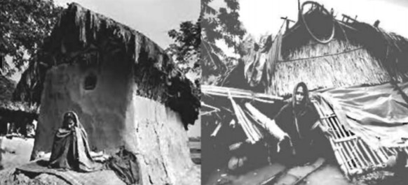
Topic: The Greed of the Mighty Rivers

Slide 5
Learning Outcomes:
After finishing this lesson students will be able to-
say what the reasons of Meherjan’s misery are.
describe what are responsible for natural disasters.
what we can do to prevent such kind of disasters.

Slide 6
Read the passage in unit-5, lesson-1 (A)
Silent Reading

Slide 7
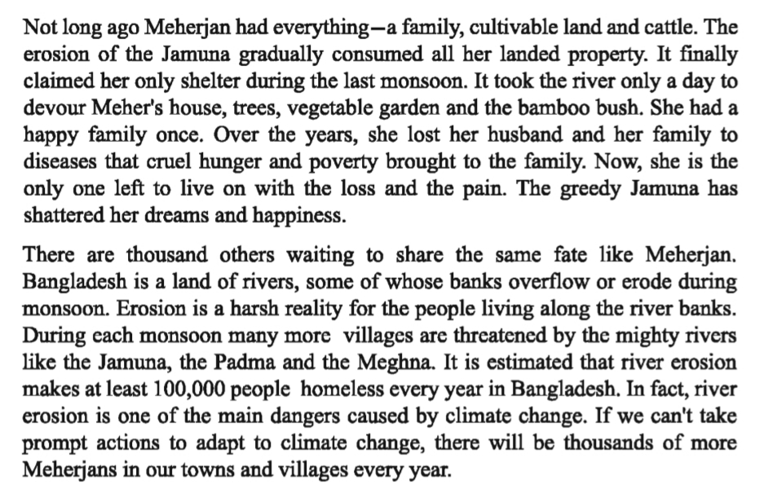
Read the passage in unit-5, lesson-1 (A)
Silent Reading

Slide 8
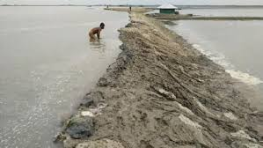
Let’s be introduced with new Words:
Embankment
Dam/Barrier
The flood water has begun to overflow the embankment of the rivers.

Slide 9
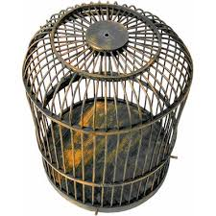
Let’s be introduced with new Words:
Cage
Enclosure
“She kept a canary in a cage."

Slide 10
Let’s be introduced with new Words:
Tremble
Shake/Palpitate
"Isobel was trembling with excitement.”

Slide 11
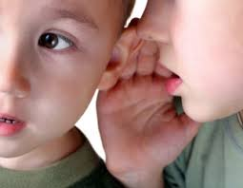
Let’s be introduced with new Words:
Whispering
Murmuring/Muttering
"Alison was whispering in his ear"

Slide 12
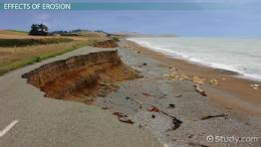
Let’s be introduced with new Words:
Erosion
Dissolving/Decay
“River erosion is a big issue for Bangladesh."

Slide 13
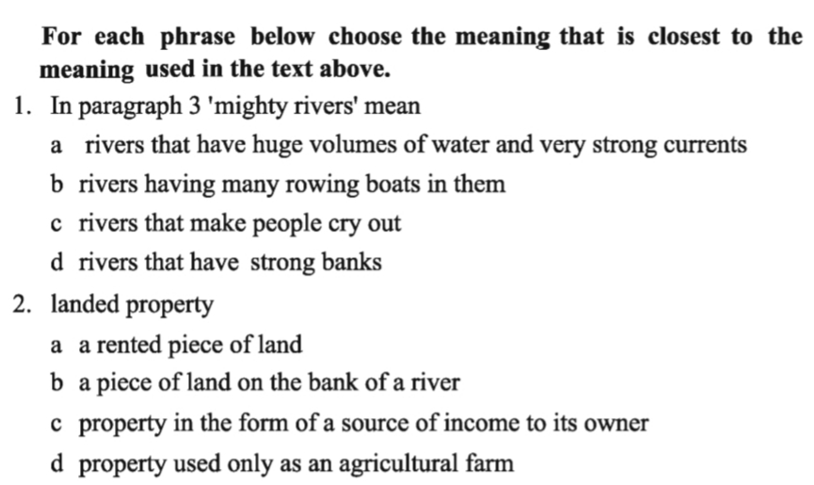
Multiple choice questions:
Pair Work

Slide 14
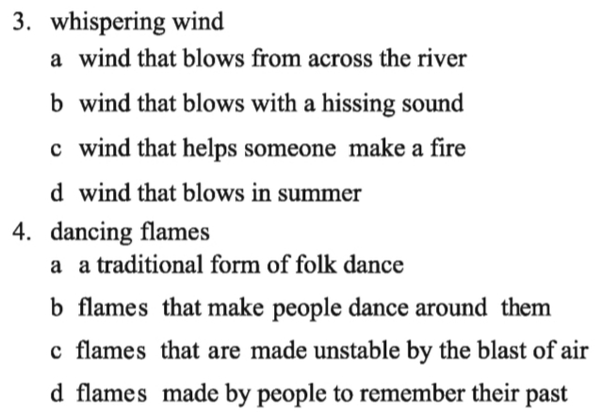
Multiple choice questions:
Pair Work

Slide 15
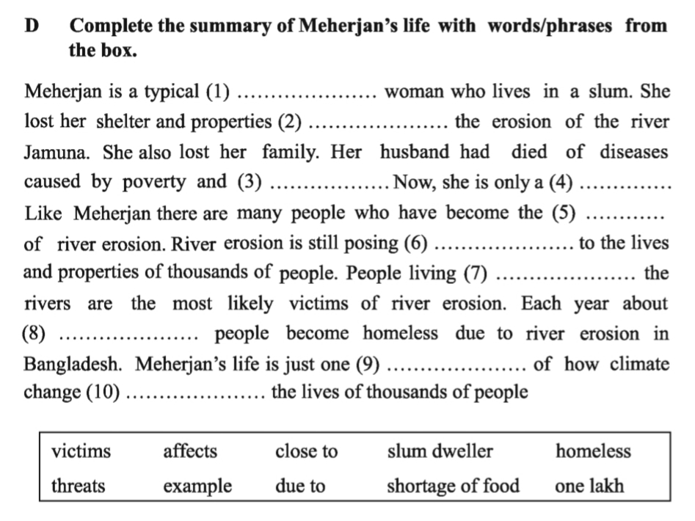
Filling gaps with clues
Group Work
homeless
due to
shortage of food
slum dweller
victims
threats
close to
one lack
example
affects

Slide 16
Write a paragraph on “Natural Calamities of Bangladesh”.

Slide 17
Thanks a lot for being with me

