Slide 1
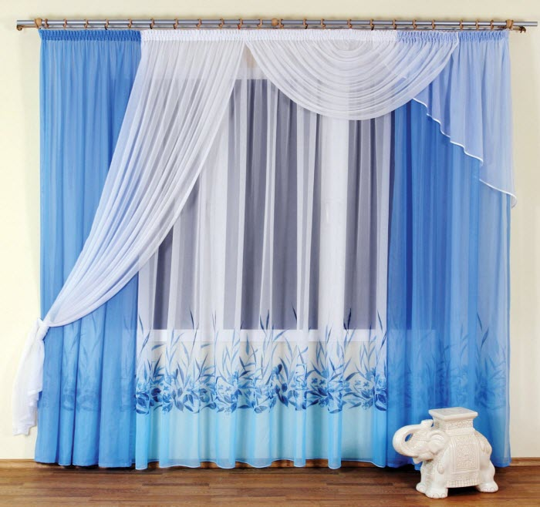

Slide 2
Welcome
To
My class

Slide 3
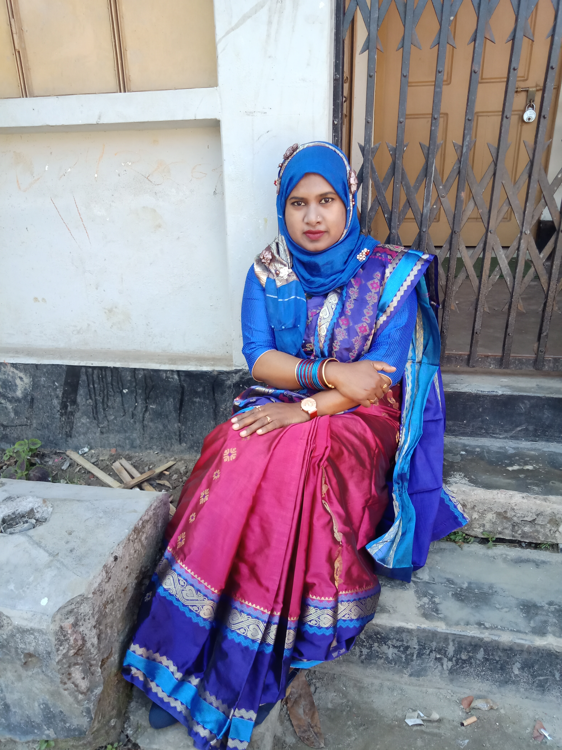
Presented by:
Norunnaher Boby
Asst. Teacher
Nowmahal Model Govt. Pry.School
Mymensingh Sadar,Mymensingh.

Slide 4
Class-two
Subject-English
Unit-19
Lessons 4-6

Slide 5
LEARNING OUTCOMES

Slide 6
http://youtube.com/watch?v=24IPnQbdLcc

Slide 7
Square
Triangle
Circle
Rectangle

Slide 8
Shapes and numbers

Slide 9
Square
Triangle
Circle
Rectangle
P-39

Slide 11
Pair work
activity A

Slide 12
10
16
23
28
P-39

Slide 13
Home WORK

Slide 14
Thanks to all

