Slide 1
To Today’s Class

Slide 2
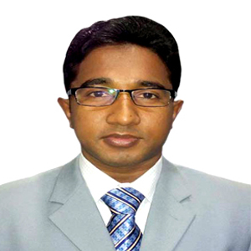
Introduction
Teacher’s Introduction
Md. Hamid Ullah
34th BCS (Non Cadre)
Assistant Teacher (English)
Daulatkhan Govt. High School
Bhola
parvezdk2@gmail.com
Lesson Introduction
English 1st Paper
Class: 9-10
Unit- 7
Lesson- 1

Slide 3
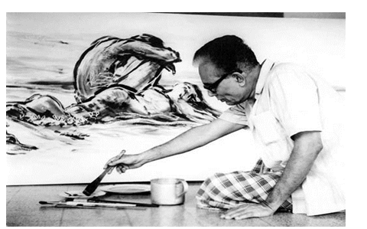
See some pictures and
try to find out the answers :
Who drew the picture ?
Do you know the man ?

Slide 4
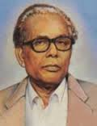
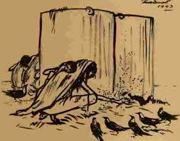
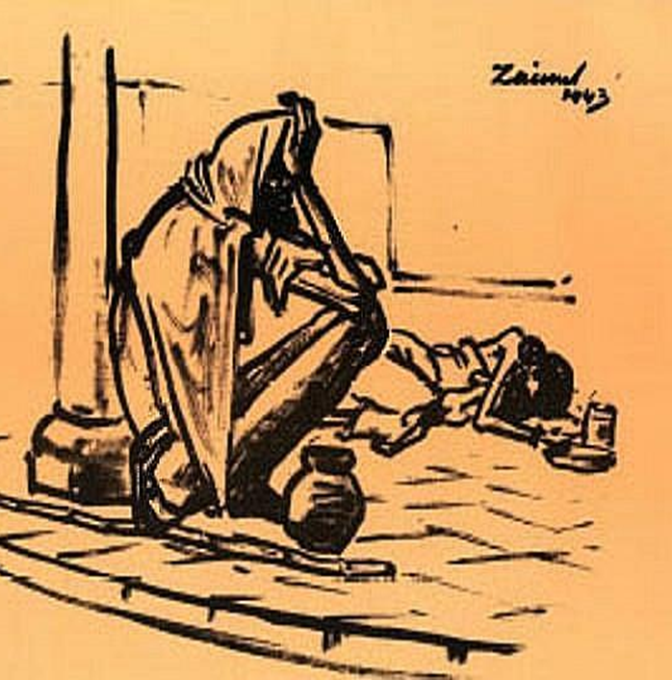
Today’s Topic is..
Zainul Abedin, the great artist

Slide 5
Outcomes of the lesson:
At the end of the lesson the students will be able to
*read and understand text through silent reading
*answer the questions
*infer meaning from context
*write about the pictures portrays of Zainul Abedin
*write the right answers from the alternatives words

Slide 6
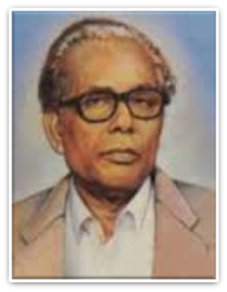
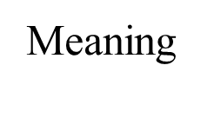
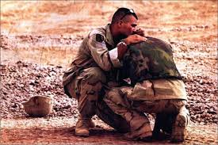
Pioneer
Begum Rokeya
Zainul Abedin
a person who is one of the first to settle in an area or a person who begins or helps develop something new and prepares the way for others to follow.
Compassion
A feeling of deep sympathy and sorrow for another who is striken by misfortune,accompanied by a strong desire to alleviate their suffering.

Slide 7
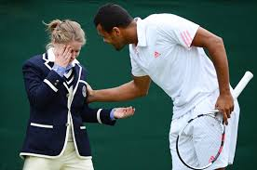
Acclaim
Meaning
to praise enthusiastically and often publicly.
or to acknowledge or declare with enthusiastic approval.
Sinister
Meaning
having an evil appearance : looking likely to cause something bad, harmful, or dangerous to happen.

Slide 8
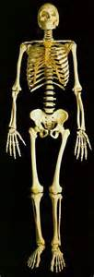
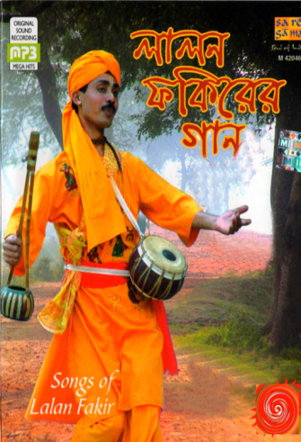
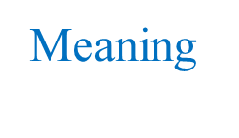
Skeletal
Meaning
the structure of bones that supports the body of a person or animal or a set or model of all the bones in the body of a person.
Folk
The great proportion of the members of a people that determines the group character and that tends to preserve its characteristic form of civilization and its customs, arts and crafts, legends, traditions, and superstitions from generation to generation.

Slide 9
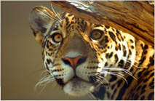
Outstanding
Meaning
extremely good or excellent. : easy to notice especially because of being important or very good. : not yet paid. Examples: outstanding in a sentence.
Predominant
Meaning
more important, powerful, successful, or noticeable than other people or things .

Slide 10
Individual Work: Write the correct answer from the alternative answers:
1. The US Ambassador to Bangladesh considered Zainul Abedin a
Great painter. b. popular painter. C.Master painter. d. unique painter.
2. Zainul’s art gallery was set up in................
a. 1972. b. 1973.
c. 1974. d. 1975.
3. The number of Zainul’s artworks preserved in the gallery is.........
53. b. 62.
c. 65. d. 75.
4. The US Ambassador commented that the museum is a global
a. wealth. b. asset.
c. gift . d. treasure.
5. Mozena visited the gallery for
a. 3 hours. b. 2 hours.
c. 1 hour. d. ½ hour.

Slide 11
Pair Work: Listen to the text again and answer the questions:
Where is Zainul’s art gallery situated?
When did the Ambassador visit the gallery?
Who else were there with the Ambassador during his visit?
Which artworks of Zainul did the Ambassador specially mention?
How did Mozena feel after visiting the gallery?

Slide 12
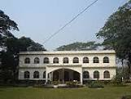
Solution of the above questions
1.Ans: Zainul’s art gallery is situated in Saheb Quarter Park in Mymensingh.

Slide 13
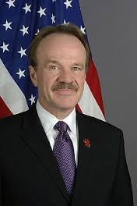
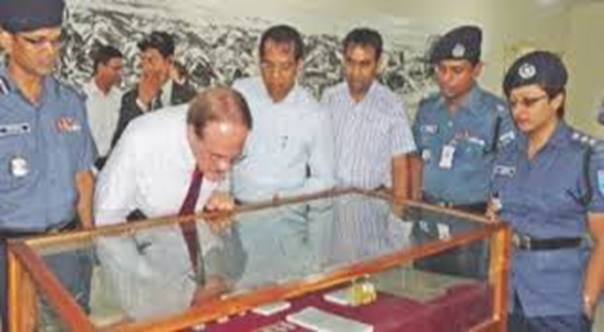
2. Ans:The Ambassador visited the gallery on Tuesday.
3. Ans: There were Deputy commissioner of Mymensingh, Police Superintendent Deputy Keeper of the art gallery with the Ambassador during his visit.

Slide 14
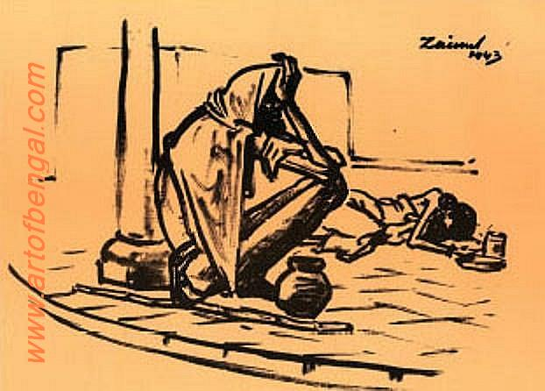
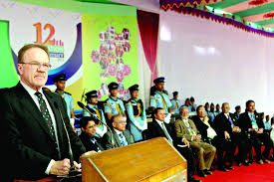
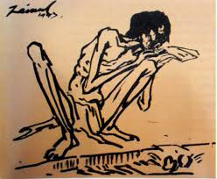
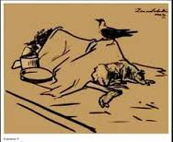
4. Ans: The Ambassador specially mentioned the famine serises.
5. Ans:Commenting on the art gallery, after visiting , Mozena said that he was honoured that his colleagues and he had the opportunity to experience the art of Zainul Abedin in his (Z.A.) hometown.

Slide 15
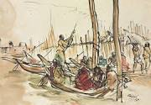
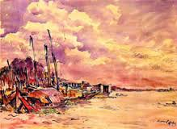
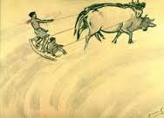
Look at the series of pictures .Work in group and talk about them. Now briefly write about what each picture portrays:
picture 1
Picture 2
Picture 3
Picture 4
picture 5
picture 6
picture 7

Slide 16
Picture 1. It depicts a skeletal figure, that is sitting beside a road and is suffering from being hungry.
Picture 2. It portrays two women, who are going to work to survive.

Slide 17
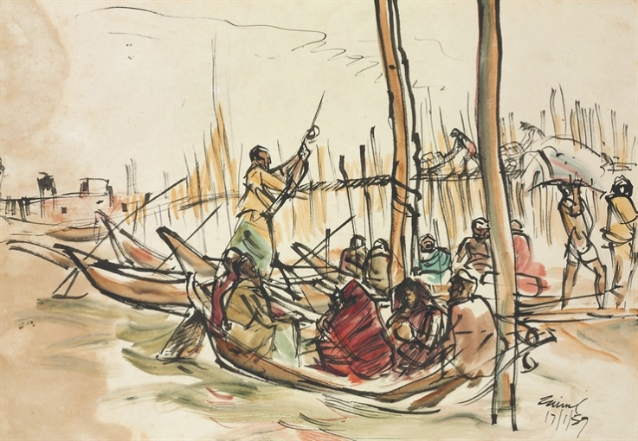
Picture 3. It delineates a very heart-rending picture. Here a crow is sitting on a dead body, who died from hunger
Picture 4. In this picture there is a watery place,where are some boats. Some people
Are in boats and some are sailing the boats

Slide 18
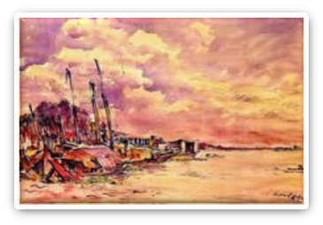
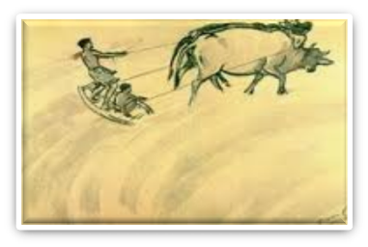
Picture 6. In this picture two farmers are on a leveller. They are at the back of two cows. They are levelling the soil and pulling the cows by strings to keep the balance
Picture 5. It portrays the picture of a village by the side of a river.We see that the sky is covered with clouds

Slide 19
Picture 7. In this picture a cart is being driven by two cows with much hardship and a man is pushing the cart from its behind.

Slide 20
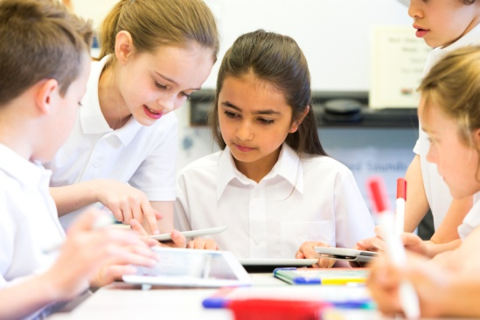
Evaluation
Choose the best answers from the alternatives
Q:1.Who designed the page of Constitution of Bangladesh?
Ans: (a)Rabindra Nath (b)Jasimuddin (c) Zainul Abedin
Q:2.Where was Zainul Abedin born?
Ans:(a)Kishorgang (b)Bogra (c) Pabna
Q:3.which river played a vital role in Zainul’s life ?
Ans:(a)The Karatoa (b) The Padma (c) The Brahmaputra

Slide 21
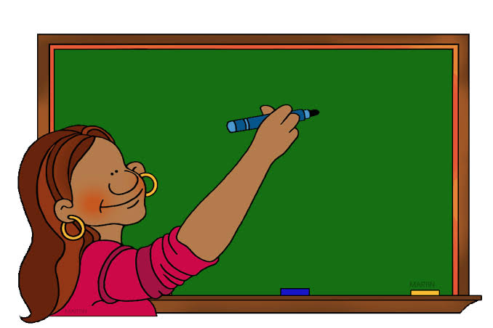
Home Work
Write a paragraph about Zainul’s Art Gallery

Slide 22
Stay Safe-Keep yourself on Study
THANK YOU ALL

