Slide 1



Slide 2


Slide 3

D.E.O Rangpur Online School
WELCOME TO OUR ONLINE CLASS

Slide 4

INTRODUCTION
MD. ANISUL HAQUE
ASSISTANT TEACHER (ENGLISH)
JAFARGONJ SCHOOL & COLLEGE
MAHANAGAR, RANGPUR
E-mail: anis127299@gmail.com
http://www.teachers.gov.bd/profile/anis127299
Class-06
Subj: English For Today.
Lesson: 24 (Aesop’s fable)

Slide 5
LET US FOLLOW

Slide 6
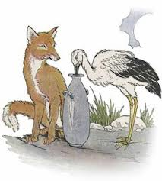
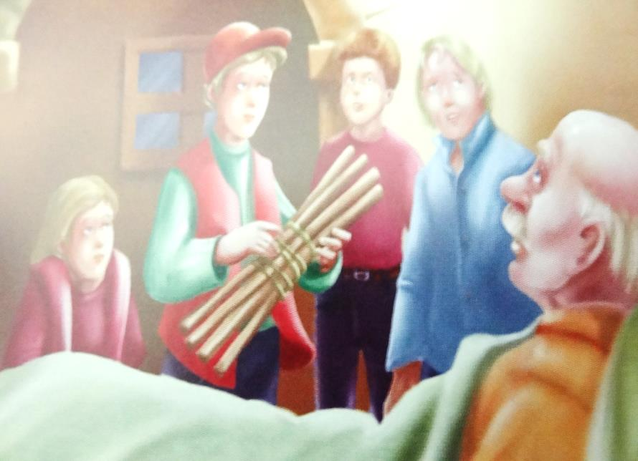
Look at these pictures.
Picture No-01
Picture No-02

Slide 7
Our todays Lesson is
a story and it is on-
Unity is strength

Slide 8
Learning outcomes
After we have studied this lesson we will be able to-
1. listen information.
2. ask and answer questions.
3. understand and enjoy stories.
4. write a story.

Slide 9
Let us enjoy a video

Slide 10
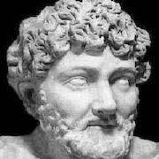
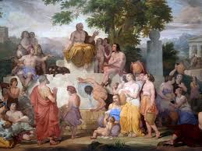
Many hundreds years ago, Aesop, a Greek slave, became famous for the fables he told. After so many years, people all over the world still enjoy reading them today.

Slide 11
Once there lived an old farmer in a village. He had five sons.

Slide 12
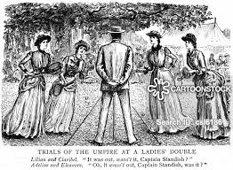

They used to quarrel each other all the time.

Slide 13
One day, the old man thought that he would not live much longer.

Slide 14
He called his sons before him. He told a servant to bring in a bundle of five sticks tied together. He handed bundle to his oldest son and said to him “Son, now break the bundle”

Slide 15
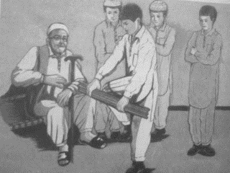
The son tried with all his might, but he could not break the bundle. One by one, the other brothers tried. None of them was strong enough.

Slide 16
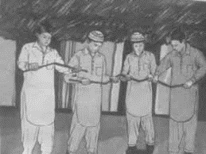
The father smiled, “Now, my sons untie the bundle. Each of you, take a stick and try to break it.” This time they had no difficulty breaking the sticks. In a few moments all the sticks were broken.

Slide 17
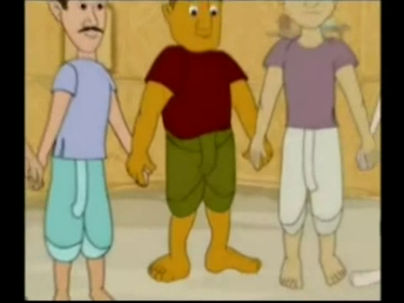
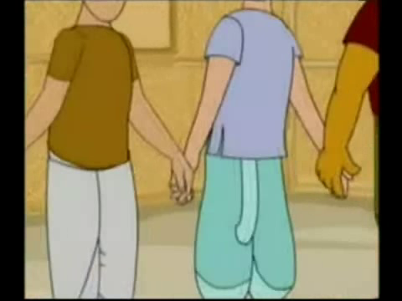
The old man looked at his sons affectionately and said, “Remember, in unity there is strength,”

Slide 18
Evaluation
Answer the following questions:
What is the story about?
How were the sons of the farmer?
What did they do very often?
Why was the farmer worried?
Why did he call his sons?
What is the moral of the story?

Slide 19
Universal
“United we stand
Divided we fall”

Slide 20
Home work
The story below is about a wood cutter, Complete the story?
Once upon a time there was a farmer living in a village near a forest. He was very poor. He had only an axe. One day he went to a deep forest beside a river forest for cutting…………………….

Slide 21

Thanks for stay with me.

