Slide 1
Welcome to our English class

Slide 2
Identity
Manik Chandra Majumder
Senior Teacher
Gazirhat High School
Senbag, Noakhali
Mobile No: 01717155169
Class : Nine-Ten
Subject : English 1st paper

Slide 3
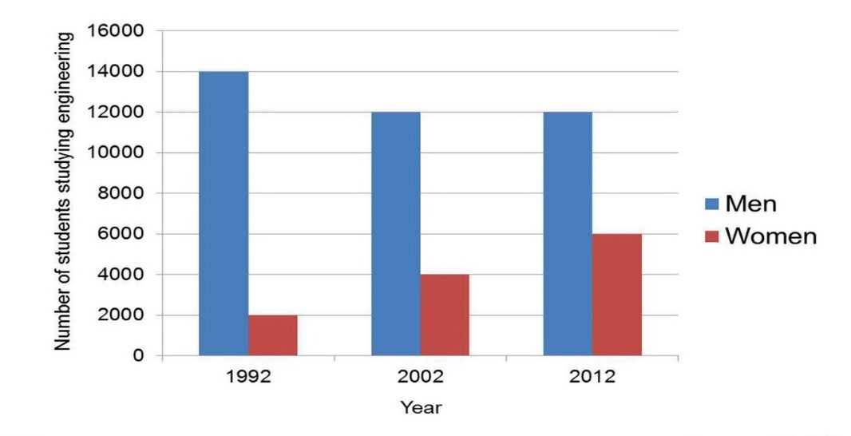
Look at the following images
Using English as a first language | Using English as a second Language | Using English in various organizations world | Information of world computer
58% | 50% | 33% | 80%

Slide 4
Can you guess about our todays topic------
Describing Graph and Chart

Slide 5
There are different types of graphs and charts
Bar graph
Pie chart
Vertical graph
Using English as a first language | Using English as a second Language | Using English in various organizations world | Information of world computer
58% | 50% | 33% | 80%
Chart

Slide 6
Learning outcomes
By the end of the lesson, students will be able to------
a)tell and write about information shown in graph
and chart
b) compare the information
c) describe the changes easily using data and number
from the graph/chart,
d) talk about similarities and differences between the
groups shown.

Slide 7
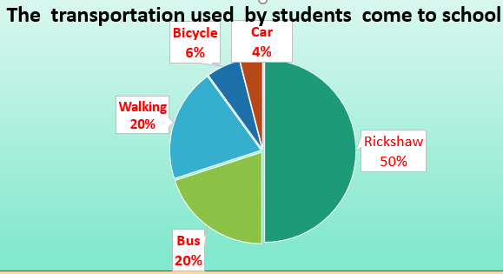
What is a pie chart ?
A pie chart is one kind of descriptive paragraph in which students arc asked to illustrate the chart provided in the question paper. In writing chart, students don't need to provide extra information which is not available in the chart. Rather, students should describe the information by analysing/ comparing/ contrasting given in the chart.
Key point:
One kind of descriptive paragraph,
No need to provide extra information out of the chart,
Illustrate the information by analysing/ comparing/contrasting the chart.

Slide 8
Why is Pie Chart used ?
Pie charts are generally used to show percentage or proportional data and usually the percentage represented by each category is provided in the chart . It’s a easy way for displaying data.

Slide 9
Observe the pie chart
The percentage of a family’s household income distributed into different categories

Slide 10
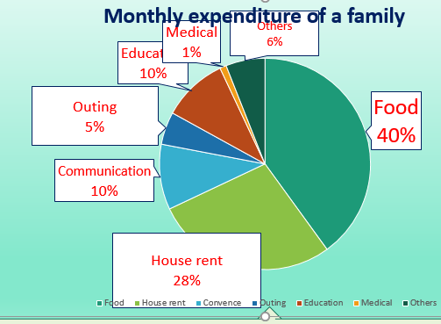
The pie chart below shows the percentage of a family’s house hold income distributed into different categories. Describe the pie chart in 150 words. You should highlight and summarize the information given in the chart.

Slide 11
Others covers 6% area
Medical covers 1% area
Education covers 10% area
Outing covers 5% area.
Food covers 40% area of the pie chart.
Communication covers 10% area
House rent covers another 28% area.

Slide 12
Compare and contrast the expenditures with each other.
The pie chart reveals food sector is greater than house rent sector.
House rent sector is less than food sector but greater than education, communication and outing sector.
Communication and education is in same position but less than food and house rent sector
Outing is less than education and communication but greater than medical sector

Slide 13
Highest portion of family expenditure goes for food and it is 40% of the total expenditure and shown in the first position in the chart.

Slide 14
The family spends 28% for house rent. It is in the second position in the chart which is (40%-28%)= 12% less than food sector.

Slide 15
10% expenditure goes for communication and same portion is spent for education. These two sectors are in the third position and 30 % less than food and 18% less than house rent.

Slide 16
Family goes for outing in each month and for this it spends 5% of its total expenditure.

Slide 17
For medical purpose the family spends1% of it’s total expenditure.

Slide 18
Apart from these specific expenses the family has some other expenditure that has been shown as ‘others’. For ‘others’ the family spends 6% of its total monthly expenditure.

Slide 19
How can we start writing chart ?
Step -1: Topic sentence : Introduction of the chart/pie chart. Example-
The pie chart provides/reveals/depicts the monthly expenditure of a family.

Slide 20
Step -2: Supporting sentences : Body of the chart/pie chart which enlarge the chart with describing/comparing and contrasting. Example-
According to the chart/pie chart it is observed that the family spends it’s income seven specific sectors food, house rent. Education, communication, outing, medical and others. ------
.
Step -3: We can notice that it’s a very well planned family.

Slide 21
Let’s observe the chart and make a summary
Summary: The Pie chart provides/depicts/reveals the monthly expenditure of a family. According to the chart/pie chart it is observed that the family spends it’s income seven specific sectors such as food, house rent. Education, communication, outing, medical and others.

Slide 22
Let’s observe the chart and make a summary
From the chart it is clear that the family’s highest portion of monthly expenditure goes for food and it is 40% of the total expenditure. The family spends 28% for house rent.

Slide 23
It is in the second position in the chart which is (40-28)= 12% less than food sector.10% expenditure goes for communication and same portion is spent for education. These two sectors are in the third position and 30 % less than food and 18% less than house rent. Family goes for outing in each month and for this it spends 5% of its total expenditure.

Slide 24
For medical purpose the family spends1% of it’s total expenditure. Apart from these specific expenses the family has some other expenditure that has been shown as ‘others’. For ‘others’ the family spends 6% of its total monthly expenditure.

Slide 25
However, the pie chart reveals that the family is very conscious and well planned family. It is also understood that the family realizes the importance of education and recreation. We can notice that it’s a very well planned family.

Slide 26
Summary of the chart at a glance :
The Pie chart provides the monthly expenditure of a family. From the chart it is clear that the family’s highest portion of monthly expenditure goes for food and it is 40% of the total expenditure. The family spends 28% for house rent. It is in the second position in the chart which is (40-28)= 12% less than food sector. 10% expenditure goes for communication and same portion is spent for education. These two sectors are in the third position and 30 % less than food and 18% less than house rent. Family goes for outing in each month and for this it spends 5% of its total expenditure.

Slide 27
Summary of the chart at a glance :
For medical purpose the family spends1% of it’s total expenditure. Apart from these specific expenses the family has some other expenditure that has been shown as ‘others’. For ‘others’ the family spends 6% of its total monthly expenditure. However, the pie chart reveals that the family is very conscious and well planned family. It is also understood that the family realizes the importance of education and recreation.

Slide 28
Evaluation
Complete the sentences with appropriate words.
realizes
shown
expenses
expenditure
position
highest
total
than
spends
provides
The Pie chart a) --------- the monthly expenditure of a family. From the chart it is clear that the family’s b) ---------- portion of monthly expenditure goes for food and it is 40% of the total expenditure. The family c) -------- 28% for house rent. It is in the second position in the chart which is (40-28)= 12% less d) ------- food sector. 10% expenditure goes for communication and same portion is spent for education. These two sectors are in the third e) -------- and 30 % less than food and 18% less than house rent. Family goes for outing in each month and for this it spends 5% of its total f) ---------------. For medical purpose the family spends1% of it’s g) -------- expenditure. Apart from these specific h)-------- the family has some other expenditure that has been i) ----------- as ‘others’. For ‘others’ the family spends 6% of its total monthly expenditure. However, the pie chart reveals that the family is very conscious and well planned family. It is also understood that the family j) --------- the importance of education and recreation

Slide 29
Home work
The pie chart shows the percentage of transportation used by students to come to school. Now write a description of the chart in your exercise book.

