Slide 1
Welcome
Md. Omar Faruq
BA, (Hons’), MA, (English), B.Ed, EMBA(M.K.T), LL.B
Assistant Teacher (English)
Adda Umedia High School, Barura, Cumilla.
English 2nd Paper

Slide 2
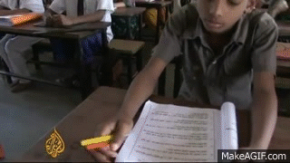
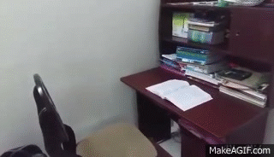
Can you describe the activities in the picture box?
Students are attending a class.
Fishermen were fishing when a launch came.
A student took his seat and started reading a book.

Slide 3
Sentence
And its kinds

Slide 4
Learning Objective
By the end of the lesson the students will be able to
a) write simple sentences correctly
b) distinguish a simple sentence from complex and compound sentences
c) describe things using three kinds of sentences

Slide 5
The birds that I saw were flying.
I saw two birds in the sky.
One was crow but the other was pigeon
Sentence
Simple
Complex
Compound

Slide 6
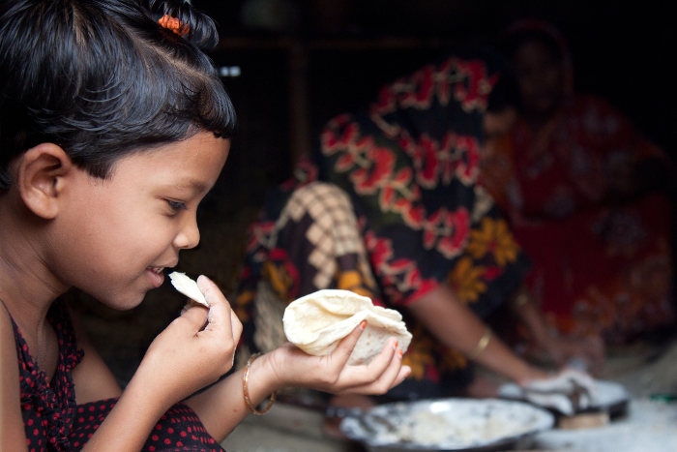
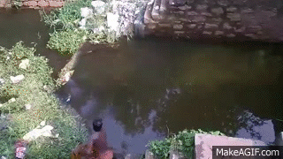
Simple Sentence
Subject
Object
A girl
is eating
bread
in the kitchen.
Verb
Subject
A man
throws
his net
Verb
into the water.

Slide 7
Some simple sentences are quite long.

Slide 8
A long simple Sentence
Present Participle
Past Participle
Main Verb
Infinitive
Going
there
I
decided
to buy
a book
written
by Nazrul.

Slide 9
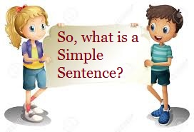
A Simple Sentence is a sentence that centres round a single Finite Verb.
It can also take-
# Infinitive
# Gerund or
# Participle.

Slide 10
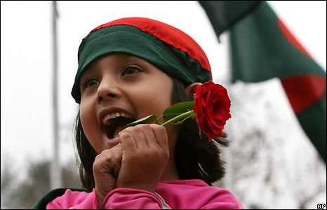
Complex Sentence
I know the girl
who came here yesterday.
This is the pen
that you are finding.
He told me
why
how
when
where
he had bought the book.
She will explain
how the sun gives light to us.
How the sun gives light to us she will explain.
As it was raining ,
I could not go there as it was raining.
I could not go there.

Slide 11
Your turn to answer
My sister
has got a prize.
# How many clauses did you find in
each sentence?
who is a student
The balls
She
are red in colour.
The book
that are rolling here
They
is interesting.
that
I bought it
yesterday
# How are the clauses different from
one another?
My friend
came here.
I invited
him
whom
# How are the clauses linked up with
one another?
# What is a Complex Sentence? How is
it different from Simple Sentence?

Slide 12
Linkers in Complex Sentence
Since | Because | Who
As | Before | Which
When | After | That
While | Lest | What
Though | So that | Whose
Although | Provided | Whom
If | Till/Until | Where

Slide 13
Compound
sentence
Joining Sentences Together
Shila entered the room .
and
She
occupied a seat.
Entering
the room
Shila
occupied a seat.
When Shila entered the room, she occupied a seat.

Slide 14
Compound
sentence
Joining Sentences Together
Shila entered the room and. occupied a seat.
Hena will go to school and attend her classes.
I went to school but could not attend classes.
but
He reached there timely .
He missed the bus.
I made a mistake, therefore I suffered a lot.
You stood first, so everyone praised you.
Cause-
Effect

Slide 15
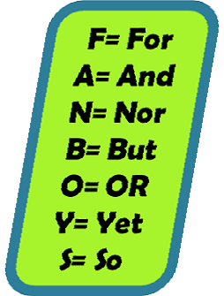
Co-relative Conjunctions

Slide 16
Group Work
An Ideal Student
An ideal student is he who possesses several ideal qualities.
Read the following paragraph on ‘An Ideal Student’. Find out Simple, Complex and Compound sentences from the paragraph.
The first and foremost duty of an ideal student
is to pay attention to study.
Leaving aside the academic
books, he is well informed in other things like current news, world politics etc.
He is friendly with everyone but never keeps evil company.
Since he knows the value of time, he never wastes time for nothing.
He gets up early in the morning and goes to bed early.
He knows that sound lies in sound body.
So, he takes exercise everyday in the evening.
A student like him really deserves our praise, therefore, all students should follow his footprint.
Simple
Complex
Compound

Slide 17
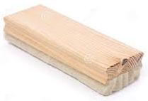
Homework
Goodbye
Write a paragraph on ‘An Ideal Teacher’
Using three kinds of sentences.

