Slide 1
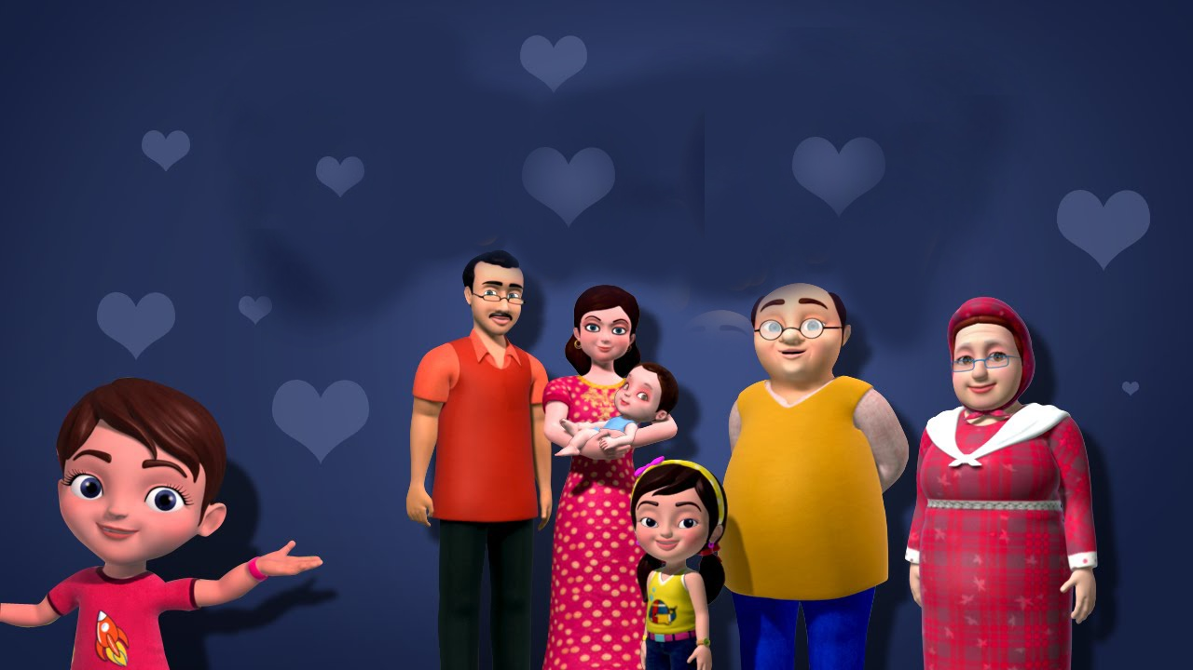
Welcome

Slide 2
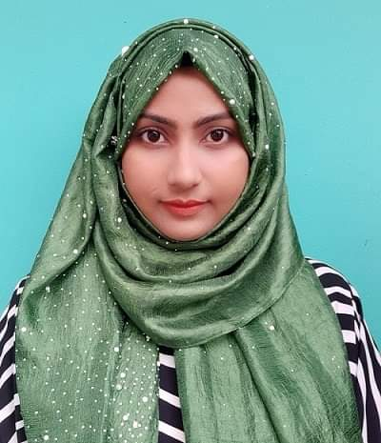
Introduction
Kalam Ferdousi Shanta
Assistant Teacher
56 No Charandwip Sikdaria Govt. Primary School.
Boalkhali, Chattogram
Mobile: 01402491372 shanta.ferdousi@gmail.com
Class- Three,
Subject-English,
Unit- 34.
Lessons- 1-3,
Duration- 40 minutes.

Slide 3
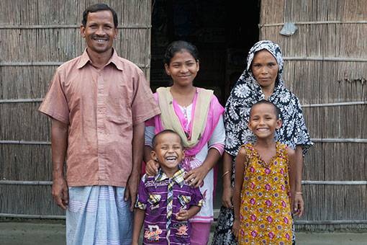
What can you see?
A family.
Think about the picture.
Father
Mother
Sister
Brother
Sister

Slide 4
Today's Our Lesson
My family

Slide 5
Learning Outcomes
Students will be able to:
Listening:
4.3.1- enjoy and understand simple stories.
Speaking:
3.1.1- ask and answer Wh questions.
Reading:
5.1.1- read simple paragraphs.
Writing:
8.1.3- write sentence from the text book or model.
10.1.1- write short and simple paragraphs answering a set of questions.

Slide 6
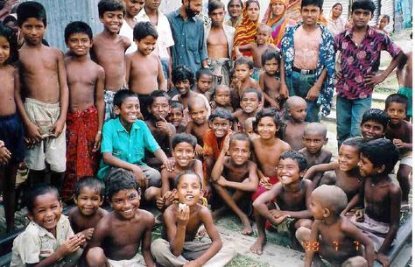
New Words
What can you see in the picture?
Human beings in general or considered collectively.
People
There are many people in this picture.

Slide 7
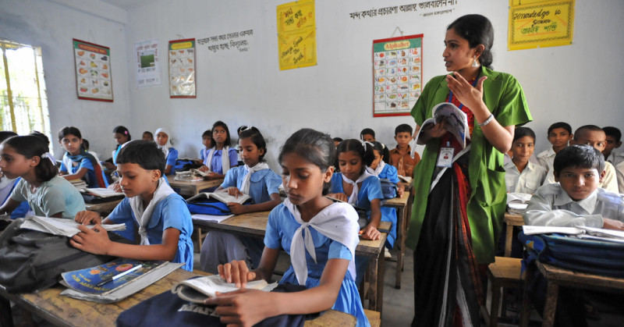
New Words
What can you see in the picture?
A person who teaches, especially in a school.
Teacher
I want to be a teacher.

Slide 8
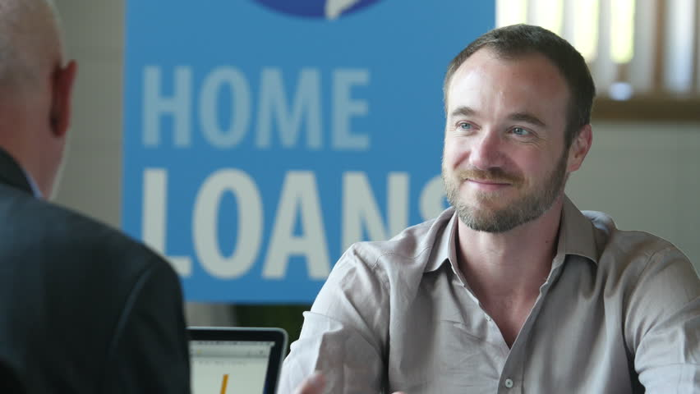
New Words
What can you see in the picture?
An officer or owner of a bank or group of banks.
Banker
My uncle is a banker.

Slide 9
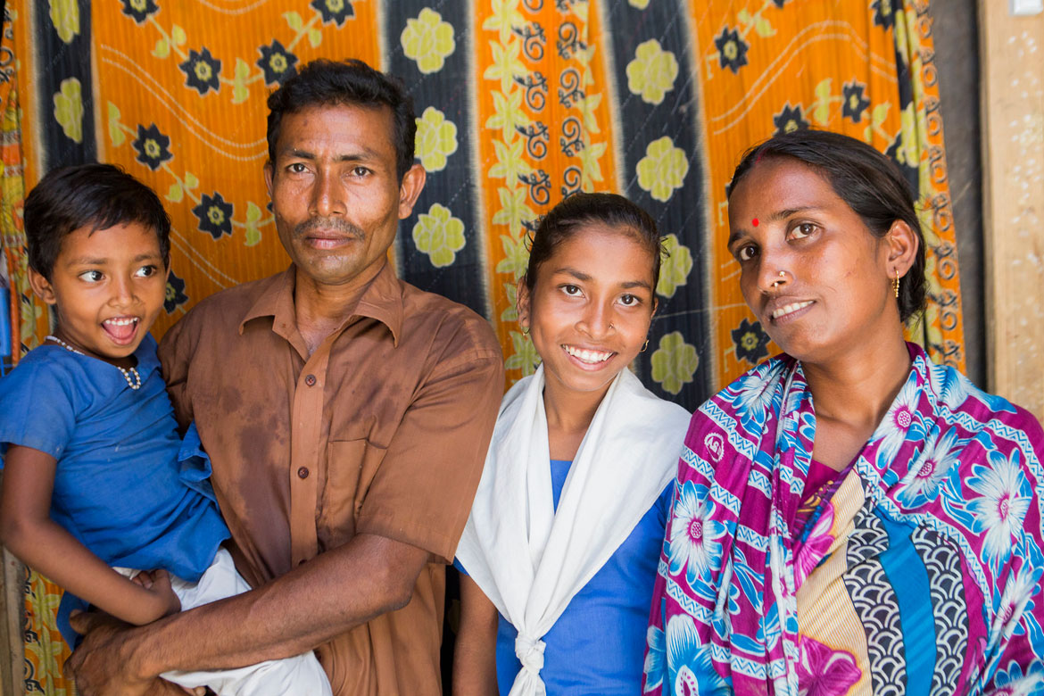
New Words
What can you see in the picture?
A group consisting of parents and children living together in a household.
Family
There are six people in our family.

Slide 10
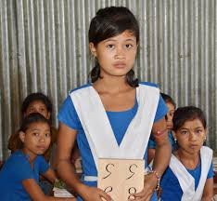
My family
I’m Tisha. I’m a student. I’m in class 3. There are four people in my family.

Slide 11
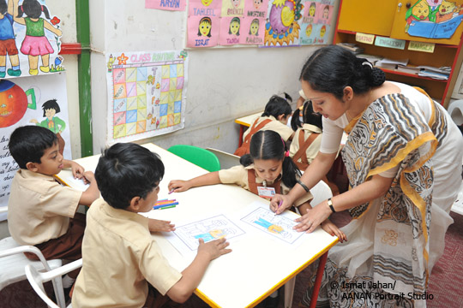
My family
My mother is a teacher.

Slide 12
My family
My father is a banker.

Slide 13
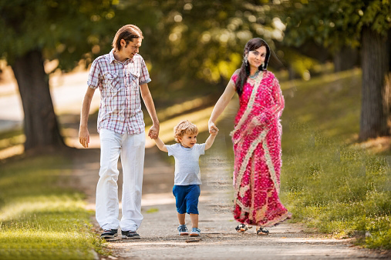
My family
My brother is two years old.

Slide 14
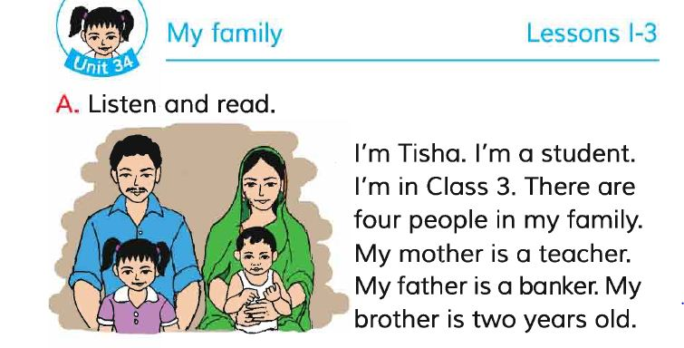
Teachers reading

Slide 15
Students reading

Slide 16
Pair Work
My family
I’m Tisha. I’m a student. I’m in class 3. There are four people in my family. My mother is a teacher . My father is a banker. My brother is two years old.
Ask and answer
What is the girl’s name? What class is she in?
How many people are there in her family?
What does her mother do?
What does her father do?
How old her brother?
Answer
Please click answer button for answer
Answer
Answer
Answer
Answer

Slide 17
Evaluation
Look attentively. Now we play a game. Everybody close your eyes.
Open your eyes.
Which word is missing?
People
Banker
Family
Teacher

Slide 18
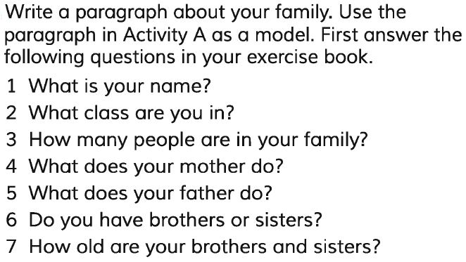
Home Work
Write a paragraph about your family

