Slide 1
WELCOME

Slide 2
Teacher’s Introduction
Md. Ibrahim Khalil
Head Teacher(Acting)
Sarfatuly Gov.t Primary School
Nangolkot, Cumilla.

Slide 3
Lesson’s Introduction
Class: Four
Subject:English
Unit and lesson:21 (Food around the word )L=1-2, P=42
Parts of the lesson :A.Read.

Slide 4
Learning Outcome
Learning outcomes : By the end of the lesson the students will be able to-
1.5.1 : read words,phrases and sentences in the text with proper pronunciation, stress and intonation.

Slide 6
Food around the world
Open at page 42.
Listen to me carefully.

Slide 7
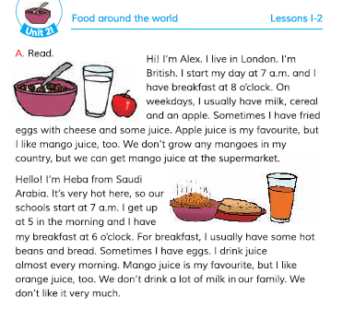

Slide 8
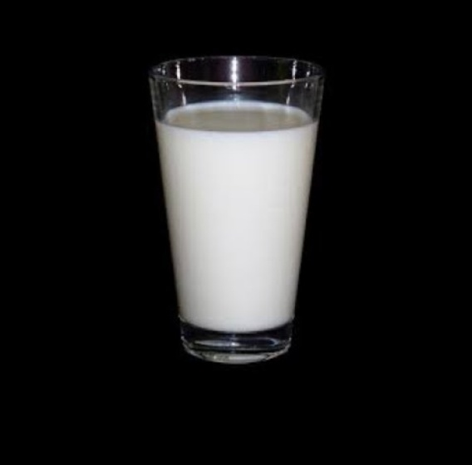
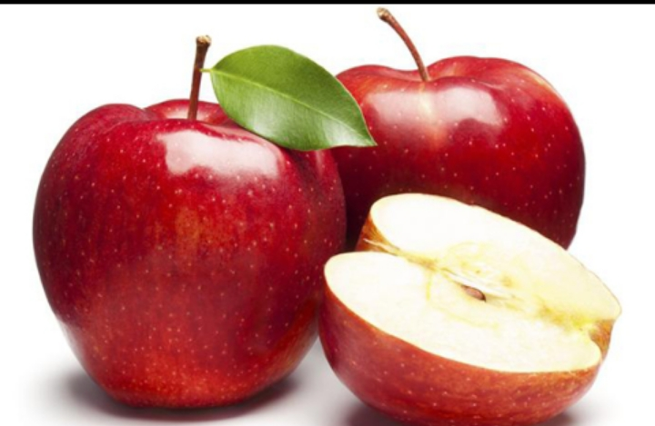
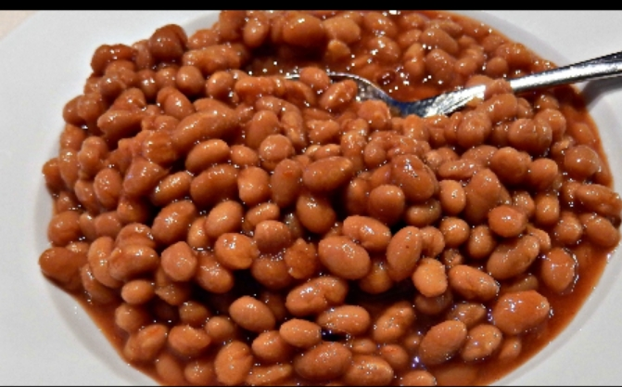
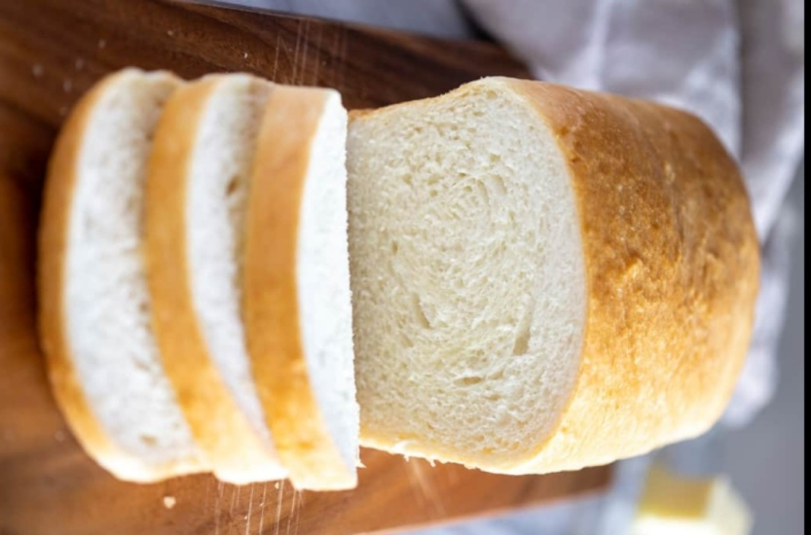
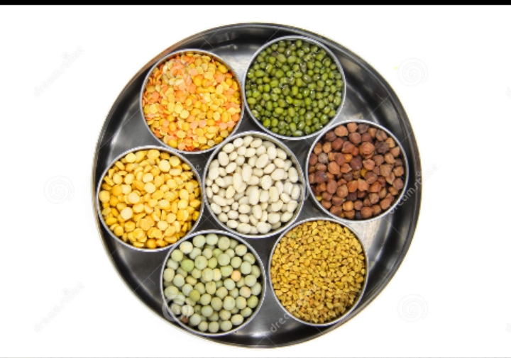
Let’s go see this picture
Apple
Milk
Cereal
Mango juice
Beans
Bread

Slide 9
Word meaning
Weekdays = সাপ্তাহিক কর্মদিবস ;
Cereal = শস্যদানা জাতীয় খাবার
Cheese = পনির ;
Juice = ফলের রস ;
Favourite = প্রিয় ;
Supermarket = বড়বাজার ;
Almost = প্রায়;
Bean = শিম;
A lot of = প্রচুর;
Usually = সাধারণত;

Slide 10
Evaluation:
1.When do you get up?
2. What time do you have breakfast?
3.What do you usually eat for breakfast?
4. Do you have any drinks with your breakfast?
5. What’s your favourite drink?
1.Ans : I get up at 6 a.m.
2.Ans: I have breakfast at 7 a.m.
3.Ans : I usually eat for breakfast bread ,cereal and an apple.
4.Ans: Yes , I like drinks with my breakfast . I like juice.
5.Ans : My favourite drink is mango juice.

Slide 11
Home work
Write a short composition about ‘’Your breakfast’’.

Slide 12
THANK YOU
That’s all for today
Stay home , Stay safe.
Goodbye.

