Slide 1
Wellcome

Slide 2
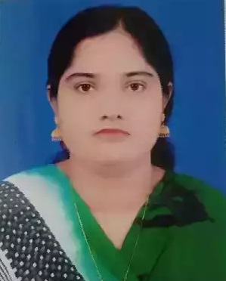
Teacherʼs Identity
Nazma Begum
Assistant Teacher
Mirzapur govt. primary school
Chandpur Sadar, Chandpur.

Slide 3
Lesson Identity
Sub: English
Class: Four
Lesson: 3- A family tree
Unite: Jamil Ahmed is…….a lokal bank .
Time: 40 min
Date: 06/03/2020

Slide 4
Learning outcomes
By the end of the lessons students will be able to –
take part in conversations on simple topics about a family.

Slide 5
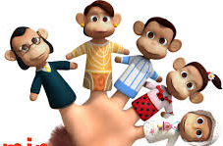

Slide 6
boy
girl
father
mother
grandfather
grandmother
family
Family tree

Slide 7
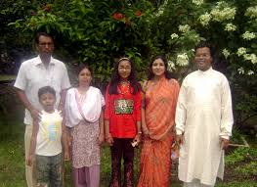
Today we learn about Jamil Ahmedʹs family.

Slide 8
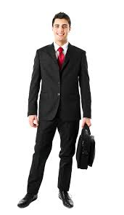
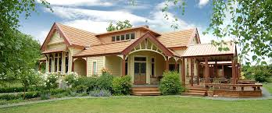
New words
Businessman
ব্যবসায়ী
Family
পরিবার
House
বাড়ি
Picture
ছবি

Slide 9
Make sentences from the following words -
Team a
Team b
Businessman ,
house .
family ,
picture .

Slide 10
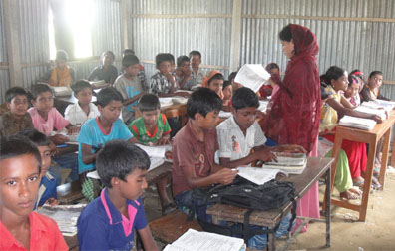
Teacherʼs reading
Jamil Ahmed is from Bogra. He is a businessman. He lives in nice house with his family . In the picture you can see his family members .Mr. Ahmedʹs wife is Parvin Ahmed .She is a bangker. She works in a lokal bank .

Slide 11
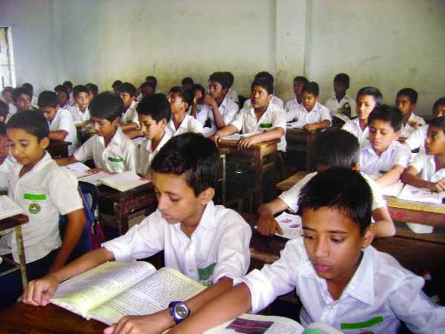
Silent reading

Slide 12
Evalution
Write 4 sentences about your family.

Slide 13
Thank you

