Slide 1
WELCOME

Slide 2
TEACHER IDENTITY
UNIT/Chapter:05
Lesson:23
E,F,T :Eight
(Grammar)
Topic : Prepositions
Time :45
Date :14/10/2020
Md: Moniruzzaman Chow. Assst. Teacher.
Dr.Abdul Aziz High School
Nawabganj,Dinajpur.
E-mail: mdmnzc@gmail.com

Slide 3
Learning outcomes:
After finishing the class student will able to learn about – The definition of Preposition The classification of Preposition The reorganization of deferent kinds of Preposition.

Slide 4
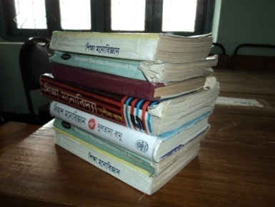
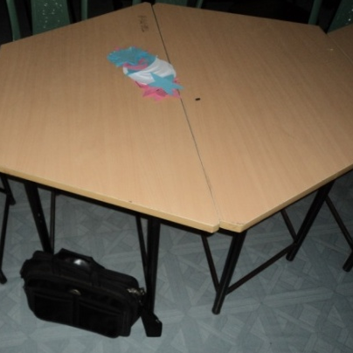
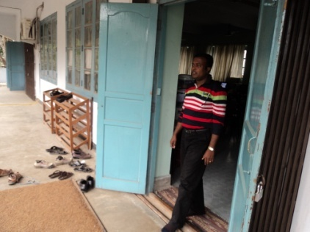
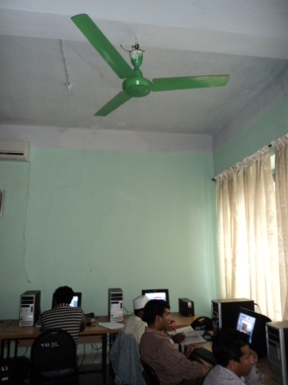
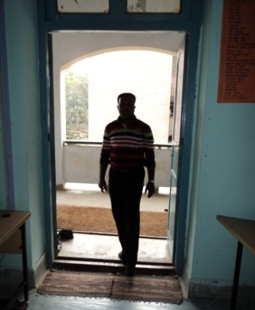
Tell about the pictures

Slide 5
Use of Preposition
above
over
on
through
into
out
under

Slide 6
Definition
Preposition is a word, which is used before a noun, a noun phrase or a pronoun , connecting it to another word.

Slide 7
A preposition is a word that relates a noun or a pronoun to another word in a sentence.
The prepositions here are in boldface. Notice how these words express a different relationship between the boy and the desk.
For example
The boy is under the desk.
The boy is beside the desk
The boy is on the desk
The boy is against the desk.

Slide 8
Find the preposition in each sentence.
The flowers along the fence were pretty.
Just wait until tomorrow.
Sam left the house without his jacket.
Have you read the letter from your cousin?
During the past month, I have read ten books.
Sally ran across the street.
The chemist knows the answer to the question.
Drive down the road.

Slide 9
Answers to the question's bellow
The flowers along the fence were pretty.
Just wait until tomorrow.
Sam left the house without his jacket.
Have you read the letter from your cousin?
During the past month, I have read ten books.
Sally ran across the street.
The chemist knows the answer to the question.
Drive down the road.

Slide 10
Some prepositions
on, through, behind, for, beneath, against, beside, over, during, without, abroad, across, among, against, around ,at the end, at the bottom, between, behind, below, by , inside , corner, into, via, after , to , about ,in, on, at, since ,while, under, over, right, left

Slide 11
Kinds of prepositions
Simple prepositions: Prepositions which consists only one word.
e.g. in, on, at, with, against etc..,
Compound prepositions: Prepositions which consists of two or more words.
e.g. instead of, in the middle of, by the side of etc..,

Slide 12
HOMEWORK
Fill in the gaps with prepositions given in the below
The sun shines ------- the sky
The fox jumped ------- the well
My brother --------- came me
The book is --------- the table
He sat down ---- the sofa
Don’t go out ---- the sun

Slide 13
THANKS

