Slide 1
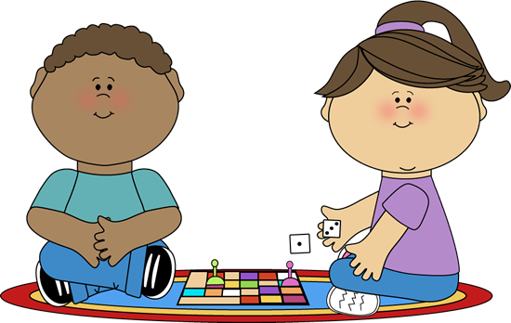
Welcome

Slide 2
Teacher & Lesson Identity
Khadiza Nasrin
Assistant Teacher
Baluakandi 2 govt.Praimary School
Raipura,Narsingdi.
English
Class:- v
Unit: 17
Lesson: 5-6
Page:68
Date: 18.10.2020

Slide 3
What can we see in this pictures?

Slide 4
Dear student’s,let’s see a video
https://www.youtube.com/watch?v=9u-RirUw5sc

Slide 5
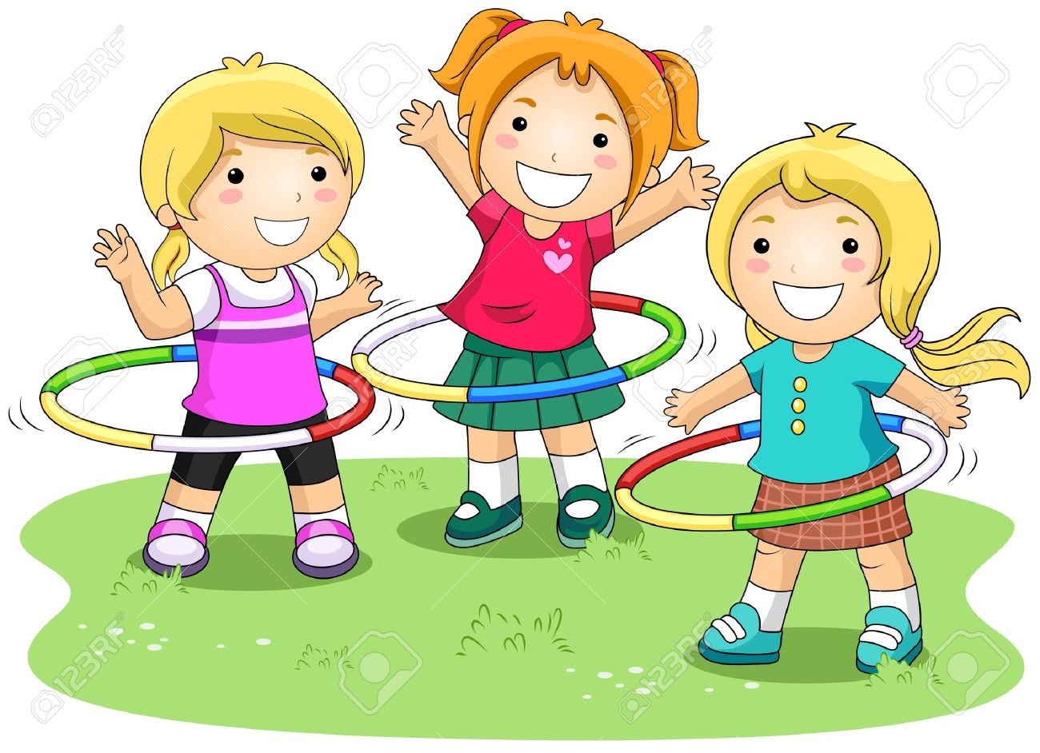
Today’s lesson is-
Sport
Olympic game
The Olympic Games is the biggest sports competition in the world.

Slide 6
Learning Outcomes
Students will be able to-
1.5.1 read words, phrases and sentences in the text
with proper pronunciation, stress and intonation.
3.3.1understand questions about objects around them.
3.4.1 understand statements made by the teacher and
Students. 8.1.1 make sentences using words and phrases
given in the textbook.
5.1.1read silently understanding the paragraph.

Slide 7
Dear student’s, what did we learn from the pictures and lessons above?

Slide 8
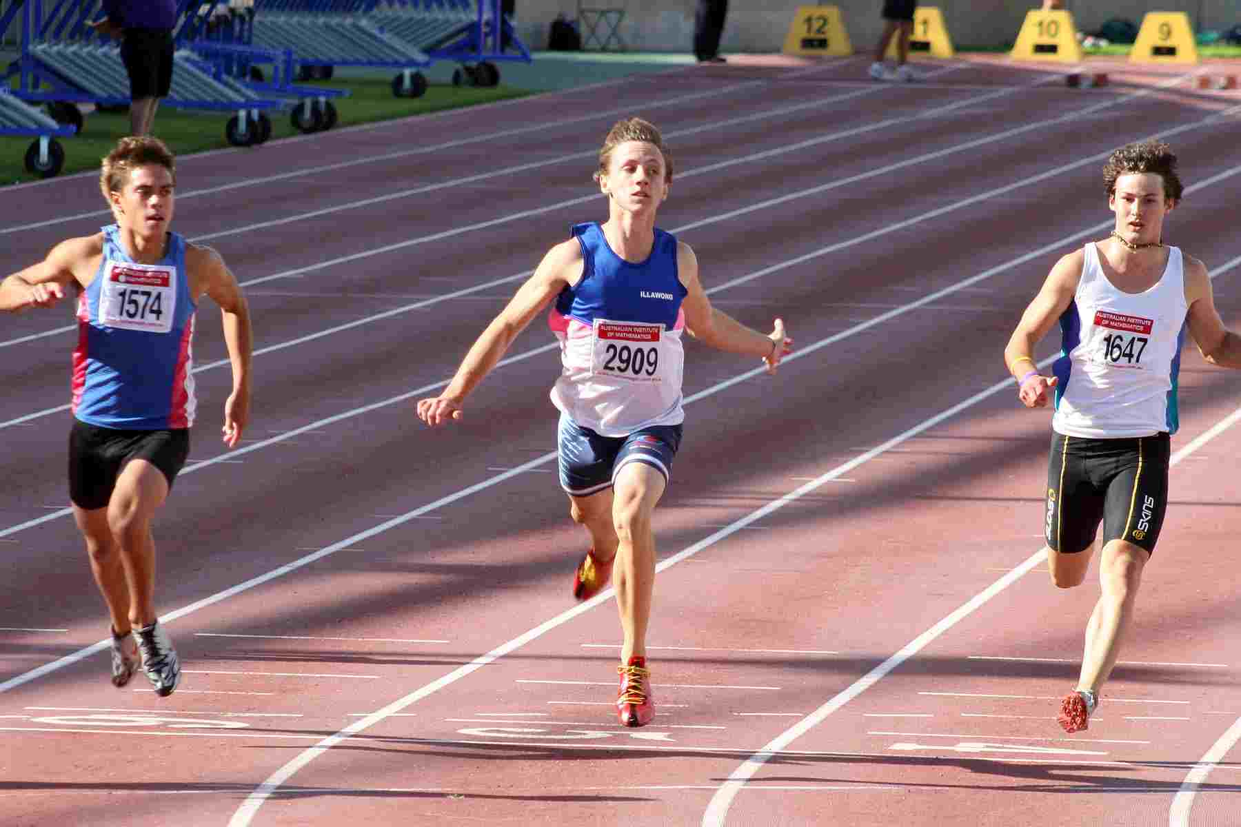
New Words
Competition
An event in which people try to win.
There have been 31 competitions since then.

Slide 9
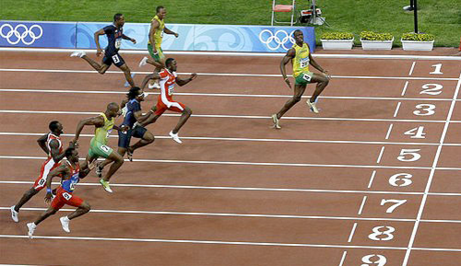
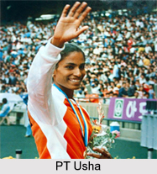
World Universe
The Olympic Games is the biggest sports competition in the world.
Athlet sportsman
About 13000 athletes compete in the Olympics.

Slide 10
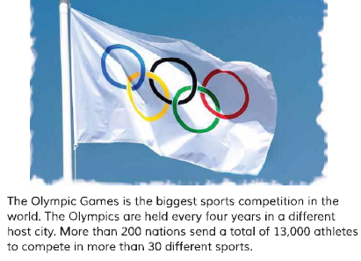
Teacher’s reading

Slide 11
Open at page-68
Teacher’s reading
The first Olympic Games was held in Greece almost 3,000 years ago. The modern Olympic games started in 1896, there have been 31 Olympic competitions since then.

Slide 12
Students reading

Slide 13
Answer the following questions
What is the biggest sports competitions of the world?
How many countries compete in the Olympics?
How often are the Olympics held?
How many sports are there in the Olympics?
When did the modern Olypic Games begin?

Slide 14
Make WH questions:
Lets do pair work
1.The Olympics are held every four years.
Ans: How often are the Olympics held ?
2.The modern Olympic Games started in 1896.
Ans: When did the modern Olympic Games begin ?
3.The first Olympic Games were held in Greece.
Ans:Where was the first Olympics held ?

Slide 15
Evaluation
I will asses the pair work by looking around the students.

Slide 16
Home Task
write five sentences about your favourite sport.

Slide 17
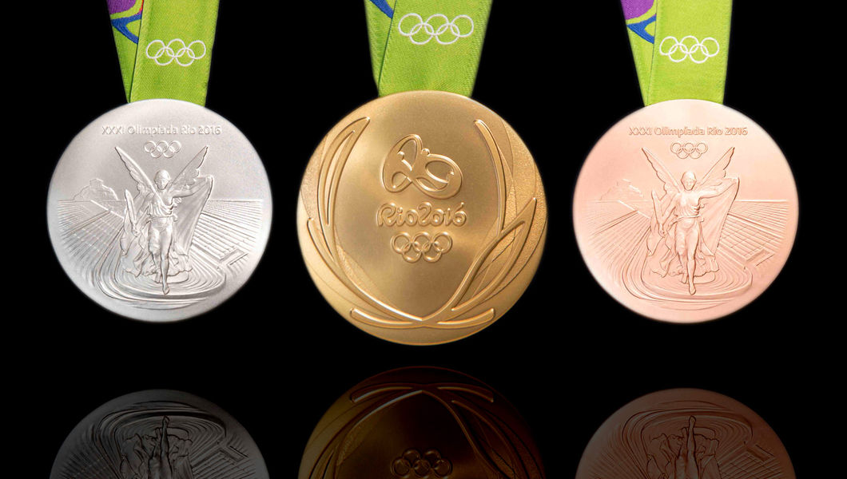
See you again

