Slide 1
Welcome

Slide 2
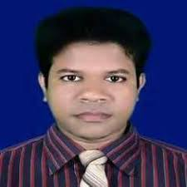
IDENTITY
Azizul F
Azizul Fakir
Assistant teacher
Dighirjan secondary school
Nazirpur, Pirojpur
Mobile: 01710745128
Email: azizul.nk@gmail.com
Azizul Fakir
Assistant teacher
Dighirjan secondary school
Nazirpur, Pirojpur
Mobile: 01710745128
Email: azizul.nk@gmail.com
Class 9
English For Today
Unit 3
Events and festivals
Time : 50 mins
17/9/2020

Slide 3
Let’s enjoy a video song
The video is related to our mother language.
What is the video related to?

Slide 4
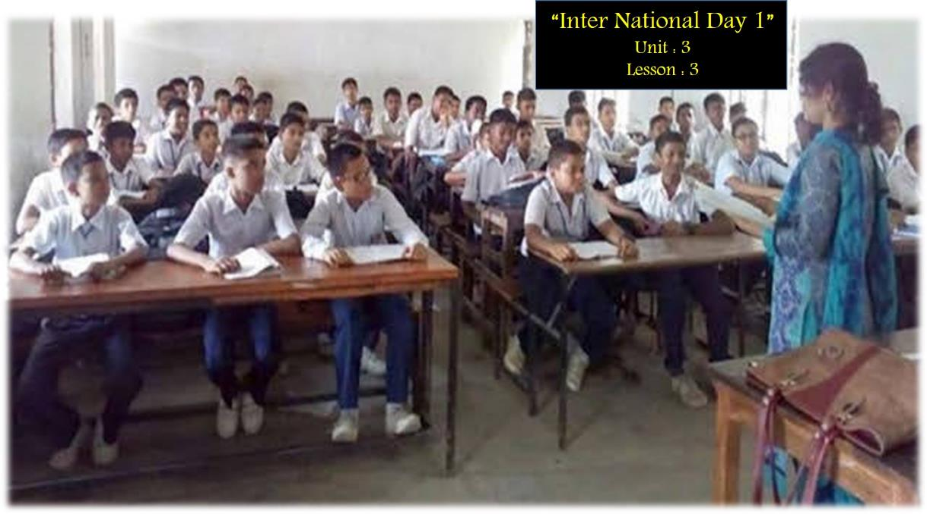
International Mother Language Day - 1
Unit: 3
Lesson: 3

Slide 5
Learning outcomes
After completing this lesson, we will be able to ----
infer meaning from the context
1
talk about the pictures
2
write answers to the questions
3
tick best answers from the alternatives
4
listen for information to the CD
5

Slide 6
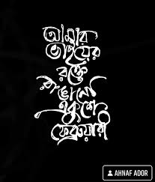
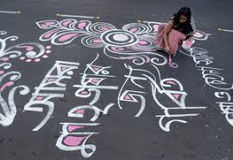
Key word
Part of speech
Meaning
Antonym
ordinary
worth remembering
Memorable -
adjective
notice or perceive (something) and register it as being significant
disrespect
Observe -
verb

Slide 7
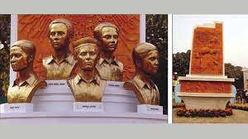
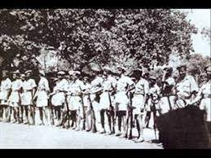
Key word
Part of speech
Meaning
Antonym
a person who suffers very much or is killed because of their religious or political belief.
---
Martyr -
noun
the expression of strong disagreement.
support
Protest -
noun

Slide 8
Key word
Part of speech
Meaning
Antonym
the ability to keep increasing of developing
---
Momentum -
noun
permit
Outlaw -
verb
to make something illegal

Slide 9
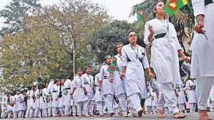
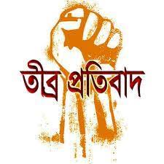
Key word
Part of speech
Meaning
Antonym
a number of people moving forward in an orderly fashion.
reversal
Procession -
noun
douse
Kindle -
verb
to start burning

Slide 10
Open at page 33 and read text carefully.
21 February is a memorable day in our national history. We observe the day every year as International Mother Language Day. The day is a national holiday.
On this day, we pay tribute to the martyr who laid down their lives to establish Bangla as a state language in undivided Pakistan in 1952. The struggle to achieve our language rights as known as the Language Movement.
The seed of language movement was sown on 21 march 1948when Mohammad Ali Zinnah, the Governor General of Pakistan, declared in a public meeting in Dhaka that Urdu would be the only state language of Pakistan. The declaration raised a storm of protest in the eastern part of the country. The protest continued non-stop, gathering momentum day by day. It turned into a movement and reached its climax in 1952. the government outlawed all sorts of public meetings and rallies to stop it.

Slide 11
The students of Dhaka University defied the law and brought out a peaceful protest procession on 21 February 1952. when the procession reached near Dhaka Medical College, the police opened fire on the students, killing Salam, Rafiq, Barkat, Safiur and Jabbar. As a result, there were mass protests all over the country and the government had to declare Bangla as a state language. This kindled the sparks of independence movement of Bangladesh.

Slide 12
Time 5mins
12
1
11
10
2
9
3
Individual works
8
4
7
5
6
Now complete the chart.
Match your answers
Time | What happened.
1947
1948
1952
Pakistan & India became independent.
Mohammda Ali Zinnah declared that Urdu would be the only state language of Pakistan.
The students of Dhaka University brought out a procession on 21 February.

Slide 13
12
1
Pair works
11
10
2
5mins
9
3
8
4
7
5
6
Match the words with their meanings.
Words | Meanings
tribute | to cause or to stimulate
climax | to refuse to obey
outlaw | to give in
defy | the ability to keep increasing or developing
provoke | an act to show respect or admiration
relent | the most exciting point in time
momentum | to ban

Slide 14
Check your answers
Ans:
Words | Meanings
tribute | --- an act to show respect or admiration
climax | --- the most exciting point in time
outlaw | --- to ban
defy | --- to refuse to obey
provoke | --- to cause or to stimulate
relent | --- to give in
momentum | --- the ability to keep increasing or developing

Slide 15
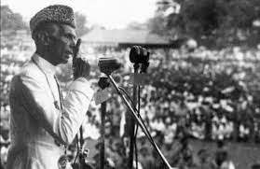
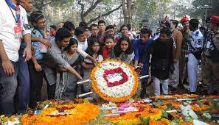
What do you see in the pictures?
Declaring Urdu as a state language of Pakistan.
Observing 21st February
When Urdu was declared as the only state language of Pakistan, there raised a storm of protest in East Pakistan. It continued non-stop. on this day, by protesting the one-sided decision of the then Government of Pakistan and by achieving Bangla as state language scarifying life, the people of East Pakistan learned how to struggle against illegal decision and oppression and also understood that they had to fight for their rights. And the people of East Pakistan dared to dream of being free from West Pakistan. We observe 21 February as International Mother Language Day to pay tribute to the language martyrs of 1952.

Slide 16
Time: 6mins
12
1
Group works
11
10
2
9
3
8
4
7
5
6
Answer these questions.
Q1: Why do we observe 21 February as the International Mother Language Day?
Q2: What happened when Urdu was declared as the only state language of Pakistan?
Q3: “The seed of independence was sown on 21 February 1952”. Do you agree? Why?

Slide 17
Check your answers
Ans1: We observe 21 February as International Mother Language Day to pay tribute to
the language martyrs of 1952.
Ans2: When Urdu was declared as the only state language of Pakistan, there raised a
storm of protest in East Pakistan. It continued non-stop.
Ans3: Yes, I agree. It is because, on this day, by protesting the one-sided decision of the
then Government of Pakistan and by achieving Bangla as state language
scarifying life, the people of East Pakistan learned how to struggle against illegal
decision and oppression and also understood that they had to fight for their rights.
And the people of East Pakistan dared to dream of being free from West Pakistan.

Slide 18
)The phrase ‘storm of protest’ means -----
i. mild protest ii. strong protest iii. moderate protest v. symbolic protest
(b) The seed of Language Movement was sown by ---
i. Salam ii. Martyrs . iii. Zinnah iv. students
(c) Salam and Barakat were the citizens of
i. West Bengle ii. Nepal iii. India iv. the then Pakistan
(d) The gap between the beginning and the climax of Language Movement is --=
i. 2 years ii. 3 years iii. 4 years iv. 5 years
(e) The word ‘declare’ cannot be the same as ----
i. renounce iii. acknowledge iv. announce iv. convey
(f) The word ‘raised’ means ---
i. lift ii. move iii. promote iv. form
(g) Which of the days is a public holiday----
i. 21 february ii. 7 March iii 21 March iv. 16th December
Tick the best answer
$$$$
$$$$
$$$$
$$$$
$$$$
$$$$
$$$$

Slide 19
Listen to the CD
Evaluation
Time: 6 mins
Now fill the gap
Every year, 21 February is observed as International Mother Language Day. The day is a national (a) ---. On this day, we pay (b) --- to the martyrs who sacrificed their lives to establish Bangla as a state language in (c) --- Pakistan, at the public meeting in Dhaka (d) --- that Urdu would be the only state language of Pakistan. The declaration (e) --- a storm of protest in the then East Pakistan.

Slide 20
You may check your answers.
Every year, 21 February is observed as International Mother Language Day. The day is a national (a) holiday. On this day, we pay (b) tribute to the martyrs who sacrificed their lives to establish Bangla as a state language in (c) undivided Pakistan, at the public meeting in Dhaka (d) declared that Urdu would be the only state language of Pakistan. The declaration (e) raised a storm of protest in the then East Pakistan.

Slide 21
Stay home stay safe
Home work
Write a short paragraph on
How you celebrated International Mother Language Day in your school this year?

Slide 22
Thank you

