Slide 2
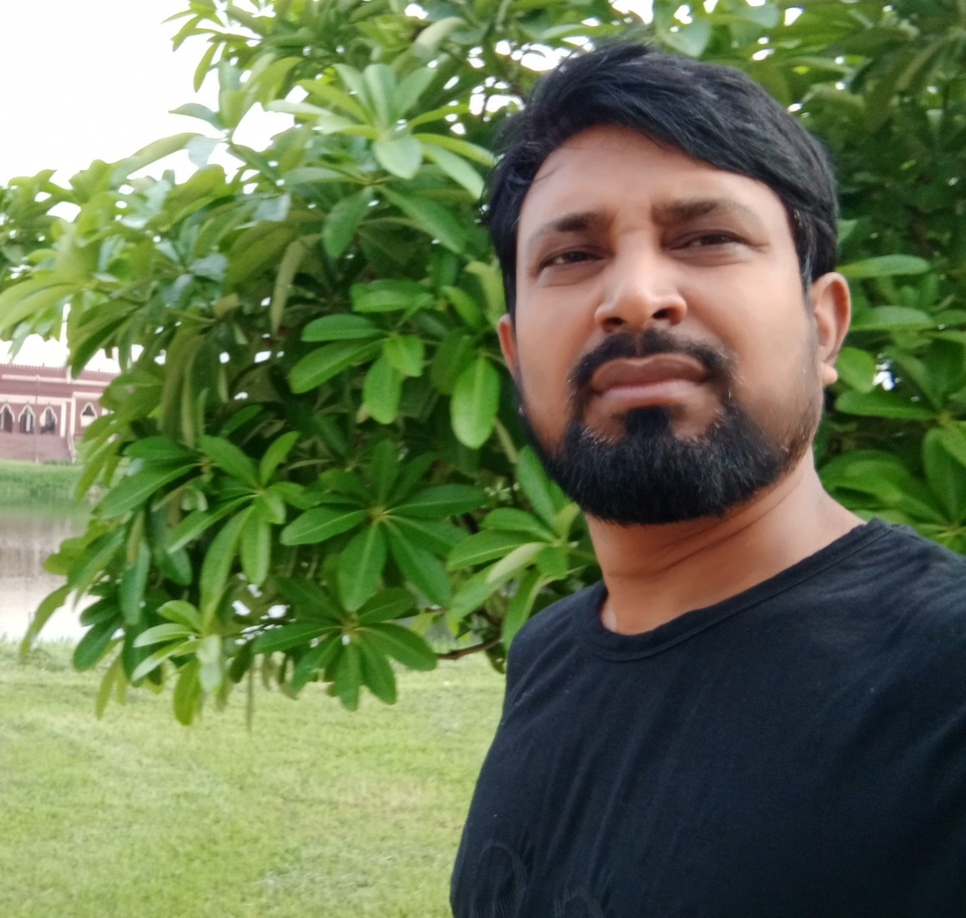
PRESENTED BY
KAWSER AHMED
HEADMASTER
RAYERDIA HIGH SCHOOL

Slide 3
WE MUST FOLLOW
Maintain Health Rules.
Watch The Classes Of Sangsad TV .
Learn 10 vocabulary every day.
Read online newspaper.
Read your text book attentively.
Exercise Math every day.
Don’t go outside unnecessarily .

Slide 5
LEARNING OUTCOME
After finishing the lesson students are able to-
Identify different types of sentences.
change the sentences as directed.

Slide 6
Phrase and clause
PHRASE
No subject and predicate.
No sentence can be formed.
CLAUSE
Contain subject and predicate.
A meaningful sentence can be formed.

Slide 7
She saw the man
going to market
clause
phrase
Classification of clause
Principal clause .
Sub-ordinate clause.
Co-ordinate clause

Slide 8
Sohel became pleased
when he heard the news
P.C
S.C
Principal cl. + Sub-ordinate clause
= COMPLEX
How can we identify Sub-ordinate clause
When
While
After
before
Till
Untill
Since
as
Because
Though
Although
if
Who
That
So that
So..that

Slide 9
Let’ practice
A flower is a glowing gift of nature.(Int.)
Ans. Isn’t a flower a glowing gift of nature ?
Isn’t it a symbol of love and beauty?(Affirmative)
Ans. It is a symbol of love and beauty.
Flowers are used on different occasions.(Active)
Ans. We use flowers on different occasions.
We present flower to our nearest and dearest persons.(Passive)
Ans. Flower is presented by us to our nearest and dearest persons.

Slide 10
We need flowers to decorate a place.(Complex)
Ans. We need flowers so that we can decorate a place.
The rose is the best scent and beautyof all flowers.(Positive)
Ans. No other flower is as good as the rose.
Having sweet scent and beauty, we love it very much.(Compound)
Ans. It has sweet scent and beauty and so we love it very much.

