Slide 1
Class: Two
Subject: English
Unit: 15; Lesson: 1-3 Activity A ; Page: 30

Slide 2
School’s name: Ayjuddin Matobbur Kandi Govt. Primary School, Faridpur Sadar, Faridpur.
Name of the teacher:
Syeda Nusrat Sarmin
Assistant Teacher
Class : Two
Subject : English
Unit: 15, Lesson: 1-3, Page: 30
Date : / /2020

Slide 3
LEARNING OUTCOMES
By the end of the lesson the students will be able to :
Listening: 1.1.1 become familiar with English sounds by listening to common English words.
2.1.1 following simple commands and instructions.
3.1.2 understand simple questions and statements about familiar objects.
4.2.1 enjoy simple stories
Speaking: 1.1.1 repeat after the teacher simple words and phrases with proper sounds and stress.
1.1.2 say simple words and phrases with proper sounds and stress.
5.1.1 say the names of the days of the week.
7.1.1 give simple commands and instructions.
Reading: 1.3.1 recognize and read the names of objects having the same initial and final sounds.
1.4.1 read words and phrases with the help of visual clues and simple sentences.
5.1.1 recognize and read the days of the week.
Writing: 1.2.1 write cardinal numbers up to 30 in figures.

Slide 4
Teaching aids :
Pictures of seed, tub, sun, plant,
Rima’s pupet
Number cards
Poster paper
Slide

Slide 5
What do you see in the picture?
Cloud
Look at the picture.
Tree
Plant
Water
Tub

Slide 6
Our today’s lesson is
Story: Rima and the seed
Unit: 15, Lesson: 1-3, Activity A ; Page: 30

Slide 7
Monday
সোমবার
Monday
Monday

Slide 8
Tuesday
মঙ্গলবার
Tuesday
Tuesday

Slide 9
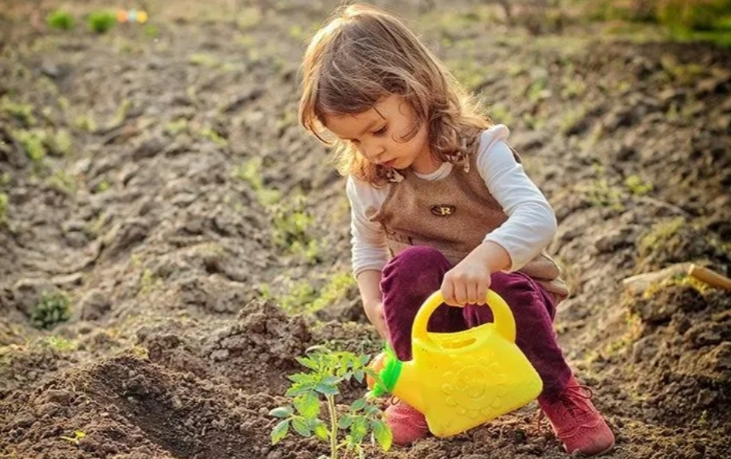
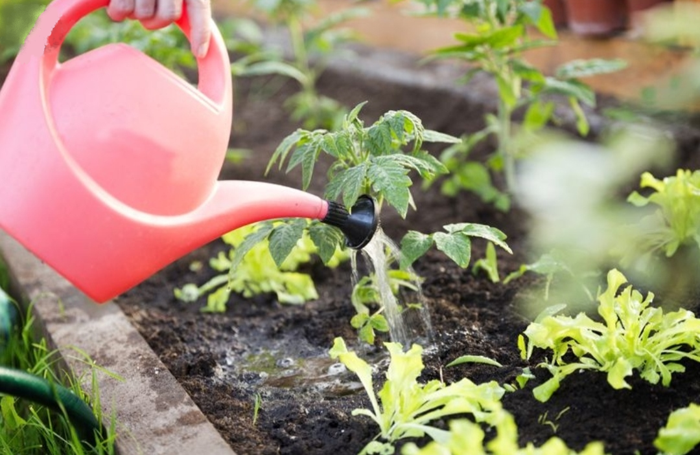
Look at the picture and say.
water
Water – পানি দেয়া
water
water

Slide 10
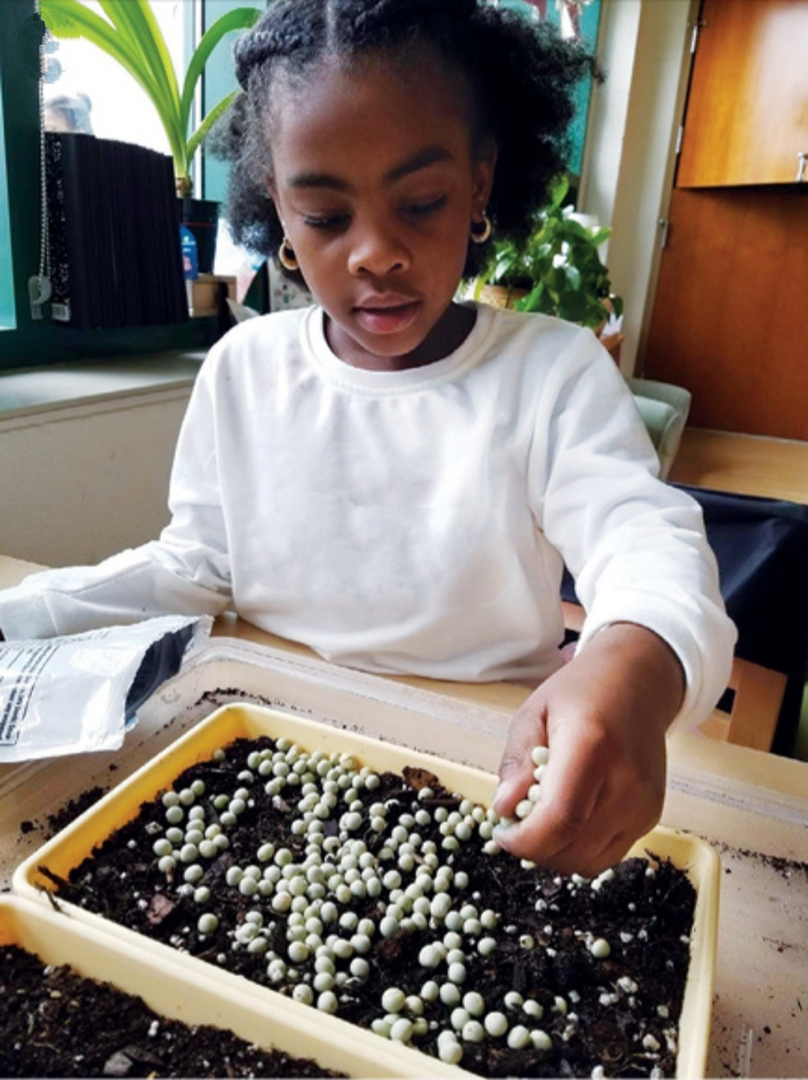
Look at the picture and say.
put
Put - রাখা
put
put

Slide 11
Find out the letters which are used to make the word - Monday
S
T
M
W
u
e
n
d
F
s
r
i
a
e
y
o
Monday

Slide 12
Find out the letters which are used to make the word - Tuesday
S
M
W
u
e
n
d
F
s
r
i
a
e
y
o
T
Tuesday

Slide 13
Re-arrange the words
1. Watre
- Water
2. Sdee
- Seed
3. Snu
- Sun

Slide 14
Open your EFT book at page-28.

Slide 15
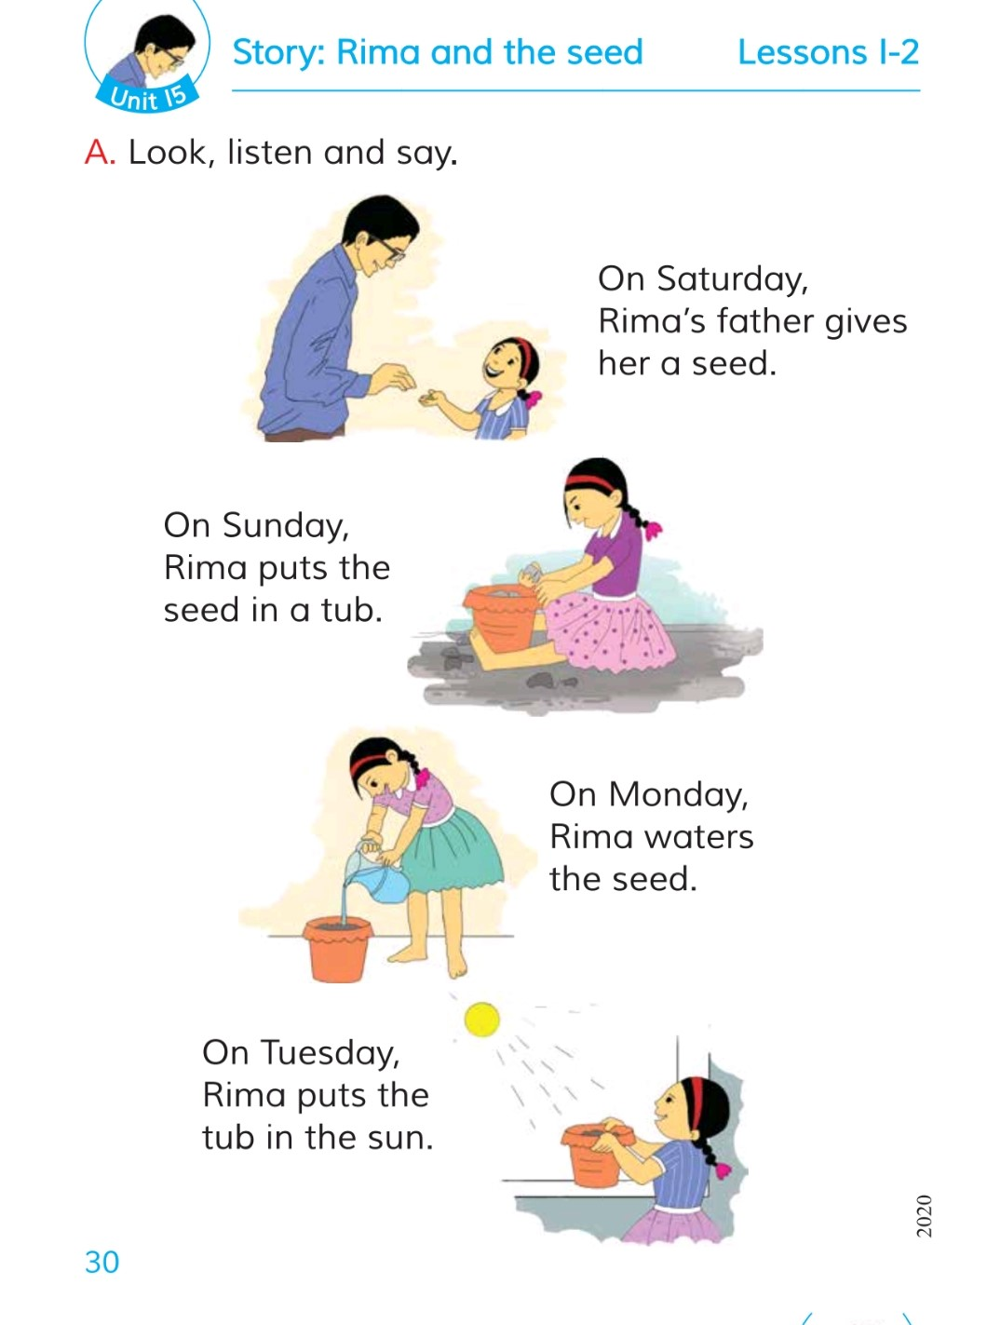

Slide 17
Evaluation
Fill in the gaps.
1. Sat_rday.
u
2. se_d
e
3.Su_day.
n

Slide 18
Home Work
Write the words 5 times on your notebook.
Tub - টব
Put – রাখা

Slide 19
One plant, one life.

Slide 20
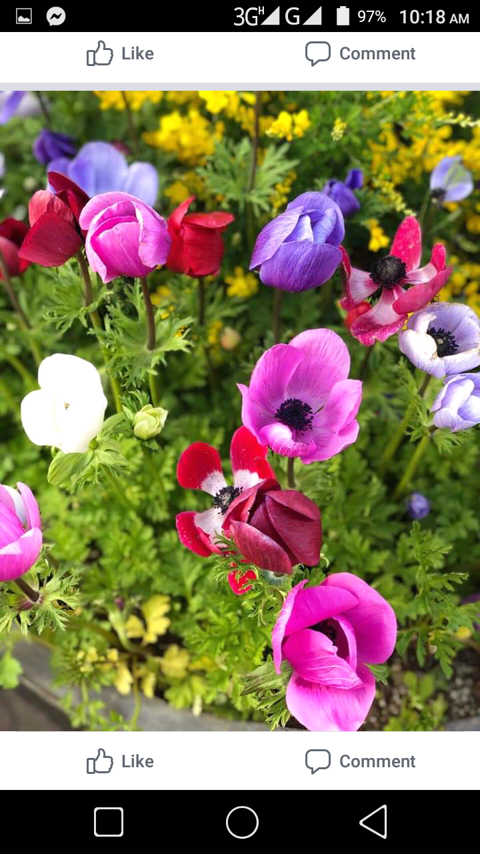
Good bye,
Dear Students.

