Slide 1
Class: Two
Subject: English
Unit:16
Lesson: 1-3
Activity: A, B & C, Page: 32

Slide 2
Syeda Nusrat Sarmin
Assistant Teacher
Ayjuddin GPS
Faridpur Sadar, Faridpur

Slide 3
LEARNING OUTCOMES
By the end of the lesson students will be able to :
Listening: 1.1.1 become familiar with English sounds by listening to
common English words
Speaking: 1.1.1 repeat after the teacher’s simple words and phrases with
proper sounds and stress.
1.1.2 say simple words and phrases with proper sounds and stress.
Reading: 2.1.1 recognize and read cardinal numbers up to 25.
Writing: 2.1.1 write cardinal numbers up to 25.

Slide 4
Teaching aids :
Pictures of pencils
Pictures of bags, shoes, flowers
Number cards
Poster paper, colour pens
slide

Slide 5
Our today’s lesson is
Numbers
Unit: 16, Lesson: 1-3, Activity A,B & C; Page: 32

Slide 6
Write the number that comes before each number.
___ 8
___ 17
___ 10
___ 25
___ 22
7
16
9
24
21

Slide 7
Write the number that comes between the two numbers.
2
1 ___ 3
20 ___ 22
8 ___ 10
23 ___ 25
19 ___ 21
21
9
24
20

Slide 8
Open your EFT book at page-28.

Slide 9
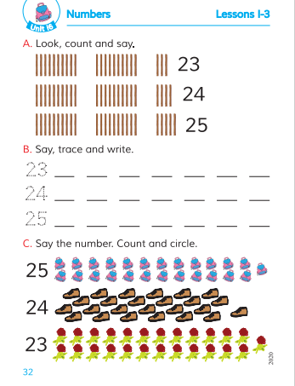

Slide 12
B. Say, trace and write.
23 __ __ __ __
24 __ __ __ __
25 __ __ __ __
23 23 23 23 23
24 24 24 24 24
25 25 25 25 25

Slide 14
1 2 3 4 5 6 7 8 9 10 11 12
13 14 15 16 17 18 19 20 21 22 23 24
25
1 2 3 4 5 6 7 8 9 10 11 12
13 14 15 16 17 18 19 20 21 22 23

Slide 15
Evaluation
Say and write the missing numbers.
2
__ 3 4 __ 6
7 8 __ 10 11 12
14 15 16 17 18
19 20 21 22 __ 24 __
5
9
23
25

Slide 16
HOME WORK
Write the numbers 1-22 on your notebook and draw a bag and colour it.

Slide 17
Good bye,
dear students.

