Slide 1
Class: Five
Subject: English
Unit: 11, Lesson: 4-5
Activity: E&F Page: 44

Slide 2
School’s name: Ayjuddin Matobbur Kandi Govt. Primary School, Faridpur Sadar, Faridpur.
Class : Five
Subject : English
Unit: 11, Lesson: 4-6,
Page: 44
Date : / /2020
Name of the teacher:
Syeda Nusrat Sarmin
Assisstant Teacher

Slide 3
Learning outcomes:
By the end of the lesson the students will be able to :
Listening: 1.4.1 Recognize and use intonation patterns for Yes/No and WH Questions.
1.4.2 Recognize and use intonation patterns for greetings and statements.
Speaking: 1.1.5 say words, phrases and sentences with proper sounds, stress and intonation.
1.8.1 take part in conversations on appropriate topics
Reading: 1.4.1 read words and phrases with the help of visual clues and simple sentences.
Writing: 8.8.1 to make sentences using words and phrases, following instructions.

Slide 4
Teaching aids :
Pictures of seed, tub, sun, plant,
Rima’s pupet
Number cards
Poster paper
Slide

Slide 5
Our today’s topic is
Where’s the library?
Unit: 11
Lesson: 4-5
Activity: E&F
Page: 44

Slide 6
New words
Behind
- পিছনে
Behind
Behind

Slide 7
Opposite
Opposite
- বিপরীত
Opposite

Slide 8
Corner
- কোনে
Corner
Corner

Slide 9
Supermarket
- বৃহৎ বিপণি
Supermarket
Supermarket

Slide 10
Outside
- বাইরের
Outside
Outside

Slide 11
In front of
- সামনে
In front of
In front of

Slide 12
Look, listen and read the dialogues.
Excuse me, sir. Could you please tell me how to get to the supermarket?
Turn right on College Road. Then turn left on Park Street. The supermarket is on the corner.
Thank you!
Ratul
Ratul
Kori
Kori

Slide 13
1.Re-arrange the words
1. utsideo
- outside
2. hindbe
- behind
3. chools
- school
4. pjee
- jeep

Slide 14
2. Match the following words in column A with their similar meaning in column B.
1. Hut
2. School
3. In front of
4. Super market
5. Behind
a. before.
b. a small, little house.
c. Institution for learning.
d. Beyond
e. Street Park
f. Shopping mall
A
B

Slide 15
Answer to the question no 2
(1+b) Hut – A small, little house.
(2+c) School – Institution for learning.
(3+a) In front of – Before.
(4+f) Super market – Shopping mall
(5+d) Behind – Beyond.

Slide 16
Open your EFT book at page 42.

Slide 17
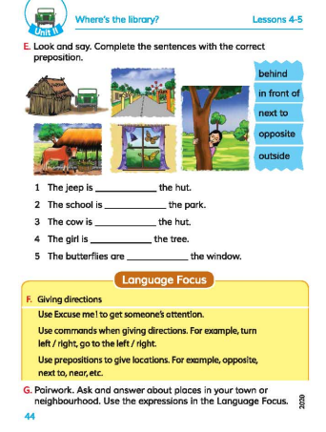

Slide 18
next to
opposite
in front of
behind
outside

Slide 20
Language focus
F. Giving directions.
Use Excuse me! To get someone’s attention.
Use commands when giving directions. For example, Turn left/ right, go to the left/ right.
Use prepositions to give locations. For example, opposite, next to, near, etc.

Slide 21
Evaluation
Re-arrange the words in the appropriate order to make meaningful sentences.
Excuse me,/there/is/a/shopping mall/ nearby?
Answer:
Excuse me, is there a shopping mall nearby?

Slide 22
Home work
Make a dialogue between two friends on the direction from home to shopping mall and act the two characters. Make a video and sent it to us.

