Slide 1
Class: Five
Subject: English
Unit: 11 Lesson: 6-7
Where’s the library?
Page- 45

Slide 2
School’s name: Ayjuddin Matobbur Kandi Govt. Primary School, Faridpur Sadar, Faridpur.
Class : Five
Subject : English
Unit: 11, Lesson: 4-6,
Page: 44
Date : / /2020
Name of the teacher:
Syeda Nusrat Sarmin
Assistant Teacher

Slide 3
Learning outcomes:
By the end of the lesson the students will be able to :
Listening: 1.4.1 Recognize and use intonation patterns for Yes/No and WH Questions.
1.4.2 Recognize and use intonation patterns for greetings and statements.
Speaking: 1.1.5 say words, phrases and sentences with proper sounds, stress and intonation.
1.8.1 take part in conversations on appropriate topics
Reading: 1.4.1 read words and phrases with the help of visual clues and simple sentences.
Writing: 8.8.1 to make sentences using words and phrases, following instructions.

Slide 4
Teaching aids :
Pictures of seed, tub, sun, plant,
Rima’s pupet
Number cards
Poster paper
Slide

Slide 5
Our today’s topic is
Where’s the library?
Unit: 11
Lesson: 6-7
Activity: H,I&J
Page: 45

Slide 6
Listen these dialogues carefully, specially the questions. Give attention on the voices when those go up or down.
Listen these dialogues carefully, specially the questions. Give attention on the voices when those go up or down.

Slide 7
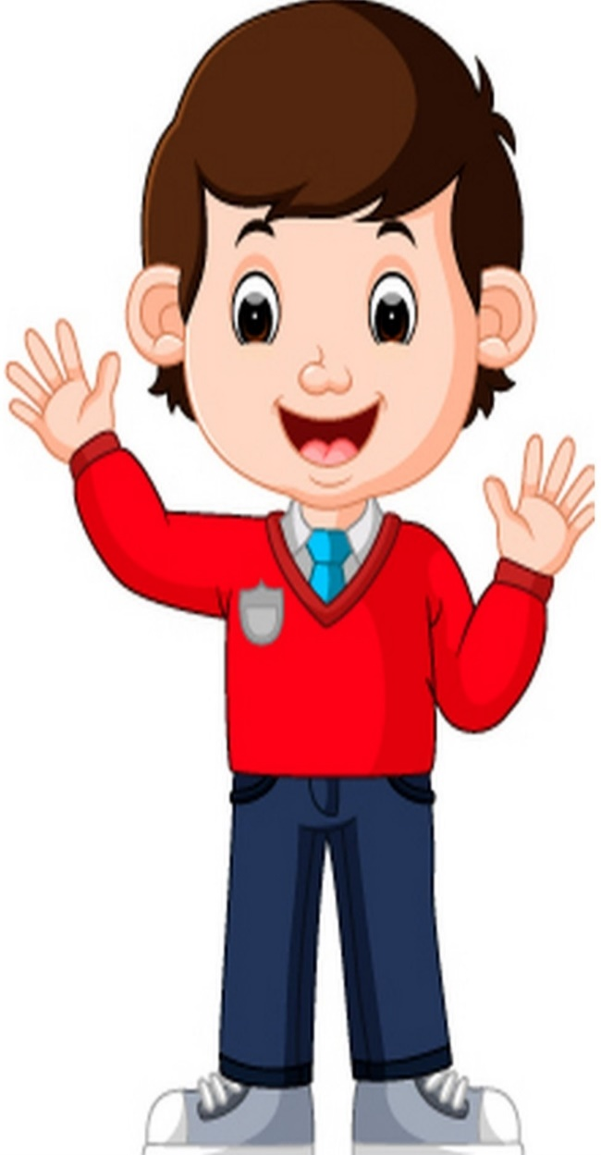
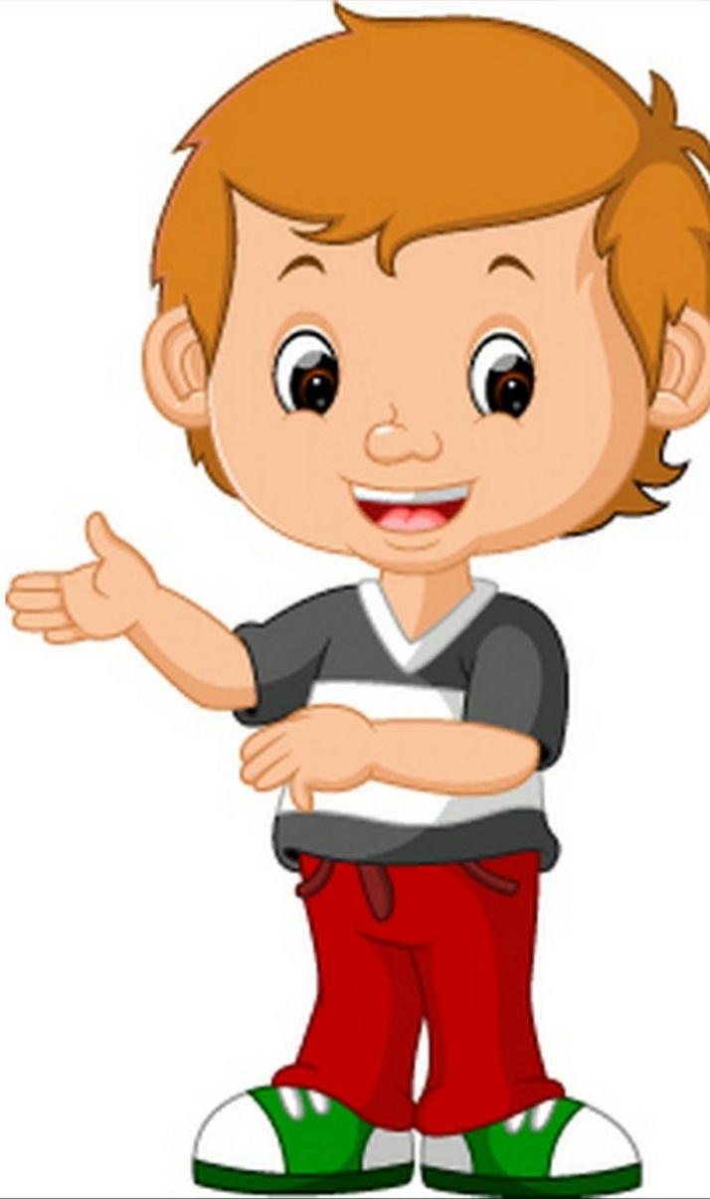
Look, listen and read the dialogues.
Excuse me, is there a library nearby?
Yes, the library is on the College Road, next to the College. Go straight and then turn left on College Road. The library will be on your left.
Thanks a lot!
Dev
Salman
Dev
Salman

Slide 8
Look, listen and read the dialogues.
Excuse me, sir. Could you please tell me how to get to the supermarket?
Turn right on College Road. Then turn left on Park Street. The supermarket is on the corner.
Thank you!
Ratul
Ratul
Kori
Kori

Slide 9
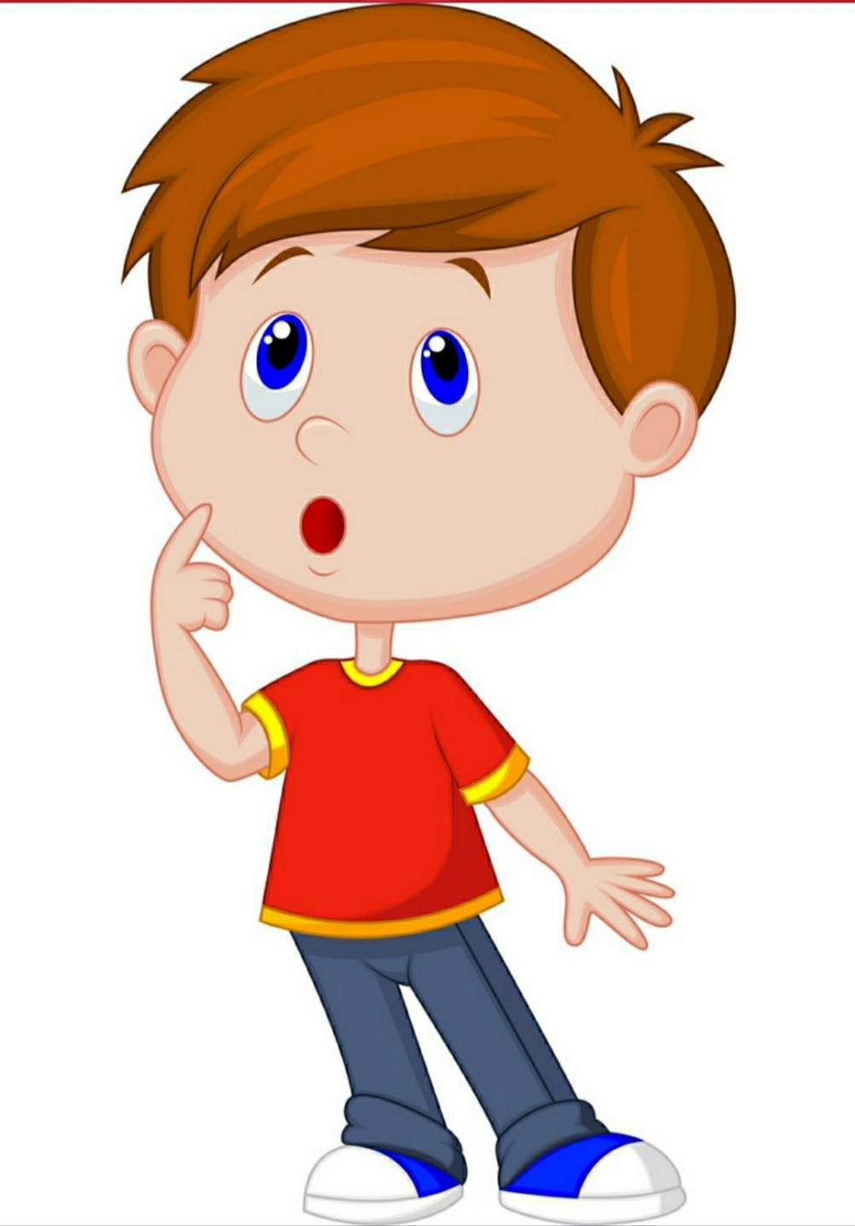
Look, listen and read the dialogues.
Excuse me, Ms. Do you know how to get to the hospital?
It’s very near! It’s only five minutes’ walk from here! Continue on this street toward Road 14. The hospital is on the corner there.
Thanks!
Laila
Laila
Tanim
Tanim

Slide 10
Open your EFT book at page 42.

Slide 12
Language Focus
I. Using our voices
Our voices go up ( ) or down ( ) when we talk.
Our voices go up for …
Greetings.
Questions that can be answered with yes/no.
Our voices go down for …
Statements.
Questions beginning with Who, What, Where, Why and How.

Slide 14
J. Pair work. Ask and answer the questions with information about yourself. Make sure your voice goes up and down correctly.
What’s your name?
Do you want to play a game?
What’s game do you like to play?
Is your family from Sylhet?
Can you speak French?
Do you live in Dhaka?
What’s your best friend’s name?

Slide 15
Home Work
Write the answer of these questions with the information about yourself.
What’s your name?
Do you want to play a game?
What’s game do you like to play?
Is your family from Sylhet?
Can you speak French?
Do you live in Dhaka?
What’s your best friend’s name?

Slide 16
No pain,
no gain.
কষ্ট না করলে কেষ্ট মেলে না।
Goodbye

