Slide 1
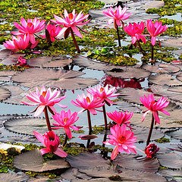
Welcome to my English
second paper class.

Slide 2
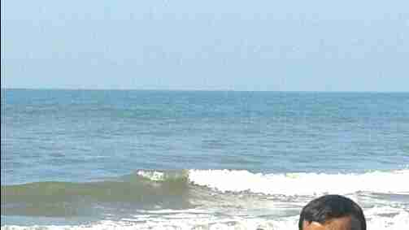
Introduction
Md. Mojibur Rahman
Assist. Teacher( English)
D. B. High School & College
Nachole, Chapainawabganj
Presentation made for
Class VI-IX
English 2nd paper
Grammar
Notes:
Introduction of the teacher and the class.

Slide 3
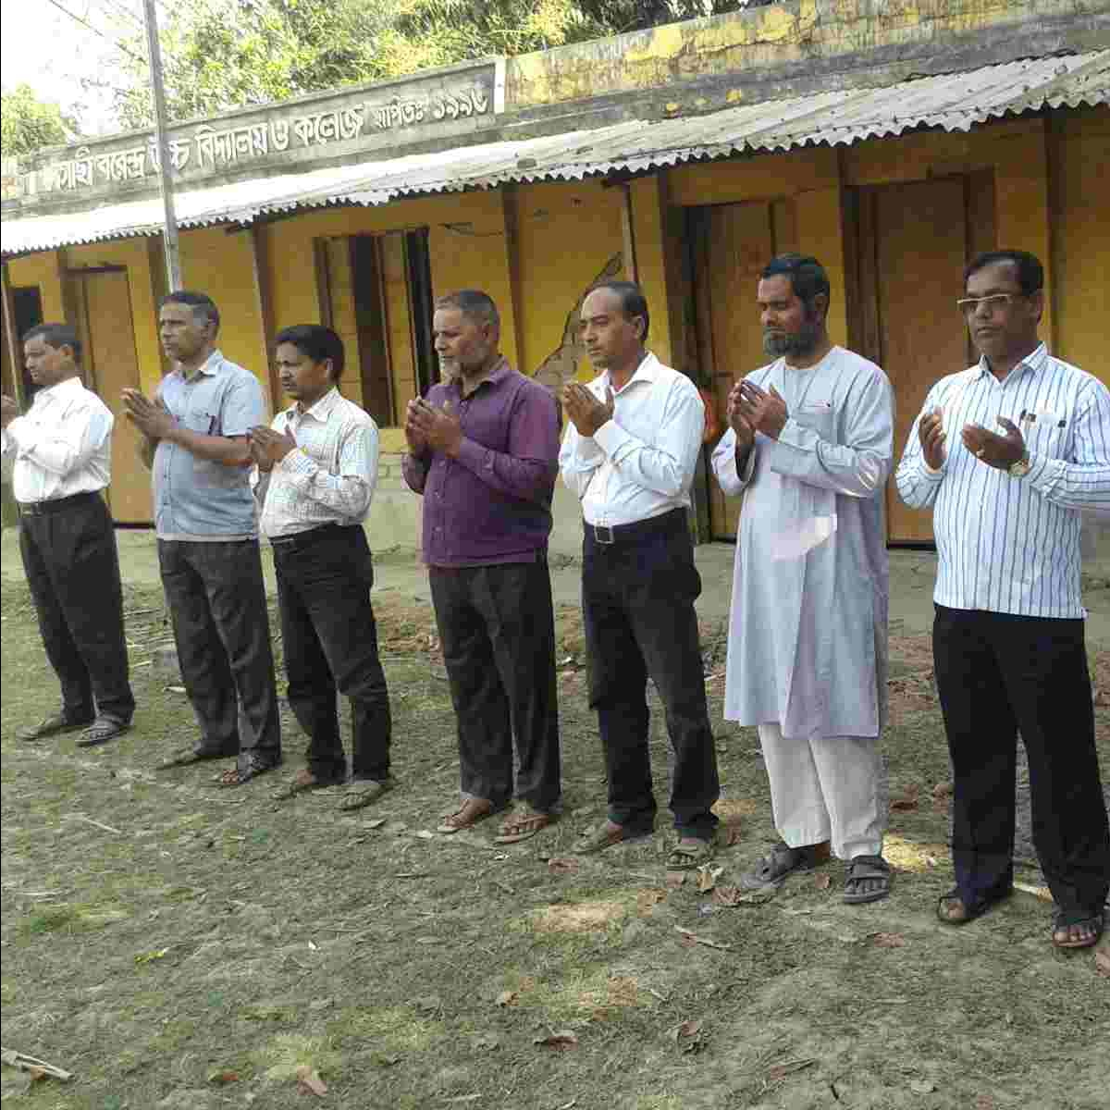
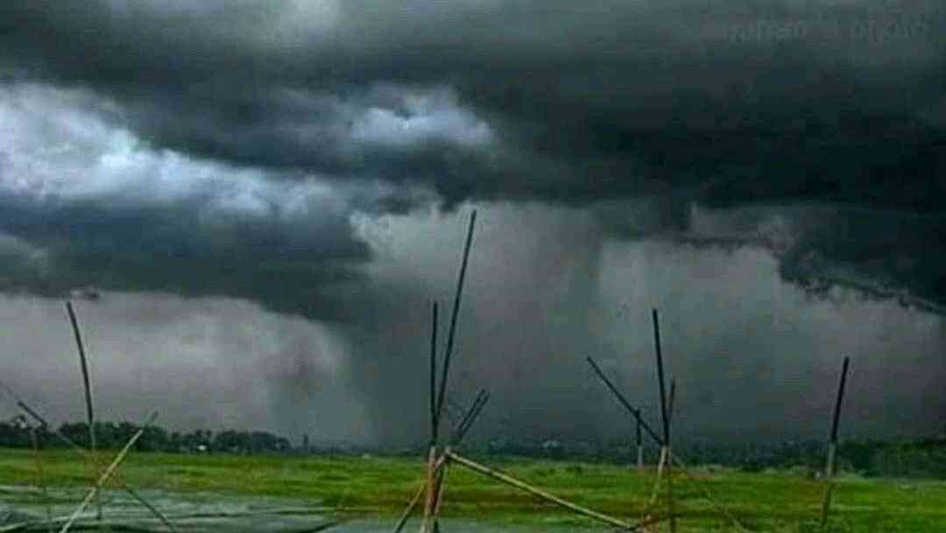
They are praying to Allah .
He sleeps.
It has been raining for two hours.
I have bought a ball.
Notes:
Suspension to lead the lesson.

Slide 4
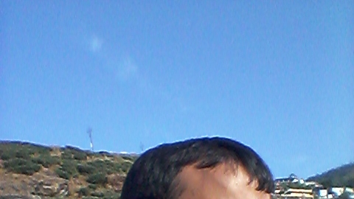
What have you observed by the pictures?
Different forms of present tense.
Let us discuss the forms of
present tenses in our today’s class.
Notes:
Lesson declaration.

Slide 5
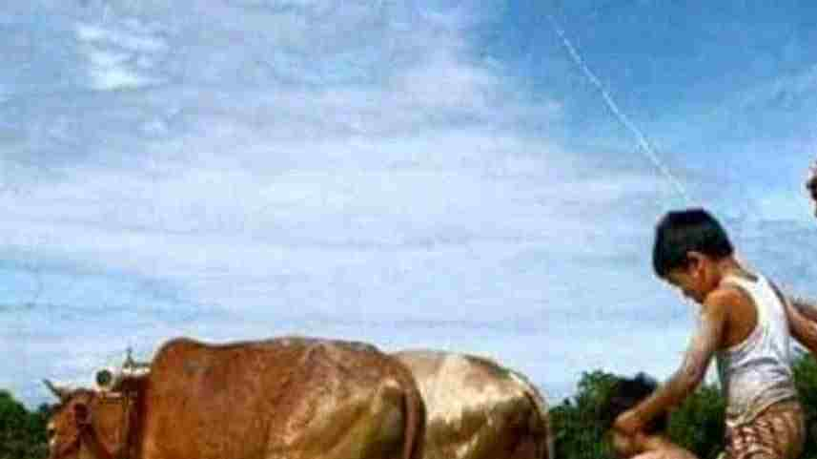
Learning outcomes
At the end of the lesson, we will be able to—
identify the forms of present tense
identify the structures of the forms of present tense
transfer from one to another form
identify the structures of the forms of the sentences
Notes:
All the above outcomes will be focused in this lesson.

Slide 6
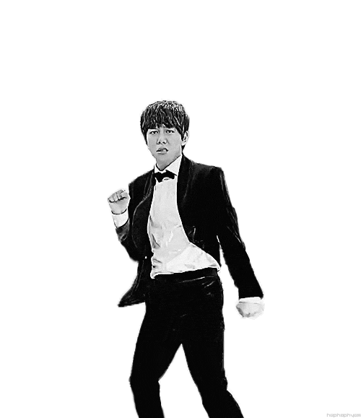
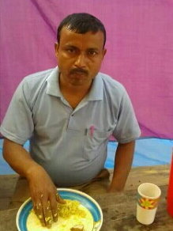
He is dancing.
The man eats rice.
We have won the match.
They have been running for 1 hour.
Notes:
Leading to four forms of present tense.

Slide 7
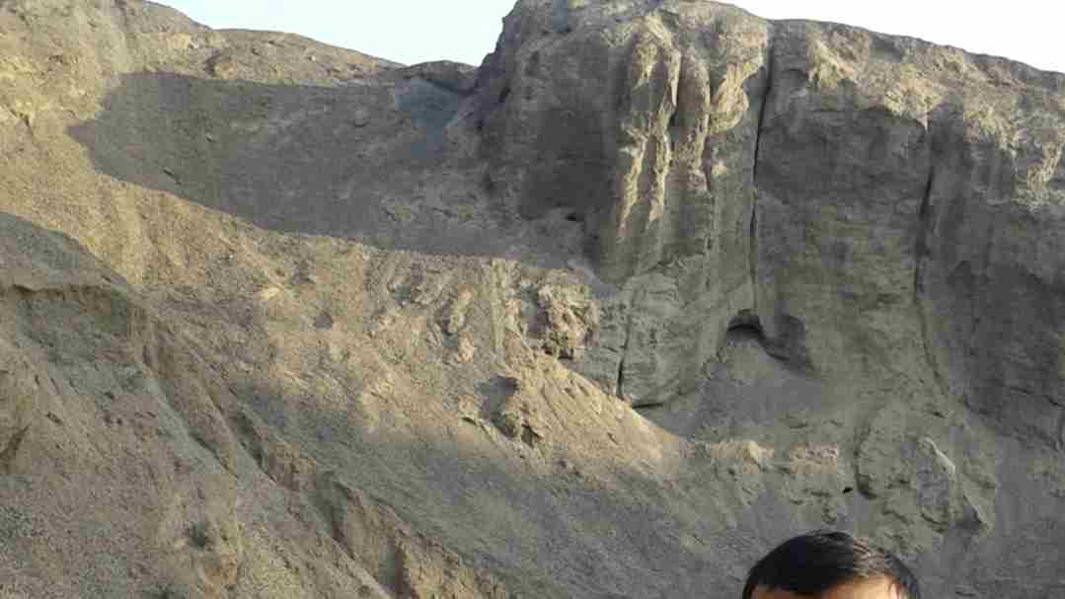
There are four forms of present tense.
Present indefinite form
Present continuous form
Present perfect form
Present perfect continuous form
Notes:
Learning outcomes No-1 will be focused in this slide.

Slide 8
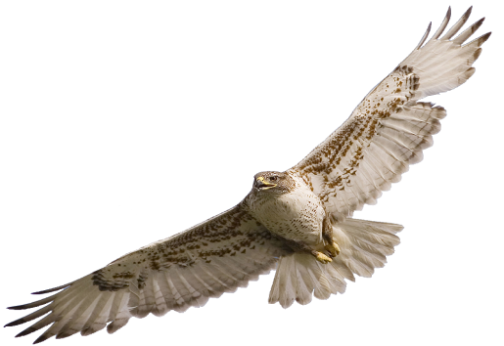
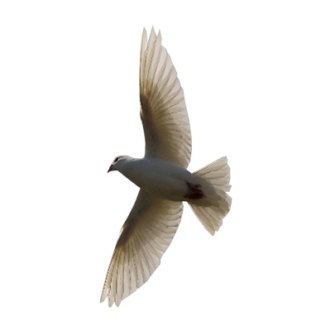
1. Present indefinite form
Structure : Subject + am/is/are/have/has/v₁ (s/es) + extension
Birds fly in the sky.
Subject
V₁
Extension
Note
If the subject is 3rd person singular number, s/es is added with V₁
Notes:
If the verb ends with o, ch, sh, s etc, ‘es’ is to be added with V_{1.} In another place ‘s’ is to be added with V₁

Slide 9
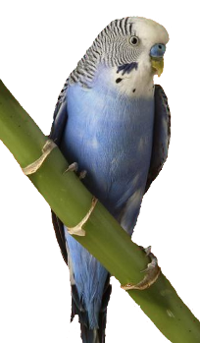
Milk is a nutritious food.
The bird looks very beautiful.
I have a pen.
Notes:
Initial test of the lesson.

Slide 10
Negative form of present indefinite tense.
Sub + be + not + Extension.
Sub + don’t +V₁ +Extension
Sub + doesn’t + V₁ + Extension
He is not a student.
He doesn’t go to school.
I don’t miss school.
Notes:
How is negative formed in present indefinite tense shown here.

Slide 11
Interrogative form of present indefinite tense.
Be + sub + Extension +?
Do + sub +V₁ +Extension+?
Does + sub + V₁ + Extension+?
Is he a student?
Does he go to school?
Do I miss college?
Notes:
How is interrogative formed in present indefinite tense shown here.

Slide 12
Activities
Fill in the gaps with the right form of verbs from the box.
am | like | make | have | has
go | is | respect | ride | are
Rahim (a)__________ a good student. He (b)________ to school regularly. I (c) _________ also a student. We (d) _________ at the same age. We (e) ________ a mutual understanding. Rahim (f) ________ a nice bicycle. We both (g) ________ it. We never (h)_______ any quarrel. All the teachers (i) ________ our friendship. We always (j) _______ our teachers.
Notes:
Feed back of previous slide. Learning outcomes No- 3 is focused here.

Slide 13
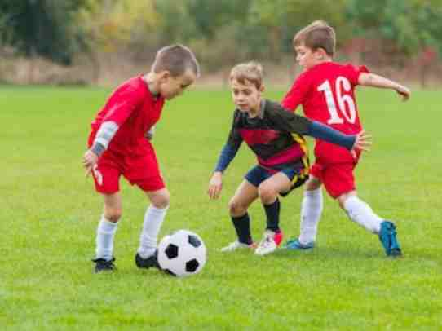
2. Present continuous tense
Structure : Subject +(be) am/is/are+ verb (ing) + extension.
They are playing football.
Sub
be
Verb (ing)
Extension
Note
‘am’ is used after ‘I’ only, after 3rd person singular number ‘is’ is used and ‘are’ is used in another places.
Notes:
Present continuous tense and its structure is shown here through example. Learning outcomes No- 2 is focused here.

Slide 14
Pair work
Transform the sentences into
present continuous tense.
Cats play.
We enjoy cats playing.
The little cat scratches the big cat.
The big cat feels good.
The cats playing looks nice.
Notes:
Feed back on the previous task. Learning outcomes No- 3 is focused here.

Slide 15
3. Present perfect tense
Structure : Subject +have/has+ V₃ (verb past participle)+ extension.
We have enjoyed the show.
Sub
have
V₃
Extension
Note
‘Has’ is used after 3rd person singular number and ‘have’ is used in all other places.
Notes:
Introducing the structure of present perfect tense with example. Learning outcomes No- 2 is focused here.

Slide 16
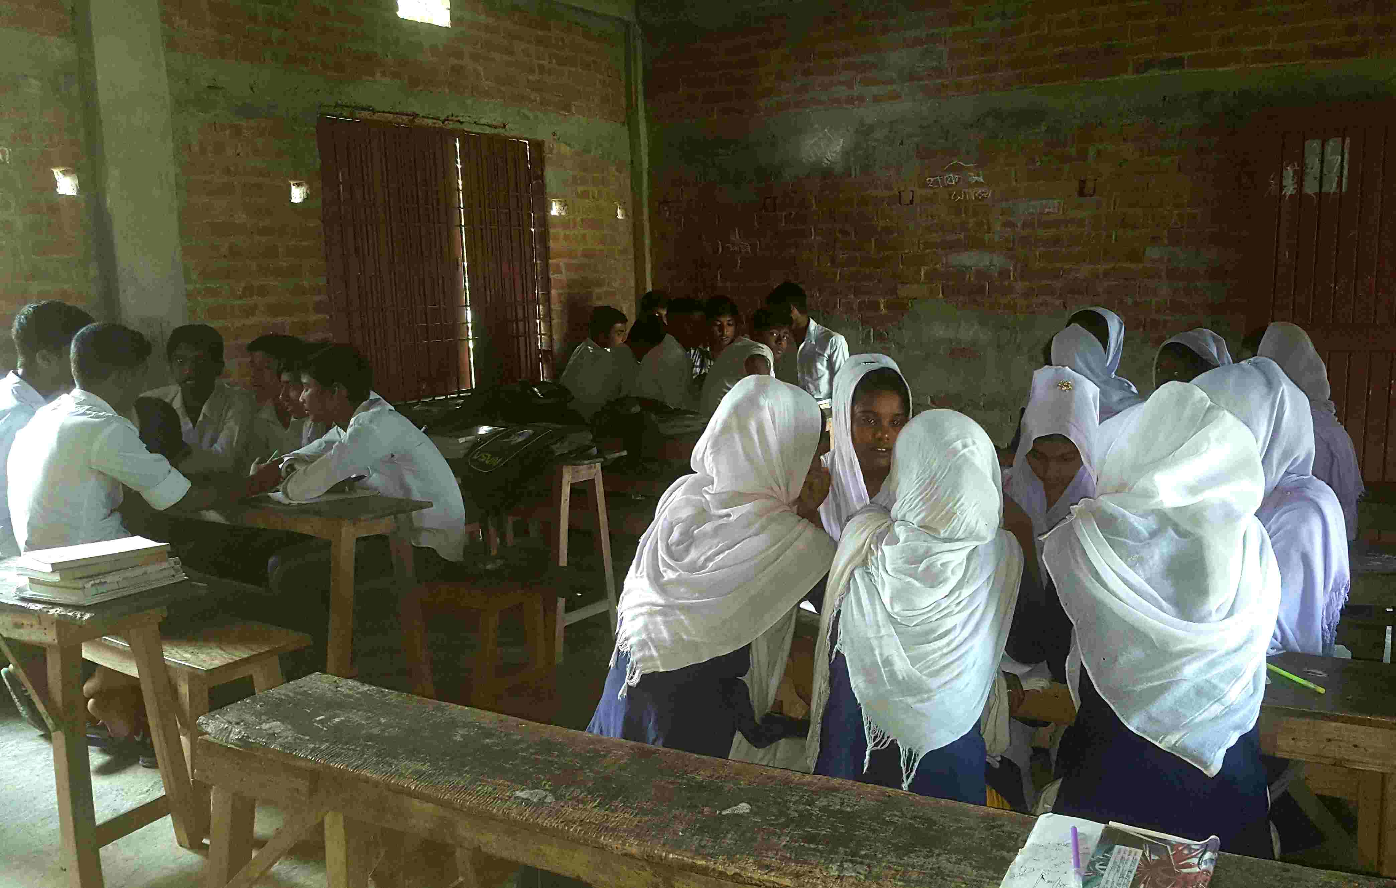
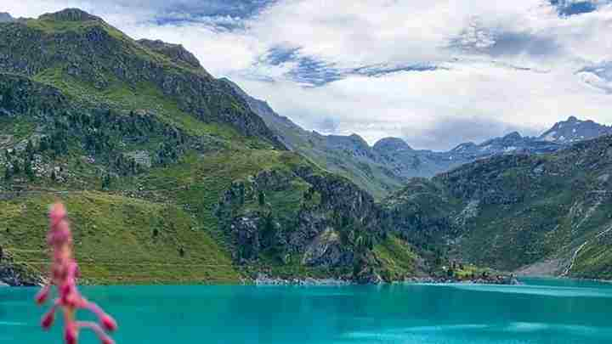
Turn the sentences into
present perfect tense.
Group work.
I go to enjoy hill.
I enjoy a beautiful hill.
I see the green sight of the hill.
The sight charms me much.
I never forget the scene.
Notes:
Evaluation on the previous task. Learning outcomes No- 3 is focused here.

Slide 17
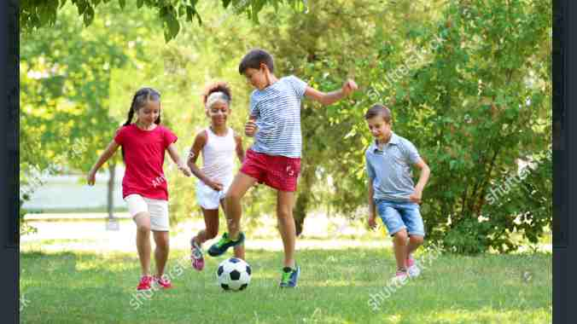
4. Present perfect continuous tense
Structure : Subject+ have been/has been+ verb (ing) + extension.
They have been playing for a long time.
Sub
have been
Verb (ing)
Extension
Note
‘has been ’ is used after 3rd person singular number and ‘have been’ is used in all other places.
Notes:
Introducing present perfect continuous tense with example. Learning outcomes No- 4 is focused here.

Slide 18
Identify the forms of the tenses
of the following sentences.
The nature gives a beautiful view with rain.
The rain has made the scenery more beautiful.
It has been raining for two hours.
It has charmed us all with joy.
Notes:
Evaluation part. Learning outcomes No- 3 is focused here.

Slide 19
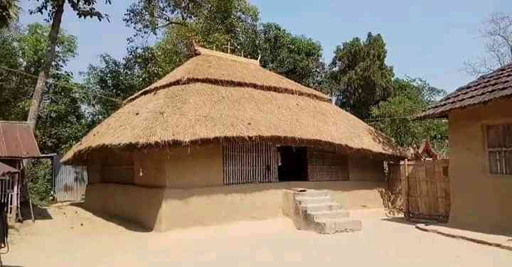
HOME WORK
Identify the form of tenses following sentences.
This is the age of science and technology.
We have been enjoying a happy life for modern ICT.
The world cannot go for a single day without ICT.
Internet has created a new era for civilized world.
It is not possible for us to go without mobile phone.
Notes:
Evaluation option. Learning outcomes No- 4 is focused here.

Slide 20
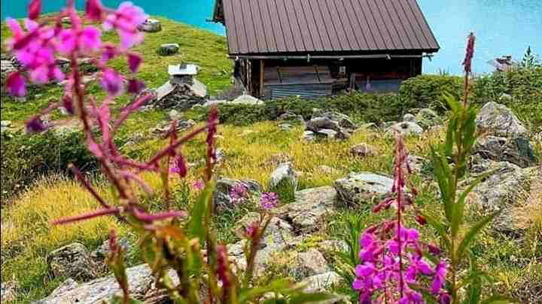
THANKS TO ALL
Notes:
Ending slide..

