Slide 1
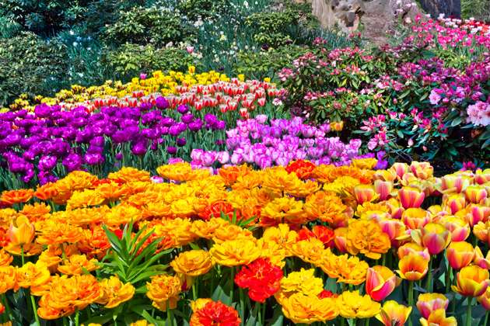
Welcome to our English class

Slide 2
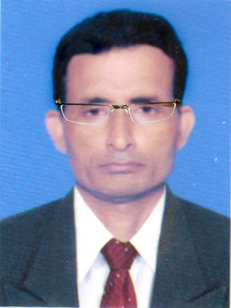

Identity
Manik Chandra Majumder
Senior Teacher (English)
Gazirhat High School
Senbag, Noakhali
Mobile No: 01717155169
email: manikmajumder01@gmail.com
Class : Nine-Ten
Subject : English 1st paper
Time : 50 Minutes
Date : 00/00/2018

Slide 3
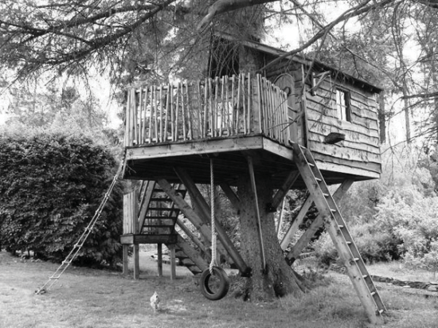
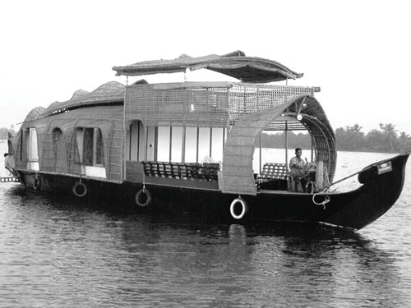
Look at the following pictures and answers the questions.
2.Why do they do so?
1.What do the people do in a tree or a boat?

Slide 4
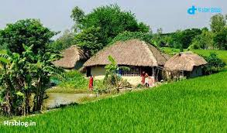
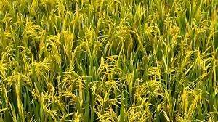
Look at the pictures and think about our lesson
What does arable land provide us?
What does house provide us?

Slide 5
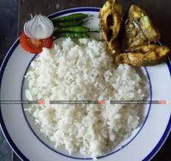
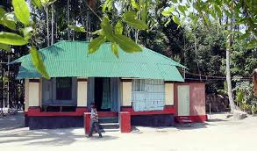
Our today’s lesson is……..
Our food and shelter
Unit: Four
Lesson :Three
Page: 55

Slide 6
Learning outcomes
After we have studied this lesson, we will be able to -----
a) ask and answer about problems,
b) seek and give suggestions,
c) describe the causes of our food and shelter problem,
d) narrate the problems of our food and shelter in writing.

Slide 7
Observe the chart and compare
 | Bangladesh | Sri Lanka | India | China
Land area | 1,47,570 sq km | 65,600 sq km | 32,87,590 sq km | 96,00,000 sq km
Population | 150m | 20m | 1.15b | 1.33b
Density of population | 1000 | 332 | 382 | 133
Birth rate (Per 1000) | 20.1 | 17.42 | 22.22 | 12.29
Death rate (Per1000) | 6.1 | 5.92 | 7.48 | 7.03
Growth rate | 1.40% | 0.7% | 1.41% | 0.5%
If Our population grows such a high rate , we will acutely face food, shelter,…………………………..problems and so on.

Slide 8
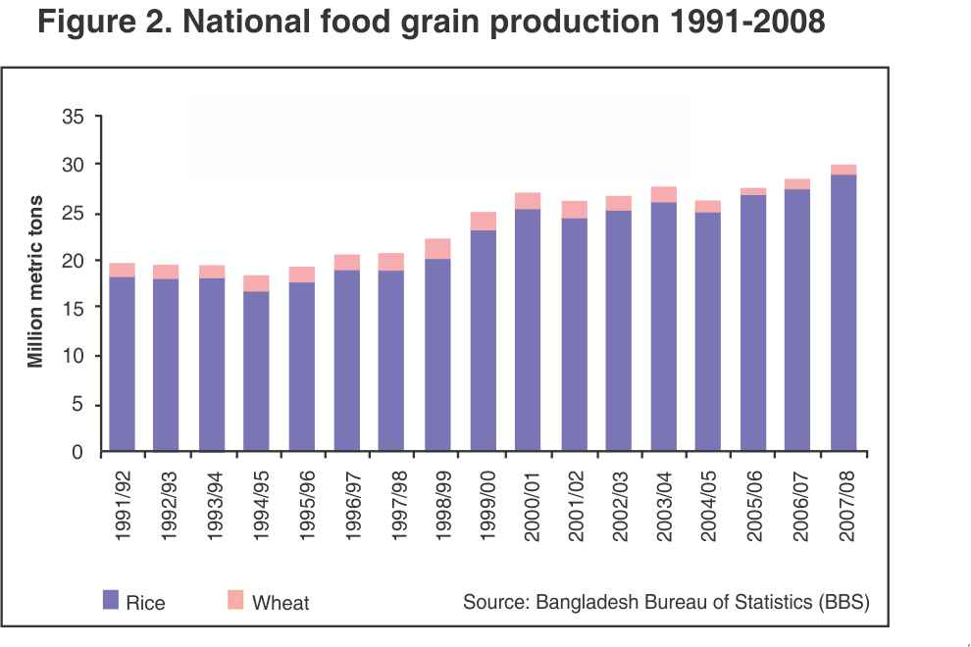
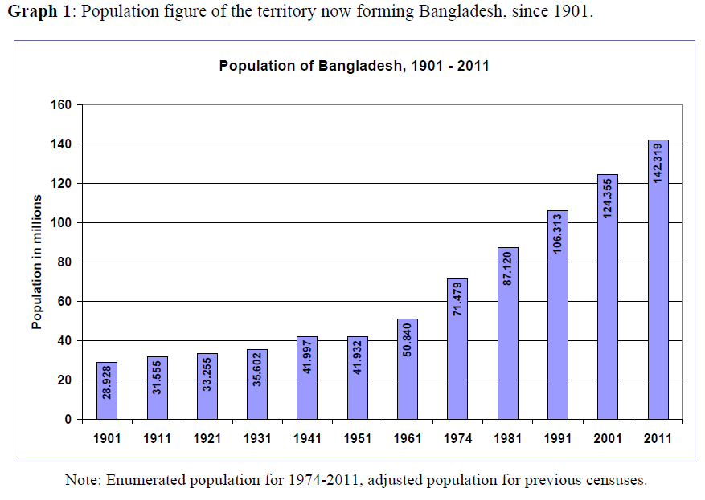
Observe and think about the charts.
Population growth chart
Food grain production chart
Population growth is higher than food production.

Slide 9
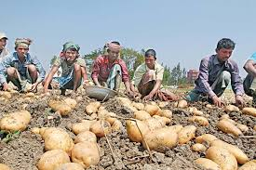
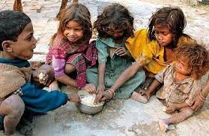
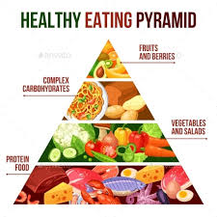
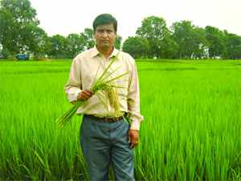

Vocabulary with sentence making
Meaning : Expert/skilled/ experienced in agriculture
Meaning : crisis, shortage
When something is not easy to find or get
Meaning : Become or make smaller in size or amount.
Click box
Meaning : A part of something
Meaning : not settled permanently
Meaning :The process of growing or making food, goods or materials.
Scarcity
Agriculturist
Production
Portion
Shrink
Floating
Sentence : Our agriculturists developed new varieties of rice.
Sentence : This year production of potato's is sufficient.
Sentence : Our cultivable land is shrinking day by day.
Sentence : Some people live on floating boat.
Sentence : The poor suffer from scarcity of food.
Sentence : Mills and factories are occupying a portion of arable.

Slide 10
Read what the teacher Ms choudhuary and her students are talking about.
The class comes up with different problems. One group leader says, "The scarcity of food will be a serious problem. It is true that our agriculturists have developed new varieties of rice and its per acre production has definitely increased. But the rate of increase in food production cannot keep pace with the rate of population growth. This is because our land is fixed, i.e. we cannot increase it, while our population is increasing rapidly.

Slide 11
Another group leader comes up with the housing problem in the country, which he says adds much to the food problem. He continues, "Families are growing larger in size and breaking into smaller families. Each such family needs a separate house to live in. Also the arable fields are being divided by these smaller families among themselves. Mills and factories are being set up, which occupy a considerable portion of our land. So when we need more land to grow more food to feed more mouths, our land is shrinking day by day. If our population grows at the present rate, a day will come when many people will not find any land to build a house on. And, as a result, many of them might live on trees or on the floating boats in the rivers." "No way," another student argues. "Trees are being cut, hills are being cleared and water bodies are being filled up --- all to meet the needs of too many people."

Slide 12
"Thank you students," Ms Choudhury says, "You're quite right. Let me tell you about this village where I was born and brought up. Things were not like this in the past. I remember as a child, the village was so beautiful! The green paddy fields and yellow mustard fields seemed to be unending. They used to wave and dance in the breeze. There used to be a wood in the northern side of the village. There was a tall tamarind tree in the middle of the wood. Also a big banyan tree looked like a huge green umbrella, with its aerial roots hanging down. I often used to go there with my age-mates. We would often have picnic there. While the boys would climb the tamarind tree and pick some tamarinds, me and my best friend Rima used to swing with the roots. But now, look, the wood is gone. The beauty of the crop fields is spoiled by the unplanned houses built here . and there."

Slide 13
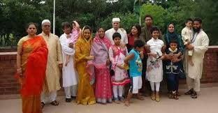
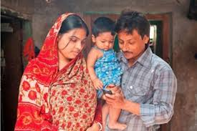
Now we will see some pictorials.
Families are growing larger in size.
Larger families are breaking into smaller families.

Slide 14
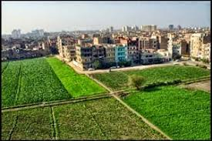
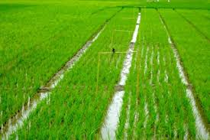
Arable land are being divided into small families.

Slide 15
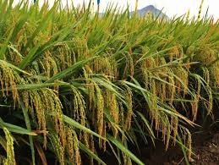
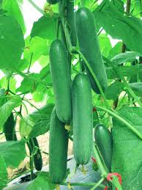
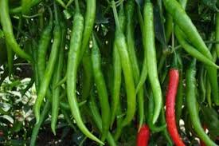
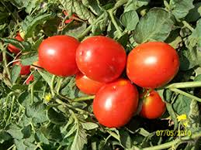
If our population grows such a high rate, the scarcity of food will be a serious problem.
Our agriculturists have developed hybrid crops but it cannot keep pace with increasing population.

Slide 16
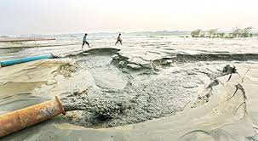
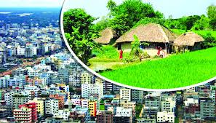
Mills and factories are being set up.
Water bodies are being filled up.
Arable land is shrinking day by day.

Slide 17
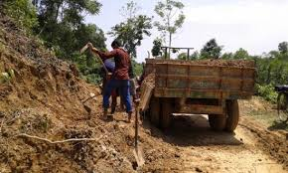
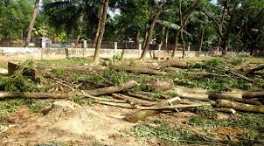
Hills are being cleared and destroyed..
Trees are being cut down.

Slide 18
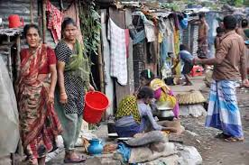
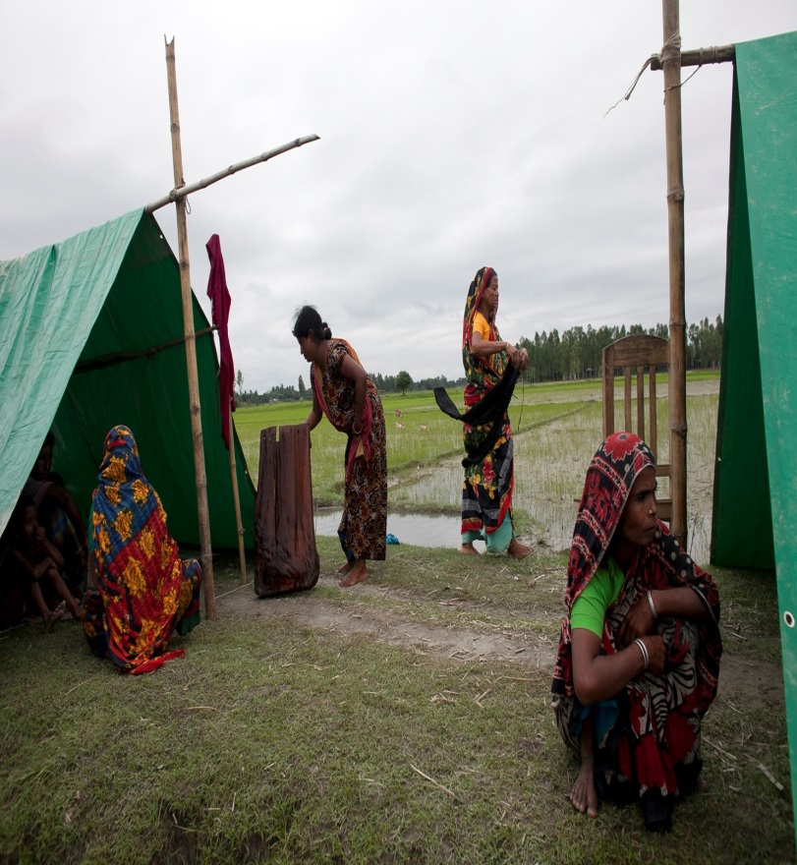
Facing acute housing problem

Slide 19
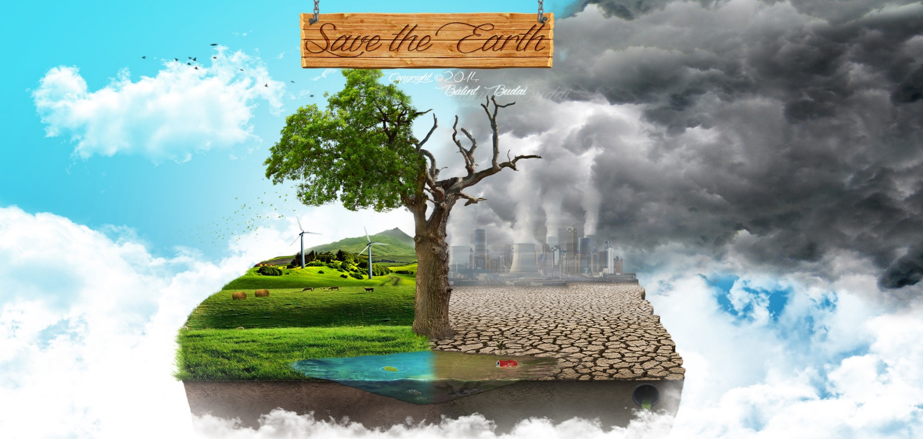
All these problems are creating serious environmental problem and our nature is losing its balance .

Slide 20
Individual work
What makes our land shrink day by day?
Describing in short.

Slide 21
Group work
Make a list of things that Ms Chowdhury saw in her village when she was a child. Why do you think she liked them.
Ans :
i. The green paddy field.
ii. Yellow mustard field.
iii. A wood in the northern side of the village.
iv. A tall tamarind tree.
v. A big banyan tree.
vi. Used to swing from the roots.
From the text we came to know that she liked them as she told her students in the class. Her childhood days were very delightful.

Slide 22
Select the best answer from the alternative.
a. The rate of increase in food production cannot keep pace with the rate of population growth.
The sentence means that the food production
i) is as much as needed.
ii) is less than what is needed.
iii) is more than what is needed.
iv) is sufficient for the population.

Slide 23
b. How can our housing problem increase our food problem?
i) After making houses, farmers do not have enough time to work in the field.
ii) After making houses, farmers do not have enough money to buy food.
iii) If you do not have a house, you cannot store your food.
iv) For making too many houses, people are using the crop land.
c. What makes our land decrease day by day?
i) Families are growing larger in size.
ii) Houses and factories are being built on it.
iii) Smaller families need smaller houses.
iv) Land grabbers are occupying a portion of our land.

Slide 24
d. Many people may have to live on trees, because-
i) they would like tree houses.
ii) making houses on trees is less expensive.
iii) they may not find land to make houses.
iv) tree houses are safer during floods.
e. People are cutting trees to-
i) plant more trees.
ii) keep the environment clean.
iii) make articles of furniture.
iv) grow crops or make houses.

Slide 25
f. There used to be a wood n the northern side of the village- Here ‘ wood’ means-----
i) an area covered with trees.
ii) log and branches of trees.
iii) a tall tree.
iv) a banyan tree.
g. The class comes up with different problems. Here ‘comes up’ replaced by----
i) summons
ii) addresses
iii) creates
iv) develops

Slide 26
Answer the following questions:
Why cannot the rate of increase in food production keep pace with he rate of population growth?
b) How can our housing problem add to our food problem?
c) Where would Ms Choudhury often have picnic with her age-mates?
d) Why may many people make houses on trees or floating boat?
e) How is the beauty of Ms Choudhury’s village spoiled?
Answer-b) As our population is increasing rapidly and larger families are breaking into smaller families. For making houses and buildings for increasing population our arable lands are used-up and shrinking day by day. Thus housing problem add to our food problem
Answer-e) The beauty of Ms Choudhury’s village is spoiled by building unplanned houses here and there.
Answer-c) Ms Choudhury would often have picnic with her age-mates in the wood beside her village .
Answer-d) Due to increasing population growth many people may not find land to build houses. So they may make their houses on trees or floating boats.
Answer-a) The rate of increase in food production cannot keep pace with he rate of population growth because our land is limited and we cannot increased it while our population is increasing rapidly. Food production is less than what we needed. So it cannot keep pace with he rate of population growth.

Slide 27
Read the following text and fill in each gap with a suitable word based on the information of the text.
In this passage, Ms Choudhury and her students are talking about different problems. One group leader says that the scarcity of food is a serious problem. The agriculturists have developed new varieties of rice and its per acre production is definitely high. But the rate of production of food is not keeping pace with the rate of population growth. Another group leader tells .about housing problem. If the population increases in the present rate, we have to build houses on trees and boats. After listening to all of their discussion Ms Choudhury tells them about her village. Once her village was full of trees and fields of various crops. But nowadays everything has changed. The beauties of the crop fields are spoiled by the unplanned houses built here and there.

Slide 28
Read the text and fill in each gap with a suitable word based on the information of the text.
Evaluation
The production of food is not (a)-------------- in comparison with population growth. Our (b) ------------- is shrinking day by day. People are making houses and factories on (c) -----------------. Housing problem is also giving (d) ---------------- to food problem. Really, a relation lies between food problem and (e) ------------------ problem.
a) sufficient/enough
b) land
c) them
d) birth
e) housing

Slide 29

Home work
Write a composition about your village or locality. Describe any change in the things you have noticed over the years such as houses, fields, trees, plants, etc.

Slide 30
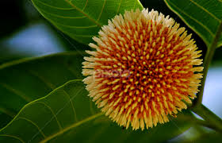
Good bye

