Slide 1
WELCOME

Slide 2
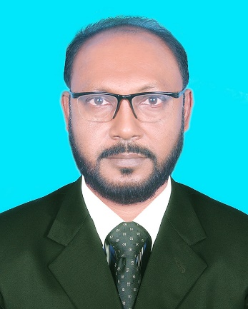
Identity
Class: Nine & Ten
Sub: English 1st Paper
Time: 50 Minutes
S.M.MOZAMMEL KABIR (TOTOL)
Asst. Head Master
Bhawal Baria Union High School,Gazipur Sadar
Mobile: 01770633593 Email:- tmcsltd777@gmail.com

Slide 3
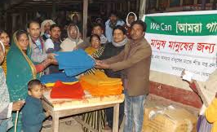
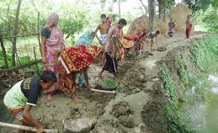
Men help men
Voluntary service

Slide 4
Today’s lesson
Responsibilities

Slide 5
The students will able to
Know what is responsibility?
Understand as a citizen what should we do for our country?
Say what a country do for it’s citizen?

Slide 6
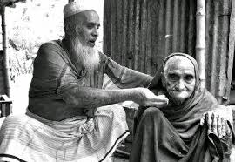
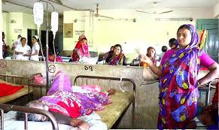
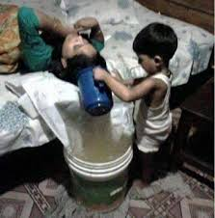
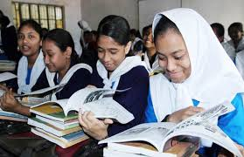
TO DO

Slide 7
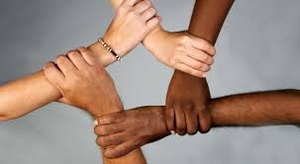
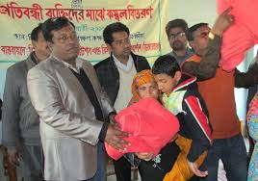
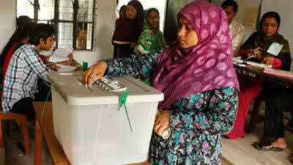
TO DO

Slide 8
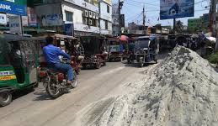
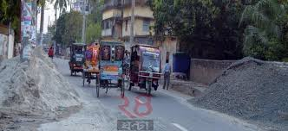
NOT TO DO

Slide 9
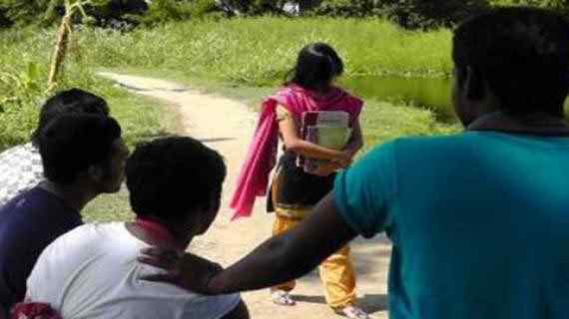
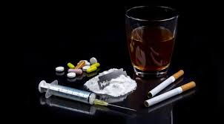
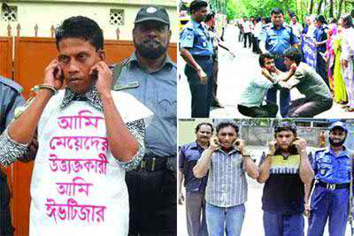
NOT TO DO

Slide 10
FOOD
CLOTHE
HABITATION
TREATMENT
EDUCATION
FOUNDAMENTAL
RIGHTS
GOVERNMENT ENSURE

Slide 11
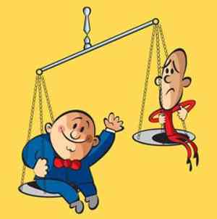
GOVERNMENT ENSURE

Slide 12
Listen attentively

Slide 13
Vocabulary
Passer by
পথিক
Groan
গোঙানো
Attitude
দৃষ্টিভংগী
Fundamental
মৌলিক
Expression
মত প্রকাশ
Whole
সম্পূর্ণ

Slide 14
Individual work
What is responsibility?
Do you mind that is responsibility what Rony has done?
What is fundamental right?
What is the responsibility of our country to us?
What is the duty to do to our country of us?

Slide 15
Group Work
Group ‘A’- Discuss about responsibility?
Group ‘B’- Give a short note about rights?

Slide 16
Evaluation
What is responsibility?
What is right?
Tell the duty of us to our country?

Slide 17
Write a short description about responsibility and rights.

Slide 18
THANK’S TO ALL

