Slide 1
Welcome

Slide 2
Identity
Teacher identity
Name: Md. Alamgir Islam
Title: Assistant teacher
Schools name: Khorakhai Boishnabpara G P S .
Parbatipur , Dinajpur.
Lesson identity
Class: Two
Sub: English
Unit: 29
Lessons: 4-6
Date: 18-03-2018

Slide 3
Learning outcome
1.1.1: Repeat after the teacher simple words and phrases with proper sounds and stress

Slide 4
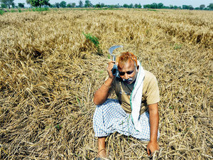
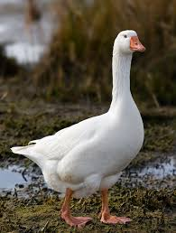
Lets we watch some pictures

Slide 5
The Golden Goose

Slide 6
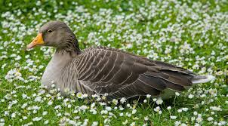
New Words
কৃষক
Farmer
Goose
Golden egg
Lay
রাজহংসী
সোনার ডিম
ডিম পাড়া

Slide 7
A poor farmer has a goose.

Slide 8
Every day, the goose lays an egg.

Slide 9
It’s a golden egg.

Slide 10
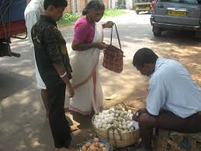
Every day, the farmer sells the egg.

Slide 11
Dear students please open your book at page-59

Slide 12
Pairwork
Say true or false. If false, say the true answer
The farmer sells the egg every day.
The farmer buys eggs every day.
The farmer is rich.
The farmer is poor.

Slide 13
Match the word with the picture
Goose
Lay
Farmer
Golden egg

Slide 14
Evaluation
Ask and answer
Who has a goose ?
What dose the farmer sell ?
How was the farmer ?
ooou

Slide 15
Thank you everybody

