Slide 1





Dear students
Dear students
Welcome to E.F.T. Class

Slide 2
Presented by
Md.Solaiman.
Assist.teacher(english)
Kapasia Horimonjury Pilot Girls’ High School.
Kapasia; Gazipur.

Slide 3


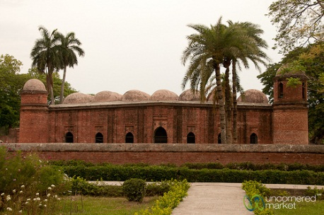

Look at the picture and answer the questions.
This is a mosque.
What is this building?
We call it Shatgambuj Masjid.
What do we call it?
We see the mosque in Bagherhat.
Where do we see this building?
It is our Heritage.
What it is for?
The Shat Gambuj Mosque is a world heritage.

Slide 4
Our today’s lesson is
The Shat Gambuj Mosque
Unit # 8 Lesson # 1
Page # 101

Slide 5
Learning outcomes
By the end of the lesson , the learners will be able to
1
Describe the ShatGambuj Mosque
2
Tell meaning of the new words.
3
Complete the chart given
4
Write about a mosque using clue.
5
Understand the text.
6/1/2017. EFT
Dated:-6/1/2017

Slide 6
Read the text silently
Heritage is what we inherit from the past , live with them in the present and then pass on to our children or future generation. Our unique source of life and inspiration is our cultural and natural heritage. When we speak of “ World Heritage” ,it indicates places and sites that we go from the past and pass on to the future generation of the entire world.

Slide 7
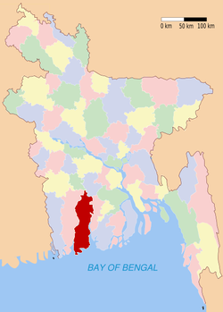

The Shat Gambuj Mosque in is such a heritage . It became a UNESCO World Heritage Site in 1985.
Originally the historic Mosque City was known as “Khalifatabad ‘. It is situated at the outskirts of Bagerhat town—not very far from the dense of the Sundarbans. Khalifatabad was a Muslim colony. It was founded by the Turkish general , a saint warrior Ulugh Khan Jahan in the 15th century. The infrastructure of the city reveals significant technical skills in many mosque as well as early Islamic monuments.
Bagerhat
mangrove forest

Slide 8
Baked bricks were used for the construction of the buildings. The planning of the city was distinctly dominated by Islamic architecture and the decorations were a combination of Moghal and Turkish architecture.
Khan Jahan built a network of roads, bridges, public buildings and reservoirs to make the city habitable. There were about 360 mosques in the city . Among them the most remarkable is the multi domed Shat Gambuj Mosque.

Slide 9
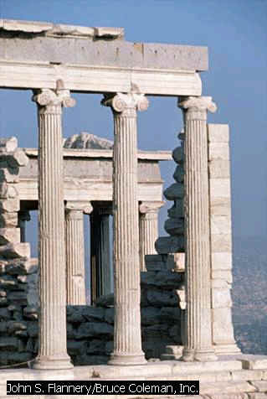
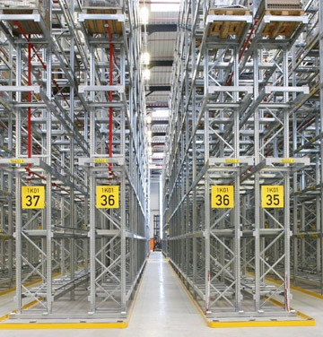
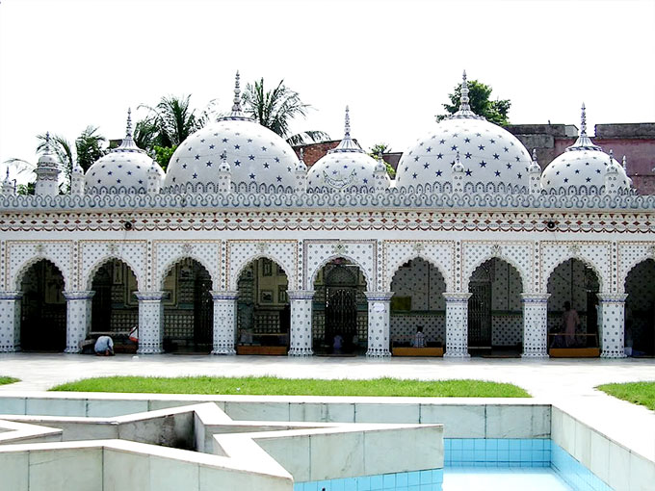
The mosque is unique in the sense that it has 60 pillars the support the roof, with 77 low height domes. The 4 towers at 4 corners have smaller on the roof as well. The vast prayer hall has 11 arched doorways on the east and 7 each on the north and south for light and ventilation. It has 7 running along the length of the mosque and 11 deep curves between the slender stone
.These column support the curving arches created by the dooms.
domes
aisles
column

Slide 10
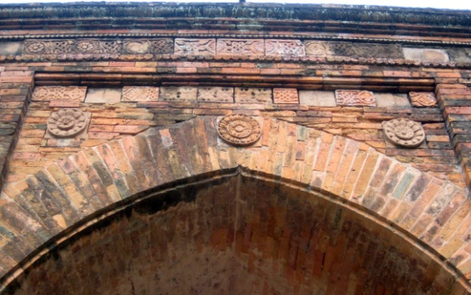
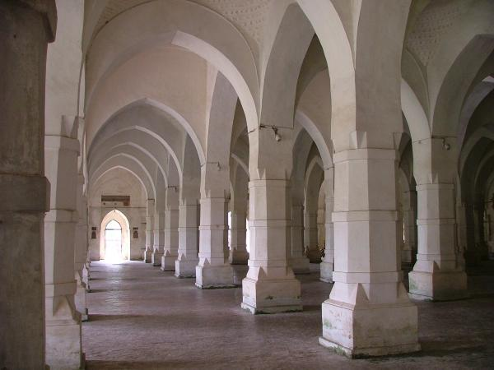
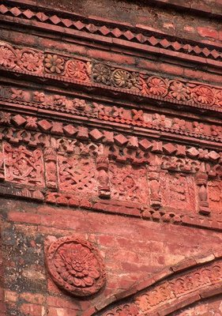
The thickness of the arches is 6 feet and have slightly
and round wall. The west wall in the interior has 11 . These mihrabs are decorated with stone work and . The floor of the mosque is made of bricks. Besides being used as a prayer hall , Khan Jahan used the mosque as his court also. Today , it is one of the greatest tourist attractions and one of the best architectural beauties of Bangladesh.
narrowing hollows
mihrabs
terracotta

Slide 11

Let’s Search difficult words

Slide 12
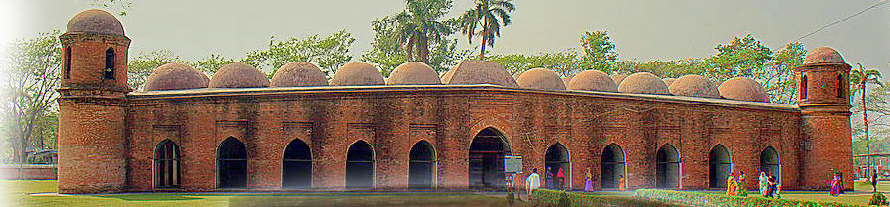
Four corners have 4 smaller dooms
77 low height dooms
11 Arched doorways on east

Slide 13
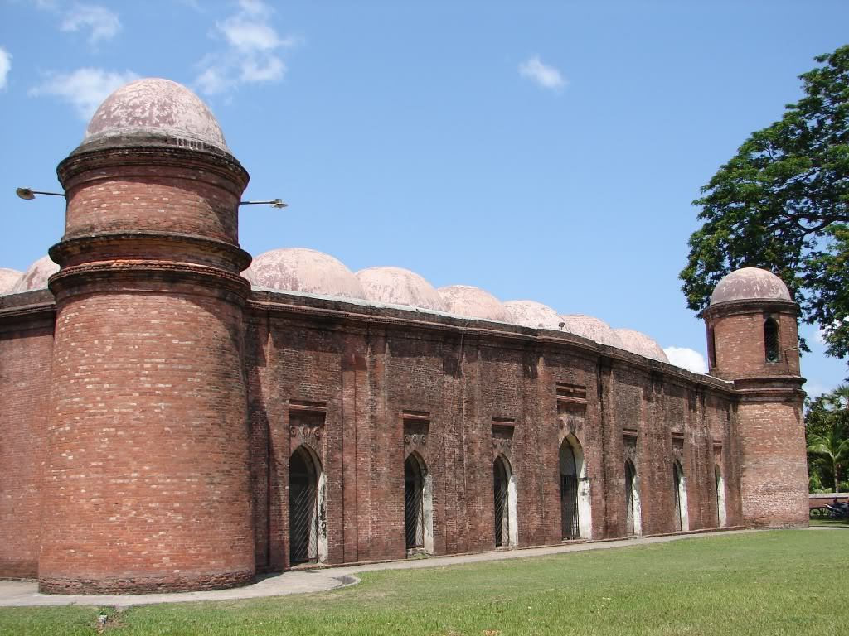
7 Arched doorways each on north and south

Slide 14
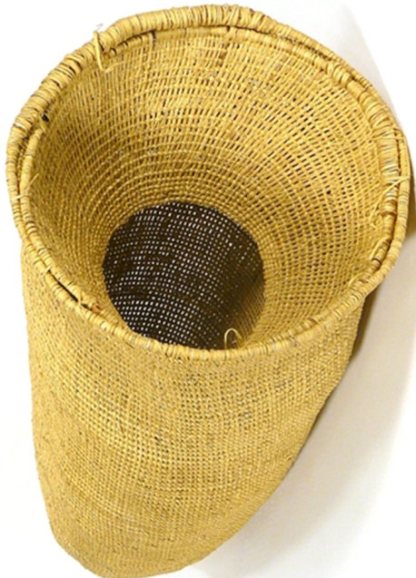
Empty space inside
Hollow
Hollow
There is a hollow in the basket.
Slender Column
Thin pillar
The building is made with some slender columns .

Slide 15
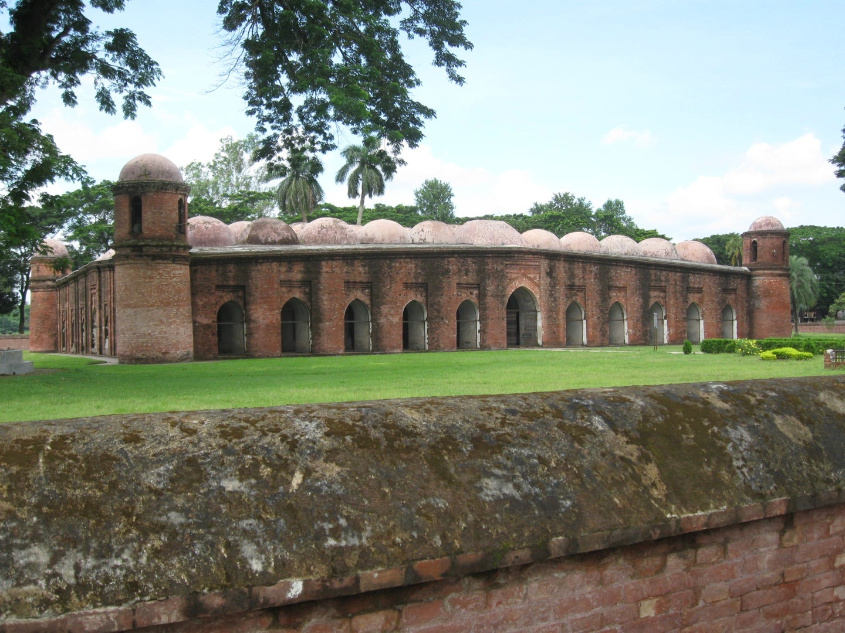
Interior
Inside the mosque
Interior side of the mosque is very nice.
Outer side
Exterior
Exterior side of the mosque is also very nice.

Slide 16

Earth/mud made decoration
terracotta
The interior western wall of the mosque is beautifully decorated with terracotta foliage and flowers .
A tree that grows in wet mud at the edge of river
Mangrove
Sundarban is a mangrove forest.

Slide 17
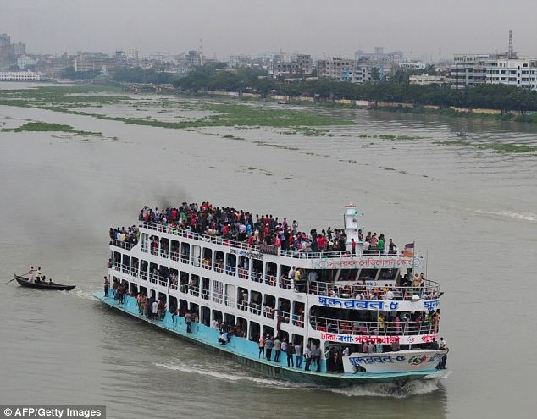
The outer parts of a city.
Outskirts
The Buriganga is at the outskirts of Dhaka city.
corridor
Aisle
There are 9 aisles in Star mosque

Slide 18
Now look at the picture. Ask and answer the following questions with your partner.
1 . How many dooms in the mosque?
2 . Where is it situated?
3 . Who founded it?
4 . How many mihrabs here?
5 . When it was founded?

Slide 19
Pair works-2
Complete the chart related Shat Gambuj Mosque
Shat Gambuj Mosque
Founded by
When
Number of dooms
Arches
Thickness of the arches
Mihrabs
Ulugh Khan Jahan
15th century
77+4=81
25
6feet
11

Slide 20

Group works
Look at the picture of the Star Mosque in Dhaka. Write a description on the Star Mosque with the help of the given clues.
Location - Dhaka
Established- 18th century
Style- Mughal
At- Abul Khairat Road
Interior-mosaic floor
By- Mirza Golam Pir
Materials
China ware and white cement
Decoration- deferent size of stars on dome and outside wall

Slide 21
Grammar discussion and further open works
The Shat GambKhalifatabad
Sundarbans
Khan Jahan Ali
World Heritage Site
Bagerhat
Use of Capitals
Proper NOUN
/ Combined words Capital letter noun
Note:- Capital letter is used Before proper noun
Now pick out another words from the text .

Slide 22
Feedback of the students.
Answer the following questions
1
Who was Khan Jahan Ali
2
Who built the Shat Gambuj Mosque?
3
When did the mosque establish ?
4
How many door ways it has?
5
What it is for?
Khan Jahan Ali was a saint.
Ulugh Khan Jahan Ali
In 15th century
There are 25 doors
It is World Heritage

Slide 23
Home work
Kapasia Horimonjury Pilot Girls’ High School.
Do you want to visit the Shat Gambuj Mosque? Why?

Slide 24


Thanks again.Bye
See you again
next class

