Slide 1


Slide 2

Welcome to you

Slide 3

Thakurgaon Road Girls’ High School
Subject : English 1st paper
Class : nine
Unit : One
Lesson : One
Date : 22 September, 2020
TIME : 5O M

Slide 4
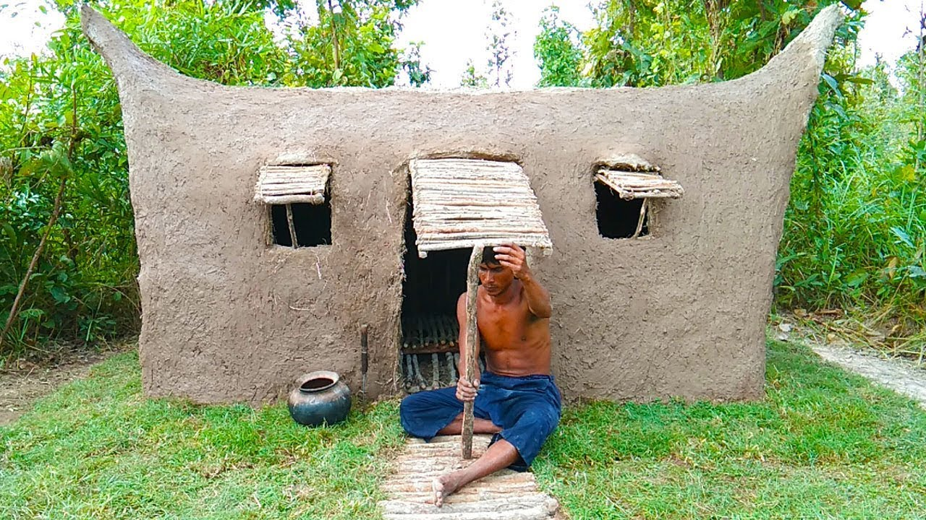
Let’s see a picture & answer the questions
Karim makes his house in the jangle. He lives alone.
What does karim do in the jangle?
Why is he doing that?

Slide 5
Can you live alone?
Unit: One
Lesson: One
Topic

Slide 6
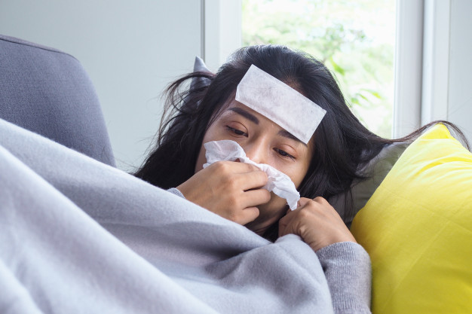
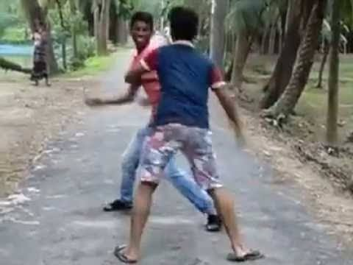
Text book
Page no: 2
Sufferings
Pain
The sufferings of the girl know no bound.
Quarrel
struggle
The boys are quarrelling on the road

Slide 7
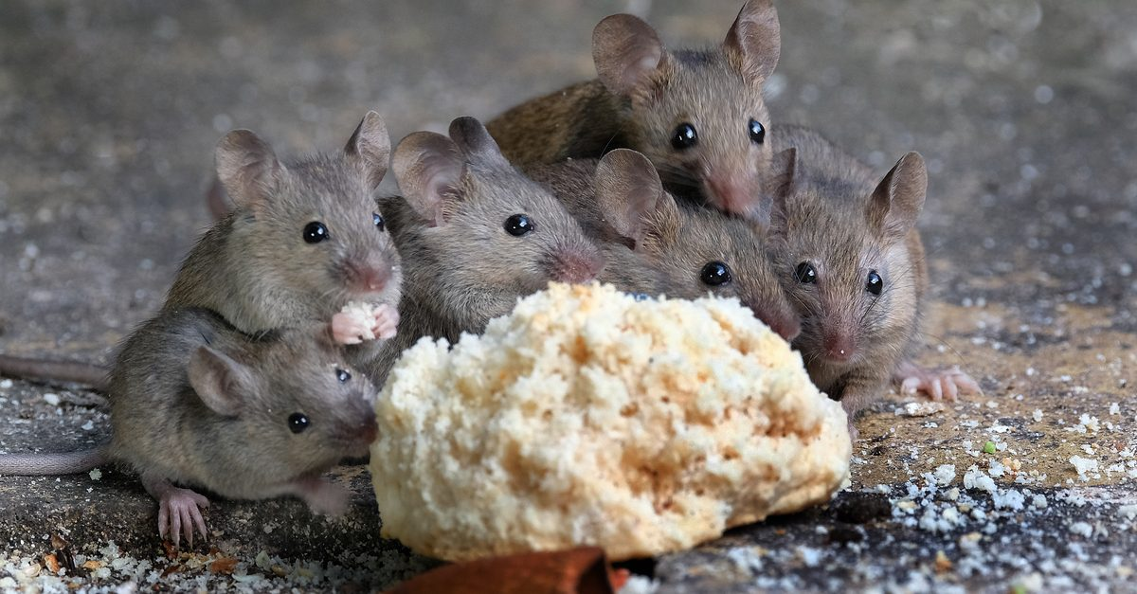
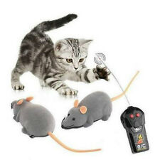
Mice
A little creature
Mice are eating their food.
Ill feeling
Enmity
There is a great enmity between cat and mice.

Slide 8
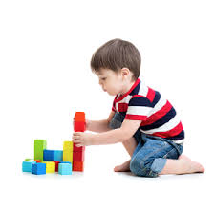
Individual work
Choose the best answer from the alternatives.
Where did the young man go to live alone?
a) in a town b) in a village c) in a hill d) in the woods.
Why did the young man live his house? For having ______.
  a) problems b) peace c) popularity d) prosperity
  What were the little creatures here?
  a) cows b) mice c) dogs d) snakes
  A cow was brought to __________ the cat.
  a) kill b) feed c) guard d) take care of
√
√
√
√

Slide 9

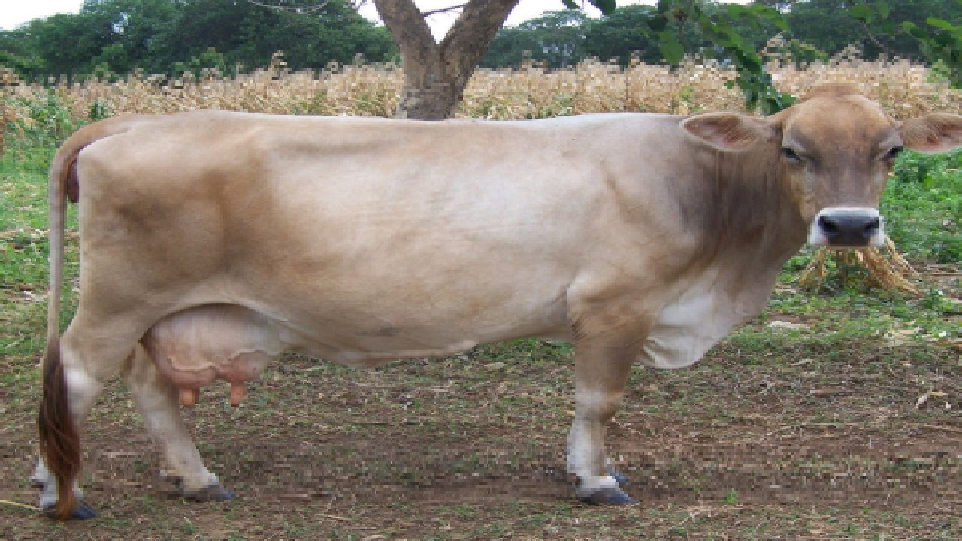
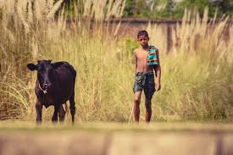
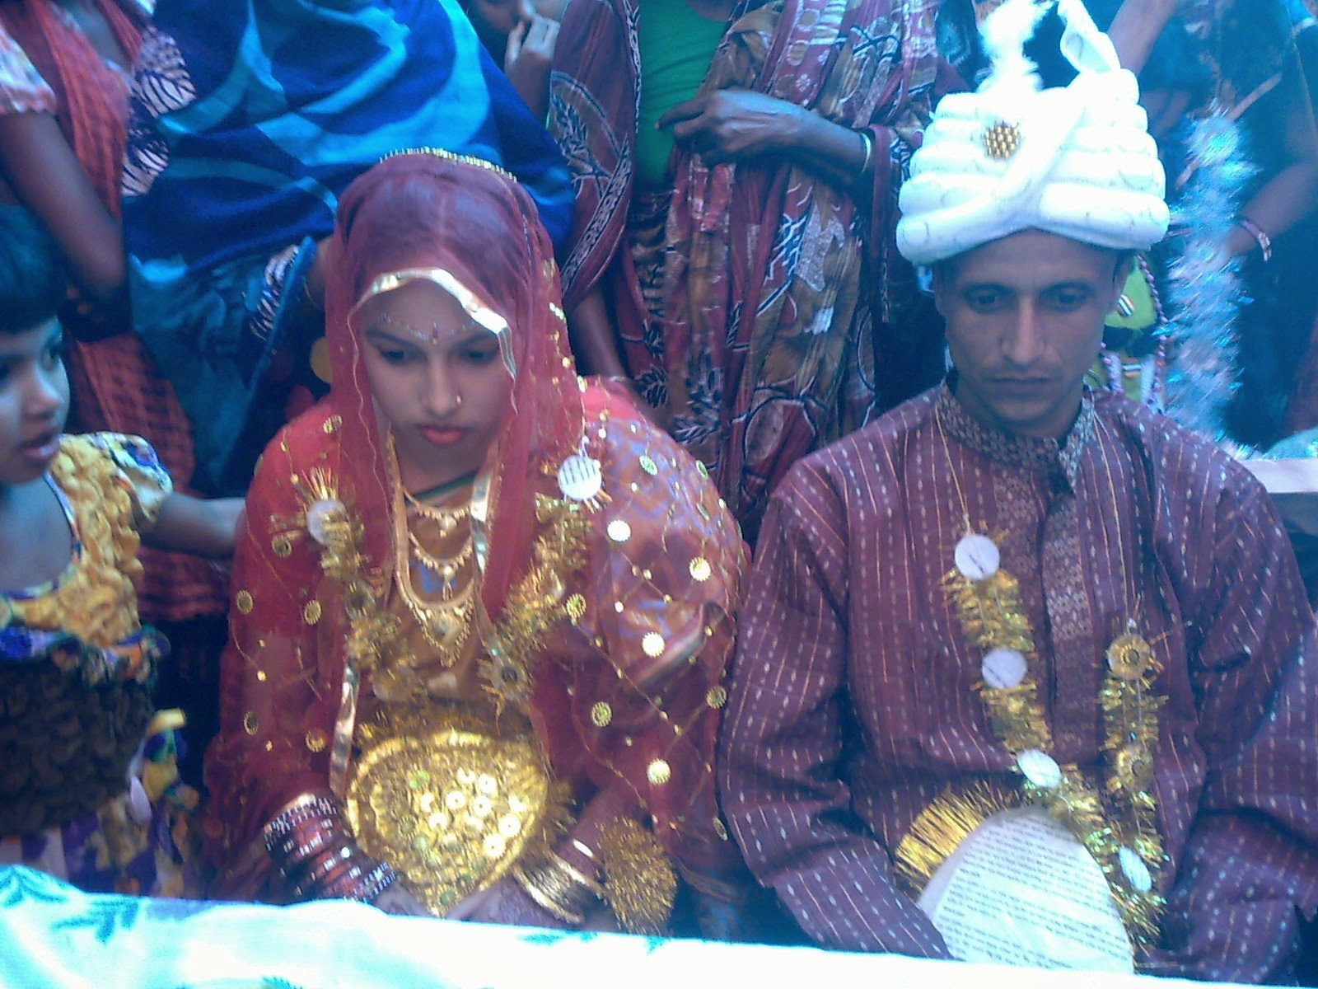
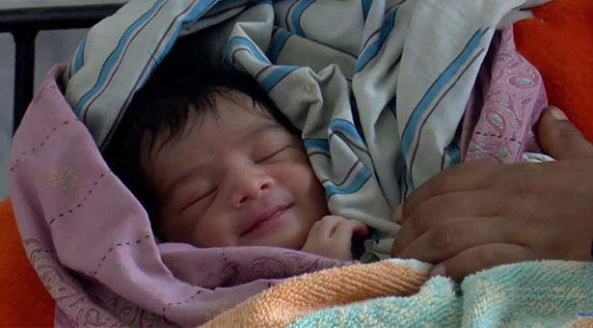
Work in pairs
Fill in the gaps with the appropriate word.
A young man started to live alone in the jangle. One day he found some __________ making hole in his blanket. So he brought a _________ to kill the mice. But the cat needed milk. So he brought ___________. To take care of the cow, he brought a ________. For making food for the cow boy, he was ________ . Then a ________ was born to them. Finally he found himself in the family.

Slide 10
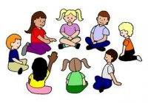
Group work
Read this text and find out which statement is true or false. If false give the correct answer.
The young man was not pleased at his family life.
He made his nice hut in the jangle to live safely.
He brought a cow to kill the mice.
Finally he found himself in a family again.

Slide 11
Solutions
The solutions of the works True or false---------
True.
False; C/A: He made his nice hut to live alone.
False; C/A: He brought a cow to feed the cat.
True.

Slide 12
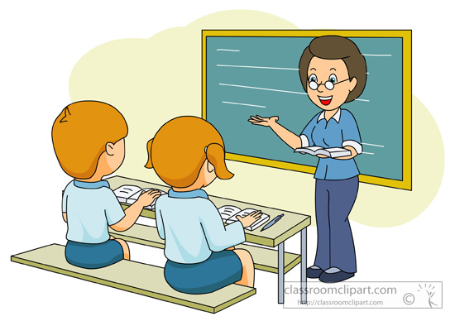
Evaluation
Where did the young man go to live?
Why did he bring a cat?
Why did he bring a cow boy?
Why did he bring a wife for the cowboy?

Slide 13

Home work
Write the problems of the young man to live alone in the jangle. And how he found himself again in a family.

Slide 14



