Slide 1
welcome

Slide 2
Md.Jahangir Hasan
Assistant Teacher
Pepuiya Govt. Primary school, Chandina,Comilla.
Mobile:01817599225

Slide 3
Class-One
Subject- English
Lesson- (4-6)
Time-35 Minute

Slide 4
Sing ABC Song

Slide 5
Unit-(2-5)
Page-5,7,9,11
A. Look listen and say.

Slide 6
Learning outcomes
1.1.1-Become familior with English sounds by listening to common English words speak.

Slide 7
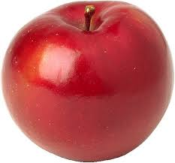
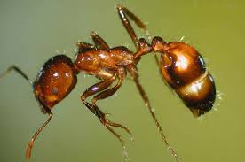
A
ant
Apple
a

Slide 8
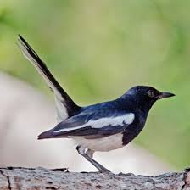
B
b
Ball
bird

Slide 9
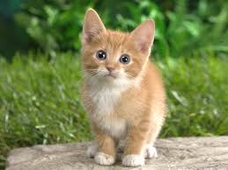
C
c
Cap
cat

Slide 10
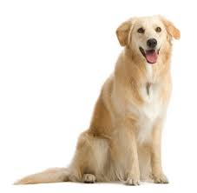
D
d
Dog
doll

Slide 11
A
_pple
a
_nt

Slide 12
B
b
_all
_ird

Slide 13
c
C
_ap
_at

Slide 14
D
_og
d
_oll

Slide 15
See you again

