Slide 1
Welcome to my class

Slide 2
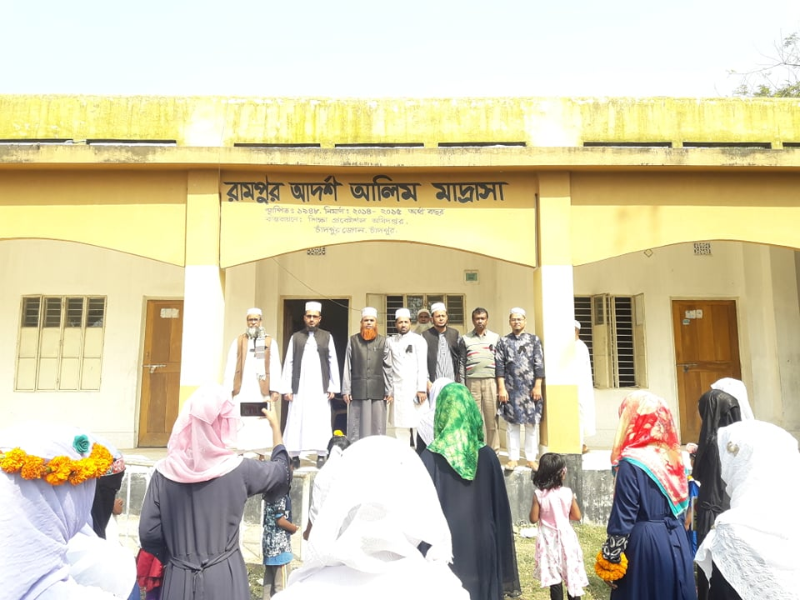
Introduction
Parvin Akter
Lecturer, English
Rampur Ideal Alim Madrasah,
Sadar, Chandpur.

Slide 3
Class: Eleven-Twelve
Subject: English.
Orientation Class

Slide 4
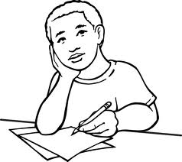
Learning outcomes
After the end of the lesson, the students will be able to:
tell marks distribution of Paper One
tell marks distribution of Paper Two

Slide 5
We will discuss about the Mark Distribution of Paper One first…..

Slide 6
English for Today ( Paper One)
Total Marks: 100
Part A-Reading: 60 marks

Slide 7
Passage -1
1.A.Multiple Choice Questions (MCQ)
Guessing meaning from the context 05
1.B.Comprehensive questions (open ended questions relating to analysis, synthesis and evaluation) 10

Slide 8
Passage-2
2. Information Transfer/
Flow Chart 10

Slide 9
Passage-3
3. Writing Summary 10

Slide 10
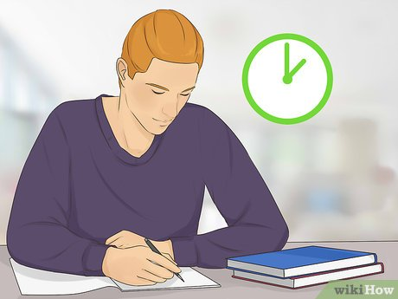
4. Cloze test with clues 05
5. Cloze test without clues 10

Slide 11
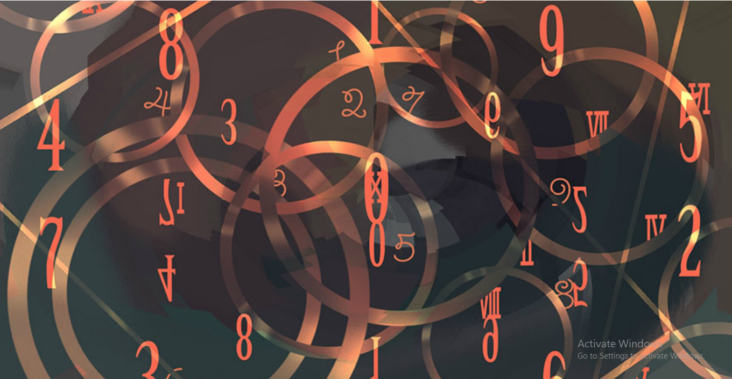
6. Rearranging 10

Slide 12
Part B: Writing-40
7. Writing Paragraph answering questions 10

Slide 13
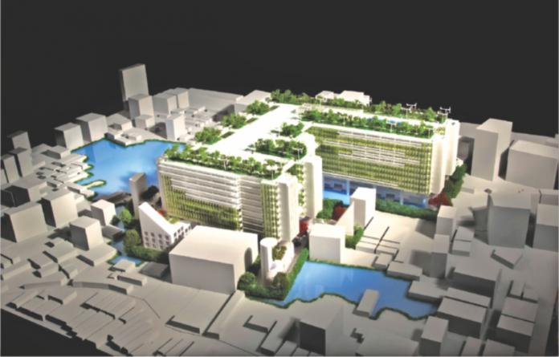
8. Completing a story 07

Slide 14
9. Writing informal letter/ e-mail 05

Slide 15
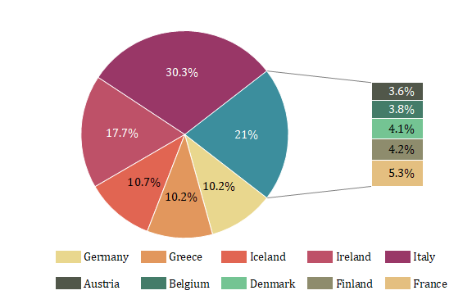
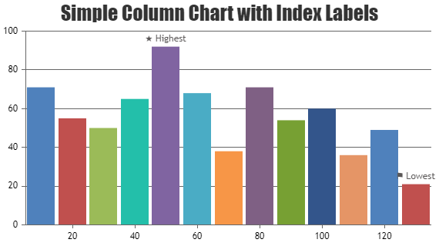
10. Describing graphs and charts 10

Slide 16
11. Appreciating short story/ poem ( identifying theme, subject-matter and interpretation) 08

Slide 17
Now it is the turn to know the marks distribution of Paper Two….

Slide 18
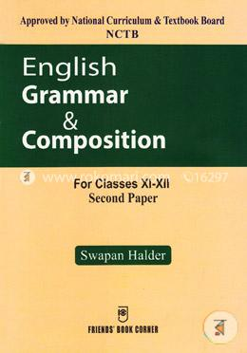
English Grammar and Composition
( Paper Two)
Total Marks : 100

Slide 19
Part A- Grammar : 60 marks
1.Gap filling activities without clues ( for articles) 0.5x10=5
2.Gap filling activities without clues ( for prepositions) 0.5x10=5
3. Gap filling activities with clues ( special clues) 0.5x10=5

Slide 20
4. Completing sentence (use of conditionals, phrase and clause) 0.5x10 = 5
5. Use of verbs ( right form of verbs and
subject-verb agreement as per context)
0.5x10=5
6. Changing sentence ( change of voice,
sentence types, degrees) 0.5x10=5

Slide 21
7. Narrative style ( direct to indirect and vice versa) 1x5=5
8. Pronoun reference /pronoun agreement 0.5x10=5
9. Use of modifiers 0.5x10=5

Slide 22
10. Use of sentence connectors 0.5x10=5
11. Use of synonyms and antonym 0.5x10=5
12. Punctuation 0.5x10=5

Slide 23
Part B: Composition: 40 marks

Slide 24
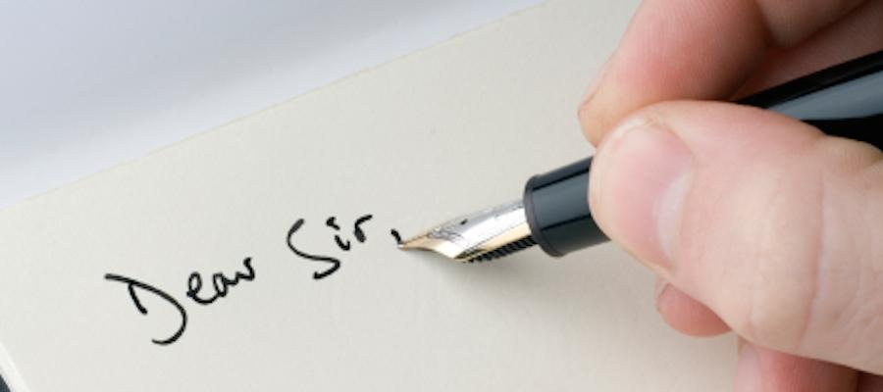
13: Writing formal letter/ E-mail 08

Slide 25
14. Report Writing ( for newspapers) 08

Slide 26
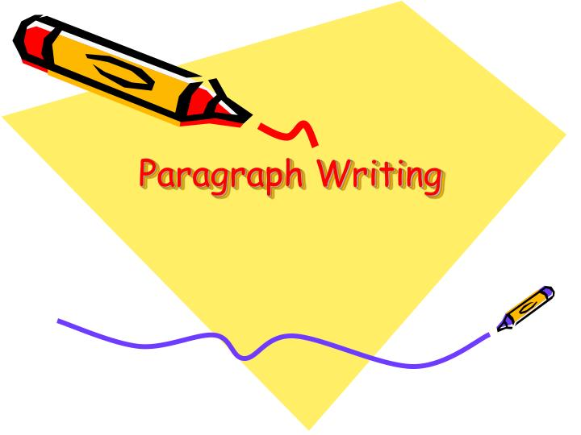
15. Paragraphs ( based on one of the paragraph types: listing, narration, comparison and contrast, cause and effect) 10

Slide 27
16: Free Writing: descriptive, narrative, persuasive/argumentative, imaginative and creative writing of 200-250 words based on personal experience, everyday problems, familiar topics, recent events and incidents etc. 14

