Slide 1
WELCOME

Slide 2
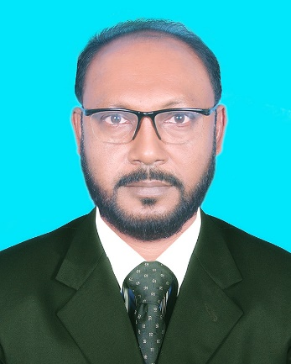
INTRODUCE
S.M.MOZAMMEL KABIR (TOTOL)
Asst. Head Master
Bhawal Baria Union High School,Gazipur Sadar
Mobile: 01770633593 Email:- tmcsltd777@gmail.com

Slide 3
LESSON INDENTITY
Class: Nine & Ten
Sub: English second paper
Text: Changing Sentence
Time: 1 Hour
Date: 24/10/20
Notes:
Identity of class

Slide 4
Let’s see some image and texts to guess something.
Notes:
Advance to some tropes.

Slide 5
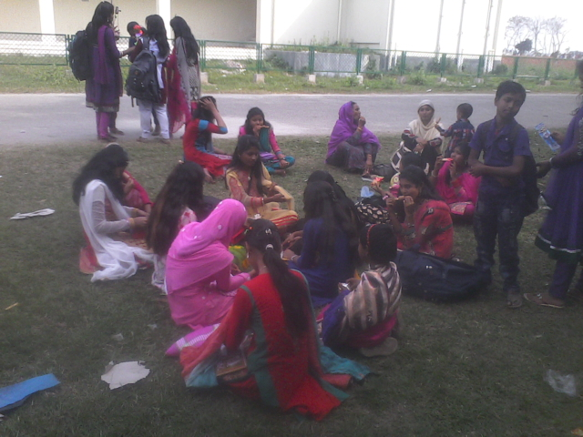
They are conversing under the mango trees in Mujibnagor.
Notes:
Suspension of sentence

Slide 6
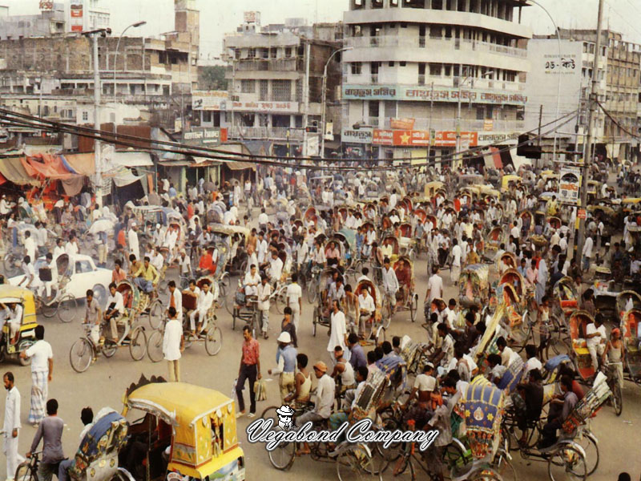
Though Bangladesh is a small country, she has a huge population
Notes:
Suspension of sentence

Slide 7
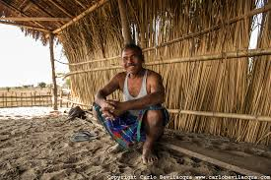
The man is poor but he is honest
Notes:
Suspension of sentence

Slide 8
What have you guessed by
the images and texts?
Sentence
Notes:
Asking lesson declaration

Slide 9
Our Today’s Lesson is……….....
Simple, complex & compound
Changing Part- 1
Notes:
Lesson declaration

Slide 10
Learning outcomes
After we have studied this lesson,
we will be able to---
define sentence
identify the classification of sentence
Identify from simple, complex to compound sentence
Notes:
Target of today’s class.

Slide 11
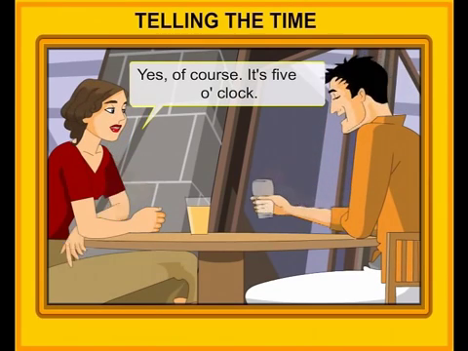
What is sentence?
A sentence is a group of words expressing a complete sense or meaning.
Notes:
Definition of sentence.

Slide 12
Classifications of sentence(structure)
Simple
Complex
Compound
Notes:
Classification of sentence.

Slide 13
Mahdi reads his lesson’s regularly
They like to play after school
Subject $+ Finite verb$
A sentence which has only one subject, only one Finite verb and only one clause is called a simple sentence.
Notes:
Definition of simple sentence.

Slide 14
When the thief saw the police , he ran away.
He worked hard so that he could prosper in life.
Principal clause $+Conjunction+Subordinate clause$
A complex sentence is one that contains one principal clause with one or more subordinate clauses
Notes:
Definition of complex sentence.

Slide 15
I was ill and I could not attend the meeting.
Work hard or you will not prosper in life.
Principle clause $+conjunction+Subordinate clause$
A compound sentence has more than one principal clause connected by one or more co - ordinating conjunction.
Notes:
Definition of compound sentence.

Slide 16
Let us know the basics of
Changing sentence.
Notes:
Lead to changing basics.

Slide 17
How to change from sentence.
Simple | Complex | compound
V$+ing$ | Since/as/when | And
In/at/at the time of/at the age of | When$+time$ | Time$+and+subordinate ciause$
without$+$V$+ing$ | If $+Negative$ | Principal v$+or+$2nd sentence
By$+$V$+ing$ | If$+Affairmative$ | Principal v$+or+$2nd sentence
To$+$principal v 2ndsen. | So that | And
In spite of$+v+ing$ | Though/ Although | But
 | Who/Which/That | And
Too…………. To | So.............. That | Very …………… And
Because of | Since/ As/ When | And
Notes:
Change from simple, complex to compound sentence.

Slide 18
Example of simple sentence
Subject | Finite verb
Mime | reads his lesson’s regularly
Rony | lives in Dhaka with his parents.
Nadia | is in class nine.
Hasan | likes to play after school.
Both Nadia and Joy | are good friend.

Slide 19
Example of complex sentence
Principal clause | C0njunction | Subordinate clause
We know | when | he will come.
They returned home | after | the sun had set.
You can not succeed | if | you do not work hard.
He can not come | because | he is ill.
I read more | So that | i can make a good result.
He could not work hard | since | he was small.
A complex sentence must contain the flowing conjunction : that, when, why, who, which, where, how, whether, while, until , till, unless, if, though, although, so that, because, after etc.

Slide 20
Example of compound sentence
Principle clause | Conjunction | Subord: clause
The man is rich | but | not happy.
The boy came here | and | returned at once.
Work hard | or | you will not prosper in life.
I forgot him | and | went outside the cabin.
Do | or | die.
The sun had set | and | we returned home.
In a compound sentence each clause is a principal clause and the flowing conjunctions are usually in it: and, but, or, both and, not….but also, neither…..nor, either…..or, otherwise, therefor etc.

Slide 21
Single work
He is so weak that he can not move.
Complex
Compound
Complex
Compound
Simple
Simple
The door opened and he stepped in.
If you do not move, you will die.
Run fast and you can win the prize.
Della sold her hair to buy a gift for Jim.
I could not join the meeting because of my illness.

Slide 22
Open Question
Although he has riches, he leads a simple life
In spite of his being healthy , he is lazy.
The water being very hot, I could not drink it.
The weather is cold and we can not go out.
A man who is drowning catches at a straw.
Read attentively or you can not pass the examination.
Complex sentence
Simple sentence
Compound sentence
Complex sentence
Compound sentence
Simple sentence

Slide 23
Home work
Make five (simple, complex and compound) sentence

Slide 24
Thanks to all

