Slide 1
WELCOME

Slide 2
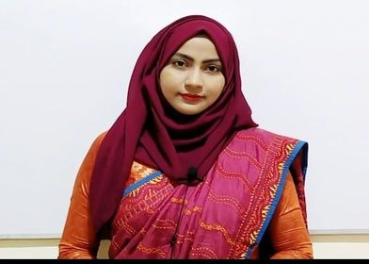
Kalam Ferdousi Shanta
Assistant Teacher
Charandwip Sikdaria Government Primary School, Boalkhali
Chattogram.

Slide 3
Class: Five
Subject: English
Unit:22, Completing forms
Lesson:1-2
Part: Activity A,B,C
Page no: 86
Time: 40 minutes
Date:18/10/2020

Slide 4
Today’s we are going to learn about two friends..
Completing forms

Slide 6
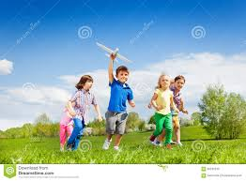
What are the names of your friends?
Today’s we are going to learn about two friends..

Slide 7
Introducing new words
Friend - a person who you know and like a lot- বন্ধু
Different - not the same- আলাদা
Run - to move faster- দৌড়ানো
Active - always busy in work- প্রাণবন্ত/কর্মঠ
Talkative - liking to talk a lot- বেশি কথা বলে যে, বাচাল

Slide 8
Let’s see a picture
Do you know them?
Let’s find their identity

Slide 9
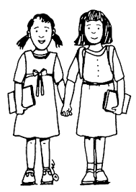
Laila and Bithi are friends. But they are very different.

Slide 10
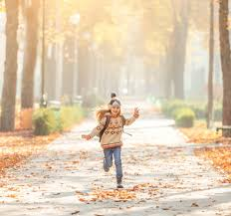
Laila likes to run in the park and swim . She is very active. She also likes to talk. Her mother says ,” oh, Laila! You’re so talkative.”

Slide 11
On the other hand , Bithi is a quiet person. She doesn’t like running or swimming. She enjoys reading. She especially loves stories about other countries.

Slide 12
Students reading

Slide 13
Bithi
Laila

Slide 15
Clever—My friend Ritu is very clever. She can makes other fool easily.
Funny– My brother is very funny . He tells us interesting jokes.
Kind--- My grandfather is very kind. He helps poor always.
Quiet—My elder sister is very quiet.She likes to draw pictures.
Talkative--- My cousin , Keya is very talkative . She talks a lot all the day.

Slide 16
Home Task
Write 5 sentences about About your friend.

Slide 17
THANK YOU

