Slide 1
WELCOME

Slide 2
TEACHER’S IDENTITY
MD. REZAUL KARIM
LECTURER
DEPT. OF ENGLISH
MULFATGANJ A.J FAZIL MADRASAH
NARIA,SHARIATPUR

Slide 3
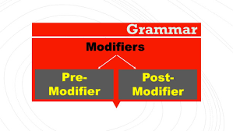
LESSON’S IDENTITY
MODIFIER

Slide 4
LEARNING OUTCOME
You can analysis the sentences.
You can identify adjective in the sentence.
You can modify the sentence.
You can learn about the position of adjective in the sentence.

Slide 5
GENERAL FOCUS POINT
Definition of Modifier
Classifications
In the field of using-----Premodifier
In the field of using----Postmodifier

Slide 6
SUBJECTMATTER OF THE LESSON
Definition
Classification
Use of Premodifier:
A)Fields:
1.Adjective-e.g.Sabrina is a beautiful girl.
2.Present Participle-e.g.The dancing girl is my sister.
3.Past Participle-e.g.An educated man is honoured by all.
4.Determiner-e.g.Every student will get a pen.
5.Possessive-e.g.This is my country.
6.Noun-e.g.She wanted to buy an air ticket.
7.Noun- adjective-e.g.Kamlapur is a busy railway-station.
Use of Postmodifier:
B) Fields:
1.Relative Clause-e.g.I think it was your mother who phoned.
2.Prepositional phrase-e.g. Advances in medical science are praiseworthy.
3.Present Participle Phrase-e.g. I saw the boys playing in the field.
4.Present Participle-e.g. I saw the girl singing.
5.Past participle phrase-e.g.The cat found on the road is very good.
6.Past participle-e.g.The man got the work done.
7.Infinitive phrase-e.g.He bought a car to please his darling.
8.Case in Apposition-e.g.Mr. Basir,principal of ABC College is a learned man.

Slide 7
VALUATION
Find out modifiers in the following selected sentences.

Slide 8
HOMEWORK
Define the modifier
Classify the modifiers.
Find out the modifiers.
Filling the gaps with indicated modifiers

Slide 9
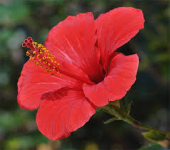
THANKS ALL

