Slide 1
WELCOME

Slide 2
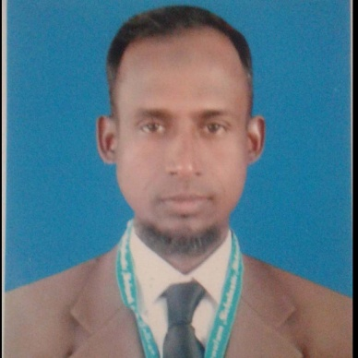
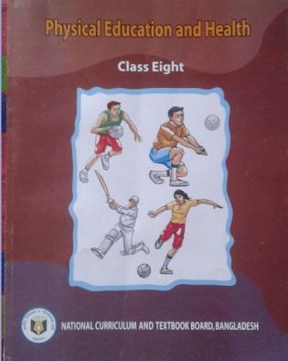
INTRODUCING
Md. Amirul Islam
Teacher
Millennium Scholastic School & College, Bogra
E-mail: iamirul113@gmail.com
Subject: (142)Physical Education & Health
Class: VIII
Chapter: Five
Heading: Sports for Life
Topic: Foot Ball
Date: 01.10.2020

Slide 3
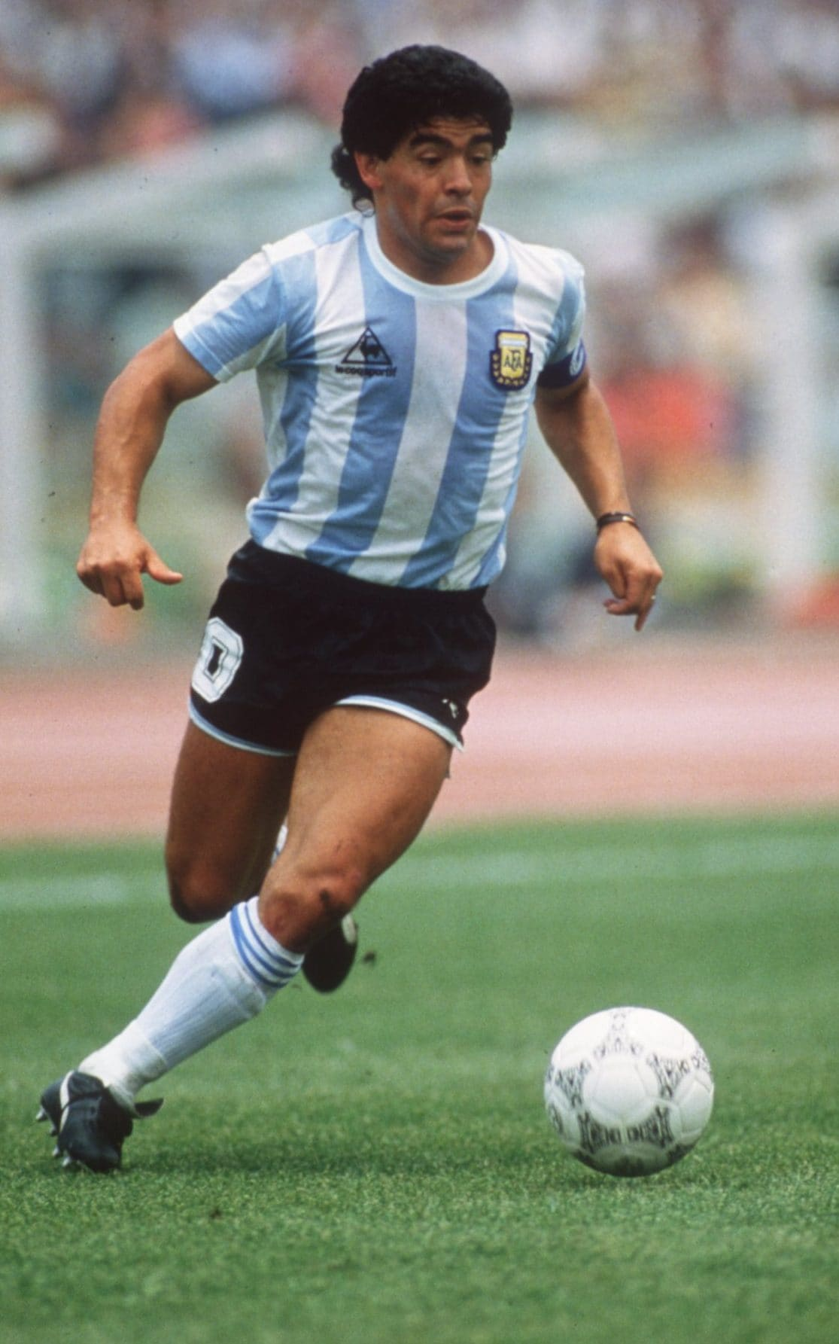
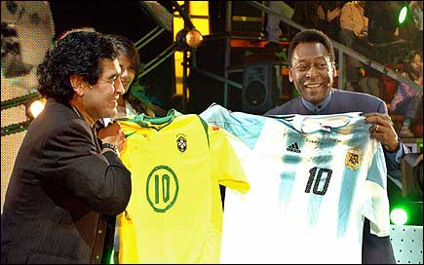
Look at the pictures!
What are these?

Slide 4
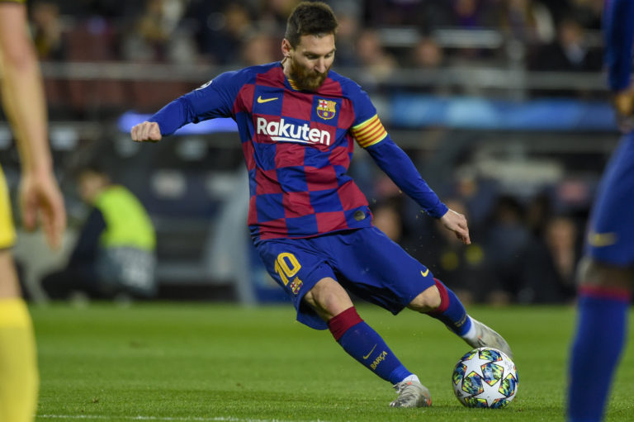
Todays Topic Is Foot Ball Game…

Slide 5
LEARNING OUT COMES…..
By the end of this topic, we will able to :
1. Talk about the Foot ball game.
2. Describe the rules of game
3. Explain the technique
4. Practice obeying the rules of Foot ball
5. Skillful to participate in the game

Slide 6
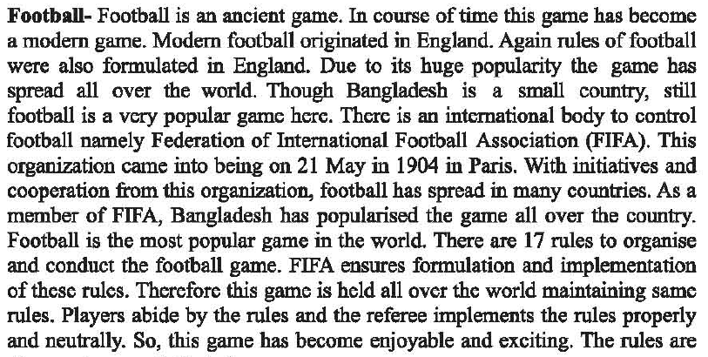

Slide 7
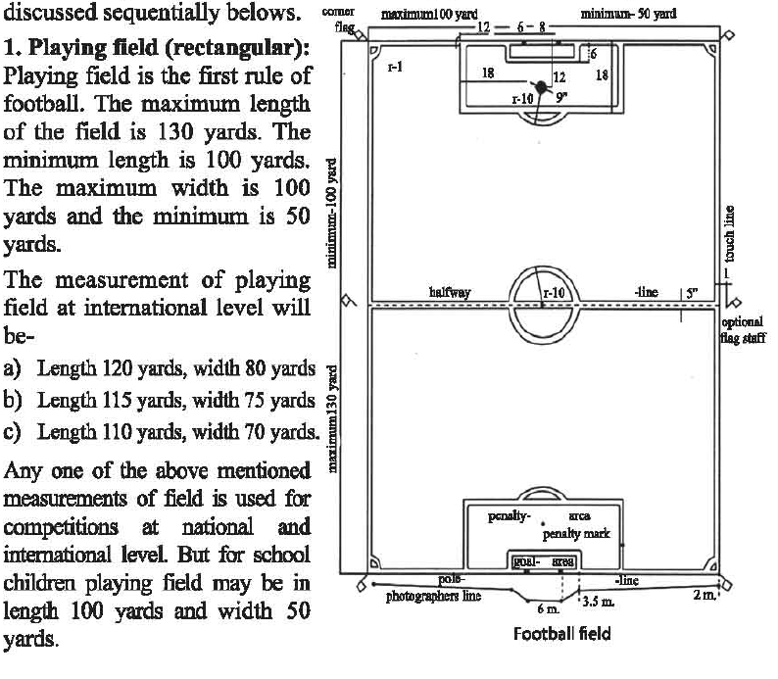

Slide 8
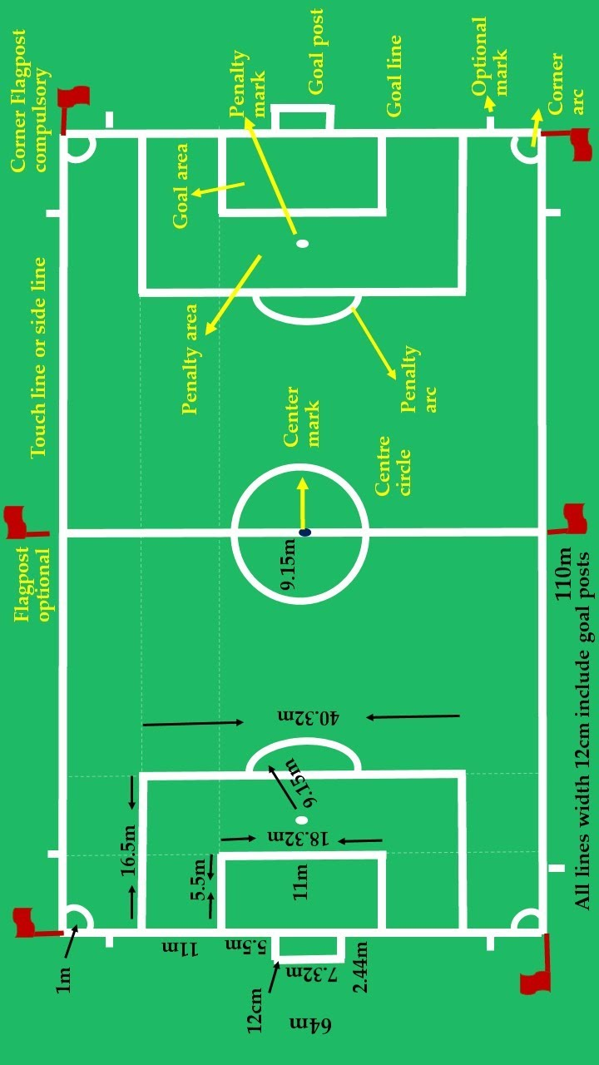
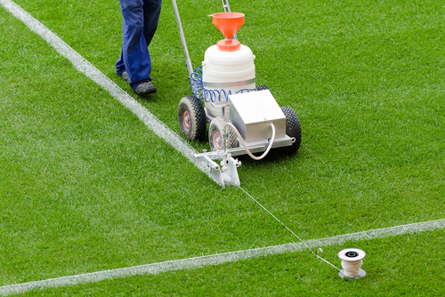
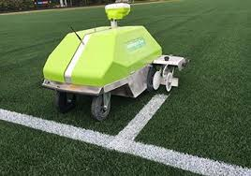

Slide 9
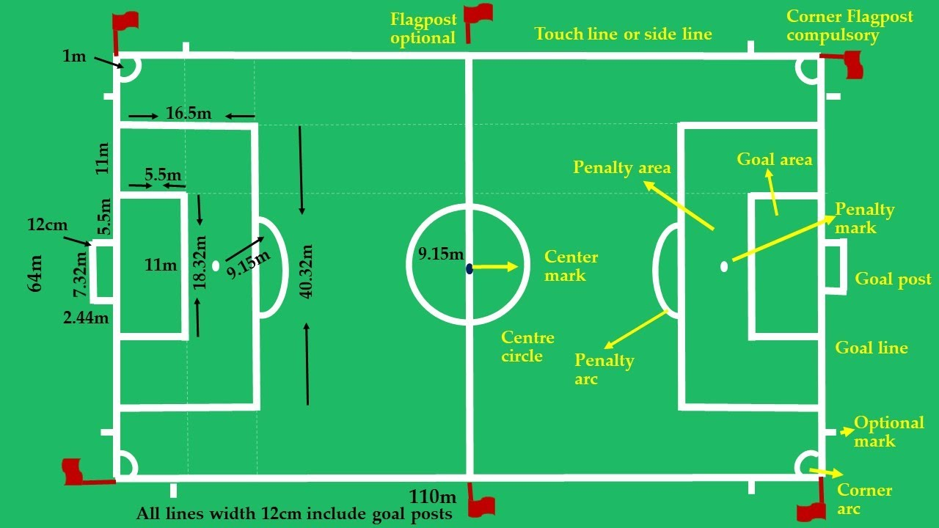
20 yards

Slide 10
44 yards

Slide 14
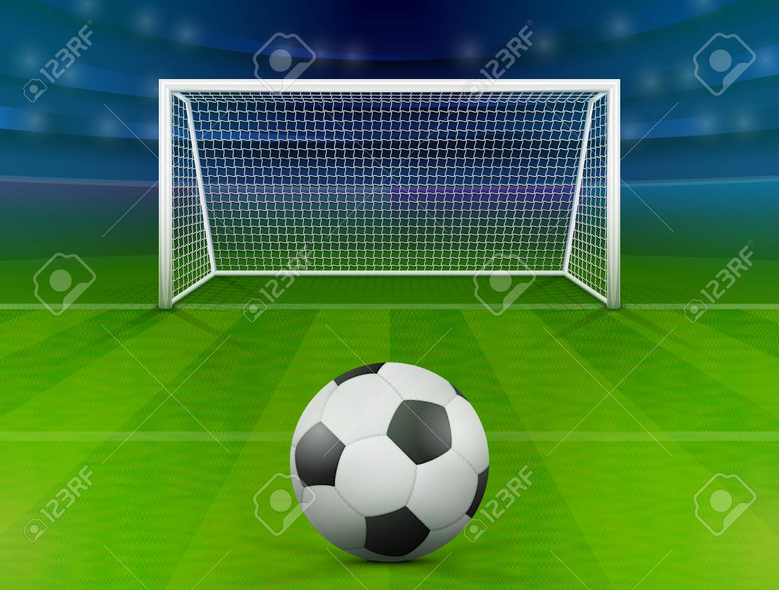
8 yards

Slide 15
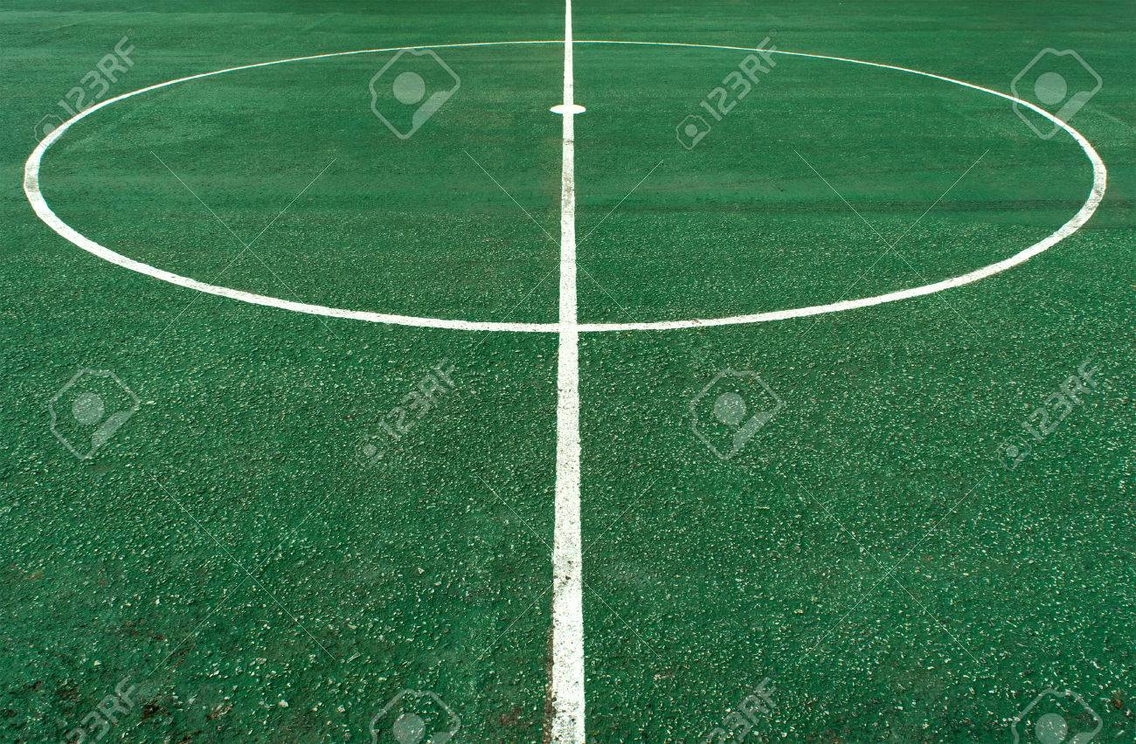
10 yards radius

Slide 16
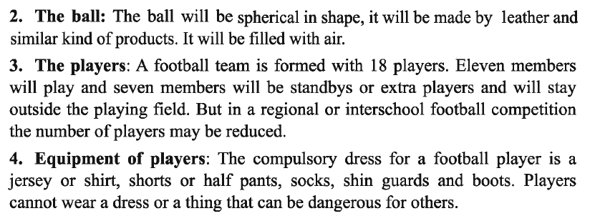
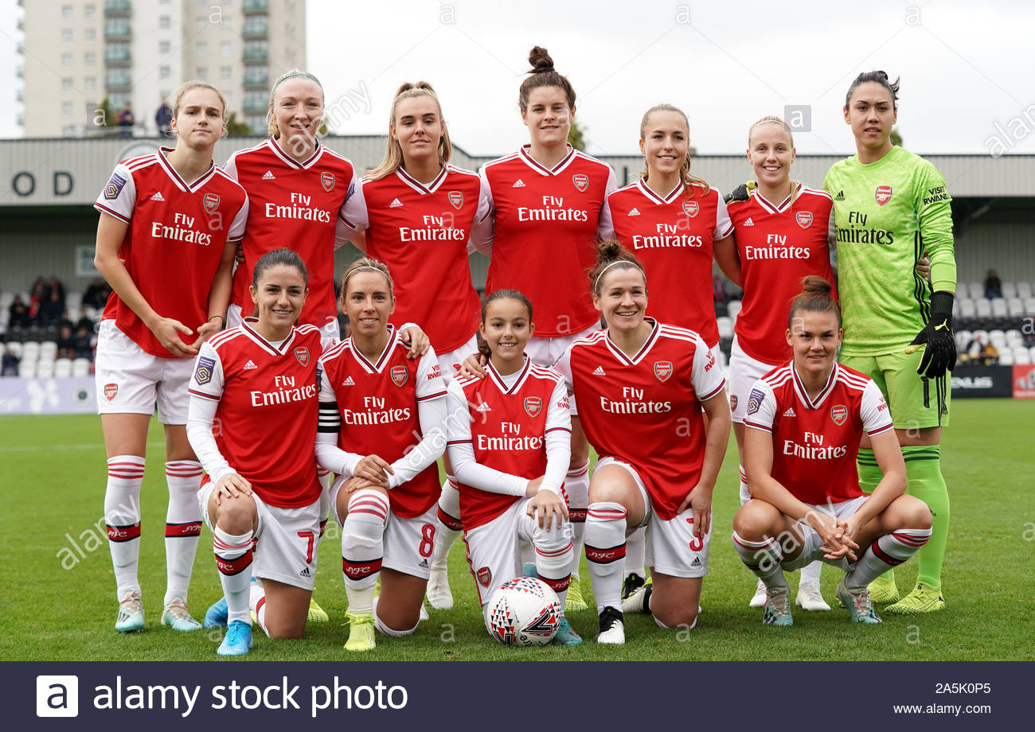
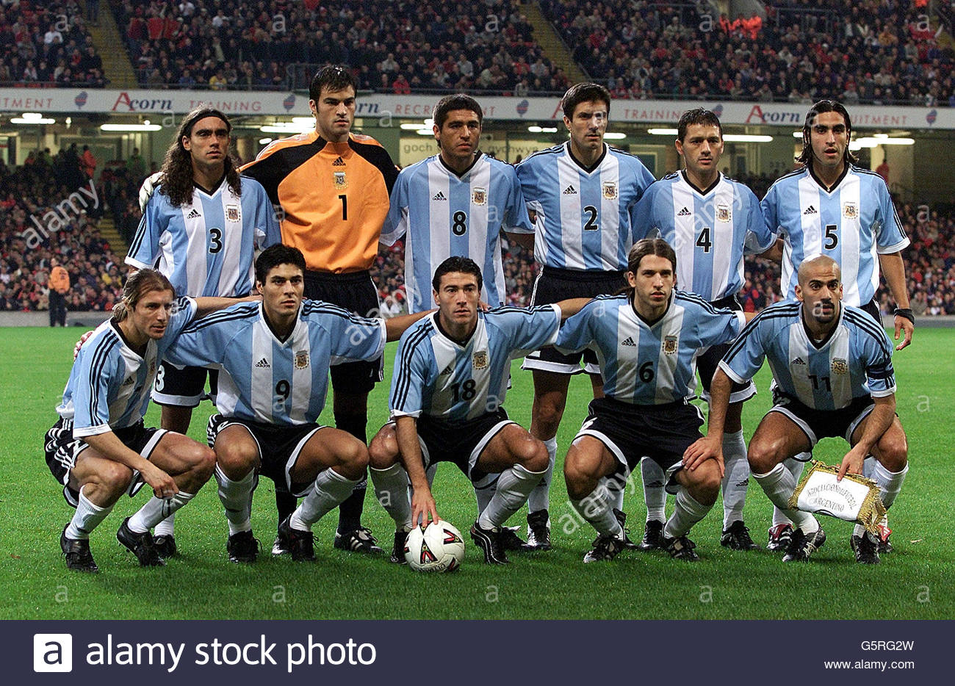

Slide 17
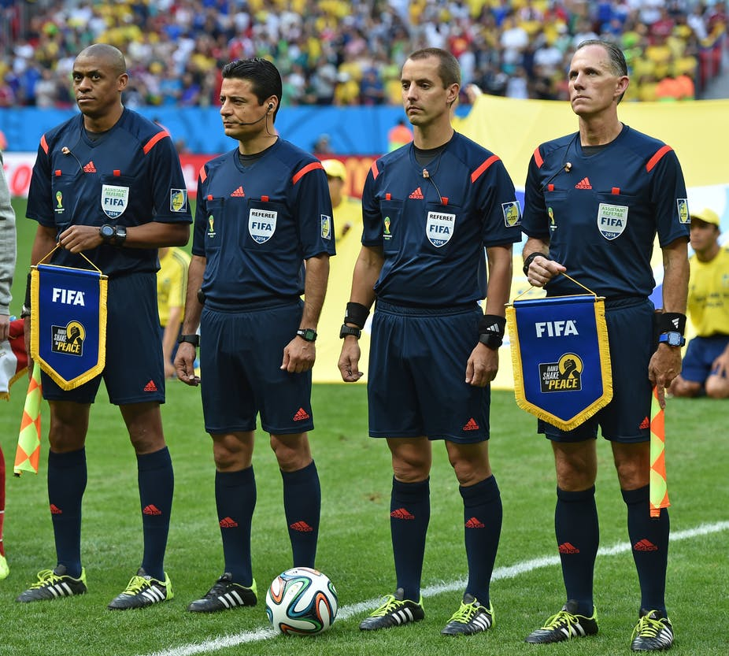

Slide 18
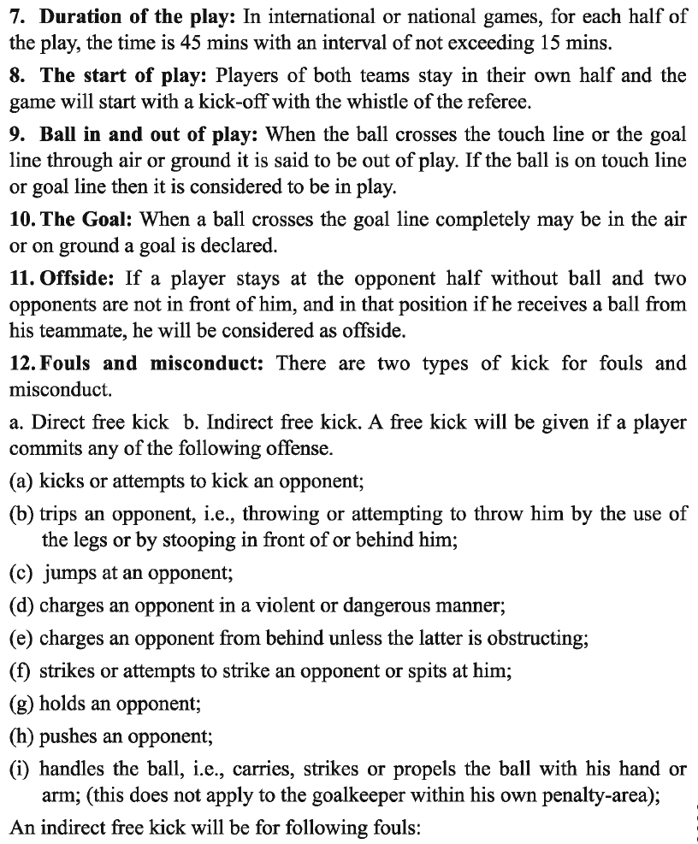

Slide 19
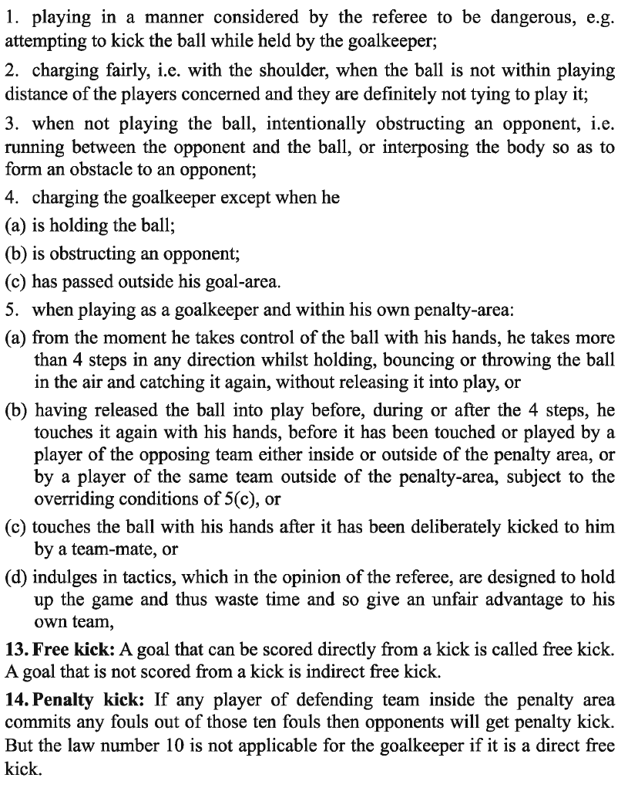

Slide 20
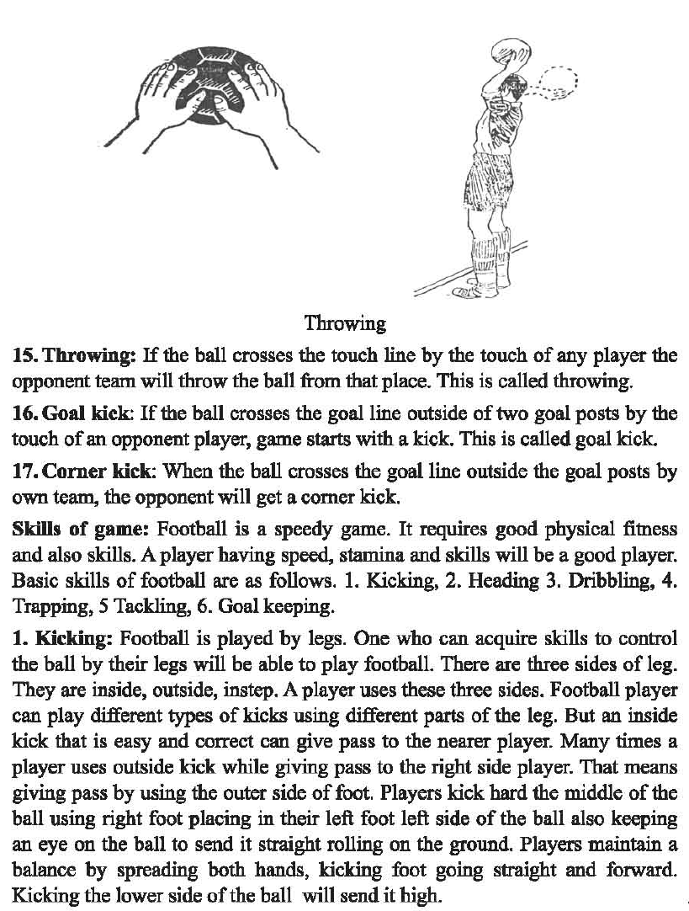

Slide 21
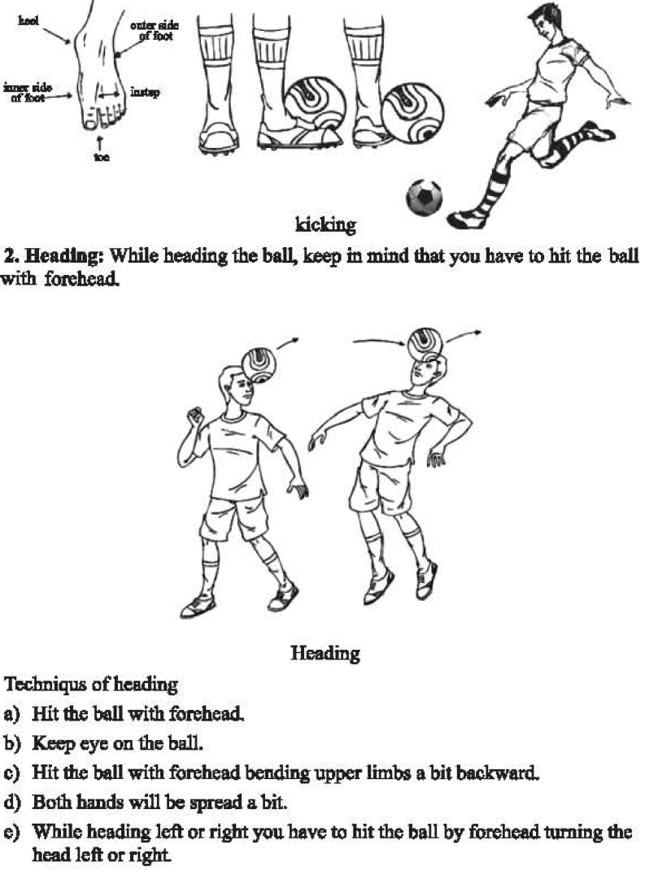

Slide 22
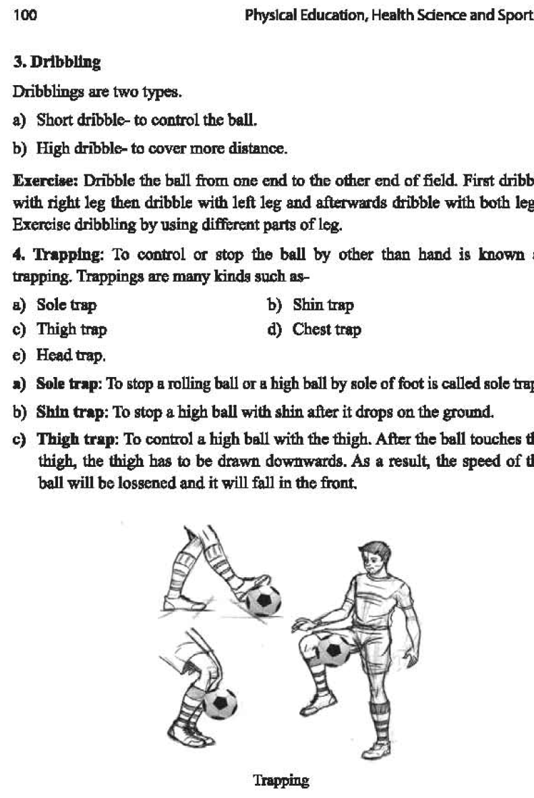

Slide 23
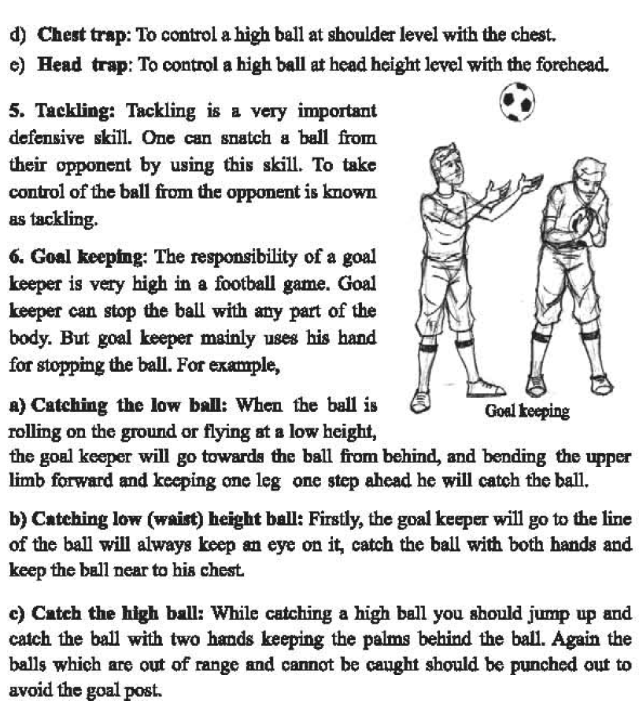

Slide 24
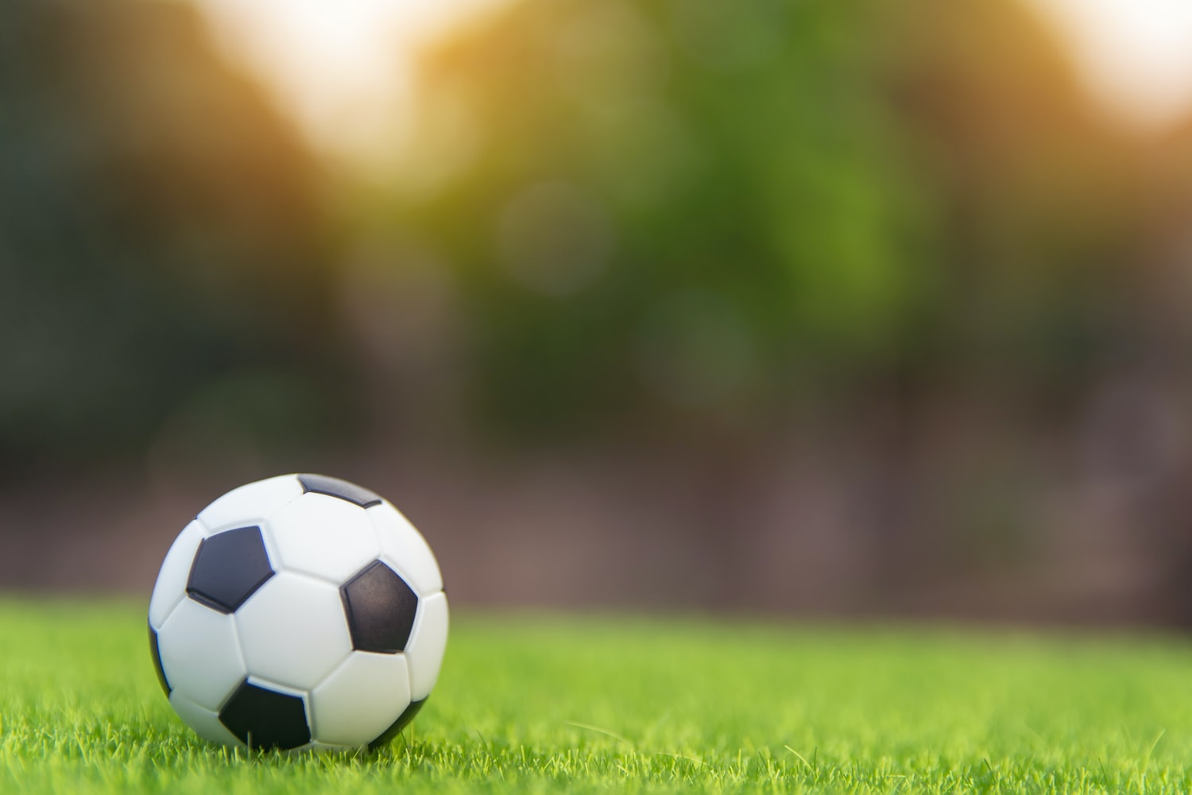
HOME WORK
Write an assignment on Football

Slide 25
THANK YOU

