Slide 1
WELCOME

Slide 2
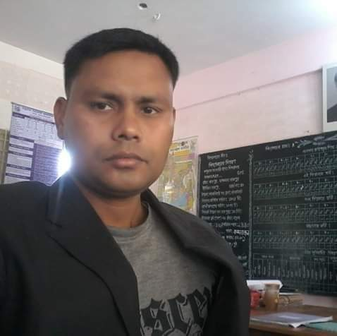
Introduction
Md. Farhad Hossain
M.S.S (Economics)
Assistant Teacher
Modhuram GPS , Lalmonirhat Sadar.

Slide 3
Welcome once again to my English Class for Class Five .
“ Framing WH questions ”

Slide 4
Questions:
a)Yes /No Question
Q: Do you read in class five?
A: Yes or no.
Q: Is he a student ?
A: Yes or no.
b) WH questions :
Q : What is your name ?
A : My name is Farhad .
Q : How old are you ?
A : I am ten years old .

Slide 5
প্রশ্নবোধক করতে / To make interrogative
1 . Subject এর আগে Helping verb / সাহায্যকারী verb বসাতে হয় ।
২ । বাক্যের শেষে প্রশ্নবোধক চিহ্ন (?) বসাতে হয় ।
কিছু Heping verb : am , is , are , was , were , have , has , had , shall , should , will , would , can , could , may , might , etc .
Jessica is going to Chottogram . (Int/ wh)
=Is Jessica going to Chottogram ?
=Where Is Jessica going ?
They should listen to their teacher . (Int/wh)
=Should they listen to their teacher ?
=Whom should they listen to ?

Slide 6
Sentence এ সাহায্যকারী Verb না থাকলে
1. মূল Verb টি Present form হলে Do / does ব্যবহার করতে হয় ।
১ . মূল verb এর সাথে s / es না থাকলে do ব্যবহার করতে হয় ।
2. Subject third person হলে, verb এর সাথে s / es থাকলে does ব্যবহার করতে হয় ।
They practise speaking English .
=What do they practise ?
Saikat lives in Bogura .
=Where does Saikat live ?
2. মূল Verb টি Past form হল did ব্যবহার করতে হয় ।
The doctor visited Sima last night .
= When did the doctor visit Sima ?

Slide 7
Person পরিবর্তন
১ . Sentence এ I / We থাকলে WH করার সময় You ব্যবহার করতে হয় ।
I / we go to school everyday .
=Where do you / you go everyday ?
2 . Sentence এ My / Our থাকলে WH করার সময় Your ব্যবহার করতে হয় ।
I /We love my / our parents .
= Whom do you / you love ?
১ . Sentence এ you , your , he , she , it , any name , any third person থাকলে WH করার সময়
পরিবর্তন হবে না ।
He / She / Rina is a good students .
= Who is a good students ?

Slide 8
Wh words :
Who– কে / কারা
Whom— কাকে / কাদেরকে
Whose --- কার / কাদের
What— কী
Which– কোনটি / কোনগুলো
When— কখন
Where— কোথায়
How— কত / কেমন / কিভাবে
Why--- কেন

Slide 9
Who --- কে
একক ব্যক্তি বোঝাতে
Saikat lives in Bogura .
= Who lives in bogura ?
Mr. Rashidul Islam is a banker .
= Who is a banker ?
He / She is a good student .
=Who is a good student ?

Slide 10
Who – কারা
একের বেশী ব্যক্তি বোঝাতে
The teachers helped the students .
= Who helped the students ?
They should listen to their teachers .
= Who should listen to their teachers ?
Sima and Tamal are in the town hall language club .
Who are in the town hall language club ?

Slide 11
Who = কারা
একের অধিক / বেশী ব্যক্তি বোঝাতে
Sima and Tamal are in the Town Hall Language Club.
= Who are in the Town Hall Language Club ?
They called their friends to watch .
= Who called their friends to watch ?

Slide 12
Whom – কাকে / কাদেরকে
কাকে / কাদেরকে বোঝাতে Whom ব্যবহৃত হয় ।
Object এর পরিবর্তেWhom ব্যবহৃত হয় ।
Tamal met Andy Smith yesterday .
= Whom did Tamal meet yesterday ?
They called their friends to watch .
=Whom did They call to watch ?

Slide 13
Whose -- কার / কাদের
কার / কাদের বোঝাতে Whose ব্যবহৃত হয় ।
অধিকারে থাকা বোঝায় ।
Saiat’ s father is a banker .
=Whose father is a banker ?
These are their books .
= Whose books are these ?

Slide 14
What --- কী
কী , কোন শ্রেনীতে , পেষা কি , তারিখ কত , কি বার , ইত্যাদি প্রশ্ন করতে What ব্যবহৃত হয় ।
Saikat’s father’s name is Mr. Rashidul Islam .
= What is Saikat’s father’s name ?
Babul’s father is a shop keeper .
= What is Babul’s father ?
Today is Monday . / It is Monday today .
= What day is it today ?

Slide 15
Which--- কোনটি / কোনগুলো
বস্তু সামগ্রি একবচন / বহুবচন বোঝাতে Which ব্যবহৃত হয় ।
I want the red pen .
=Which pen do you want ?
Cucumber and tomato are my favourite vegetables .
= Which are your favourite vegetables ?

Slide 16
When— কখন
সময় বোঝাতে When ব্যবহৃত হয় ।
Maria gets up early .
=When does Maria gets up ?
The doctor visited Sima last night .
= When did the doctor visit Sima ?

Slide 17
Where— কোথায়
স্থান বোঝাতে Where ব্যবহৃত হয় ।
Saikat lives in Bogura .
=Where does Saikat live ?
Jessica is going to Chottogram .
=Where Is Jessica going ?

Slide 18
কত , কতোগুলো , কতোটুকু , কেমন , কীভাবে , কীউপায়ে
, কতবার , ইত্যাদি প্রশ্ন করতে How ব্যবহৃত হয় ।
She is ten years old .
=How old is she ?
There are five members in my family .
=How many members are there in your family ?
There is a little water in the jug .
= How much water is there in the jug ?

Slide 19
We travelled from Dhaka to Sreemangal by train .
= How did you travell from Dhaka to Sreemangal ?
The Olympics are held every four years .
= How often are the Olympics held ?

Slide 20
Why--- কেন
কারণ বোঝাতে Why ব্যবহৃত হয় ।
Sima and Tamal come to the club to practise speaking English .
= Why do Sima and Tamal come to the club ?
Sima can’t eat very much because of her illness .
= Why can’t Sima eat very much ?

Slide 21
Bye Bye !

