Slide 1
Welcome
to this class
dear students.
Notes:
Welcome slide.

Slide 2
PREPARED &PRESENTED BY:
Md. Kamruzzaman
Assistant Teacher
Noapara Maiz Uiddn High School
Kaligonj,Gazipur
E-mail: qmkajal@gmail.com
01721244319
Class: 8
Subject: English 1st Paper
Topic: Ode on Solitude

Slide 3
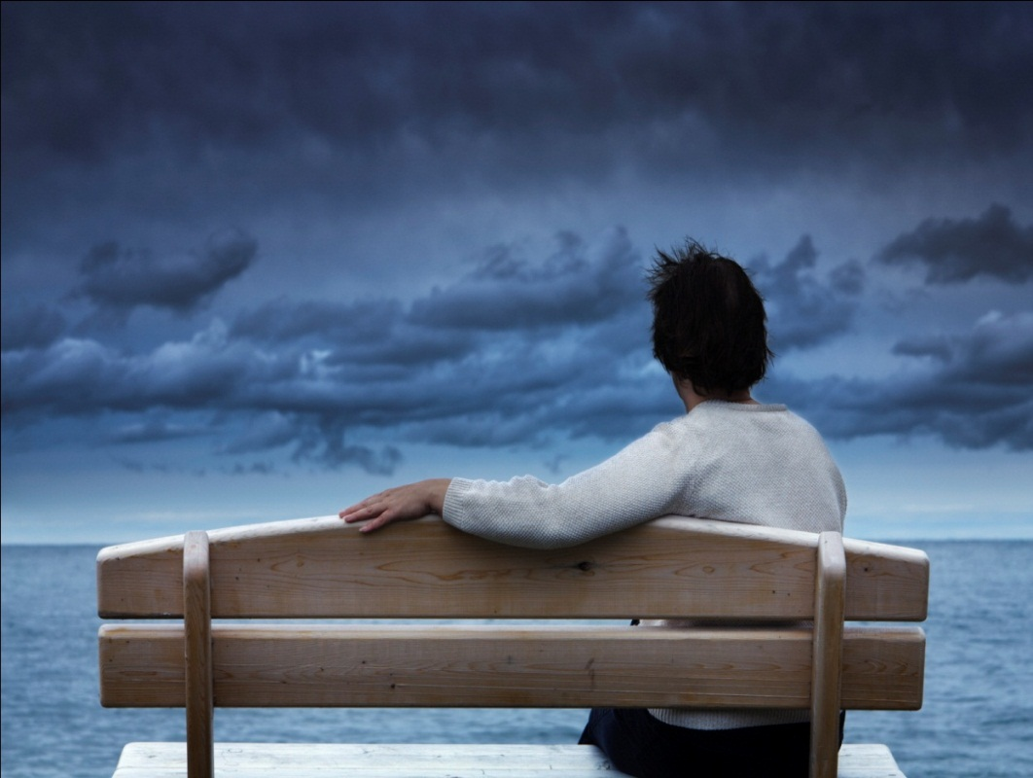
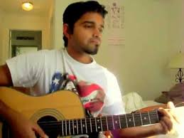
What is the picture about?
Solitude
What does it mean?
Ode
Notes:
Teacher may ask about the picture first to take out the lesson name.

Slide 4
Our today’s Lesson is-
Ode on Solitude
Unit-3, Lesson-2
Notes:
Lesson declaration.

Slide 5
Learning outcomes
After we have studied this lesson, we will be able to…
ask and answer questions
write answers to questions
recite a poem
Notes:
Bothe the four skills will be focused in this lesson.

Slide 6
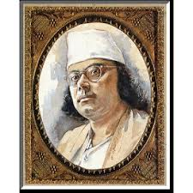
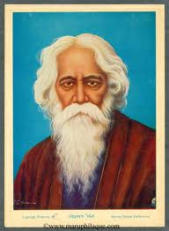
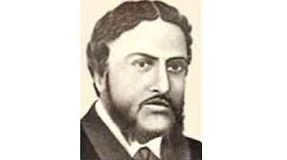
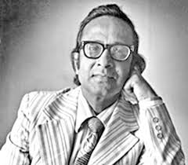
Can you tell who are they?
Kazi Nazrul Islam
Rabindronath Tagore
Michael Madhusudan
Hasan Hafizur Rahman
Notes:
To create a link to Alexander pope these pictures are shown.

Slide 7
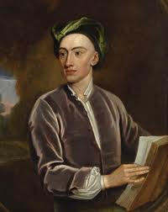
But who is he?
Alexander Pope
Notes:
To introduce the poet of the poem.

Slide 8
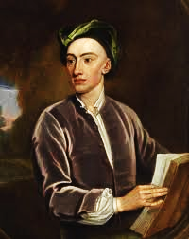
What is his identity?
A great English poet
Notes:
This picture is to introduce him a great poet.

Slide 9
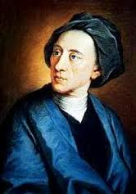
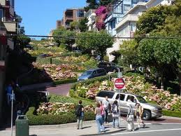
Was born on 21 May
1688
at Lombard Street,
London
Notes:
Information started about Alexander.

Slide 10
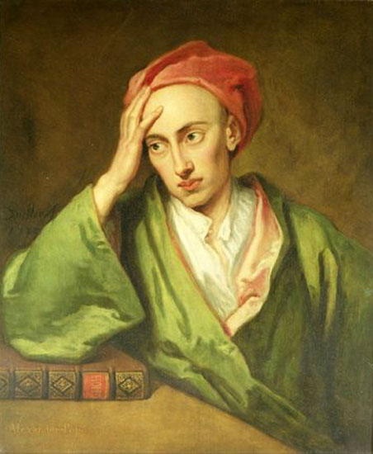
Famous works of the great poet
Pastorals- -1709
An Essay on Criticism-1711
The Critical Specimen-1711
Messiah -1712
The Rape of the Lock -1712,14,15
Winsor-Forest- -1713
Contribution of the Guardian-1713
The Iliad of Homer -1715-20
Ode on Solitude -1717
The Odyssey of Homer-1725-26
Notes:
Important works of Alexander.

Slide 11
The poet breathed his last on May 30, 1744, at
Tw Ickenham. London.
Notes:
Alexander died.

Slide 12
Let us make a tour from
“Ode on Solitude”
Notes:
Advanced to the poem.

Slide 13
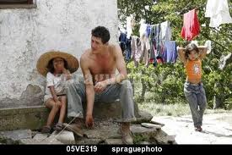
Paternal
Meaning : Fatherly/Parental
He is boast of his paternal wealth.
Notes:
Teacher may go slow accordingly to place this option.

Slide 14
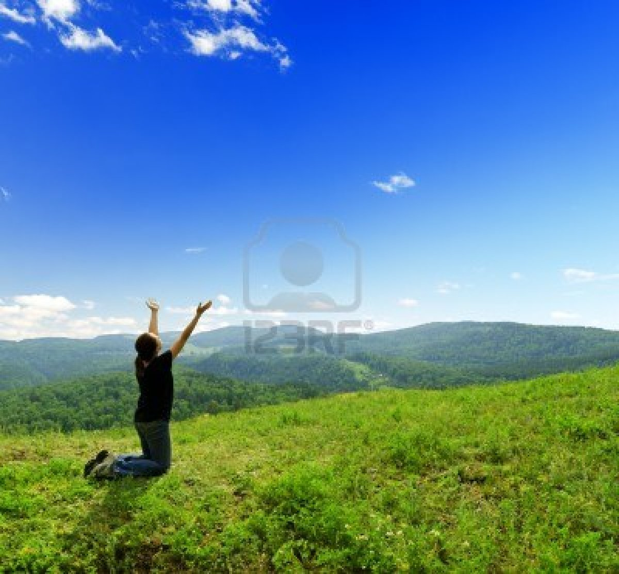
Native air
Meaning : Free breath
The poet wants to enjoy native air.
Notes:
Teacher may go slow accordingly to place this option.

Slide 15
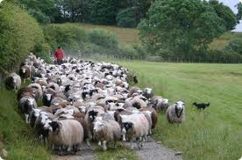
Flocks
Meaning : herd
It is a flock of sheep.
Notes:
Teacher may go slow accordingly to place this option.

Slide 16
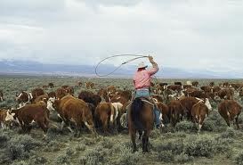
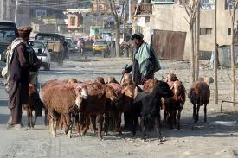
Herd
Meaning : Sheep/flock
The poet has herds with milk.
Notes:
Teacher may go slow accordingly to place this option.

Slide 17
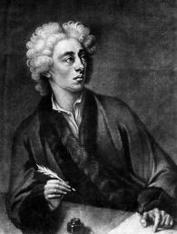
Ode on Solitude
Happy the man, whose wish and care A few paternal acres bound, Content to breathe his native air, In his own ground. Whose herds with milk, whose fields with bread, Whose flocks supply him with attire, Whose trees in summer yield him shade, In winter fire. Blest! who can unconcern'dly find Hours, days, and years slide soft away, In health of body, peace of mind, Quiet by day, Sound sleep by night; study and ease Together mix'd; sweet recreation, And innocence, which most does please, With meditation. Thus let me live, unseen, unknown; Thus unlamented let me dye; Steal from the world, and not a stone Tell where I lie.
Alexander Pope
Notes:
Teacher may recite the poem with proper sound, stress and intonation.

Slide 18
Answer the following questions.
Who was Alexander Pope?
Where was he born?
What do you mean by Ode on Solitude?
Where did he want to pass his time?
How did he want to die?
Ans- Alexander Pope was a great English poet.
Ans-He was born in Lombard, London
Ans- It means passing time in a solitary place.
Ans-He wanted to pass his time in his paternal land.
Ans-He wanted an unlamented die.
Notes:
To check the answers of the students teacher may show the answers.

Slide 19
See you again.
Notes:
Teacher may thank the students by this slide.

