Slide 1
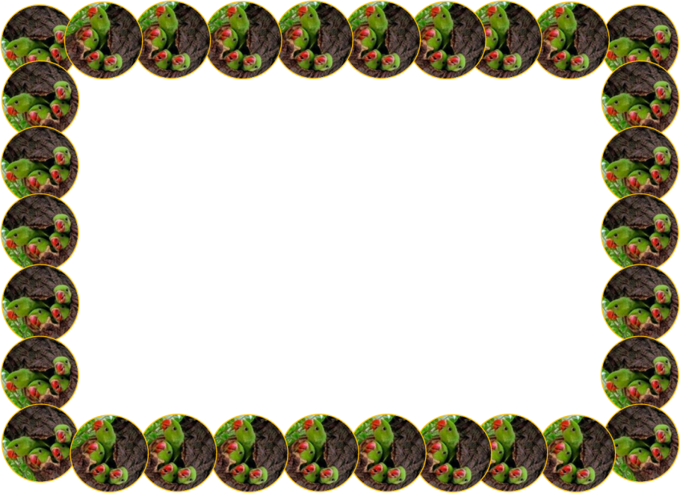
Welcome
to this class
dear students.
Notes:
Welcome slide.

Slide 2
W
E
L
C
O
M
E
INTRODUCTION
CLASS: SEVEN/EIGHT
SUBJECT: ENGLISH SECOND PAPER
TOPIC: RIGHT FORMS OF VERBS (PART ONE)
SHAH MOHAMMAD LUTFUL HAIDER
ASSISTANT TEACHER
LUTFUNNESA BALIKA BIDDANIKETON
PAGLA, GAFARGAON

Slide 3
Here is an audio clip. Let us hear a song.
Ques:
What did the singer do?
Ans:
She sang a song.

Slide 4
How do the flowers look?
The flowers look beautiful.

Slide 5
What is the parts of speech of the words in the circles?
1.She sang a song.
2.The flowers look beautiful.
Verb

Slide 6
Today Our Topic
Right forms of verbs

Slide 7
Learning Outcomes
After this lesson the we will be able to-
write the sentences using right forms of verbs.
fill the gaps with right forms of verbs (with clues).

Slide 8
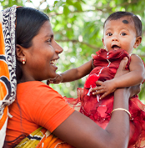
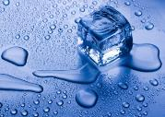
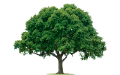
Look at the pictures and the sentences.
Mother loves her child.
Ice melts in heat.
Trees give us oxygen.
If the sentence is Universal truth, it will be Present Simple Tense.
Do the sentences express universal truth?
Can you tell why the sentences are present simple?
Present simple tense
Which tense is expressed by the sentences?
Notes:
After showing and explaining the rule, the teacher can give another exercises. The exercises can be done on the board or students’ writing copies. In the same way, rules on other slides can be conducted.

Slide 9
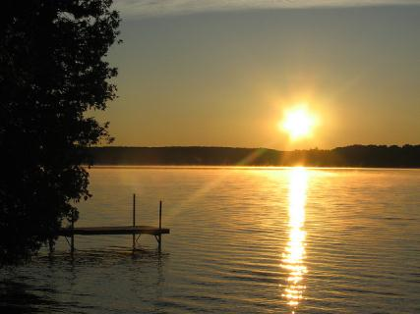
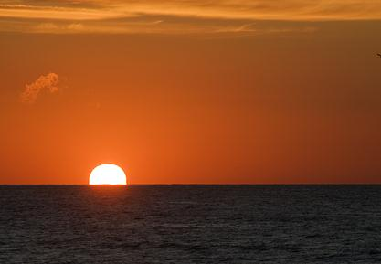
Give answers using right forms of verbs.
The sun _____ (rise) in the east. It ____ (give) us light. It _____ (be) the most important source of energy for life on Earth. The sun _____ (set) in the west.
rises
gives
is
sets
Notes:
The teacher can give few minutes the students to think about the answers. Then she/he can ask the students randomly to give answers.

Slide 10
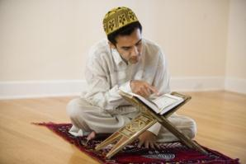
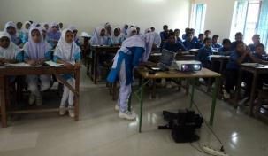
Look at the pictures and the sentences.
He reads the Holy Quran everyday.
They attend the multimedia class regularly.
If in the sentence there is everyday/always/regularly/
occasionally/usually/often/sometimes/generally , the sentence will be Present Simple Tense.
Can you tell why the sentences are present simple?
Present simple tense
Which tense is expressed by the sentences?

Slide 11
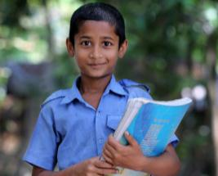
Give answers using right forms of verbs.
goes
1. The boy ____ (go) to school regularly.
studies
2. He ____ (study) attentively everyday.
3. He always ____ (speak) the truth.
speaks
4. He and his parents often ____ (visit) their relatives.
visit

Slide 12
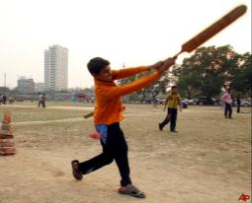
Look at the pictures and the sentences.
Manna is playing cricket now.
The wheel is moving on the line at this moment.
If in the sentence there is now/at this moment/at this time , the sentence will be Present Continuous tense.
Can you tell why the sentences are present continuous tense?
Which tense is expressed by the sentences?
Present continuous tense

Slide 13
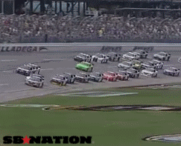
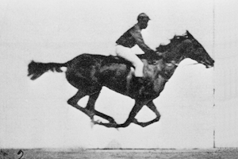
Give answers using right forms of verbs.
are watching
1. We _______ (watch) car race now.
is riding
2. The man _______ (ride) a horse at this moment.

Slide 14
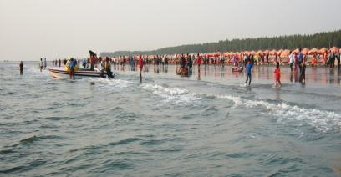
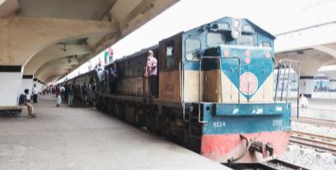
Look at the pictures and the sentences.
I have recently visited Cox’s Bazar.
The train has just reached the station.
If in the sentence there is recently/already/just/just now/lately , the sentence will be Present Perfect tense.
Can you tell why the sentences are present perfect tense?
Which tense is expressed by the sentences?
Present Perfect Tense
Notes:
The teacher can give more example of the placement of the words recently/already/just/just now/lately/ever/yet .

Slide 15
Give answers using right forms of verbs.
1. They already (leave) the place.
Ans: They have already left the place.
2. She just (finish) her homework.
Ans: She has just finished her homework.
3. Tapu lately (get) student visa or USA.
Ans: Tapu has lately got student visa for USA.

Slide 16
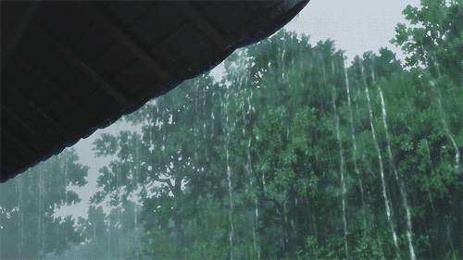
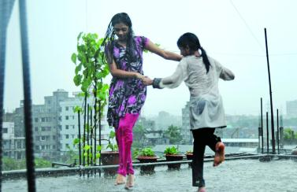
Look at the pictures and the sentences.
It has been raining since morning.
They have been enjoying rain for one hour.
If in the sentence there is for/since+ time the sentence will be Present Perfect Continuous Tense.
Which tense is expressed by the sentences?
Can you tell why the sentences are present perfect continuous tense?
Present Perfect Continuous Tense

Slide 17
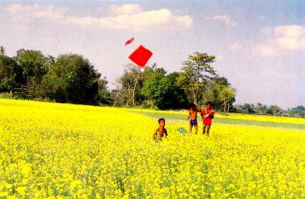
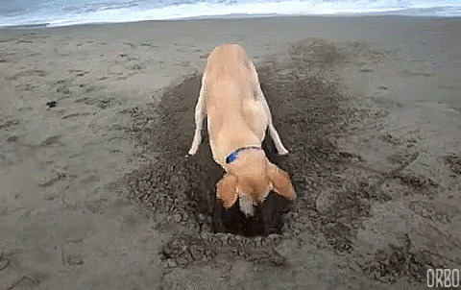
Give answers using right forms of verbs.
1. The boys (fly) kites since morning.
Ans: The boys have been flying kites since morning.
2. The dog (dig) the soil for an hour.
Ans: The dog has been digging the soil for an hour.

Slide 18
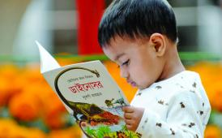
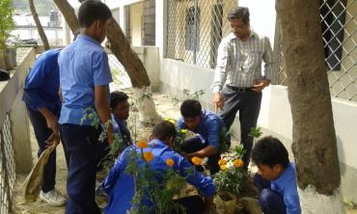
Pair work
Write the sentences using right forms of verbs.
is reading
1. She (read) a book now.
have been working
1. They (work) in the garden for half an hour.

Slide 19
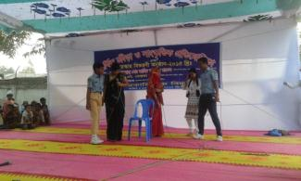
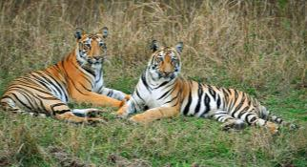
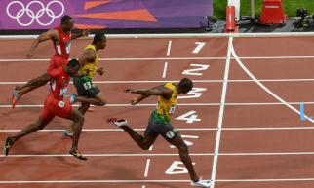
Pair work
Write the sentences using right forms of verbs.
celebrate
3. The students (celebrate) school’s cultural programme every year.
are
4. Tigers (be) symbols of strength and courage.
has just touched
5. Usain Bolt just (touch) the finishing line of the race.

Slide 20
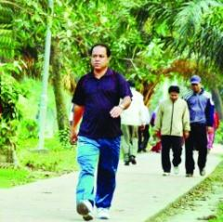
Evaluation
(Group work)
Take verb from the box and fill in the gaps. Use right forms of the verbs.
leave, walk, sleep, take
Mr. Anwar Rahman _____ in the open air every morning. He feels fresh. Today he _________ already a mile. Now he _______
rest sitting on a bench. A dog ____________
for one hour near the bench
walks
has already walked
is taking
has been sleeping

Slide 21
See you again.
Notes:
Teacher may thank the students by this slide.

