Slide 1
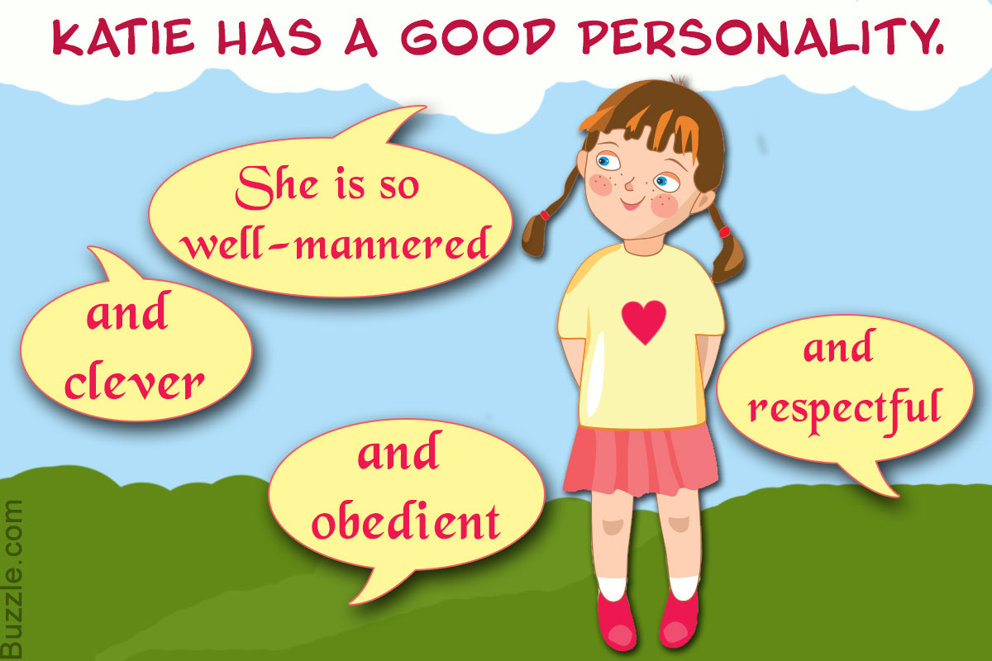
Welcome To All

Slide 2
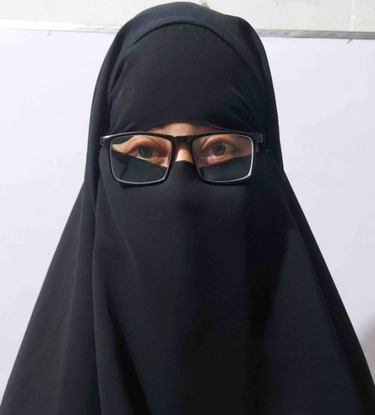
Identity
Mst. Arifa Khatun
Assistant Teacher ( English)
Chand Sultana Secondary Girls’
School, Kushtia Sadar, Kushtia
Mobile: 01936601076
E-mail: arifakch87@gmail.com
Sub: English For Today
Class : 9-10
Unit : One
Lesson: Three
Time : 45 Minutes

Slide 3
Learning outcomes: After we have studied this lesson, we will be able to-
Ask and answer questions,
Read and understand chart,
Tick the best answer,
Fill in the blanks.

Slide 4
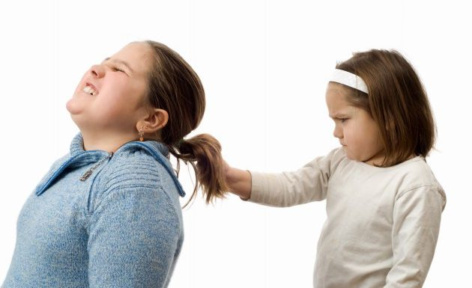
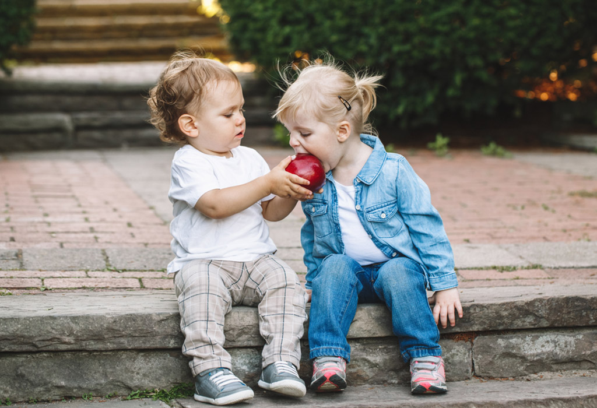
What do you see in these two pictures?

Slide 5
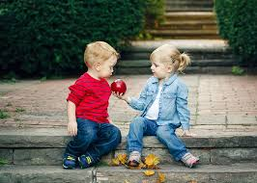
Today’s Lesson is-
Good character

Slide 6
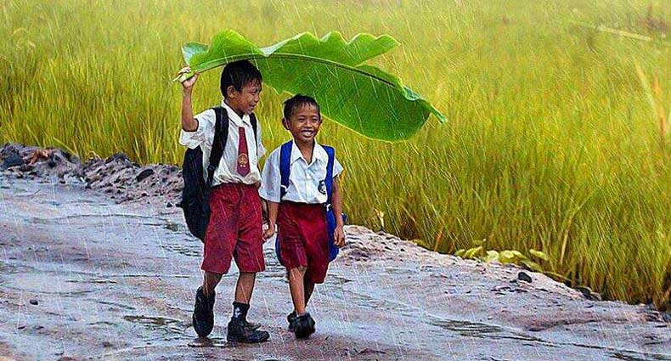
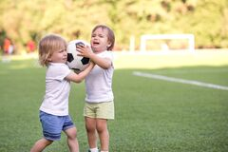
Look at the pictures and answer the following questions.
A
Ask and answer these questions in pairs.
What do you understand by character?
What does a person with a good character usually do to others?

Slide 7
Listen to the Audio/ Teacher and answer the following questions.
B
Good citizen means “gain good quality”. To be a good citizen you should gain all the good and positive attitudes to life that you do not gain automatically but personally. It is not God given. These qualities differentiate you from others. So, you obviously learned and practiced it.

Slide 8
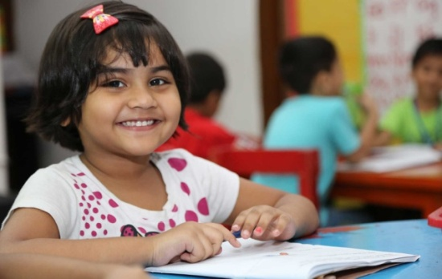
Individual work
Questions: Tick the best answer.
Which is the correct statement according to the information in the listening /above text?
Good character does not mean special qualities.
Good citizens must have good character along with other qualities.
Character means a tool to curve wood.
Character traits are distinctive marks always seen on a person’s face.

Slide 9
2. The red crest of a rooster
is a symbol of power and strength.
enables it to crow in the morning.
makes the bird tall and beautiful.
shows how it is different from a hen.
3. The expression ‘distinctive qualities’ means those qualities of a person, which
are the same as others’.
emphasise honesty in him/her.
make him / her different from others.
he / she gets from their parents.

Slide 10
4. Character traits are
naturally gifted.
personally learned.
God given.
physically visible.

Slide 11
Look at the chart:
Good character traits-
Integrity
Positive
attitudes
Honesty
Respect
Faithfulness

Slide 12
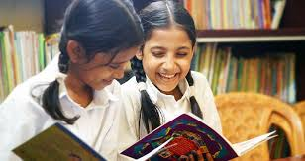
Pairs work
Fill in the blanks in the following passage with appropriate words from the box.
C
harmonious allow behaviour respect
good doing family class others
sense qualities believe personally

Slide 13
Citizens possessing good character live a life of virtue. They may belong to any social 1)------, upper or lower. Their thoughts and 2) ------ show high moral values. That is, they have a strong 3) ------ of right and wrong. So what they do is 4)------ for themselves as well as for others in the 5)------ and in the society. In fact, they cannot even think of 6)------- any wrong to others. One of the most positive 7)------ of these people is tolerance towards 8)-------. Suppose a group of people in your community 9)------ or practise something which you do not like 10)------. But as a good citizen you should 11)------ them to perform their activities. Thus tolerance can generate 12)------- for people of other cultures. Tolerance and respect together can make life 13)------ and peaceful in society.
Correct answer: 1, class; 2, behaviour; 3, sense;4, good; 5, family; 6, doing; 7, qualities; 8, others; 9, believe; 10, personally; 11, allow; 12, respect; 13, harmonious

Slide 14
Look at the chart
Good character traits-
Responsibility
Sympathy
Fairness
Humanity
Forgiveness

Slide 15
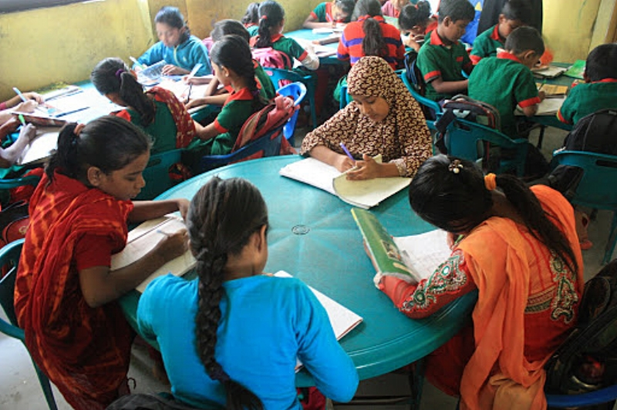
Groups work
Find the opposites of these words. If you do not know any, look it up in your dictionary. Then make a meaningful sentence with each of these opposites:
E
tolerance, respect, allow, enjoyable

Slide 16
Look at the chart
Good character traits-
Generosity
Kindness
Courageousness
Politeness
Lovingness

Slide 17
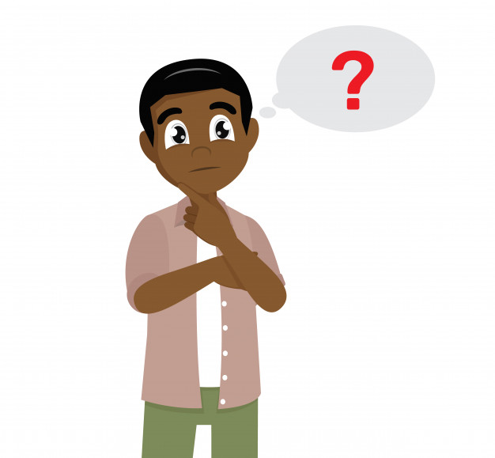
Evaluation
“People with moral values” means---
‘Tolerance’ means---
What can make life harmonious in society?

Slide 18
Look at the chart
Good character traits-
Optimism
Conscientiousness
Self-
discipline
Reliability
Loyalty

Slide 19
Home work
Write a paragraph about how tolerate or intolerant you are towards your family members.

Slide 20
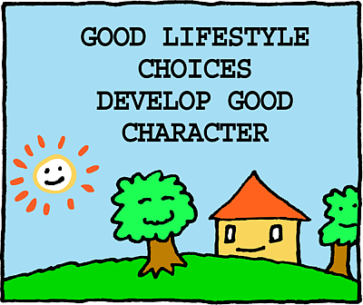
Thanks to all

