Slide 1
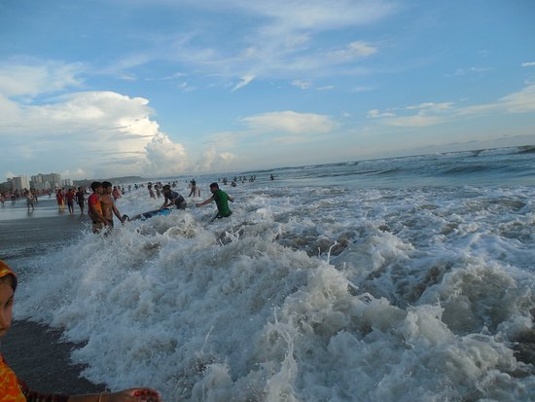
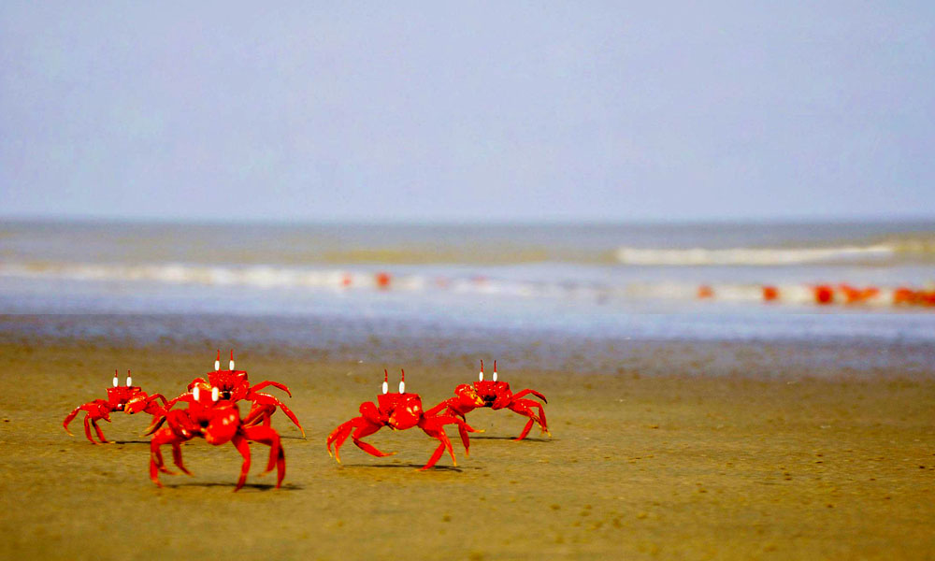
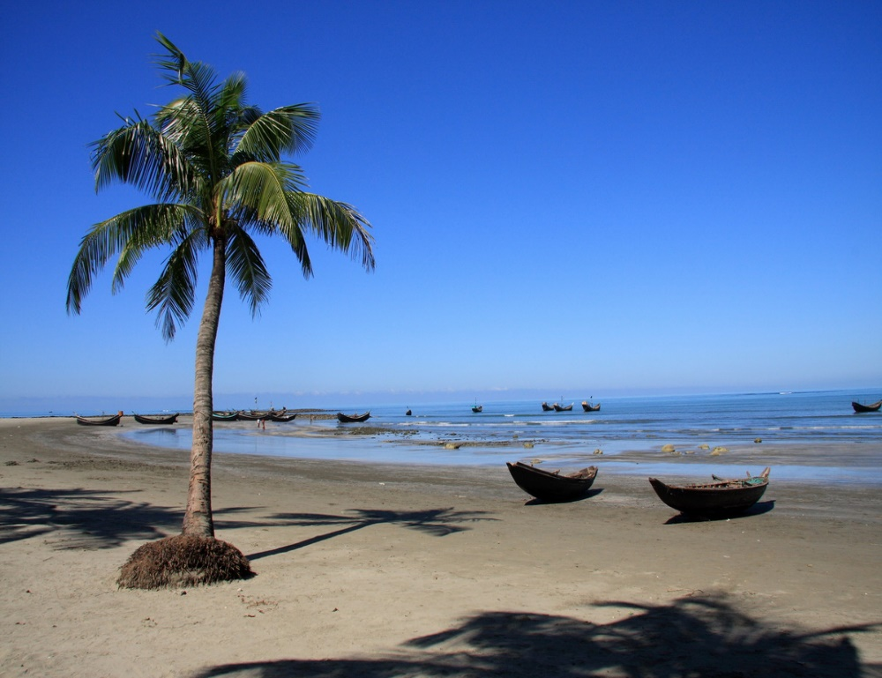
Cox’sBazar ; My district
Our proud
24-Oct-20

Slide 2
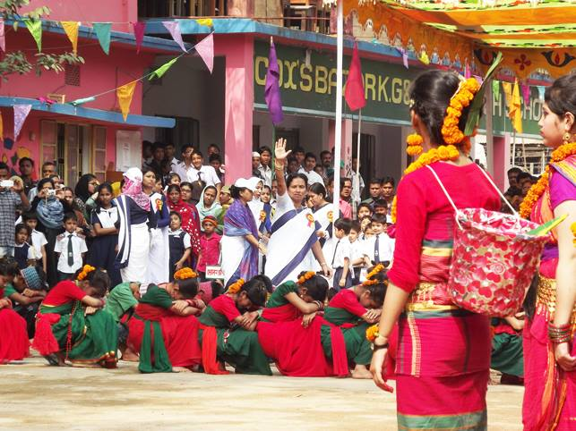
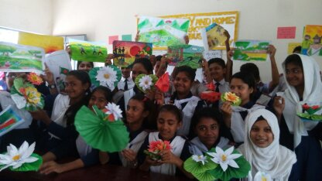
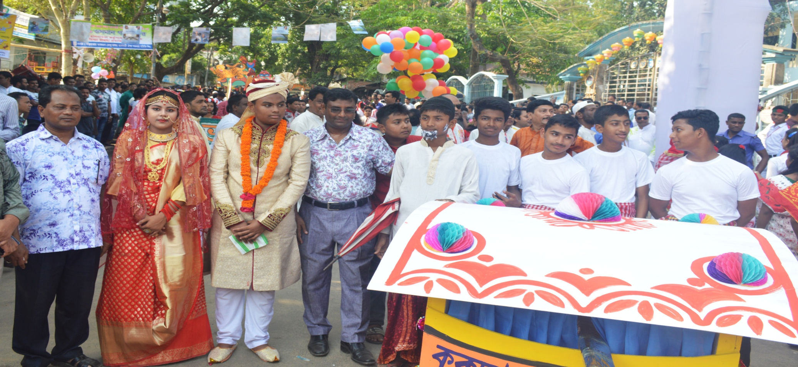

Slide 3
Dear students
Dear students
Welcome to E.F.T. Class

Slide 4
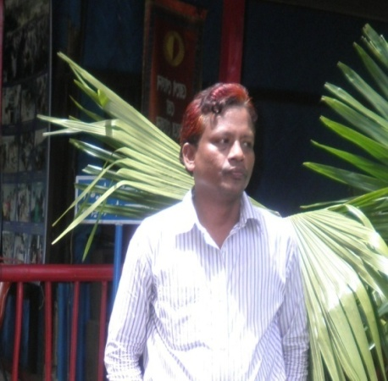
Introduction
Presented by
Nazrul Islam Hossainy
Assistant Head master
English For Today
Class VI
U# 21 L# 21
Time:- 22minutes
Cox’s Bazar Model High School

Slide 5
Let`s enjoy a song.
What about the song ?
This songs about Hason Raja.
Notes:
After showing this video teacher can ask his/her students – What did Hason Raja think about mankind, death and life of here and here after ?

Slide 6
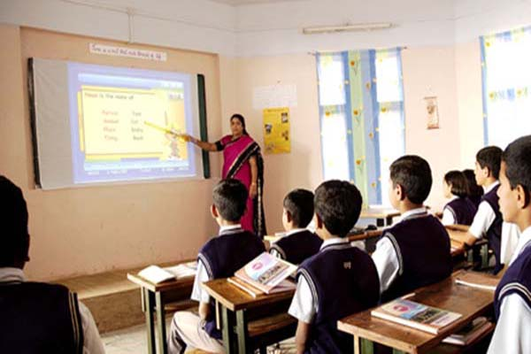
Our today’s lesson is
Hason Raja :
The mystic bard of Bangladesh
Lesson # 21, page #66

Slide 7
Aim of this content
AFTER THE END OF THE LESSON THE LEARNERS
WILL BE ABLE TO
read and understand texts through silent reading.
infer meaning from context
Listen for information
Write answers to questions
ask and answer questions

Slide 8
Let’s Search
Difficult

Slide 9
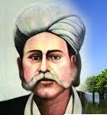
mystic
Hason Raja is a mystic bard of Bangladesh.
Who tries to search the truth and become united with God through prayer and meditation.
Meaning
spiritualist

Slide 10
More discussions
Mystic
Parts of speech
Noun
Adjective
Synonym
Mystical
Spiritual
Adverb
magic
Mystically
Super natural
Verb
medium
Mystify
Sage

Slide 11
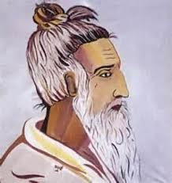
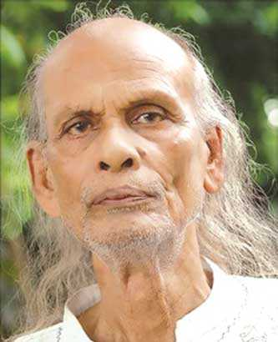
bard
They are mystic bards of Bangladesh.
Meaning
Who writes poems and songs.

Slide 12
More discussions
Bard
Parts of speech
Noun
Adjective
Synonym
Bardic
Poet
Adverb
Writer
bardically
winner
Verb
Rhymester
Be bard
Lyricist

Slide 13
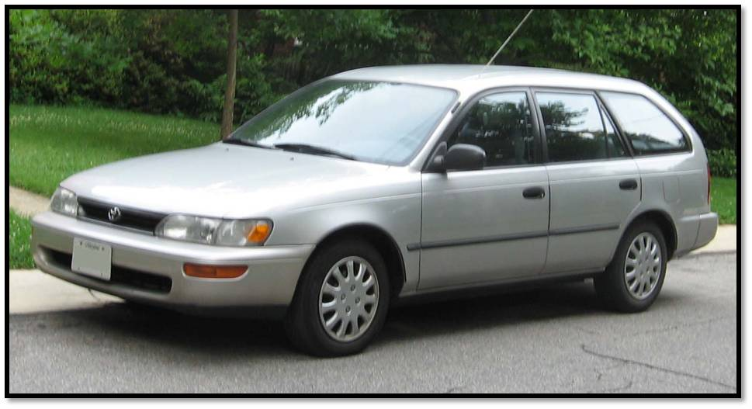
Comfortable
The baby has been living a comfortable life.
Meaning
The state of having a pleasant life
Luxury
The car is a luxurious vehicle.
Meaning
The enjoyment of expensive things.

Slide 14
More discussions
Comfortable
Parts of speech
Adjective
Noun
Synonym
Comfort
Relax
Adverb
Happy
Comfortably
At easy
Verb
Calm
Be Comfort
Contented

Slide 15
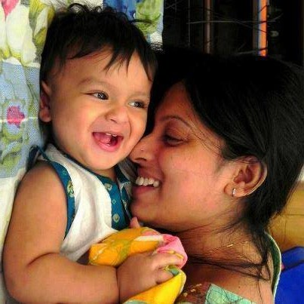
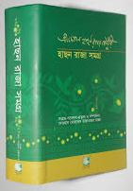
Pleasure
They lead a pleasurable life.
Meaning
Enjoyment / delight.
Volume
A large book
This is a volume of Hason Raja that contained 500 poems and songs.

Slide 16
More discussions
Pleasure
Parts of speech
Noun
Adjective
Synonym
Pleasurable
Relax
Adverb
Happy
Pleasurably
At easy
Verb
Calm
Pleasuring
Contented

Slide 17
More discussions
Volume
Parts of speech
Noun
Adjective
Synonym
Volumetric
Quantity
Adverb
Amount
Volumetrically
Degree
Verb
Large book
Volumes
Size

Slide 18
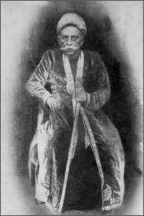
Crazy
In his songs Hason Raja called himself ‘Crazy Hason Raja’.
Meaning
Excited about something / mad.

Slide 19
More discussions
Crazy
Parts of speech
Adjective
Noun
Synonym
Craziness
Mad
Adverb
Wild
Crazily
Passionate
Verb
Foolish
Crazes
Extreme

Slide 20
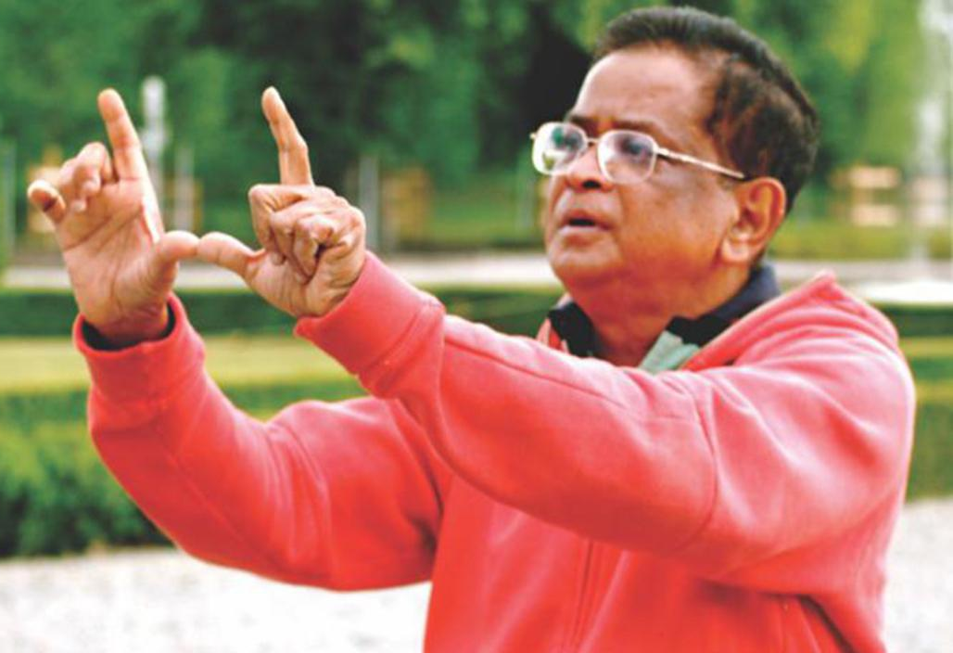
Eminent
Humayon Ahmad was an eminent figure.
Meaning
Famous/ renowned

Slide 21
More discussions
Eminent
Parts of speech
Adjective
Noun
Synonym
Eminence
Well known
Adverb
famous
Eminently
Prominent
Verb
Out standing
Eminences
Important

Slide 22
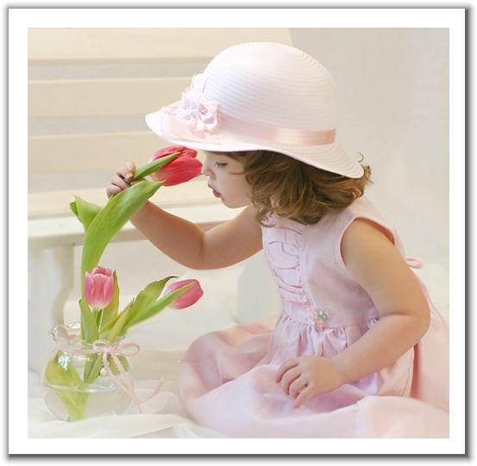
See you again with next part of this lesson

