Slide 1
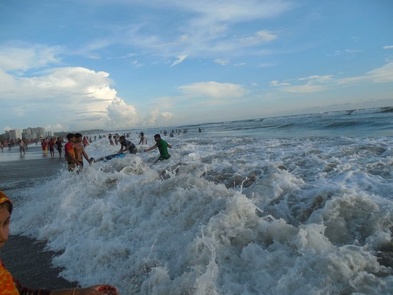
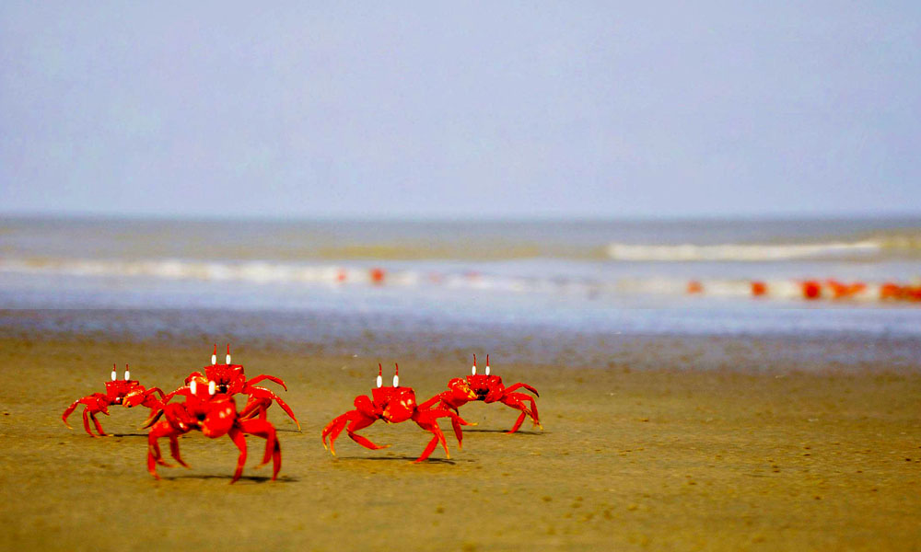
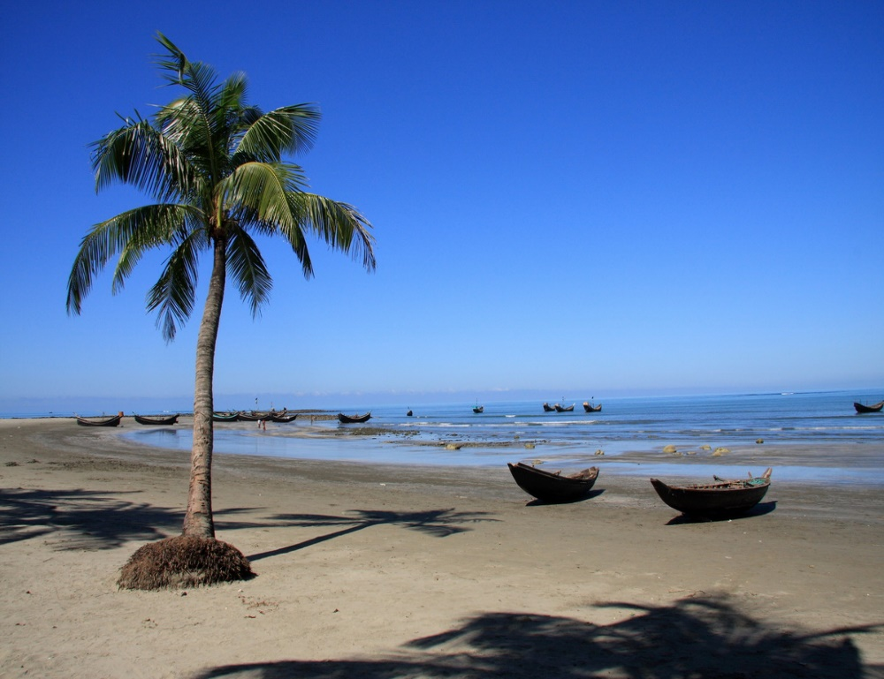
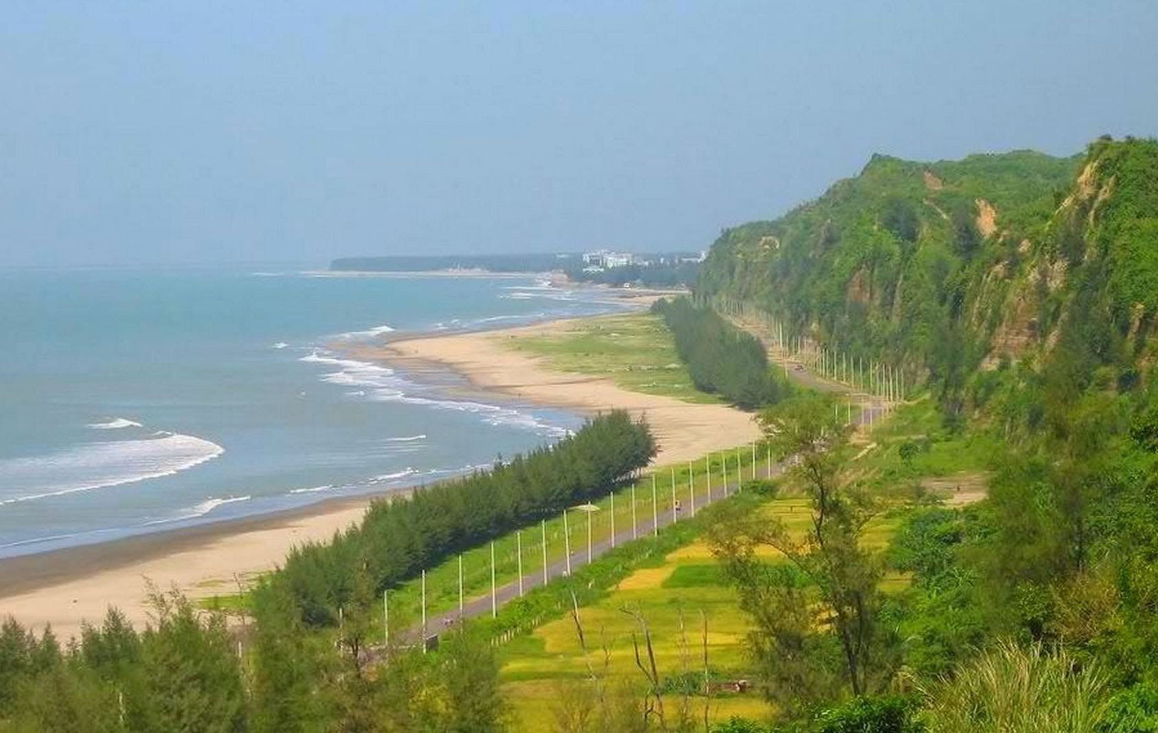
কক্সবাজার আমার জেলা
আমার অহংকার
18-Sep-20

Slide 2
Aim of this content
AFTER THE END OF THE LESSON THE LEARNERS
WILL BE ABLE TO
read and understand texts through silent reading.
infer meaning from context
Listen for information
Write answers to questions
ask and answer questions

Slide 3
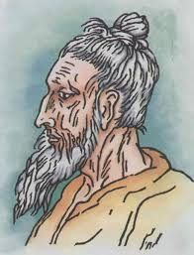
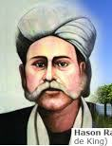
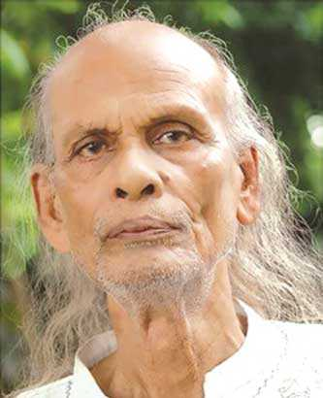
Look at the picture
Do you know who they are or anything about them?
Lalon Shah
Hason Raja
Shah Abdul Karim

Slide 4
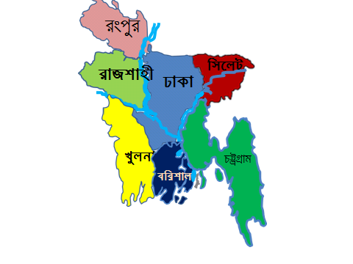
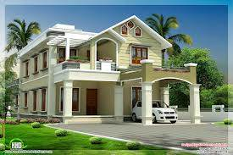
Now go to unit 21, section – A. Read the passage carefully and find out who they are.
Hason Raja was born in 1854 in a wealthy landlords family in Sylhet. He did not receive much formal education . In his youth , he led a life of luxury . He had everything –money, comfort and pleasure. At one time he understood that all these are meaningless. He gave away all of his properties . He started to think deeply about the Creator, about life, death and mankind.

Slide 5
Hason Raja wrote a lot of songs perhaps about a thousand in number. His book called “Hason Udash” was published in 1906. The book had 206 songs in it. In his songs Hason called himself “Creazy Hason Raja” or the Pagla Hason Raja . A volume called “Hason Raja Samogra” was also published. The book contained 500 poems and songs. Some of the songs were written by the poet in Hindi.
Hason Raja’s songs were always popular in Sylhet. But every soon they spread all over Bangladesh and beyond. In India’s West Bengal ,some eminent folk singers made Hasion’s songs popular.

Slide 6
Identity of Hason Raja
Hason Raja was born in 1854 in a wealthy landlord`s family in Sylhet.
Notes:
Teacher will discuss about Hason Raja with pictures.

Slide 7
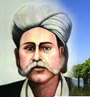
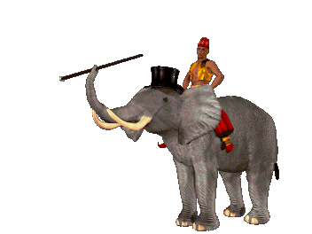
His previous life style
Do you know Hason Raja`s previous life style?
In his youth, he led a life of luxury. He did not lack anything – money, comfort or pleasure. But then a time came when he started to find all these comfort and joy meaningless.
Notes:
Teacher will discuss about Hason Raja with pictures.

Slide 8
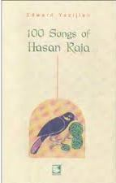
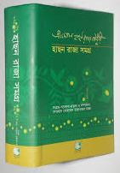
Writer Hason Raja.
Do you know the name of Hason Raja`s book?
The Hason Udas
The Hason Raja Samagro
Hason Raja wrote a lot of songs, perhaps about a thousand in number. His books called “Hason Udash” and “Hason Raja Samagra”.
Notes:
Teacher will discuss about Hason Raja with pictures.

Slide 9
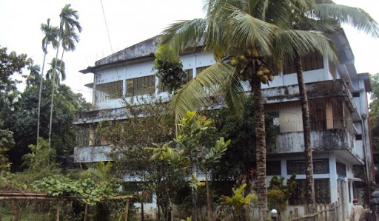
Hason Raja’s Museam

Slide 10
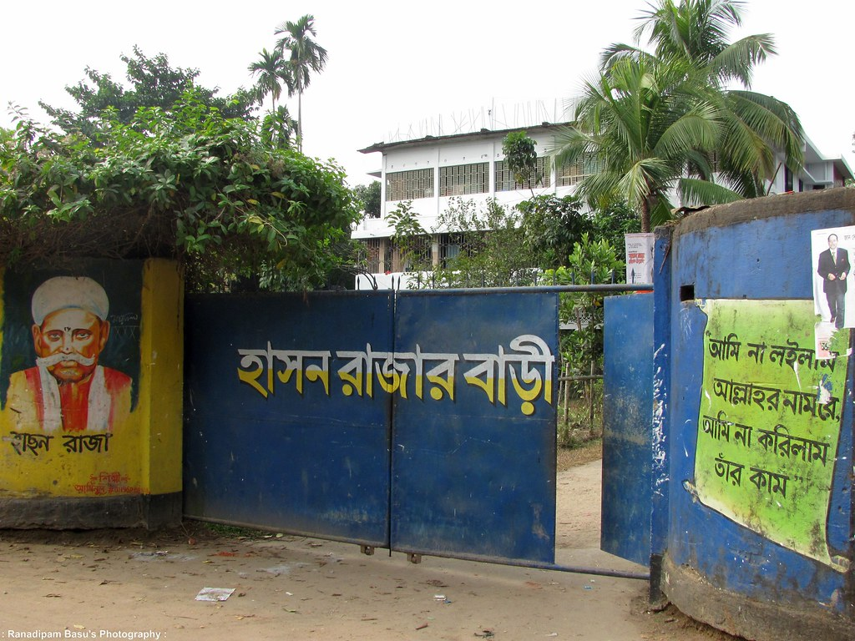

Slide 11
Close your book, listen me attentively then answer the following questions with me
When was Hason Raja born ?
Where did he come from ?
What was his childhood life ?
Why did Hason Raja leave the life of comfort and pleasure ?
What was the other name by which Hason Raja was known ?

Slide 12
Put a word in the gaps from the box matching their meanings.
comfort
luxury
pleasure
volume
crazy
a. ---------------- = enjoyment / happy.
b. ----------------- = a large book.
c. ------------------ = excited about something.
d. ----------------- = the state of having a pleasant life.
e. ----------------- = the enjoyment of expensive things.

Slide 13
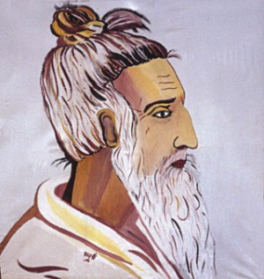
Home work
Write a short paragraph about another mystic bard of Bangladesh
‘LALON SHAH’.
Notes:
Teacher can discuss about Lalin Shah.

Slide 14
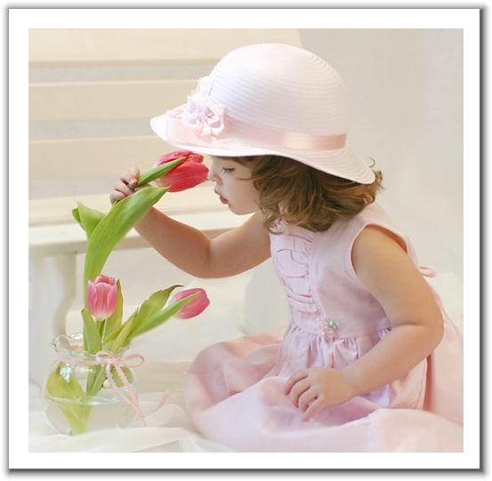
That’s all for today
Thanks all

