Slide 1
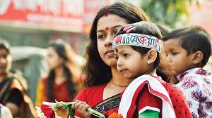
Welcome to our English class

Slide 2
IDENTITY
Md Rabiul Hasan Robi
Asst. Teacher in English
Shaharpar Gausul Azam Dakhil Madrasah
Debidwar, Cumilla

Slide 3
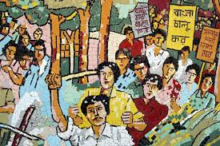
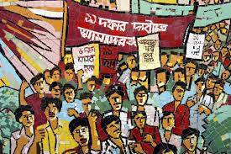
Let’s see the pictures and talk about them.
What are the pictures about?
What are they doing ?

Slide 4
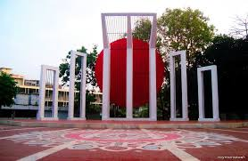
What does the picture commemorate us?
Where is the Central Shaheed Minar situated?
Why was the Shaheed Minar built?

Slide 5
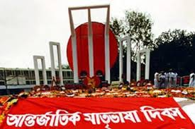
Can you guess about our today’s topic?
Our today’s topic is……
International Mother Language Day-1
Unit : 3
Lesson : 3
Page No : 37

Slide 6
Learning Outcomes
After the end of the lesson students will be
able to :
a) tell about Shaheed Minar.
b) narrate about the back ground of it.
c) take interview of the language activists.
d) write paragraph.

Slide 7
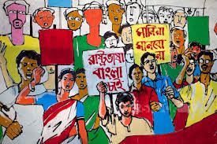
Look and talk about the pictures with your partners
When did the language movement take place ?
Who took part in the Language movement ?

Slide 8
Observe the text related video
Individual work-1
Now write down the name of some language activists.

Slide 9
Loud/silent Reading
Para 1-4
21st February is a memorable day…………

Slide 10
Pair work (Writing)
Write the answer of the questions and compare with your partner
a) Who took part in language movement ?
b) When and where did Md. Ali Zinnah declare
Urdu would be the state language of Pakistan ?
c) Who claimed first Bangla to be the state
language of pakistan ?

Slide 11
Group work
Complete the following chart.
Time | What happened
1947
1948
1952

Slide 12
Now match your answer
Time | What happened
1947 | India and Pakistan divided .
1948 | Md. Ali Zinnah, the then Governor general of Pakistan declared that Urdu would be the only state language of Pakistan
1952 | All classes of people headed by the students of DU bought out procession demanding Bangla as one of the state language. But police opened fire on the procession killing several students

Slide 13
Individual work-2
Match the words with their meanings.
Words | Meanings
tribute | To cause of stimulate
climax | to refuse to obey
outlaw | to give in
defy | the ability to keep increasing or developing
provoke | an act to show respect or admiration
relent | the most exciting point in time
Momentum | to ban

Slide 14
Evaluation
a) Who are the known language martyrs ?
b) When was the seed of language movement sown ?
c) Where did the police open fire to the procession ?
d) Why did the then government outlaw all sorts of public
meeting in 1952 ?

Slide 15
HOME WORK
Write a paragraph On “International Mother Language Day”.

Slide 16
This lesson is dedicated to the all language martyrs and activists.
As our language is Bangla , our culture should be Bangla.
Thank you all

