Slide 1
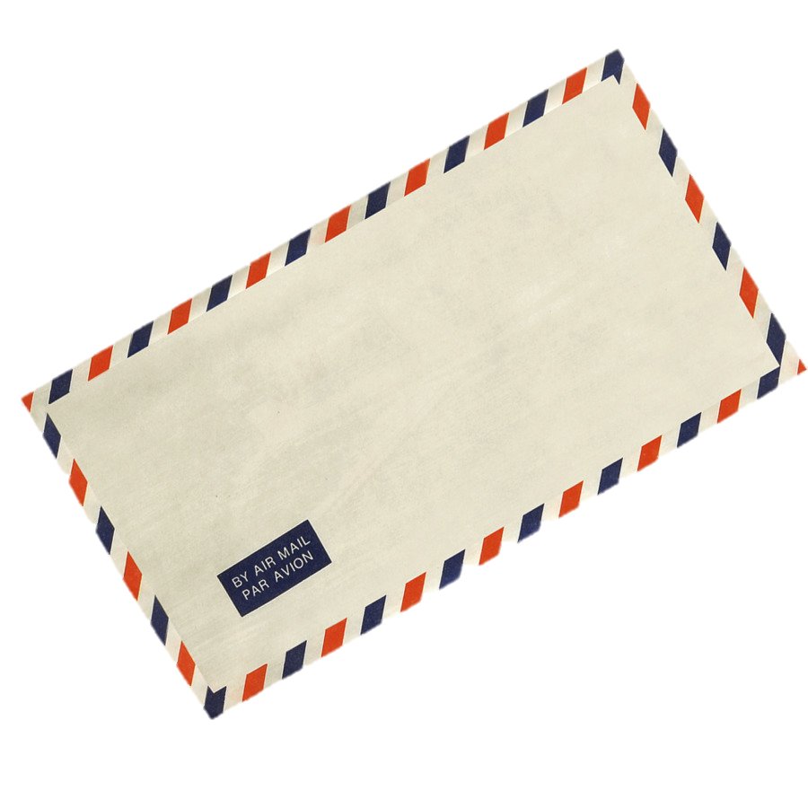
Wellcome my dear students

Slide 2
 Prepared By
Md. Sultan-ul Arefin
Assistant Teacher
Gurudaspur Model Govt. Primary School
Gurudaspur, Natore.

Slide 3
Lesson Detail
Class: Four
Subject: English
Unit: 28, Lesson: 1-3
Title: Letter to a friend

Slide 4
Dear students let’s enjoy a rhyme.

Slide 5
Check learning of previous class
Write capital letters, full stops, commas, questions marks in the following sentences.
1. Is hasna hena a teacher
2. Yes she is
3. I want to buy a pen a
4. khata and a book

Slide 6
Showing picture, I will ask some questions to my students
Look at the picture attentively and answer the questions.
Let’s watch the pictures

Slide 7
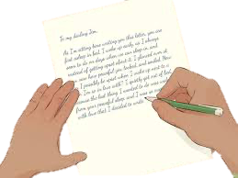
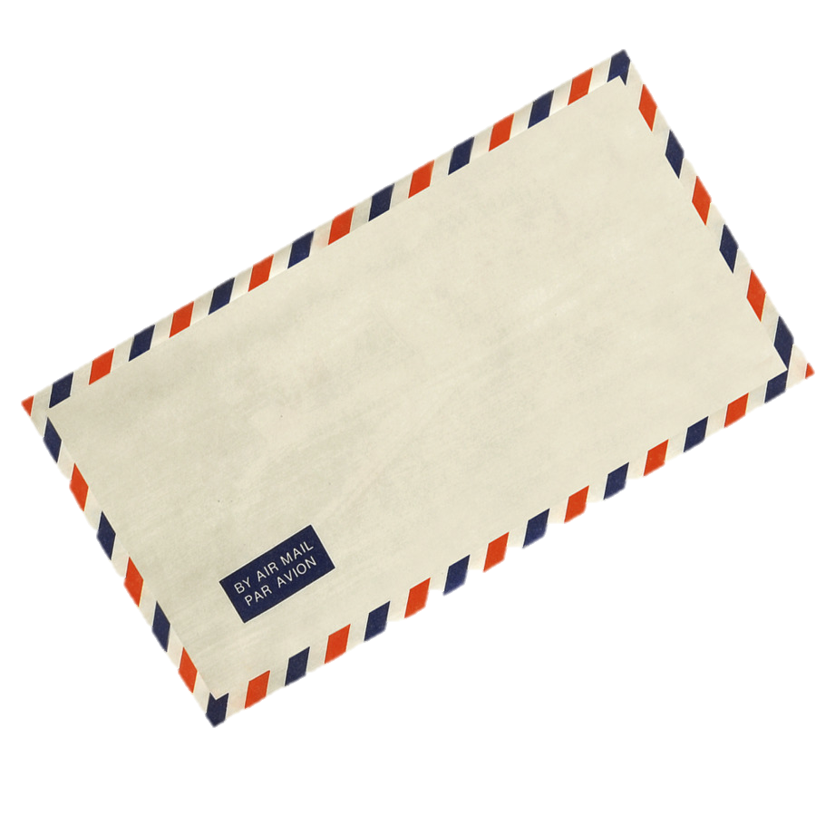
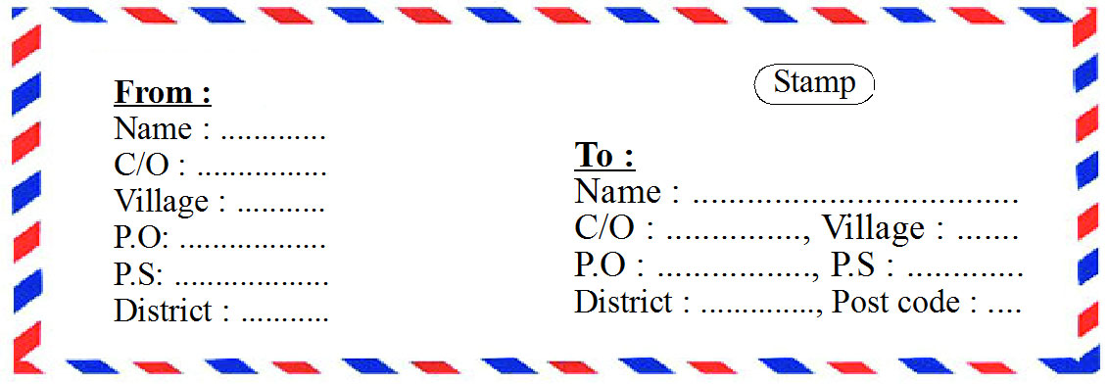
Here is some pictures. Let’s watch the picture attentively and ready to answer the question.
1
2
3

Slide 8
Questions:
1
3. What do you see in picture 3?
2. What do you see in picture 2?
1. What do you see in picture 1?
Dear students, just think what we are going to read today.
2
Possible solutions:
3
3. An envelop with the address of the reciver and sender.
2. A letter is in an envelop.
1. A man or weman is writing a letter.

Slide 9
Lesson Declaration
Well, To day we are going to read-
Letter to a friend
Part -1

Slide 11
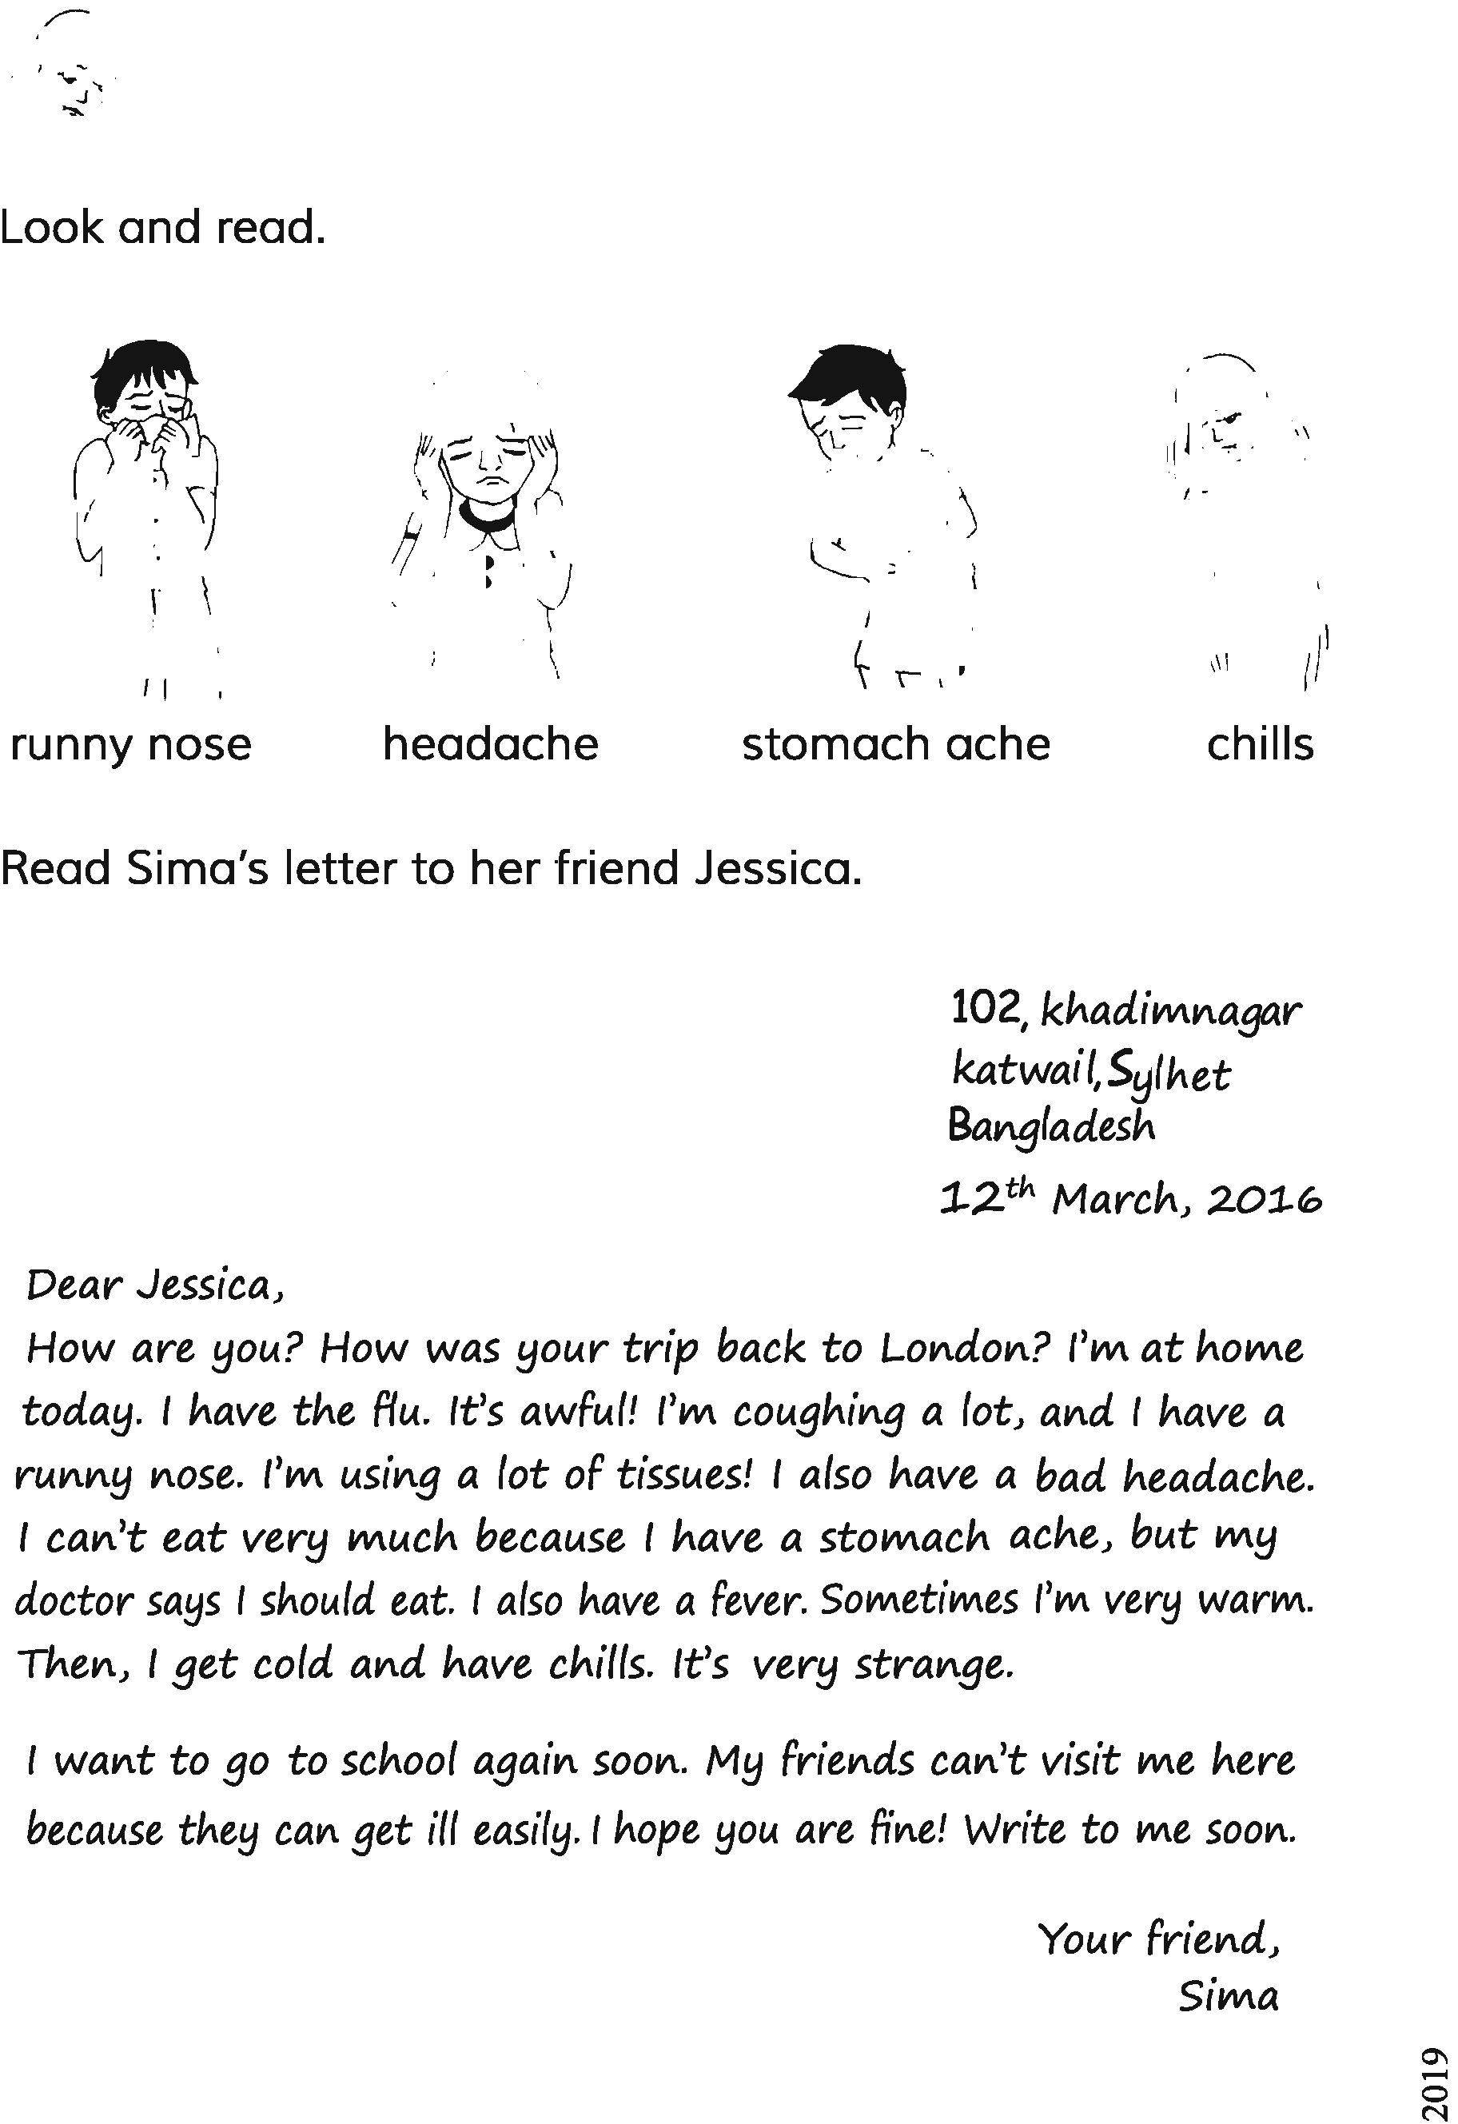

Slide 12
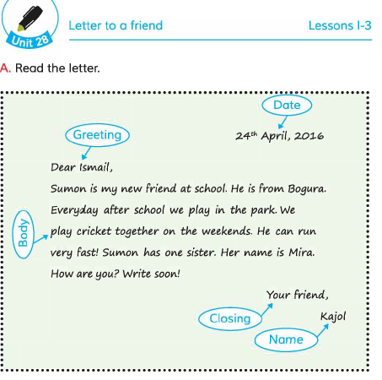
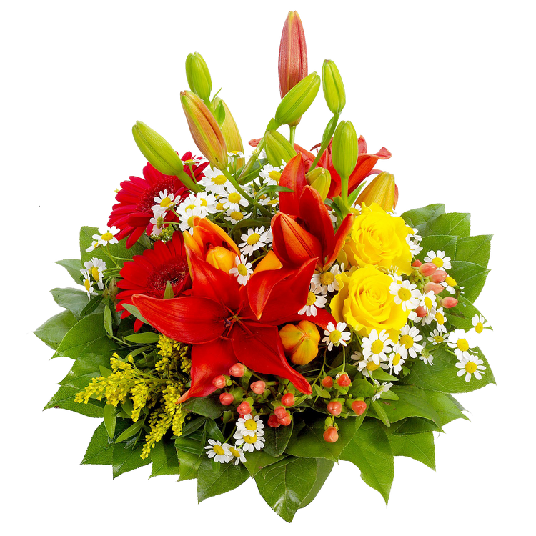
Date
Dear students, please open your text book at page 56 and look at the activity A in the letter and a pay a special attention to see the words written in blue colour in the oval. Well say after me.
Greeting
Body
Closing
Name

Slide 13
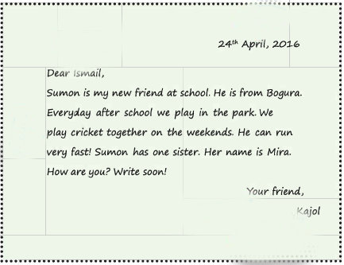
Date
Greeting
Body
Closing
Name

Slide 14
Let’s know the meaning of the above words.
Date
The day the letter was written
Greeting
Saying hello and what the letter is for
Body
The main part of the letter
Closing
Saying goodbye
Name
Saying who the letter is from

Slide 15
Teaching Vocabulary
Do you know the meaning of the following words?
Greeting.
Run.
Together.
Park.
Weekend.
Fast.

Slide 16
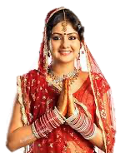
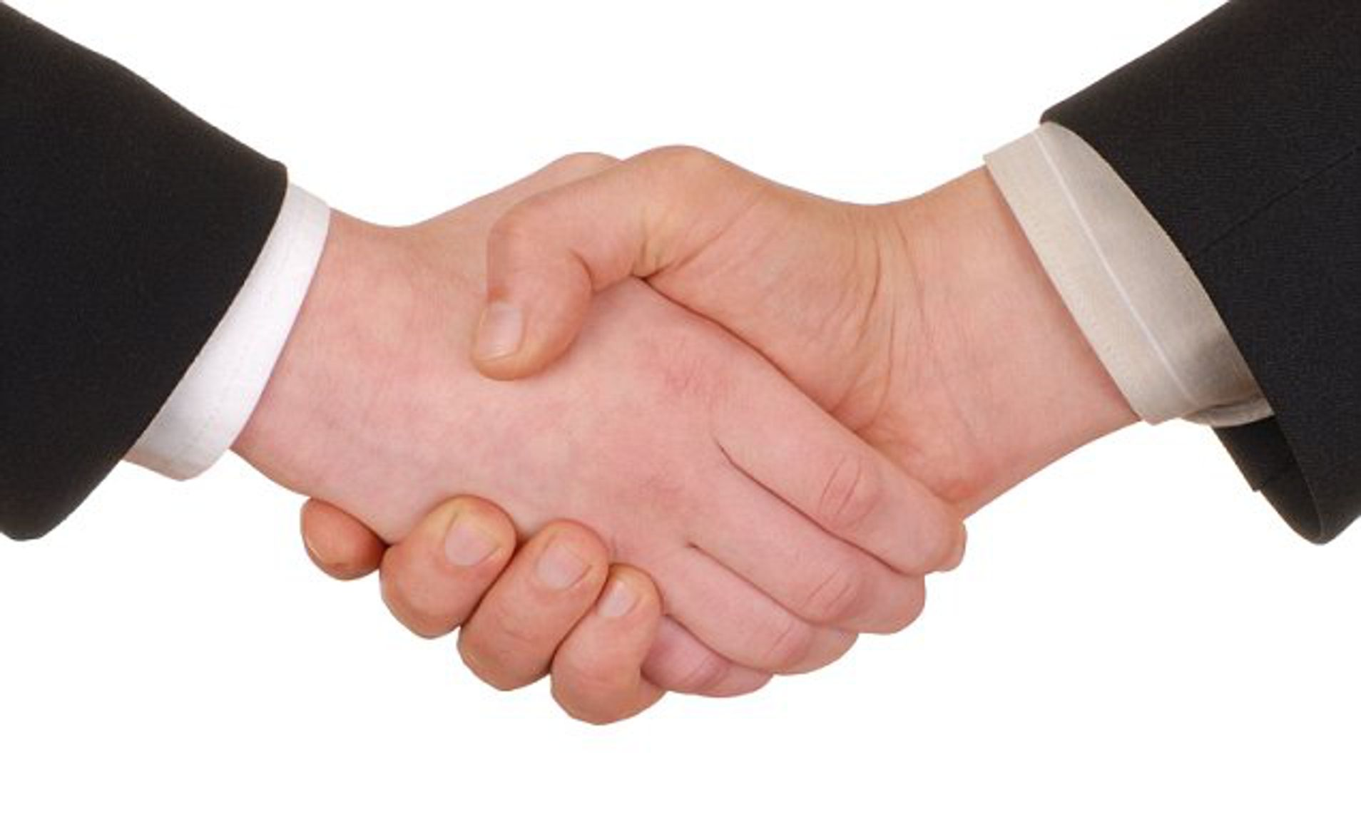
Greeting
a polite word or sign of welcome or recognition.
Similar meaning
:
welcome, salutation

Slide 17
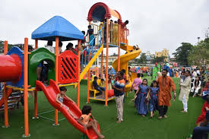
Park
a large public garden or area of land used for recreation.
Similar meaning
:
recreation ground, play ground

Slide 18
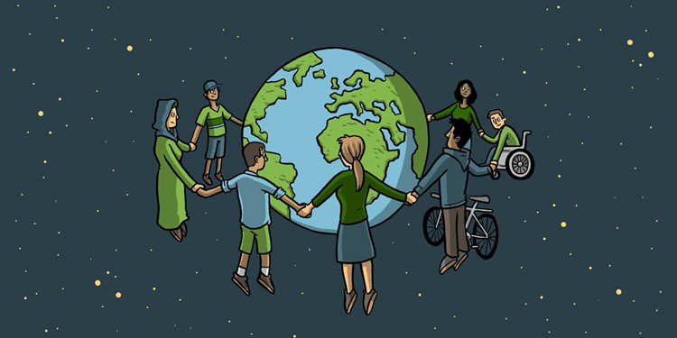
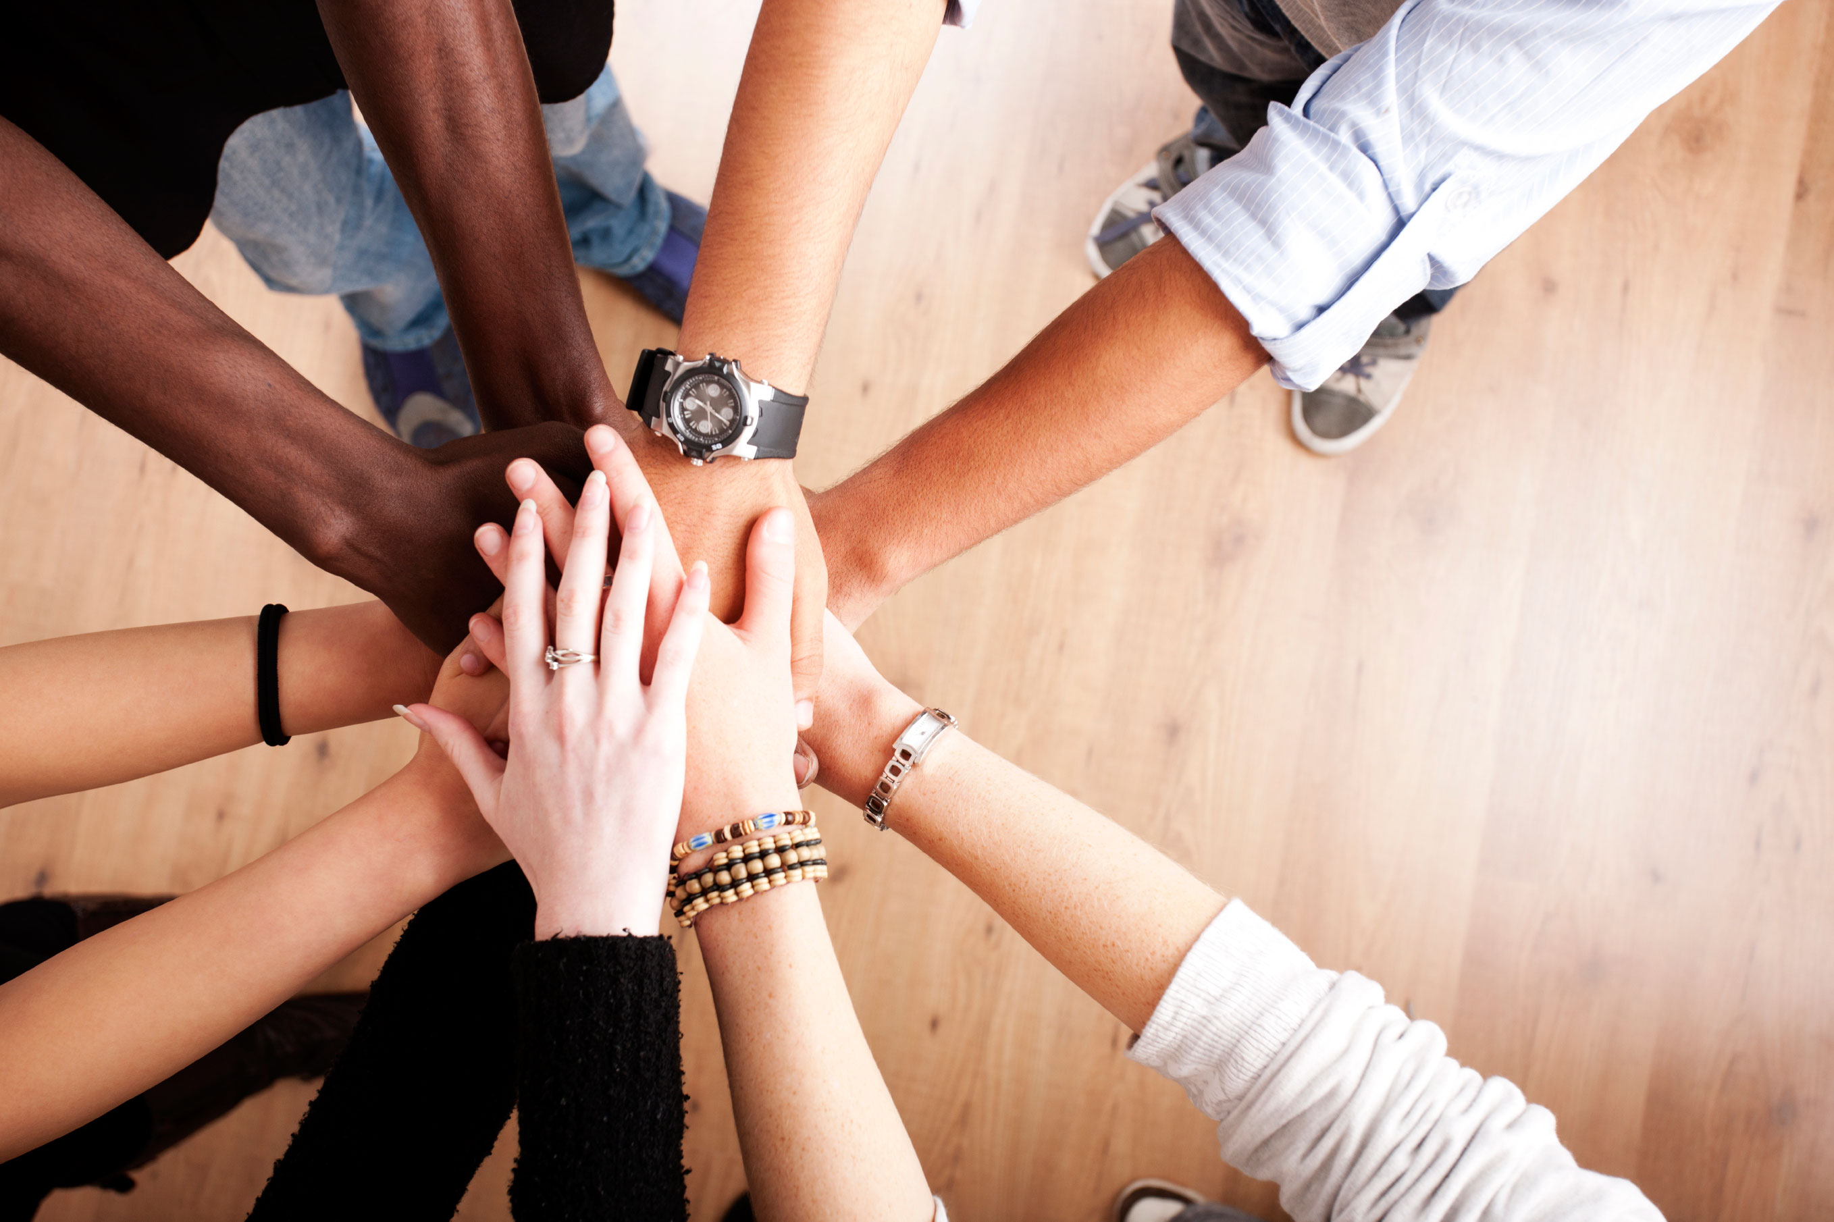
Together
with or in proximity to another person or people.
Similar meaning
jointly, in conjunction
:

Slide 19
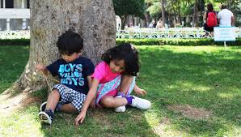
Weekend
regarded as a time for leisure.
Similar meaning
:
Holiday, vacation

Slide 20
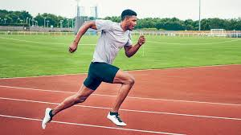
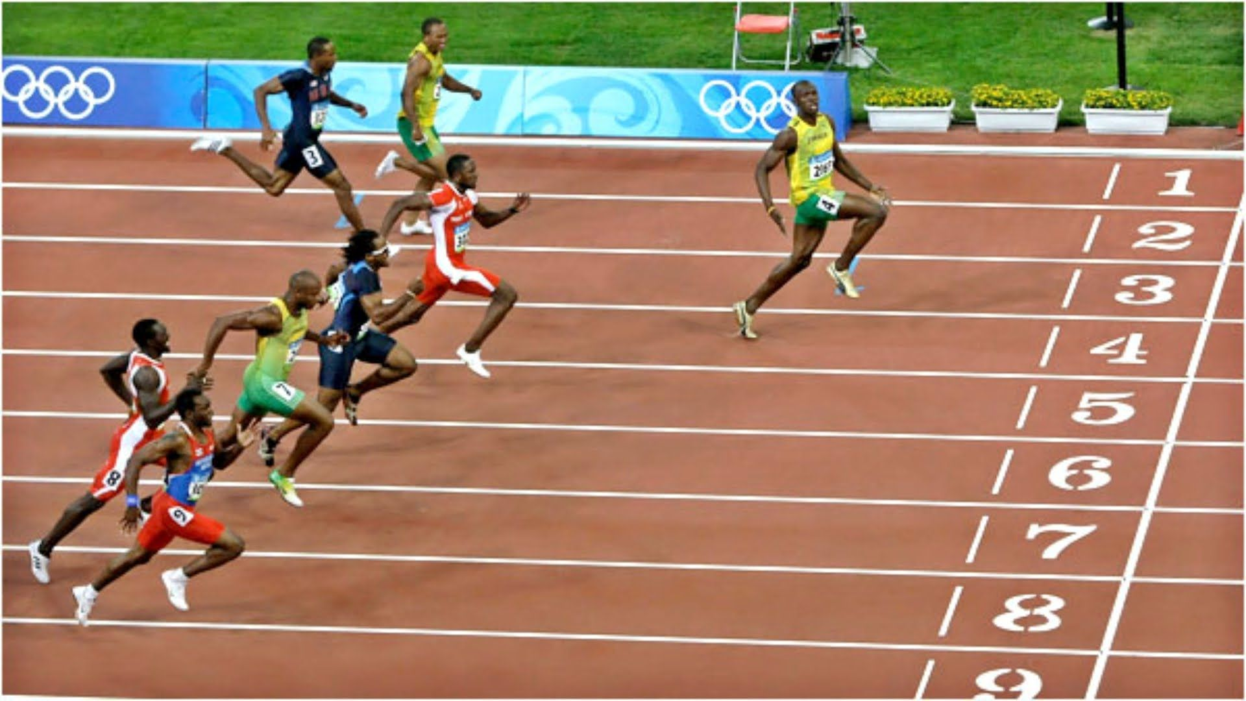
Run
.
move at a speed faster than a walk, never having both or all the feet on the ground at the same time.
Similar meaning
Race, sprint
:

Slide 21
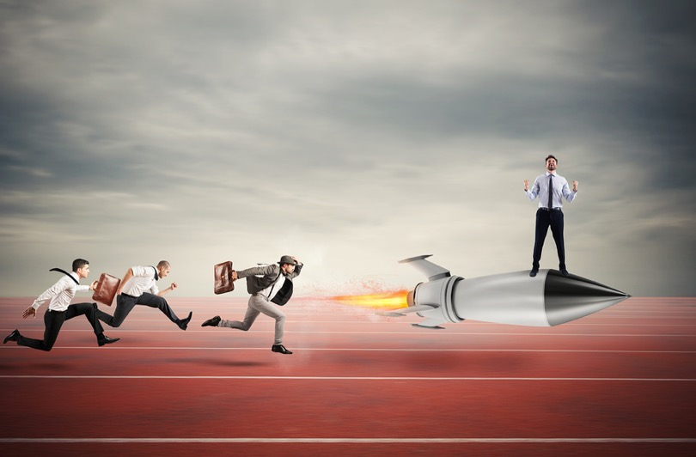
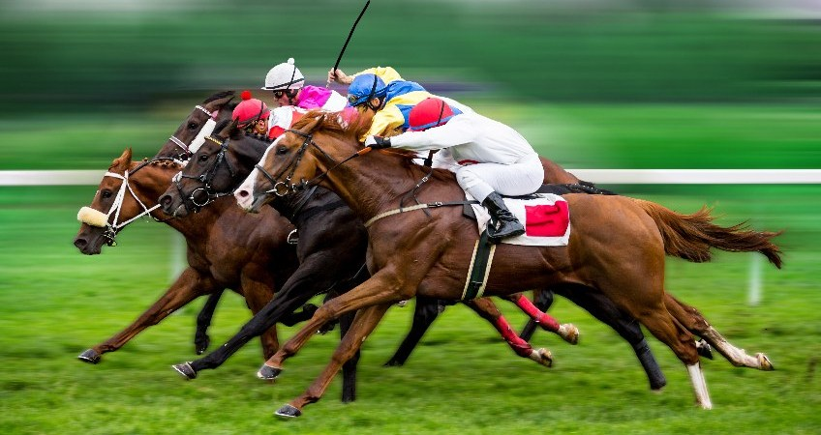
Fast
.
moving or capable of moving at high speed.
Similar meaning
:
Swift, rapid

Slide 22
PRACTICE
Playing Game
Dear students, now we are going to play a game. It is called “Memory Game”. Listen the instruction carefully.
After playing the game I will rewards the winner(s).

Slide 23
Let’s play the memory game.
Greeting
Run
Friend
Fast
Soon
Weekend
Together
Date
Park
Dear

Slide 24
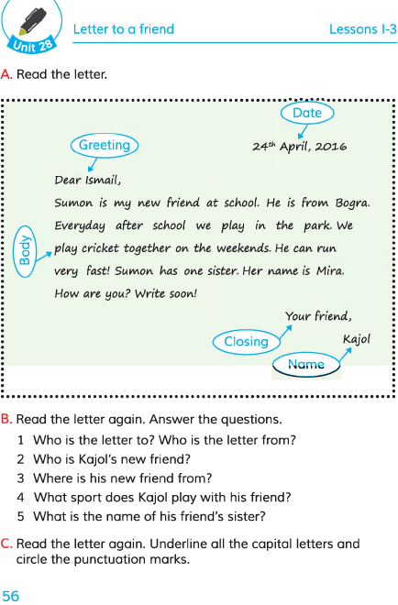
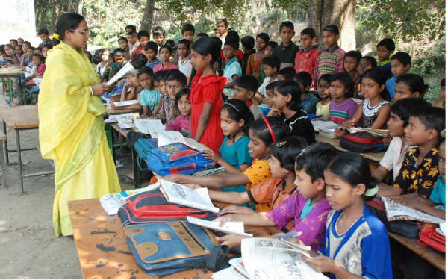
Teacher’s Model Reading
Dear students, open your English book at page 79. I am reading the text loudly, please put your fingers on the text.

Slide 25
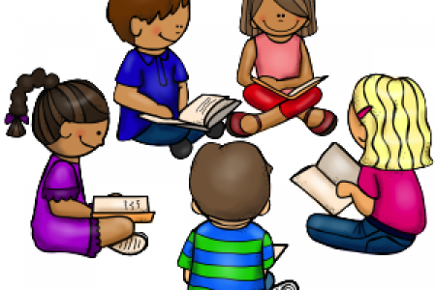
Group Reading
In this stage the students will read the text in group.

Slide 26
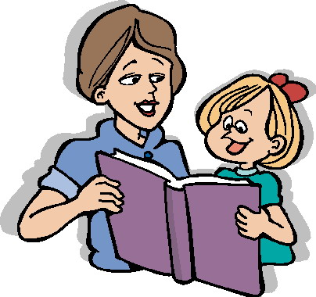
Pair Reading
In this stage the students will read the text in pair.

Slide 27
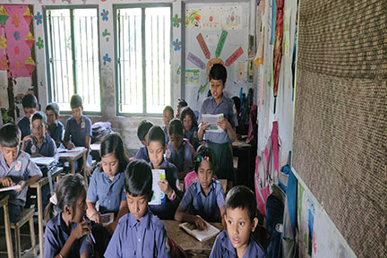
Student’s reading
In this stage one student reads the text and others listen.

Slide 28
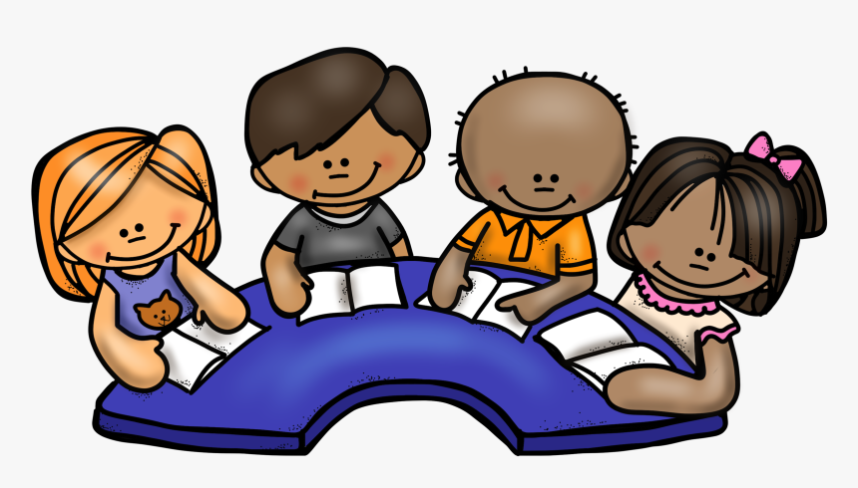
Silent Reading
Students, please read the
text silently and try to understand.

Slide 29
Free question
Who is from Bogura?
2. Who is Mira?
3. Who is new friend?

Slide 30
Solution to the question:
1. Sumon from Bogura.
2. Mira is Sumon’s sister.
3. Sumon is new friend.

Slide 31
Pair work
Match the words from left side with their similar meaning in right side.
Greeting
Race
Park
Welcome
Run
Jointly
Together
Swift
Fast
Recreation ground

Slide 32
Evaluation
Answer the questions.
1. Who is the letter to?
2. Who is the letter from?
3. Which part is said closing?
4. What is said whom a letter is written?
5. Where is date written?

Slide 33
Task
Write a letter to your friend to know about his/her new friend.

Slide 34
My dear students, thank you very much for
your nice co-operation.

