Slide 1
WELCOME TO ALL

Slide 2
identity
MD.AL-AMIN
B.A(Hon’s),M.A (English), B.ED
Assistant Teacher (English)
Sanmania High School
Kapasia, Gazipur
Email: alamingazipur51@gmail.com
Class:- Six-twelve
Subject:-English 2nd paper
Topic:-Capitalization

Slide 3
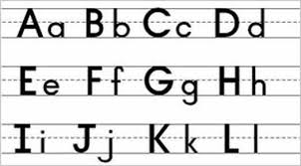
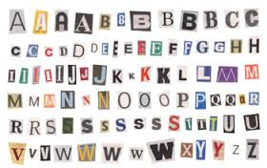
Capital letter
Small letter

Slide 4
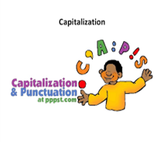
By the end of the lesson students will have ---
Practice CAPITALIZATION.

Slide 5
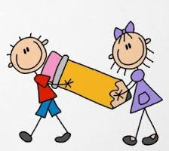
Rule of capitalization
(a) Always capitalization the first letter of the word of the every sentence.
1) This is my book .
2) He is my friend..
First letter of the sentenc.
(b ) Even when introducing a quotation that begins its own sentence.
Abraham Lincoln said, “ Four score and seven year ago----”
First letter of Quotation.

Slide 6
( c) Always capitalize the pronoun “ I “
Example:-
I think I’m in good shape because I’ve written a great paper !
Pronoun
Proper noun
( d) Proper noun are specific people, place, or things, and they are always capitalized.
Proper noun can be----
Real people
Fictional people
Family Members
Bill Clinton
Huckde berry Finn
Aunt Ester
Pair’s Hilton
Harry potter
Uncle Jim.
Etc.
Etc.
Etc.

Slide 7
Proper noun
Rules for “Mam and Dad”
Mam and Dad may or may not be Capitalized depending on how they are used---
Discription are lower case:
Tell your dad to set the table !
If it’s used as the person’s name, Capitalized !
Hey, Dad ! (Set the table.)
Proper nouns can be specific places/ structures----
Paris, France
The learning Tower of Pisa.
Beijing, China.
The Great Barrier Reef.

Slide 8
Proper noun can be organization / Products----
Toyota
Nintendo.
Microsoft
Mc Donald,s
Proper noun
Proper noun

Slide 9
Proper Adjectives
Proper Adjectives are derived from proper nouns, so they are also Capitalized.
Proper Adjectives describe-----
Religion
Ethnicity
Schools of Thought
Jewish
French
Machiavelian .
Buddhist
Brazilian
Freudinan.

Slide 10
CAPITALIZING TITLES.
(e ) Always capitalize the titles of books, songs, movies, etc.
----but not every word in the title.
Always capitalize the first and last word.
Always capitalize nouns, pronouns, verbs, adjectives, and adverbs.
Note; Donot capitalize articles “ a, an, the” unless they are at the beginning of your Title.
Note; Donot capitalize prepositions that are less than three letter,s long “ in, on, etc “
Note; Capitalize short conjunctions “ and or nor”
For example:-
Articles are lower case.
The Cat in the Flat.
Fiirst word is capitalized
Nouns are capitalized
Last word is capitalized
Prepositions are lower case.

Slide 11
TIPES and TRICKS
God is capitalized if it is a specific god. Other specific religions figures are proper noun too---
The Judeo Christion God
Allah
Buddha
The Virgin Mary.
Shiva
Zeus .
Directions ( north, south, east, and west ) are capitalized if they refer to specific areas----
Example:-
The America Civil War was between The North and The South.
The days of the week, months in the year and holidays are capitalized.
Example:-
Monday
January
Laborr Day
Tuesday
February
Halloween

Slide 12
The four seasons ( winter, spring, summer, fall ) normally are not capitalized.
Unless it’s a specific time in history-----
Example:-
The Summer of 2016.

Slide 13
Home work
Use appropriate punctuation marks and capital letters where necessary.
the next day samira was reading her diary again under the mango tree karim saw her and asked samira why do you write a diary samira showed karim a letter I received this a few days ago it’s from my pen-friend shes australian.

Slide 14
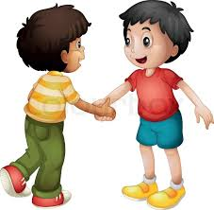
THANKS ALL.

