Slide 1

WELCOME

Slide 2
* Learning Out Come
    Student Will be able to--- *say the number.
*Write number .

Slide 3
Lerning Introduction :Class One Subject English.
Unit 4
Lesson – 2 Number (1)(A)

Slide 4
Creat Emotion
Rhyme(one two)

Slide 5

Input

Slide 6

1
ball

Slide 7

Cat
2

Slide 8
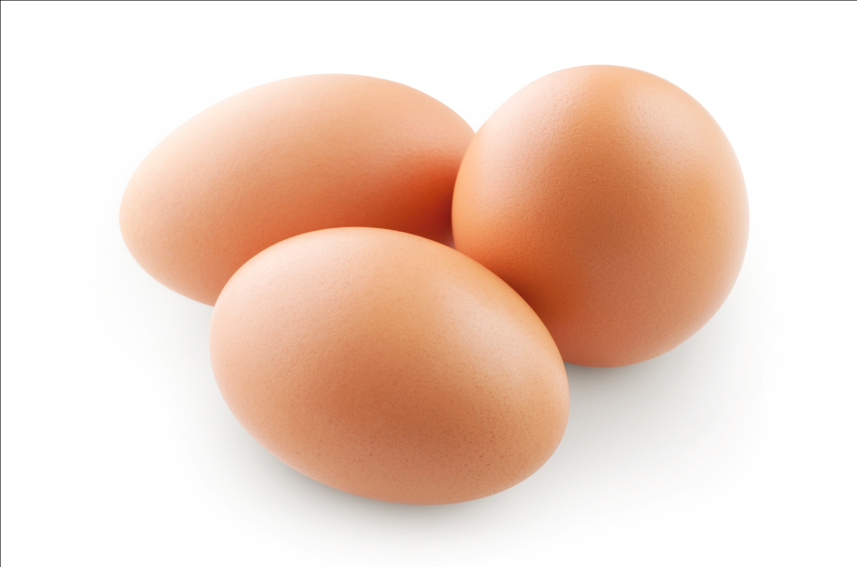
egg
3

Slide 9
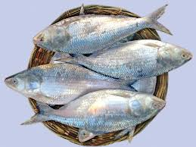
fishes
4

Slide 10

5
hats

Slide 11

practic

Slide 12


Group work
Group--- 1
Group---2

Slide 13

Pair work
Discus and say number each other.

Slide 14
Indivisual work
Read the text.

Slide 15
Task
*** Say following numbers:- 2, 1, 5
***Match number
5
4
3

Slide 16

Thanks for all

