Slide 1
Presented by Md.Maznu Mia Lecturer in English
Garadoba Siratunnabi Alim Madrasah
01736-664583
WELCOME
to
English Class on Preposition

Slide 2
Presentation
For
Students of Class-6 to 12

Slide 3
Objectives:
By the end of the lesson you will have
practised writing and speaking skills.
b) Learnt some uses of preposition.
c) Written the correct prepositions in the gaps.

Slide 4
behind
Mr. Mickey is ___________the car.
on
Mr. Mickey is _____________ the car.

Slide 5
Use appropriate prepositions in the gaps
The screen --- me
I am --- the stage

Slide 6
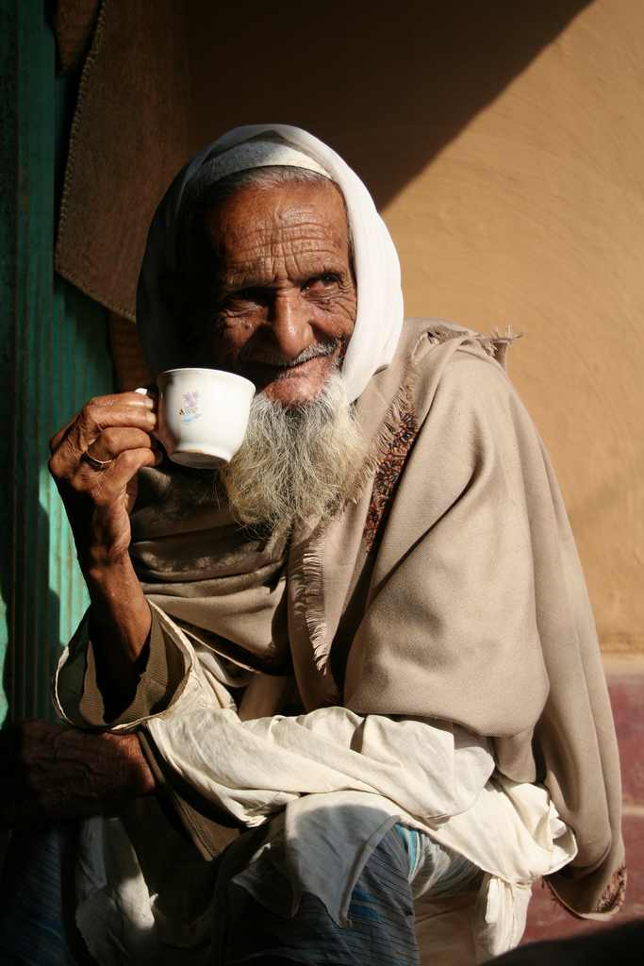
The old man is fond of tea.
fond of

Slide 7
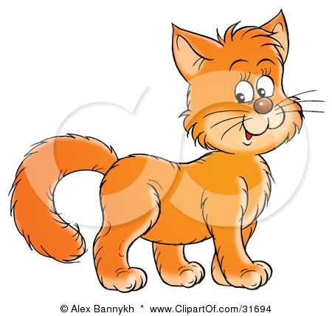
The sun is _________ the car.
above
over
The cat jumped ________ the chair.

Slide 8
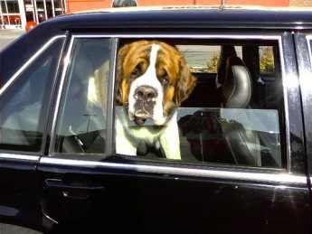
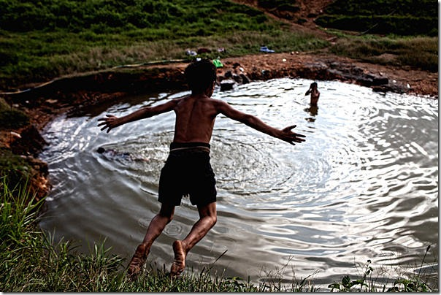
in/inside
The dog is sitting _________ the car.
into
The boy is jumping ____ the pond.

Slide 9
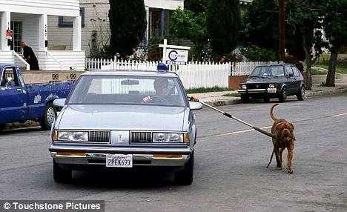
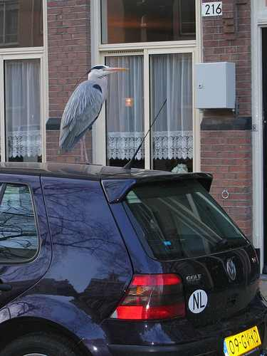
by/beside
The dog is __________ the car.
on
The bird is ______ the car.
Alongside = side by side

Slide 10
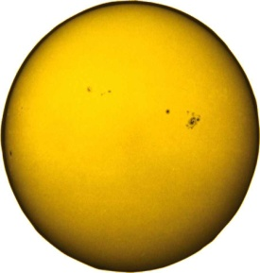
sun
sun
round
The earth moves ___________ the sun.
The car is running ________the tunnel.
through

Slide 11
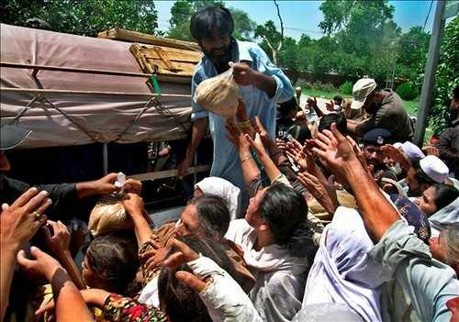
between
Mina is sitting ______________ her mother and grandmother.
Between – two/more individual persons/things
The man is distributing relief _______ the flood-affected people.
among
Among- more than two persons/things.

Slide 12
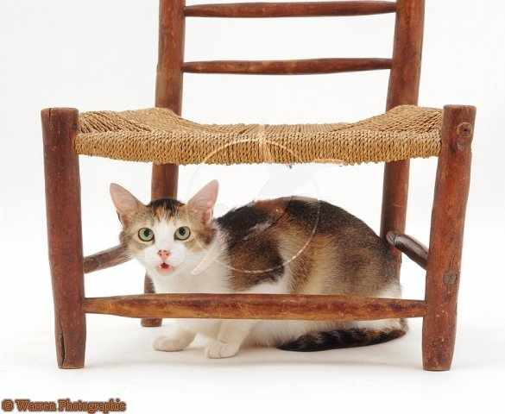
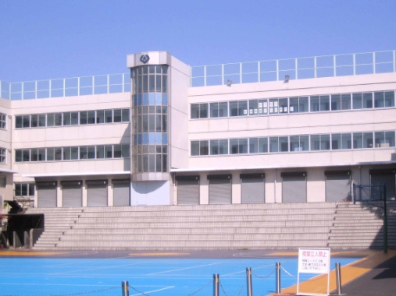
The cat is sitting ___________ the chair.
under
The pool is ________ the building.
in front of

Slide 13
Where am I standing?
Ans: you are --- us
Where are you?
Ans: You all are --- me

Slide 14
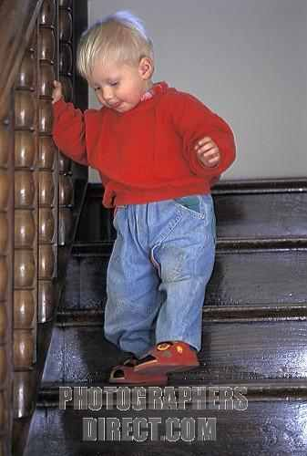
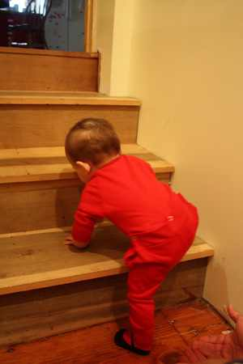
The boy is walking __________ the stairs.
down
The child is walking _______________ the stairs.
up

Slide 15
Rajshahi : 87 km
Natore : 74 km
Pabna : 26 km
along
The car is running ______________ the road.

Slide 16
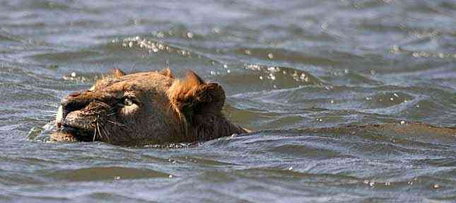
across
The lion is swimming _____________ the river.

Slide 17
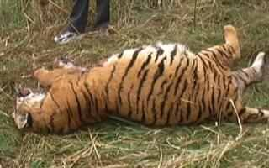
by
The tiger was killed _____ the hunter _____ a gun.
with
By---- Before doers & With -----before weapons

Slide 18
Sum up

Slide 19
Fill in the blanks with preposition from the box.
on
in
over
by
between
among
above
into
The students are sitting _______ their class room.
The teacher entered __________ the classroom hurriedly.
Distribute the chocolates ________ the students.
The boy jumped ___________ the wall.
The ceiling ________ our head is white.

