Slide 1
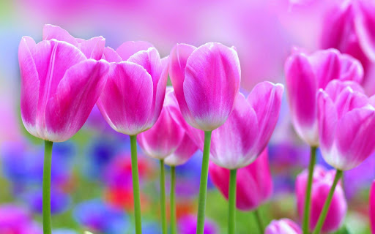

Slide 2
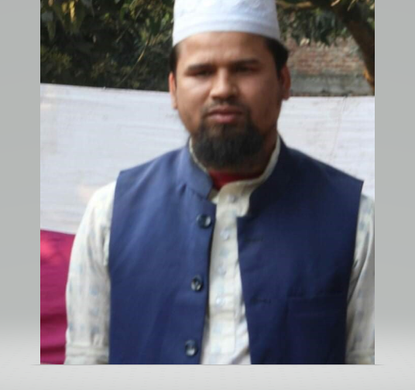
Identity
Md. Farid Uddin
(BA Hon’s, MA, B Ed, M Ed)
Assistant Teacher,
Dupchanchia D.S Fazil Madrasah
English Grammar
Class- 9-10
By N C T B

Slide 3
What do you mean by the Question chart?

Slide 4
Today’s Lesson-
( আজকের পাঠ )
Right Form of Verb

Slide 5
After the End of the lesson,
Students will be able to-
* use Verb in proper tense and proper form,
*
*
Learning
Outcomes

Slide 6
Presentation-
As Below:

Slide 7
Note: Right form of Verb এর ক্ষেত্রে পুরো Passage এর Tense এর সাথে সঙ্গতি রেখে এবং Grammatical গঠন ঠিক রেখে Verb প্রয়োগ করতে হবে।
Right form of Verb এর কতিপয় ‍সংক্ষিপ্ত নিয়ম :
As below:

Slide 8
Rule - 1
কোন Sentence যদি চিরন্তন সত্য হয় বা অভ্যাসগত সত্য (habitual truth) প্রকাশ করে এ জাতীয় sentence সব সময়ই Present indefinite tense হয়।
Example:
a) The earth moves round the sun.
b) Two and two make four
c) The rich are not always happy.
d) Bela goes to school regularly.
e) Man is mortal.

Slide 9
Rule - 2
Adjective এর পূর্বে যদি The বসে তা যদি নামপদে পরিণত হয় তবে তা হবে শ্রেণিবাচক Noun এবং তা সব সময়ই বহুবচন হয়। এসব Noun এর ক্ষেত্রে ব্যবহৃত Verb ও বহুবচন করতে হয়।
Example:
The poor are not always unhappy.
Only the brave deserve the fair.
The coward do not come to use for the welfare of the nation.
The idle are always burden to society.

Slide 10
Rule - 3
Bare infinitive (let, behold, make, see, watch, hear, bid, need, dare, feel, cannot but, used to)
Modal Auxiliaries (can could, shall, should, will, would, may, might, must); be(am/is/are) +to, have to, has to, ought to, going to, had better, would rather ইত্যাদির পরের Verb টির Present Form হয়।
Example:
I behold him reap the crops.
He made me do the work.
I watched him leave the place.
I used to go to club.
It may rain today.
They cannot but shed tears.
The will reach soon; you would better go there.
Note: ‘Go’ Verb টির পরে যদি Infinitive (to+verb) থাকে তাহলে Sentence- টি Present continuous tense হয়।
Example: a) We are going to organize a club.

Slide 11
For Practice:
Use the correct form of verb of the parenthesis word.
None can (avoid) death.
Misfortune (do) not come alone.
Mother made the baby (walk) on the yard.
Champa (do) her duty regularly.
Shrabani used to (visit) my home.
The brave (deserve) the fair.
Happiness (be) a name of an abstract thing.
We (go) to build a house.
Yesterday, she (put) on a new dress.
I saw him (go) there.

Slide 12
Desired Answer:
None can avoid death.
Misfortune does not come alone.
Mothe made the baby walk on the yard.
Champa does her duty regularly.
Shrabani used to visit my home.
The brave deserve the fair.
Happiness is a name of an abstract thing.
We are going to build a house.
Yesterday, she put on a new dress.
I saw him go there.

Slide 13
Rule -4
Preposition ‘to’ এর পরে Verb এর Present Form হয়।
যেমন:- a) We go to school to learn our lesson. b) They went to the field to play football.
Exceptional: owing to, view to এর পরে বব্যহৃত verb সব সময় Present Participle ( Verb+ing) form হয়।
কিন্তু For, about, on, of, in এর পরে বব্যহৃত verb সব সময় Present Participle (Verb+ing) form হয়।
Example:
I’m waiting for stopping the rain.
b) The flowers are now on blooming.
c) The young use Facebook only for wasting time.

Slide 14
Rule -5
Sentence এ অতীত নির্দেশক শব্দ, যেমন- yesterday, previous day, since, last year, last night, last week, ago, long ইত্যাদি থাকলে সেটি Past Indefinite Tense হয়। সুতরাং এই শব্দ সংশ্লিষ্ট Sentence এর Subject এর পরে ব্যবহৃত Verb টি Past Tense হয়।
Example:
a) I received your letter yesterday.
b) Last night, I had a wonderful dream.
c) The bell rang five minutes ago.
d) Ten years have passed since I met you last.

Slide 15
Rule -6
Already, just, just now, recently, lately, never, ever, yet প্রভৃতি শব্দ সাধারণত Present Perfect Tense নির্দেশ করে। সুতরাং এই শব্দ সংশ্লিষ্ট Sentence এর Subject এর পরে ব্যবহৃত Verb টি Present Perfect Form হয়।
Example:
The enemy just fled away.
Have you ever been to Dhaka?
I have already finished my duty.

Slide 16
For Practice:
Use the correct form of verb of the parenthesis word.
Raju (come) home yesterday.
He already (finish) his work.
Ratul came here to (meet) me.
The car is now on (run).
The tree is about to (fall)

Slide 17
Desired Answer:
Raju came home yesterday.
He already has finished his work.
Ratul came here to meet me.
The car is now on running
The tree is about to fall

Slide 18
Rule -7
If +(অবাস্তব অতীত), wish, অথবা fancy এর পরে ‘be’ verb থাকলে তা ‘were’ করতে হবে Subject কোন factor নয়।
Example:
I wish I were a king.
If I were a bird!

Slide 19
Rule -8
It is high time এর পরের Clause Past Indefinite Tense করতে হয়।
Example:
It is high time we did the work.
It is high time they went there.

Slide 20
Rule -9
‘As if/ As though’ Clause এর আগের Clause যদি Present Tense হয় তাহলে ‘As if /As though’ Clause টির Verb Past Tense করতে হবে। এবং ‘As if/ As though’ Clause এর আগের Clause যদি Past Tense হয় তাহলে ‘As if /As though’ Clause টির Verb Past Perfect Tense করতে হবে।
Example:
a) He behaves as though he were a scholar.
b) She told as if she had known everything.

Slide 21
For Practice:
Use the correct form of verb of the parenthesis word.
I wish I (be) a child again.
She works as though she (be) an expert.
It is high time he (solve) the problem.
He explained as if he (be) a teacher.
If I (be) president I would help the poor.

Slide 22
Desired Answer:
I wish I were a child again.
She works as though she were an expert.
It is high time he solved the problem.
He explained as if he had been a teacher.
If I were president I would help the poor.

Slide 23
Rule -10
Lest যুক্ত Sentence - এ ‘lest’ এর পরে ব্যবহৃত Subject এর পর ‘should/might’ বসাতে হবে এবং মূল Verb এর Present form/V₁ হবে।
Example:
a) Walk fast lest you should miss the bus.
b) He worked hard lest he might fail in the Exam.

Slide 24
Rule -11
While এর পর verb উক্ত verb সাথে ing / আবার While এর পর sub. থাকলে Verb এর Past Continuous Tense হয়।
Example:
I became thirsty while running.
While I was reading, a bird entered into my room.

Slide 25
For Practice:
Use the correct form of verb of the parenthesis word.
Read attentively lest you (fail) in the Exam.
While I (read), a nice bird entered into my room.
The old man walks slowly lest he (fall) on the floor.
They became tired while (work).
While the train (run) a man fell down from it.
She walked fast lest she (miss) the class.

Slide 26
Desired Answer:
Read attentively lest you should fail in the Exam.
While I was reading, a nice bird entered into my room.
The old man walks slowly lest he should fall on the floor.
They became tired while working.
While the train was running / running a man fell down from it.
She walked fast lest she might miss the class.

Slide 27
Evaluation: (Orally)
1. Preposition ‘to’ Gi c‡i Verb mvaviYZ †Kvb& Form G _v‡K?
2. evK¨ wPišÍb mZ¨ n‡j Verb mvaviYZ †Kvb& Tense G _v‡K?
3. Preposition ‘about, for, on, of, in’ Gi c‡i Verb mvaviYZ †Kvb Form G _v‡K?
4. Aev¯Íe AZxZ eySv‡j Subject Singular n‡jI Gi c‡i e¨eüZ ‘Be’ Verb mvaviYZ wK iƒc nq?
5. While / While Clause hy³ Sentence এ While Gi mwbœK‡Ui Verb wU mvaviYZ †Kvb& Form G _v‡K?

Slide 28
Home Work
Complete the following text with right forms of the Verbs given in the box.
prosper | call | mould | make | have
repent | sow | do | waste | reap
Man is the architect of his own life. If he (a)…….… a proper division of his time and (b)….….…his duties accurately, he is sure (c)….……in life; but if he does otherwise, he sure to (d)……… when it is too late. Our life is nothing but the sum of hours, days and years. Youth is the golden season of life. In youth mind is soft and can (e)………. in any form we like. If we (f)…….... the precious time of our youth. We shall (g)……… to suffer afterwards. Youth (h)………. the seed time of life. If we (i) ………. good seeds in your early life, we shall (j)……… a good harvest.

Slide 29
Thanks a lot

