Slide 1
Welcome
Notes:
Welcome slide.

Slide 2
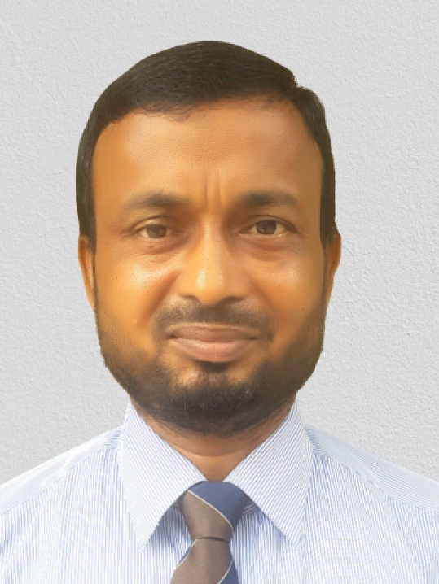
Introduction
Mojibur Rahman (M. A. In Eng.)
Assist. Teacher ( English)
Dogachi Barendro High School & College
Nachole, Chapainawabganj
Presentation made for
Class VI-IX
English 2nd paper
Grammar
Notes:
Introduction of the teacher and the class.

Slide 3
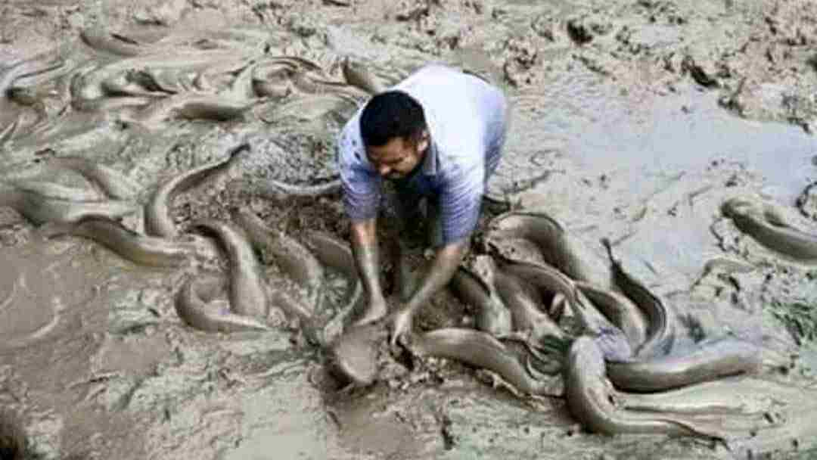
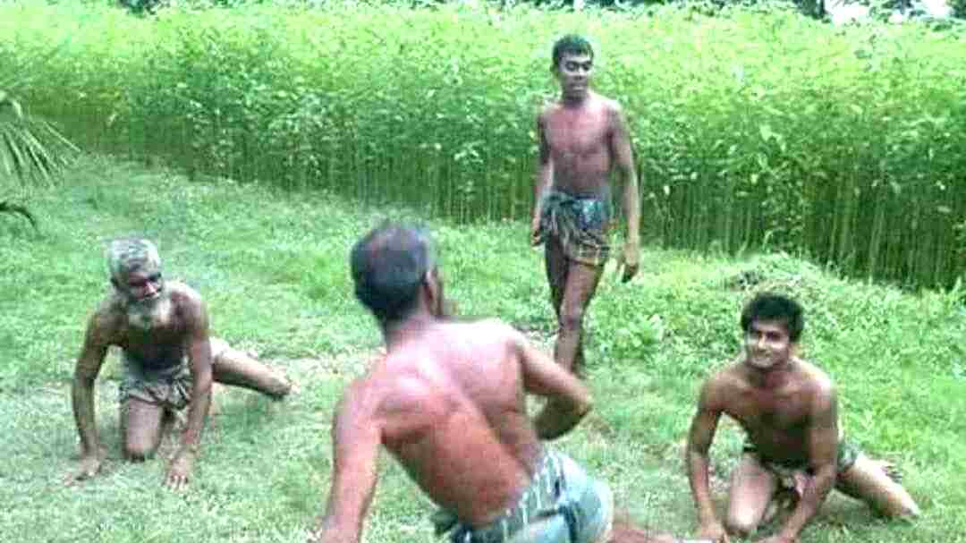
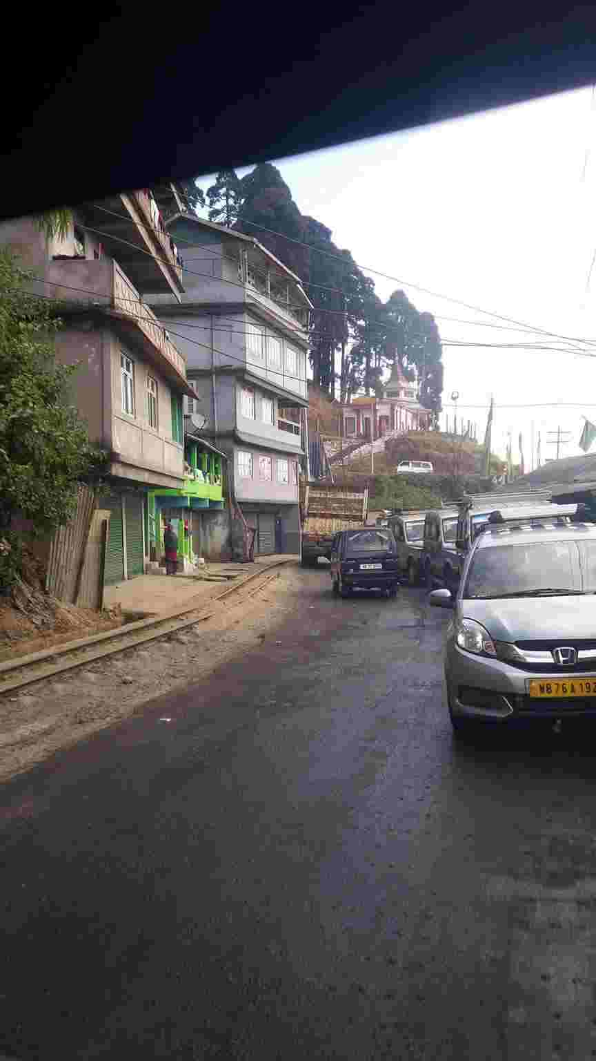
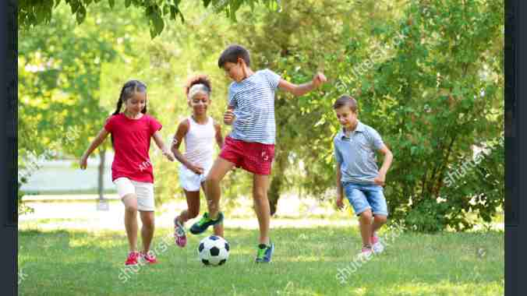
They were playing Kabadi.
He caught
Only one fish.
I had gone to Siligury
They had been plying for two hours.
Notes:
Suspension to lead the lesson.

Slide 4
What have you observed by the pictures?
Different forms of past tense.
Let us discuss the forms of
past tenses in our today’s class.
Notes:
Lesson declaration.

Slide 5
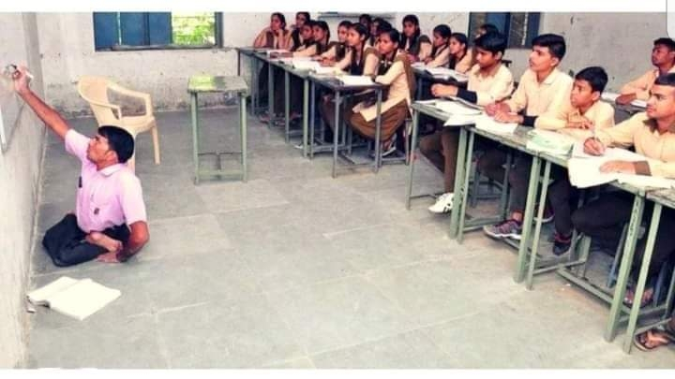
Learning outcomes
At the end of the lesson, we will be able to—
identify the forms of past tense
identify the structures of the forms of past tense
transfer from one to another form
identify the structures of the forms of the sentences
Notes:
All the above outcomes will be focused in this lesson.

Slide 6
There are four forms of past tense.
Past indefinite form
Past continuous form
Past perfect form
Past perfect continuous form
Notes:
Learning outcomes No-1 will be focused in this slide.

Slide 7
1. Past indefinite form
Structure : Subject + Be (was/were)/had/v₂ + extension
They were players.
Subject
be
Extension
Fill in the blank with v₂
Once they ________ football. They _______ a glorious history of football. People ________ their performance very much.
Notes:
Structure and examples of past indefinite tense.

Slide 8
Negative form of past indefinite tense.
Sub + be + not + Extension.
Sub + didn’t +V₁ +Extension
He was not a student.
He didn’t go to school.
I didn’t miss school.
Notes:
How is negative formed in past indefinite tense shown here.

Slide 9
Interrogative form of past indefinite tense.
Be + sub + Extension +?
Did + sub +V₁ +Extension+?
Was he a student?
Did he go to school?
Did I miss college?
Notes:
How is interrogative formed in past indefinite tense shown here.

Slide 10
Activities
Fill in the gaps with v₂ from the box.
am | like | make | have | has
go | is | respect | ride | are
Rahim (a)__________ a good student. He (b)________ to school regularly. I (c) _________ also a student. We (d) _________ at the same age. We (e) ________ a mutual understanding. Rahim (f) ________ a nice bicycle. We both (g) ________ it. We never (h)_______ any quarrel. All the teachers (i) ________ our friendship. We always (j) _______ our teachers.
Notes:
Feed back of previous slide. Learning outcomes No- 3 is focused here.

Slide 11
2. Past continuous tense
Structure : Subject +(be) was/were+ verb (ing) + extension.
They were playing football.
Sub
be
Verb (ing)
Extension
Note
‘was’ is used after ‘I’ and 3rd person singular number and ‘were’ is used in another places.
Notes:
Past continuous tense and its structure is shown here through example. Learning outcomes No- 2 is focused here.

Slide 12
Pair work
Transform the sentences into
past continuous tense.
Cats play.
We enjoy cats playing.
The little cat scratches the big cat.
The big cat feels good.
The cats playing looks nice.
Notes:
Feed back on the previous task. Learning outcomes No- 3 is focused here.

Slide 13
3. Past perfect tense
Structure : Subject +had+ V₃ (verb past participle)+ extension.
We had enjoyed the show.
Sub
had
V₃
Extension
Apply past perfect tense in the gap.
We _______ to Singapore to enjoy many things. We ______ a hotel. The people of the hotel _______ us cordially. We ______ very pleased with their behieviour. We ______ there for a week.
Notes:
Introducing the structure of past perfect tense with example. Learning outcomes No- 2 is focused here.

Slide 14
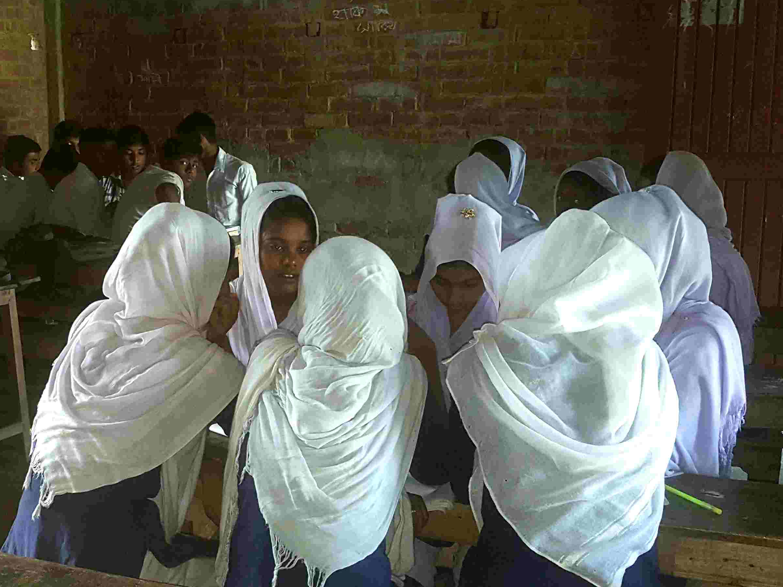
GROUP WORK
Turn the sentences into past perfect tense.
I go to enjoy hill and water fall.
I enjoy a beautiful water fall.
I see the green sight of the hill.
The sight charms me much.
I never forget the scene.
Notes:
Evaluation on the previous task. Learning outcomes No- 3 is focused here.

Slide 15
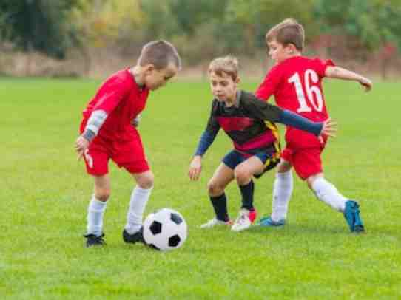
4. Past perfect continuous tense
Structure : Subject+ had been + verb (ing) + extension.
They had been playing for a long time.
Sub
had been
Verb (ing)
Extension
Apply past perfect continuous tense in the gap.
He _______ suffering from fever since Monday last. We had_______ trying to make him cure for three days but failed.
Notes:
Introducing past perfect continuous tense with example. Learning outcomes No- 4 is focused here.

Slide 16
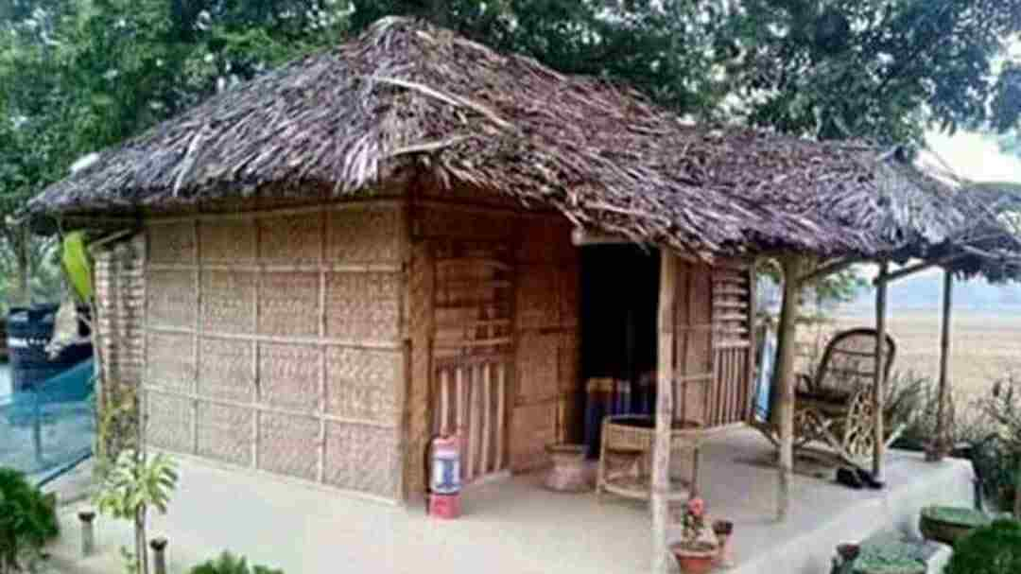
HOME WORK
Identify the forms of the tenses ofthefollowing sentences.
The nature gave a beautiful view with rain.
The rain had made the scenery more beautiful.
It had been raining for two hours.
It had charmed us all with joy.
Notes:
Evaluation part. Learning outcomes No- 3 is focused here.

Slide 17
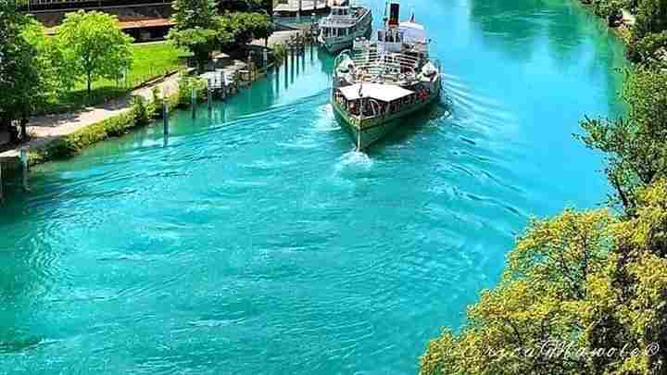
Allah Hafiz
Notes:
Ending slide..

