Slide 1
Welcome
to
All
to
Attend
Digital Class

Slide 2
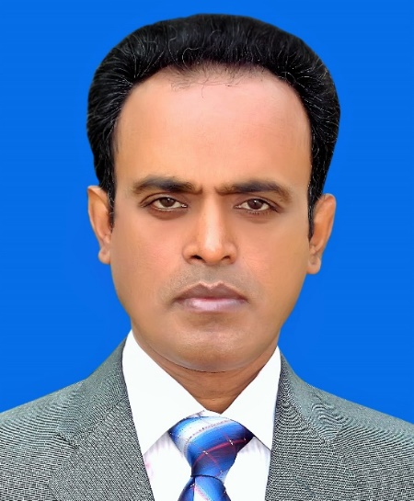
Identity
Uttam Adhikary
[ BA Hon’s, M A, B Ed, M Ed ]
Asstt. Headteacher,
Mahilara A. N. High School
Gournadi, Barishal.
E-mail cum Cell-Phone: uttam01712310595@gmail.com
English Grammar
For Classes- 9 & 10
Friday, 30 October, 2020
uttam01712310595@gmail.com
2

Slide 3
Here every sentence wants to give a complete sense.
…………………….unless you work hard.
……………………. until the rain stops.
His boss knows his faults well still …………… .
Dear students can you say what is indicated through these sentences?

Slide 4
Announcement
Today’s Lesson:
Completing Sentence
Part-6
Using: Until/till, unless, still/yet
Rules: 15, 16, 17 of 24

Slide 5
Learning Outcomes
After the End of the Lesson,
Students will be able to-
complete sentence,
to grow the skills of completing sentence,
-----------------

Slide 6
Presentation-
As Below:

Slide 7
cÖviw¤¢K K_v:
একটি sentence এর অংশবিশেষ দেয়া হয়। প্রদত্ত অংশের সাথে সংগতি রেখে নিজস্ব ধারণা দিয়ে sentence টির পূর্ণ রূপ দিতে হয়। এ sentence গুলো প্রায়শই complex sentence হয়। সে জন্য উক্ত sentence এর conjunction এর প্রতি বিশেষ খেয়াল রাখতে হবে। কারণ conjunction এর অর্থই বাক্য তৈরির দিক নির্দেশনা দিয়ে থাকে।
সাধারণত নিম্নোক্ত conjunction গুলো completing sentence এ ব্যবহৃত হয় -
Most Common Conjunctions those are used in Completing Sentences:
Since / As, Because, If, Had, Provide / providing that / provided that, As if / As though, Lest, Though / Although, Which/who/ that/what/whom/whose, Where, When/while, As soon as, No soon had……than, Scarcely had…….when, Until, till, Unless, Still/yet, So that / in order that, So…..that, So many / so much……..that, Wish/fancy, would that .....

Slide 8
Meaning of these Conjunctions :
Since / As – (যেহেতু……সেহেতু)
Because – (কারণ)
If – (যদি……তাহলে)
Had – (যদি……তাহলে)
Provide / providing that / provided that – (যদি)
As if / As though -- (যেন)
Lest- (পাছে ভয় যদি)
Though / Although (যদিও ……তথাপি)
Which/who/ that/what/whom/whose/ (যা/ যিনি/ যে/যেটা/যাকে/যার)
Where (যেখানে / যেথায় / কোথায়)
When/while (যখন………তখন)
As soon as (যেই মাত্র……)
No sooner had……than ( কোন ঘটনা হতে না হতেই)
Scarcely had…….when ( কোন ঘটনা হতে না হতেই)
Until, till (যতক্ষণ না, যে পর্যন্ত)
Unless (যদি না)
Still/yet (এমন কি/তথাপিও/ তবুও)
So that / in order that (যাতে )
So…..that (এত…… যে )
So many / so much……..that (এত ……যে)
Wish/fancy, would that (ইচ্ছা হয়/ সাধ হয়…..যদি)

Slide 9
15
Until, till (যতক্ষণ না, যে পর্যন্ত)
Example
I will be waiting for you until you come. (আমি তোমার জন্য আপেক্ষা করতে থাকব যতক্ষণ না পর্যন্ত তুমি আস।
Mukta will be reading book till stay beside her. (মুক্তা বই পড়তে থাকবে যে পর্যন্ত তুমি তার পাশে থাকবে।)
For Practice
Probable Answer
the rain stopped.
Arno had been singing song until……………………..
………………………… till the sun set.
The game will be continued till, ………………………..
We had been playing
the dark will come.
Click here for Answer

Slide 10
16
Unless (যদি না .....তাহলে)
Example
Unless you read attentively you cannot make a good result. (যদি না তুমি মনযোগ সহকার পরো তাহলে তুমি ভালো রেজাল্ট করতে পারবে না)
You will miss the bus unless you walk fast. (তুমি বাসটি ধরতে পারবে না যদি না তুমি দ্রুত হাঁট।)
For Practice
Probable Answer
you can not succeed in life.
Unless you work hard,………………………………
Unless I ran fast, ………………………………….
…….…………………………….you can not expect bright future.
I would not gain the prize.
Unless you are industrious
Click here for Answer

Slide 11
17
Still / yet (এমন কি/তথাপিও/ তবুও)
Example
He was ill yet he finished his work timely. (সে অসুস্থ ছিল তথাপি সে যথাসময় কাজটি শেষ করেছিল।)
I was injured seriously still I played the game. (আমি আহত হয়েছিলাম তবুও আমি খেলাটা খেলেছিলাম।)
For Practice
Probable Answer
she could not reach her goal.
Rupa was a brilliant student yet……………………………….
Mowsumi is a qualified candidate still……………………………….
………………………………. yet he did not get good job.
she was not selected for the job.
He did well in examination
Click here for Answer

Slide 12
Asking and Answering

Slide 13
Evaluation
Orally
Complete the following sentences. (One by one)
the sun set.
He had been preparing his lesson until, -----------------------.
he could not shine in life
He worked hard still ------------------.
You can not make a good result
------------------------------------------- unless you read attentively.
the sunlight will be visible.
He will be doing the work till--------------------------------
He is seriously busy with his job
------------------------------------------- yet he continues social work.
Plz Click here for probable Answer

Slide 14
Home Work
Practice more and more at home.

Slide 15
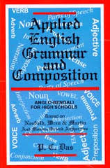
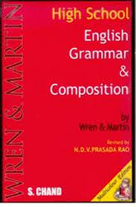
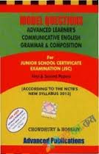
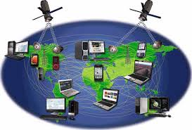
Content Reference
f
Facebook
Reference Books
Internet

Slide 16
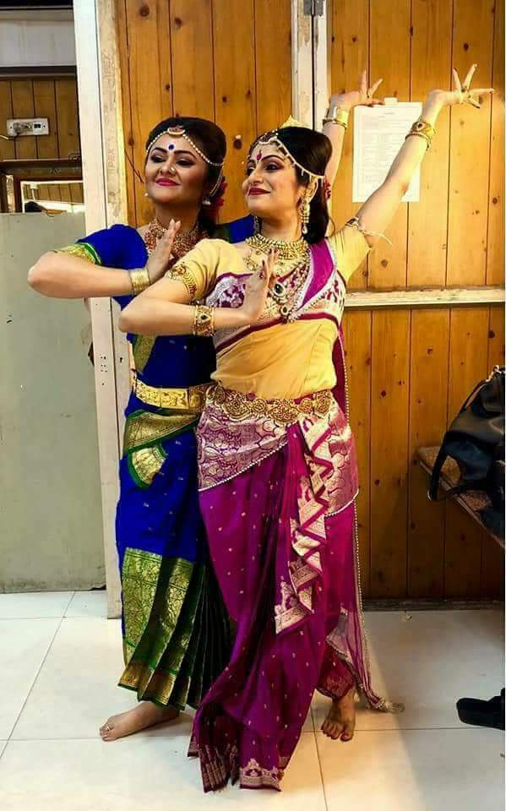
Thanks
to
All
for now.

