Slide 1
Welcome

Slide 2
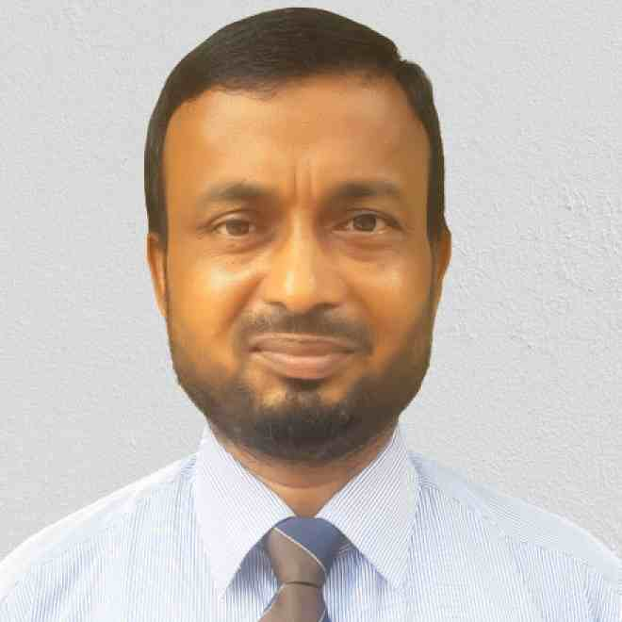
Identity
Mojibur Rohman (M.A Eng.)
Assist. Teacher(English)
Dogachi Barendro High School & College.
Nachole, Chapainawabganj
CLASS:EIGHT
SUB-ENGLISH FIRST PAPER
UNIT 2
LESSON 3
TIME-45 MINUTES

Slide 3
LET’S SEE SOME PICTURES

Slide 4
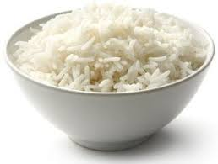
RICE

Slide 5
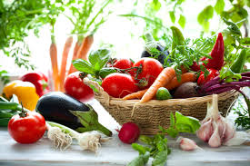
VEGETABLES

Slide 6
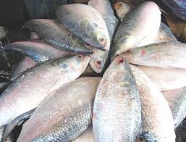
FISH

Slide 7
Today our lesson is
OUR DAILY DIET

Slide 8
LEARNING OUTCOMES
By the end of the lesson, the students will be able to
read and understand the text.
Tell the meaning of some new words.
ask and answer questions.
Write a dialogue.

Slide 9
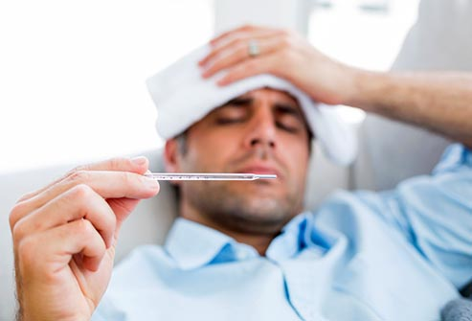
New words and it᾿s meaning:
Essential
Fundamental
Disease
Illness
calcium
plaster

Slide 10
Silent Reading

Slide 11
We eat rice,ruti,fish and meat everyday.

Slide 12
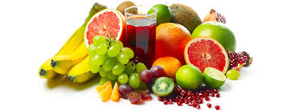
We must also eat vegetables and fruits.They contain a lot of vitamins and minerals.

Slide 13
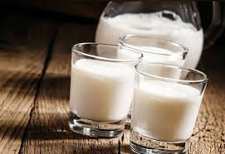
We need to drink milk every day.Milk is highly rich in calcium.

Slide 14
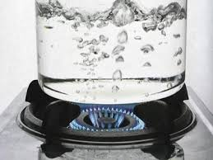
We must drink pure water at regular intervals too.It’s essential for our body.

Slide 15
GROUP WORK
Why What What foods | do are is | essential for our body? good for our skin?We need to eat good food? Vegetables contain? Minerals do to us?

Slide 16
Evaluation
1.Milk is highly rich in fat|calcium|sugar.
2.Fruits and vegetables are good for eyes|general health|teeth.
3.Water|energy drink|milk is most important for life.

Slide 17
Home-Work
Write a dialogue about our daily diet.

Slide 18
Thanks

