Slide 1
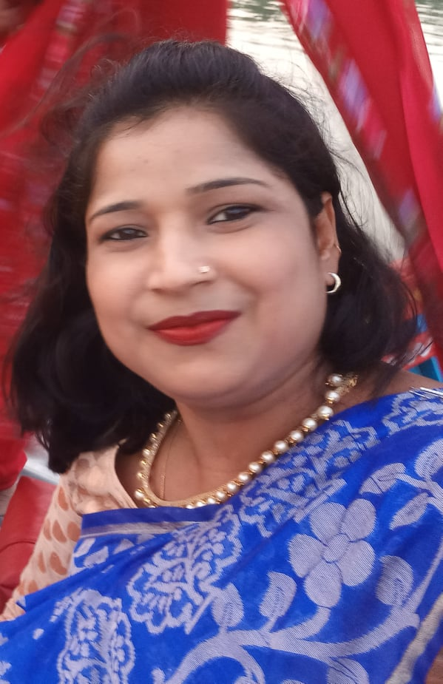
Welcome

Slide 2
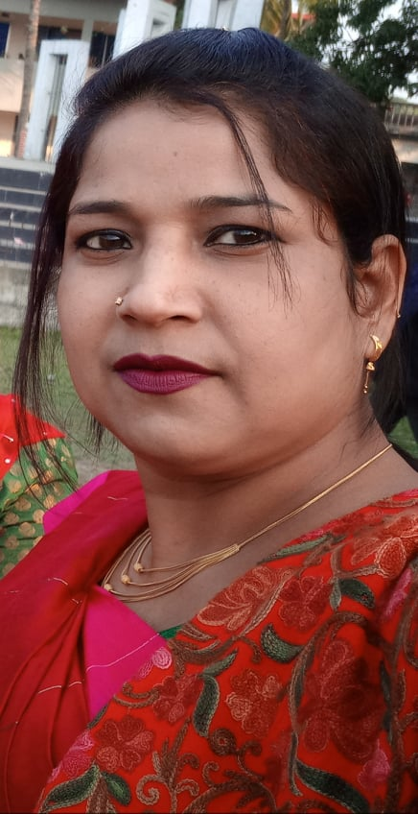
Nasima Akter
Assistant teacher
Chatia Chala Gov: Primary School.
Sakhipur,
Tangail.

Slide 3
Sub: English
Unit: 23
Time: 40 mins
Write well 1
Lesson 1-3
Class: 4

Slide 4
Learning Outcomes:
Students will be able to -
recognize punctuation mark and read accordingly.
R 7.1.1
use full stop, comma, question mark and exclamation mark.
W 5.1.1
W 6.1.1
use capital letters for sentence beginnings.
W 6.1.2
use capital letters for proper nouns.

Slide 5
Let’s watch a video.

Slide 6
Today we will know
about using capital
letters and full stop .

Slide 7
Before that we will learn a one day one word
The word is-
Sell=
বিক্রি করা
It’s opposite word is = Buy
Sentence: He sells egg in the market

Slide 8
Let’s see some picture:

Slide 9
Full stop
Comma

Slide 10
Exclamation mark
Question mark

Slide 11
Whole class work
Shihab lives in Dhaka. One day, he is at home with his mother. They are talking. Suddenly, it starts raining. Shihab runs to the window and closes it. His mother is very happy.

Slide 12
Some key points:
Capital Letter-
Sentences always starts with a capital letter.
Names of people starts with a capital letter.
Names of places starts with a capital letter.
Full Stop-
We use the full stop to end a statement.

Slide 13
H
e is Kamal
They are Somi,Koli,Lata and Jhoma
They live Tangail

Slide 14
Let’s see the capital letters and the full stops in the sentences:
Shihab lives in Dhaka
His mother is very happy
He is at home with his mother
They are talking
S
D
H
H
T

Slide 15
Group work:
(I will ask the students to divide in six groups. They will read the following passage and find out the capital letters and the full stop from the passage. They will make circles around them.)
Shihab lives in Dhaka. One day, he is at home with his mother. They are talking. Suddenly, it starts raining. Shihab runs to the window and closes it. His mother is very happy.
Let’s check their answers.

Slide 16
Pair work:
(Student will discuss in pair and write the following passage again by using capital letters and full stop.)
anik is six years old e has a sister er name is ina
he is five years old anik and ina live in ylhet with their parents
Match with your answers
M
H
h
m
h
H
m
M
S
s
s
M
m
S
m
M

Slide 17
Indivisual work:
I will write the following sentences on the board. Randomly selected students will come to the board and use capital letters and full stops in the sentences. If they do any mistake other students will correct them.
runa is going to school
ankur and shuvo live in magura
i love bangladesh
mohona is samina’s sister
do not run in the sun

Slide 18
Assessment:
I will write some sentences in a card give the sentence cards in every group and ask them to use capital letters and full stop in sentences. The sentences are given below-
sha is hitra’s mother
like to read story books
ucky is your cousin
nkur loves cricket
Let’s check your answers.
A
a
c
C
i
I
l
a
A
L

Slide 19
The student will write about their
family use capital letter,
Comma, question mark and full stop.

Slide 20
Thank you

